Slide 1
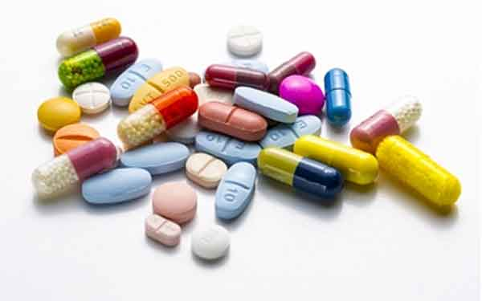
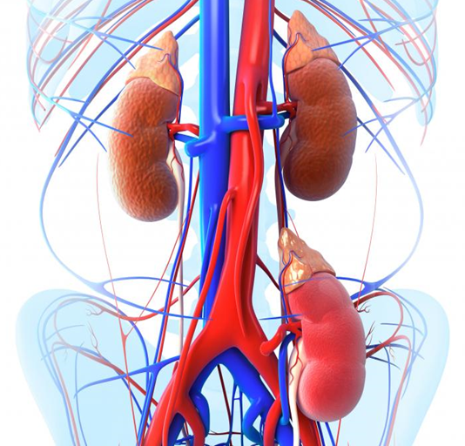
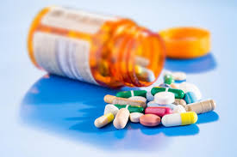
KIDNEY TRANSPLANT DRUGS

Slide 2
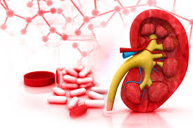
Calcineurin Inhibitors (CNIs)
Cyclosporine
Cyclosporine is a small lipophilic cyclic polypeptide of fungal origin. It consists of 11 amino acids and has a MW of 1,203g/mol.
Tacrolimus
FK506, is a macrolide antibiotic compound isolated from Streptomyces tsukubaensis with a MW of 804.
Notes:
Although they are biochemically distinct, they are remarkably similar, not only in their mechanism of action, but also in their clinical efficacy and side-effect profile.

Slide 3
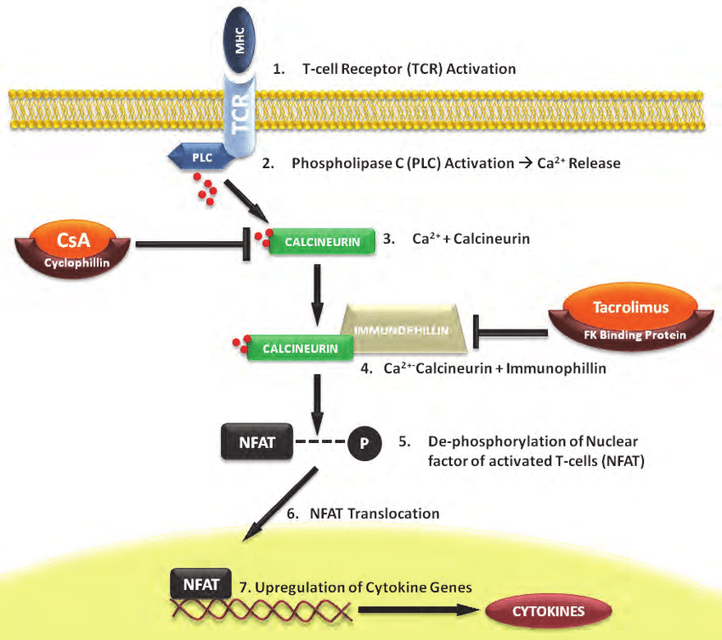
Mechanism of Action
Formation of a complex with their cytoplasmic receptor proteins (cyclophilin/FKBP).
Binds to and inhibit calcineurin impairing the transcription of IL-2 and several other cytokines (IL-4, IL-3, IFN-g, TNF-a, GMCSF).
Reduction of T-lymphocyte proliferation.
Notes:
Binds to calcineurin, whose normal function is to act as a phosphatase that dephosphorylates certain nuclear regulatory proteins (e.g., nuclear factor of activated T cells) and hence facilitates their passage through the nuclear membrane.

Slide 4
Cyclosporine
Injection solution 50 mg/ml (5 ml) (Sandimmun)(non-modified)
Capsule 25, 50, 100 mg (Neoral, Iminoral)
Oral solution 100 mg/1 ml (50 ml) (Neoral)
In general, patients stabilized on one preparation should not be switched to another, because there are concerns about differences in pharmacokinetics.
If a conversion between preparations is necessary, monitoring trough concentrations should be performed until the results are stable.

Slide 5
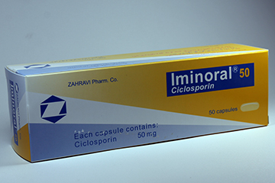
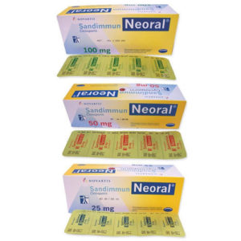
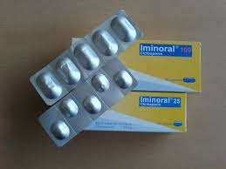

Slide 6
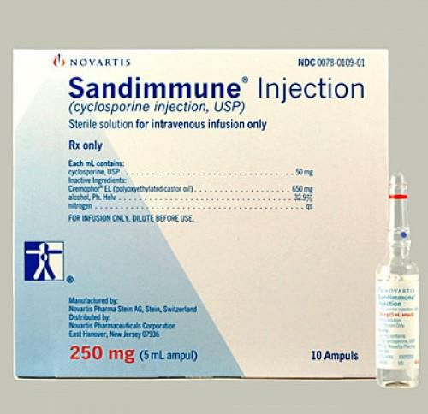
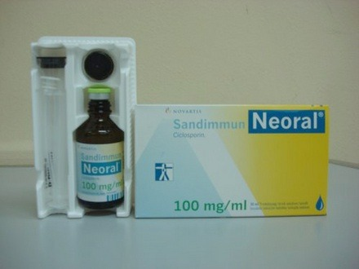

Slide 7
Cyclosporine
Nonmodified and modified formulations
Nonmodified (Sandimmun) oral cyclosporine depends upon bile for absorption and has erratic GI absorption patterns.
Modified (Neoral) cyclosporine, a microemulsion formulation, does not depend upon bile salts for absorption and exhibits increased BA and more consistent absorption.

Slide 8
Cyclosporine
Should be administered at a consistent time of the day (at 12-hour intervals), and with a consistent relation to meals, in order to decrease the intra-individual blood concentration variations.
Nonmodified oral solution should be mixed with milk, chocolate milk, or orange juice at room temperature.
Modified oral solution should be mixed with water, orange juice, or apple juice.
Both cyclosporine solutions may adhere to plastic and therefore should not be mixed in a plastic cup or with plastic utensils.
Notes:
If a dose is missed, patients should take it as soon as possible, ideally within four hours. They should not double the next dose.

Slide 9
Tacrolimus
Tacrolimus is a more powerful immunosuppressive than cyclosporine
XR capsule 0.5 , 1 , 3 , 5 mg (advagraf)
IR capsule 0.5 , 1 , 5 mg (prograf, cograft, suprotac)
Injection solution concentrate 5 mg/ml (1 ml)
 ER tacrolimus tablets are only approved in KT patients converted from IR tacrolimus.
 Short courses of sublingual tacrolimus have been used as an alternative to IV tacrolimus when enteral administration is not possible.
Notes:
There are two extended-release formulations of tacrolimus designed for once-daily administration. Their mechanisms of prolonged release and pharmacokinetic profiles differ; therefore, the two are not interchangeable. The extended-release tacrolimus capsule (Astagraf XL) is a modified-release formulation that allows slow release of the drug by controlling water penetration and forming a protective polymer gel layer around tacrolimus [11]. The extended-release tacrolimus tablet (Envarsus XR) uses a drug-delivery technology that improves the bioavailability of drugs with low water solubility [12].
Extended-release tacrolimus capsules are not approved in liver transplantation due to an increase in mortality in female liver transplant recipients [13]. Extended-release tacrolimus tablets are only approved in kidney transplant patients converted from immediate-release tacrolimus.

Slide 10
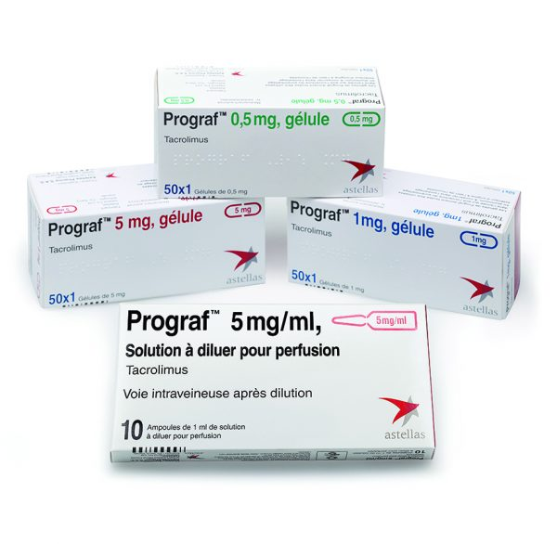
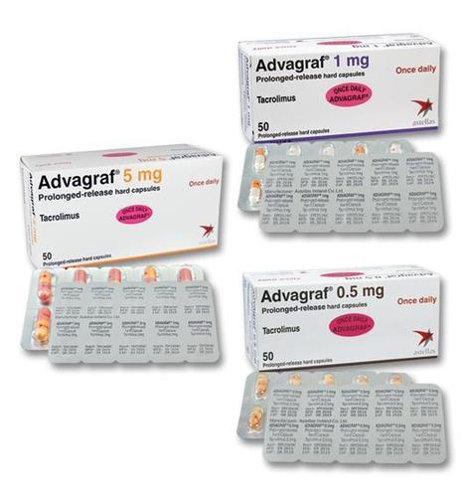
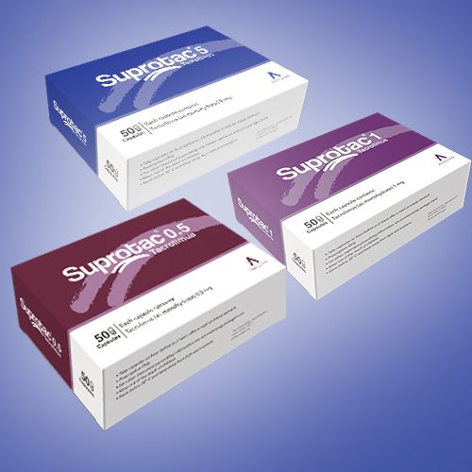
modified-release formulation
once-daily dosing

Slide 11
Tacrolimus
The immediate-release should be administered at a consistent time of the day (at 12-hour intervals) and preferably on an empty stomach.
The extended-release products should be taken at the same time of the day, preferably in the morning.
Patients should not chew, divide, or crush the tablets.
If an IR tacrolimus dose is missed, patients should take it as soon as possible, ideally within 4 hours.

Slide 12
Dose
0.08-0.1 mg/kg/day (IBW) orally in two divided doses
Start at the lower end of the dosing range and adjustments based upon drug concentrations.
Tacrolimus can be administered through a NGT or SL.
Sublingual dosing is more variable, but is usually one-half that required by the oral route.
Tacrolimus and cyclosporine reach steady-state concentrations after 4-6 doses, and therefore, dose adjustments can be assessed via drug concentration monitoring 2-3 days after an adjustment.
Notes:
This dosing is achieved either by opening a capsule and allowing the contents to dissolve under the tongue or by using a compounded suspension similarly held under the tongue.

Slide 13
PHARMACOKINETICS

Slide 14
Absorption
Oral CSA/TAC are only partially absorbed with large inter- and intra-individual variability.
They are absorbed in the small intestine, and plasma peak concentrations occur after 1-8 hours.
⇒ BA for both drugs is as a result of poor absorption, partial metabolism by enzymes in the bowel mucosa, and first-pass hepatic metabolism.
AUC modified formulations of CSA > AUC of nonmodified preparations

Slide 15
Distribution
CSA and TAC are lipophilic and undergo extensive body distribution.
In the blood, most of the absorbed amount of each drug is taken up by RBC.
In the plasma, CSA binds mainly to lipoproteins, whereas TAC binds to proteins, primarily albumin and alpha-1-acid glycoprotein.
CSA penetrates well into synovial fluid but does not cross the BBB.
Both drugs cross the placenta and appear to some extent in breast milk, but actual toxicity in breastfed infants appears to be rare.
Notes:
cyclosporine also exhibits very high protein binding in the plasma, especially to lipoproteins. As such, whole blood is the preferred matrix for concentration determination.
Approximately 95% of tacrolimus is bound to erythrocytes secondary to the high concentration of FKBP found in these cells.
Both agents cross the placenta and enter breast milk; breast-feeding is not recommended for female renal transplant recipients who have had successful pregnancies post-transplant (KT)

Slide 16
Metabolism
CYP-450 CYP3A enzymes in the liver & Some metabolism in the gut mucosa
In the gut, the CNIs are repeatedly taken up and transported out of intestinal enterocytes by P-gp  repeated exposure to CYP3A4/5  significant presystemic metabolism
The most active CSA metabolites have only 10-20% of the drug's immunosuppressive activity.
By comparison, one of the metabolites of TAC possesses equal immunosuppressive potency to the parent drug.

Slide 17
Elimination
CSA and TAC are excreted in the bile.
The elimination half-life ≈ 19 hours for cyclosporine modified and 12 hours for IR tacrolimus.
Liver dysfunction  ⬆ half-life of both CSA and TAC

Slide 18
Food interactions
Because the avoidance of food at the time of medication administration is not always practical, many clinicians recommend that patients be consistent and always take their medication in the same manner, whether it is with or without food.
Grapefruit or grapefruit juice can result in an increase in systemic exposure to CSA or TAC  completely avoid grapefruit and grapefruit juice.
Notes:
The presence, composition, and timing of food may affect the absorption of many of the immunosuppressive drugs.

Slide 19
Drug interactions
Substrates for CYP3A4/5 enzymes
Drugs that affect GI motility or emptying (eg, prokinetic agents)
Concomitant use with other nephrotoxic drugs
Divalent cations may influence the absorption of tacrolimus (2 hours apart)
Cyclosporine is a substrate and inhibitor of P-gp

Slide 20
Pharmacokinetic Drug–Drug Interactions

Slide 21
Pharmacokinetic Drug–Drug Interactions

Slide 22
Pharmacodynamic Drug–Drug Interactions

Slide 23
Drugs that May Exaggerate CNI Nephrotoxicity
Amphotericin
AG
NSAID drugs should be avoided if possible but can be given for short periods under supervision.
CNIs may potentiate the hemodynamic renal dysfunction seen with ACEI/ARB.

Slide 24
Lipid-Lowering Agents
Lovastatin  ARF
lovastatin + CSA  rhabdomyolysis with elevated CPK levels and ARF
lovastatin + CSA  Myopathy (muscle pain and tenderness developing 6 weeks to 16 months after commencement of therapy)
Pravastatin, fluvastatin, atorvastatin, rosuvastatin  should be introduced at low doses and maximal doses avoided secondary to the inhibitory CYP3A and P-gp effects of CSA.
Notes:
The myopathic syndrome has not been observed when lovastatin is used in a daily dose of 20 mg or less. Even this dose should be used with caution.

Slide 25
Lipid-Lowering Agents
While this effect is not seen with tacrolimus, other CYP3A or P-gp inhibiting agents commonly used with tacrolimus-containing regimens can have similar effects (i.e., diltiazem).
Cholestyramine may interfere with CSA absorption from the GI tract.
Interactions with the new PCSK9 inhibitors have not yet been described, but their use in transplant patients should be carefully monitored.

Slide 26
SIDE EFFECTS

Slide 27
Nephrotoxicity
Dose-related, reversible, renal vasoconstriction that particularly affects the afferent arteriole (⬆ TX, endothelin, sympathetic nervous system, ⬇ NO)
Cyclosporine > Tacrolimus
Acute increase in Scr, which is largely reversible after reducing the dose, or as chronic occasionally progressive renal disease, which is usually irreversible.

Slide 28
Electrolyte Abnormalities and HTN
Sodium retention is a reflection of the renal vasoconstrictive effect of CNIs.
Activation of the RAAS and sympathetic nervous system and suppression of atrial natriuretic factor, which results in attenuation of the natriuretic and diuretic response to an acute volume load .
NO production is also impaired.
HTN: Cyclosporine > Tacrolimus
Hyperkalemia, hypomagnesemia, hypocalcemia, Hyperuricemia (Cyclosporine > Tacrolimus)
Notes:
The blood pressure elevation usually responds to dose reduction, but antihypertensive medications may be required.
because of reduced renal uric acid clearance, is a common complication of CNI use, particularly when diuretics are also employed.
While both cyclosporine and tacrolimus can produce hyperuricemia, only cyclosporine has been associated with gout, which has been reported in up to 7% of patients.
This may resolve when cyclosporine is switched to tacrolimus.

Slide 29
Neurotoxicity
Tacrolimus > Cyclosporine
Coarse tremor, dysesthesias, headache, and insomnia are common and may be dose- and blood-level related.
Rare: visual abnormalities, seizures, and leukoencephalopathy
☹ Hypocholesterolemia, Hypomagnesemia  ⬆ Neurotoxicity

Slide 30
Neurotoxicity
Is less with prolonged-release formulations of tacrolimus
Usually reversible following a change from IV to an oral preparation, lowering of the drug dose, or drug discontinuation.
With IR tacrolimus, administering a higher evening dose than that given in the morning (i.e., 3 mg in the morning and 4 mg in the evening) may also lead to an improvement in neurologic symptoms owing to reduced morning peak levels .

Slide 31
Hyperlipidemia
Hypercholesterolemia
Dose dependent
Up to two-thirds of patients develop de novo hyperlipidemia in the first post-transplantation year.
Cyclosporine > Tacrolimus

Slide 32
Glucose Intolerance
CNIs are toxic to pancreatic islets
Tacrolimus > Cyclosporine
Dose related and may be exaggerated by concomitant corticosteroid use.
Obesity, African-American or Hispanic ethnicity, family history of DM, and HCV infection may predispose to NODAT.

Slide 33
Infection and Malignancy
Bacterial, viral (most often, CMV), and fungal infections
CSA/TAC  increased risk of squamous cell skin cancer and benign or malignant lymphoproliferative disorders

Slide 34
Gastrointestinal
Subclinical, mild, self-limited, dose-dependent ⬆ LFT, Bili
Cyclosporine > Tacrolimus
Varying degrees of anorexia, nausea, vomiting, diarrhea, and abdominal discomfort (Tacrolimus > Cyclosporine)

Slide 35
Cosmetic
Cosmetic complications are often exaggerated by concomitant use of corticosteroids.
Cyclosporine > Tacrolimus
Gingival hyperplasia and hirsutism
Tacrolimus  hair loss and frank alopecia
Cyclosporine  ⬆ prolactin levels, occasionally producing gynecomastia in men and breast enlargement in women.
Notes:
Gingival hyperplasia, which can be severe, may develop in patients receiving cyclosporine and is exaggerated by poor dental hygiene and possibly by concomitant use of calcium channel blockers.

Slide 36
Mycophenolic Acid

Slide 37
Mycophenolic Acid
MMF, is a prodrug  mycophenolic acid (MPA), a fermentation product of several Penicillium species; the mofetil moiety serves to markedly improve its oral BA.
An enteric-coated form of MPA (Myfortic) became available in 2004
MMF and EC-MPS are similar in efficacy and safety.
Notes:
CellCept, was introduced into clinical transplantation in 1995 after a series of clinical trials (see Part III) showed that it was more effective than azathioprine for the prevention of acute rejection in recipients of deceased donor kidney transplants when used in combination with cyclosporine and prednisone.

Slide 38
Mechanism of Action
MPA exhibits a cytostatic effect on T and B lymphocytes
Is a reversible inhibitor of the enzyme inosine monophosphate dehydrogenase (IMPDH).
IMPDH is a critical, rate-limiting enzyme in de novo synthesis of purines and catalyzes the formation of guanosine nucleotides from inosine.
T and B lymphocytes are dependent on this pathway for proliferation.

Slide 40
Formulations
CellCept is the morpholinoethyl ester of MPA
Cap 250 mg (cellcept)
Tab 500 mg (cellcept, citogan, cytocept, suprimun)
Powder for suspension oral 1 g/5 ml (cellcept)
Myfortic (ecMPA) is a delayed-release formulation of MPA as a sodium salt
Delayed release oral tab 180, 360 mg (myfortic)

Slide 41
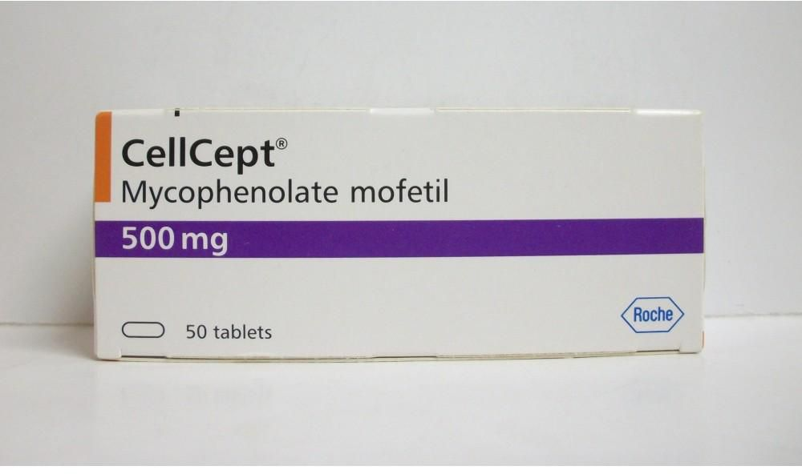
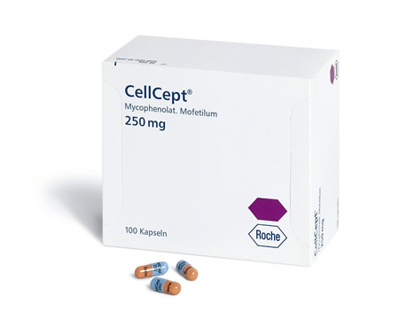
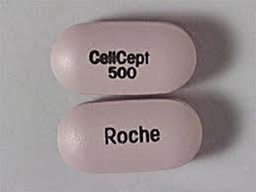

Slide 42
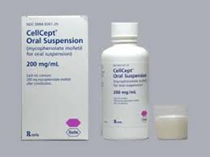
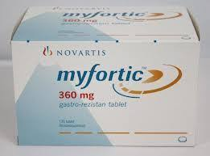

Slide 43
Administration
Oral: May be administered with or without food as effects of food on BA are minor.
Oral suspension may be administered via a NGT; do not mix oral suspension with other medications.
Myfortic should be swallowed whole and should not be crushed, cut, or chewed.

Slide 44
Absorption and Distribution
Orally administered MMF is hydrolyzed to MPA presystemically and is rapidly absorbed, producing a peak level in approximately 1 hour.
The BA of MMF is roughly 90%, with 97% of the MPA protein bound to albumin.
Orally administered ecMPA exhibits different absorption kinetics owing to the formulation; the tablets only dissolve under neutral pH conditions, and thus absorption only occurs in the intestine.
It has a peak concentration after approximately 2- 3 hours.

Slide 45
Metabolism
MPA is glucuronidated via glucuronyl transferase enzymes in the liver to a pharmacologically inactive form (MPAG).
Enterohepatic cycling of MPAG can occur from the liver into the bile.
Gut bacteria can then enzymatically metabolize the MPAG to MPA.
This produces a second absorption peak of MPA that occurs at 6-12 hours following administration and may account for some of its GI side effects.

Slide 46
Excretion
T 1/2 MPA = 6-18 hours
The primary route of excretion is via the kidneys as MPAG, with minimal amounts of MPA excreted unchanged in the urine.
The AUC of MPA is increased by renal impairment, although dose adjustments are not usually made.
Neither MMF nor MPA is dialyzed.

Slide 47
Pharmacokinetic and Pharmacodynamic Drug–Drug Interactions
MPA is not metabolized through the CYP3A enzyme system
CSA lowers MPA concentrations by decreasing its enterohepatic recycling.
This interaction is not seen with everolimus, sirolimus, or TAC, and the maintenance dosage of MMF, when used with standard doses and blood levels of these drugs, is typically 500-750 mg twice daily.

Slide 48
Drug–Drug Interactions
Antacids, cholestyramine, sevelamer, or oral ferrous sulfate, Ca, Mg, Zn (2 hours apart)
Acyclovir (tubular secretion)  ⬆ MMF
Ganciclovir  ⬆ BMS

Slide 49
Side Effects
GI tract (most common) (dose dependent)
Diarrhea (1/3 pts), nausea, bloating, dyspepsia, and vomiting (up to 20% pts)
Persistent administration of MMF or MPA in the face of diarrhea can lead to an inflammatory colitis.
Management: ⬇ dose, more divided, change to MPS, HOLD
Notes:
The incidence of GI side effects may be higher if the dosage is greater than 1 g twice daily. Most of these symptoms respond promptly to transient reduction of drug dosage.
As with the CNIs, food decreases its absorption; however, coadministration with food may decrease the GI side effects.

Slide 50
Side Effects
Hematologic
Leukopenia, anemia, and thrombocytopenia
Lymphoproliferative disorders
Opportunistic infections
Sepsis, candidiasis, HSV
Nephrotoxicity, neurotoxicity, and hepatotoxicity have not been observed with MMF.

Slide 51
Side Effects
Congenital malformations  teratogenic
Ear malformations and spontaneous abortions
Azathioprine is often used to replace the MMF
Acceptable forms of contraception should be used during treatment and for 6 weeks after therapy is discontinued (in female).
MMF is not recommended in lactation.

Slide 52
mTOR Inhibitors: Everolimus and Sirolimus

Slide 53
Everolimus and Sirolimus
The mTOR (mammalian target of rapamycin) is a key regulatory kinase in the process of cell division.
Sirolimus (Rapamune, rapamycin), is a macrolide antibiotic that is produced by fermentation of Streptomyces hygroscopicus.
It was originally developed as an antifungal agent, it was later found to have immunosuppressive and antiproliferative properties.
Everolimus (Certican, Afinitor) is a similar compound with a shorter half-life and is less hydrophobic.
Notes:
Although it was originally developed as an antifungal agent, it was later found to have immunosuppressive (US FDA approval in 2003 for prevention of acute rejection in kidney transplantation) and antiproliferative properties that may be useful to treat or prevent proliferative diseases such as tuberous sclerosis, psoriasis, and malignancy

Slide 54
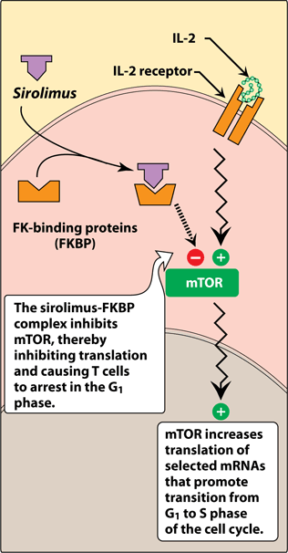
Mechanism of Action
TOR is a key regulatory kinase, and its inhibition reduces cytokine-dependent cellular proliferation at the G1 to S phase of the cell-division cycle.
Sirolimus and everolimus block the response of T and B cell activation by cytokines, which prevents cell-cycle progression and proliferation; by contrast, TAC and CSA inhibit the production of cytokines.

Slide 55
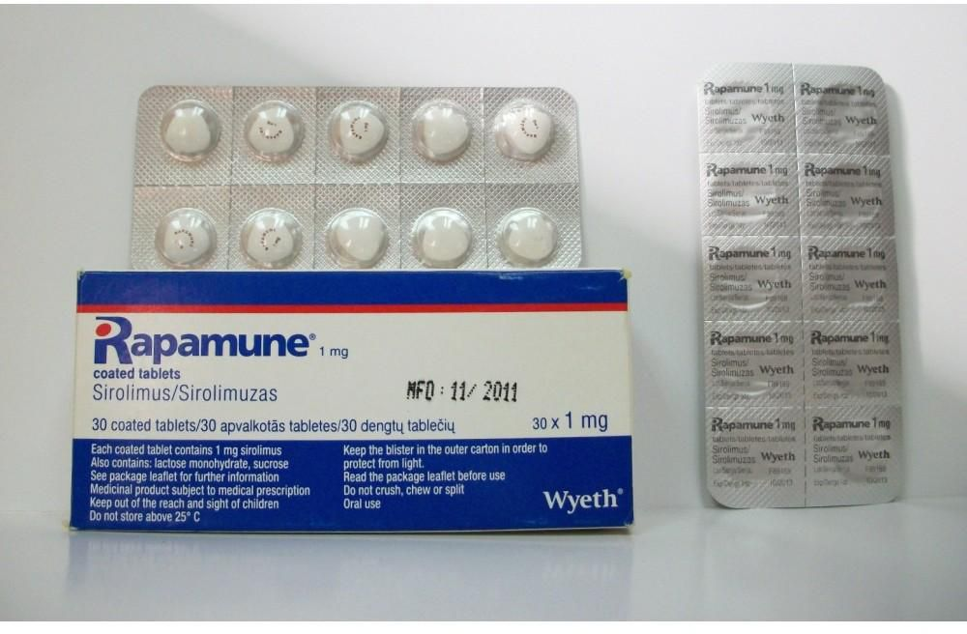
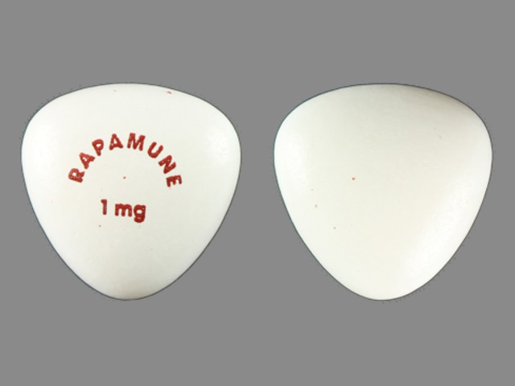
Formulations
Sirolimus
Tab 0.5, 1, 2 mg (Rapamune)

Slide 56
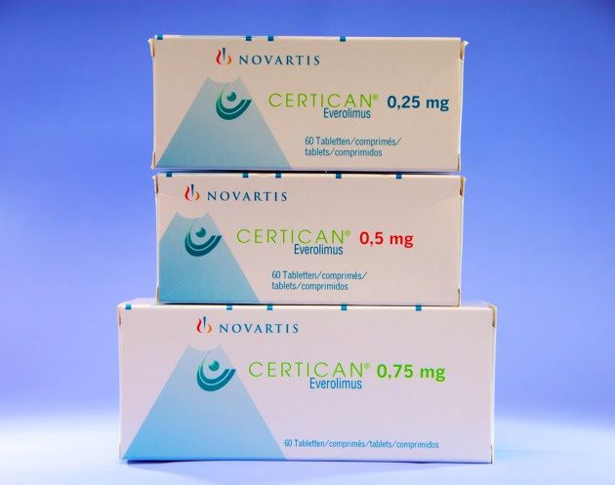
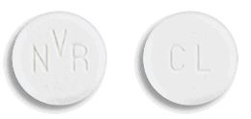
Formulations
Everolimus
Tab 0.25, 0.5, 0.75 mg (Certican, Rolima, Evinos)

Slide 57
Administration of Sirolimus
Once daily dosing
Administer consistently (either with or without food).
Renal transplant: Sirolimus should be taken 4 hours after oral cyclosporine
Tablet: Do not crush, split, or chew.

Slide 58
Dose adjustments
Based upon several factors including concomitant administration of P450 enzyme inducers or inhibitors, hepatic insufficiency, toxicity, and/or infection.
Dose adjustment of sirolimus is not required in the presence of renal impairment.
By contrast, dose reductions of approximately one-third the normal maintenance dose should be used for patients with hepatic impairment.

Slide 59
Drug monitoring
Sirolimus
The recommended time for collection is one hour prior to the next oral dose.
Whole-blood samples should be collected in tubes with EDTA and protected from light; samples collected in this fashion are stable for 24 hours at room temperature, up to one week at 2-8°C, and up to three months at -20°C.

Slide 60
TDM
Steady state: 7-10 days after sirolimus start or change dose
Dose adjustments of everolimus should be based on trough concentrations obtained 4-5 days after a previous dosing change.
Notes:
uptodate

Slide 61
Absorption
Both agents are rapidly absorbed from the GI tract, reaching peak concentrations in 1-3 hours.
Effects of food
The absorption of sirolimus and everolimus are altered by concurrent food intake.
We prefer to have patients take sirolimus at 8 AM, usually 1-2 hours after food ingestion.
Everolimus should be taken consistently with or without food.

Slide 62
Distribution
Sirolimus is about 92% protein bound, mainly to albumin, while everolimus is less protein bound at approximately 74%.
Excretion into breast milk is not known; nonetheless, breast-feeding while taking these agents is discouraged.

Slide 63
Metabolism and Excretion
Both drugs are largely metabolized by both CYP3A and p-gp in the gut and in the liver.
Concurrent use of CSA greatly affects the metabolism of the TOR inhibitors via CYP3A and P-gp interactions.
T ½ Sirolimus = 62 hours  once daily dosing
T ½ everolimus = 30 hours
The majority of both agents are excreted in the feces via biliary elimination.

Slide 64
Adverse effects

Slide 65
Hematologic and Oncologic Effects
Leukopenia (reversible, dose related), anemia, thrombocytopenia
Leukopenia or thrombocytopenia associated with mTOR inhibitors may occur if the mTOR inhibitor is combined with other medications that cause leukopenia or thrombocytopenia (eg, ATG, valganciclovir).
Hepatic artery thrombosis, graft loss and death in liver transplant recipient

Slide 66
Hyperlipidemia and Hyperglycemia
Hyperlipidemia, hypercholesterolemia, and hyperTG (> 50% pts) (dose related)
In most patients, the elevation is manageable with treatment with statins, fibrate.
Sirolimus is diabetogenic  NODAT

Slide 67
Gastrointestinal system
Constipation, diarrhea, dyspepsia, nausea, and vomiting
Mouth sores, not related to HSV (probably dose related)

Slide 68
Respiratory system
Progressive interstitial pneumonitis, ILD  2-6 months after drug therapy
Risk factors: late switch to sirolimus and impaired renal function
Symptoms: dyspnea, dry cough, fever, and fatigue

Slide 69
Nephrotoxicity
mTOR inhibitor + standard doses of CNIs  potentiation of nephrotoxicity
Tubulotoxic  ⬇ K, Mg
De novo proteinuria, nephrotic syndrome, and exaggeration of preexisting proteinuria (possibly as a result of reduced tubular protein reabsorption and impaired podocyte integrity)
Conversion to an mTOR inhibitor from a CNI should only occur in patients with proteinuria < 800 mg and an eGFR > 40 mL/min.
Notes:
sirolimus inhibits P-glycoprotein-mediated efflux of cyclosporine from renal tubular epithelial cells, thereby increasing intratubular levels of cyclosporine and potentiating cyclosporine nephrotoxicity (uptodate)

Slide 70
CONT.
Mild proteinuria ACEI/ARB
Heavy proteinuria  drug discontinuation
mTOR inhibitor + ACEI  ⬆ angioedema
localized limb edema  management: ⬇ Na intake, avoid Dihydropyridine CCB, diuretic, ⬇ dose/ HOLD

Slide 71
Impaired Healing
For patients scheduled for certain elective surgical procedures (e.g., bowel anastomosis, hernia repair, skin flap) it may be wise to switch patients off mTORs a week prior to the procedure and recommence after wound healing; a CNI, MMF, or AZA can be used in the interim.
For emergent surgery, the switch can take place immediately postoperatively.

Slide 72
Effects on Reproductive Health
Sirolimus: up to 12 weeks after drug discontinuation in female and 6 weeks in male  acceptable forms of contraception
Everolimus: up to 8 weeks after drug discontinuation in female and 4 weeks in male  acceptable forms of contraception
Reversible oligospermia and reduced testosterone levels have been described during sirolimus administration, and male patients should be informed accordingly.

Slide 73
Drug Interactions
Cytochrome P450 3A inducers
anticonvulsants, rifampin, isoniazid, St. John's wort
Cytochrome P450 3A inhibitors
antifungals, nondihydropyridine CCBs, some macrolide antibiotics, grapefruit

Slide 74
Drug Interactions
Cyclosporine
Sirolimus + CSA  significantly higher peak/trough levels and AUC CSA  four hours apart.
Tacrolimus
No significant interactions
MMF
Mycophenolate dose reductions may be necessary when using the combination of MMF and sirolimus.
Notes:
Mycophenolate mofetil — In a study published in abstract form, the pharmacokinetic profiles of patients receiving mycophenolate mofetil and either sirolimus or cyclosporine revealed a significantly higher mean AUC for mycophenolate in sirolimus-treated patients when compared with cyclosporine-treated patients [33]. Similarly, mean mycophenolic acid trough concentrations were significantly higher in sirolimus-treated patients. The authors concluded that, to avoid potential toxicity, mycophenolate dose reductions may be necessary when using the combination of mycophenolate mofetil and sirolimus. (uptodate)

Slide 75
Azathioprine

Slide 76
Azathioprine
Antimetabolite, an imidazole derivative of 6-MP
Mechanism of Action
AZA is a purine analogue that is incorporated into cellular DNA, where it inhibits purine nucleotide synthesis and interferes with the synthesis and metabolism of RNA.
AZA is usually reserved for patients who cannot tolerate MPA.

Slide 77
Dose and Administration
When used as the primary immunosuppressant, the daily oral dose is 2-3 mg/kg.
When used as adjunctive therapy with a CNI, the dose is 1- 2 mg/kg.
Tab 50 mg (azaram, imuran)
Inj 50 mg

Slide 78
Side effects

Slide 79
Hematologic effects
BMS (Leukopenia , thrombocytopenia, anemia)  reversible, dose related
Monitor CBC diff and platelets weekly during the first month, then twice a month for 2 months, then monthly (or more frequently if clinically indicated).
BMS typically observed after 7-14 days of therapy.
Delayed hematologic suppression may occur.

Slide 80
Side effects
Hepatitis and cholestasis (reversible)(usually within 6 months of Tx)
Significant hepatic dysfunction  ⬇ dose/ discontinuation
Infections
Bacterial, viral, fungal, protozoal, and opportunistic, including reactivation of latent infections.

Slide 81
Drug interaction
Azathioprine is converted to inactive 6-thiouric acid by xanthine oxidase.
The inhibition of this enzyme by allopurinol demands that this drug combination be avoided or used with great care.
When allopurinol is started, the AZA dose should be reduced to 25- 50% of its initial level, and the WBC with plt should be frequently monitored.

