Slide 1
به نام خدا
Dr m. Majidi
Assistant professor of psychiatry
QUMS

Slide 2
اندیکاسیون های بنزودیازپین ها
GAD :
Brief episodes of time relapse of anxiety
Mistaken for drug dependence
SSRIs

Slide 3
Panic disorder :
Alprazolam Frequency and higher doses than GAD
Other BZD in equivalent doses
ADs other than Bupropion = effective and better tolerated in chronic use
Combination in some pts

Slide 4
Other anxiety disorder :
Adjunct in reducing arousal in PTSD
SAD : Intermittently
Performance anxiety : β Blockers preferred acutely
Initial treatment for acute situational anxiety such as MI

Slide 5
MDD :
Alprazolam
To block early excessive activation by Ads
Anxious depression

Slide 6
Insomnia
quality and length of sleep / REM
After 1-2 m tolerance
Chronic insomnia Trazodone and Quetiapine
Insomnia caused by acute stress : hospitalization
Flurazepam
temazepam

Slide 7
Jet lag and work shift related sleep phase
BD
Clonazepam anxiety and insomnia
lorazepam

Slide 8
SCZ
Adjunct to AS agitation and anxiety
Catatonia
Lorazepam in low doses ( <5 mg/d) and high doses (12 mg/d)
More associated with BD than SCZ
ECT= DEFINITIVE TRATMENT

Slide 9
SEIZURE
Clonazepam = most ftequentlyBZD FOR adjunctive chronic seizure ct
IV diazepam , lorazepam and midazolam status epilepticus
Acute agitation
IV midazolam = severe cases
Life threatening agitation caused by delirium or other neurological condition
IV lorazepam + Haldol and ECT

Slide 10
Nonspecific agitation IM lorazepam + haloperidol
Lorazepam sleep in mania / agitation in SCZ
BZD dose of AS in agitated mania or SCZ
SGA Need for adjunctive BZD

Slide 11
Alcohol withdrawal
Standard treatment
Neuroleptic side effect
Akathisia

Slide 12
Precautions and adverse effects
Sedation
Risky for sleep apnea and COPD
Cognitive and psychomotor impairment
Retrograde amnesia caused by withdrawal from short acting high potency such as midazolam can occur after a single dose
All BZD anterograde amnesia
Impaired psychomotor performance

Slide 13
Aggravation of dementia
Falls
Lorazepam or oxazepam
BZD reduces cognitive reserve sufficiently for AD to be expressed earlier
Disinhibition
Demented pts because of further depression of ARAS delirium

Slide 14
Abuse and dependence
Likelihood of new chronic use in women, ICU or nonsurgical wards, longer hospital stays, more comorbidity, a prior Dx of alcoholism, taking more medications
Physicians reluctant to discontinue long term use with elderly
Change to long term BZD fewer dropout
Diazepam, alprazolam , lorazepam most prone to misuse

Slide 15
Dysphoria
Pts afraid of loosing ct may dysphoric when they feel rapidly calmed or sedated
Pregnancy and lactation
Rapidly cross placenta cleft lip and palate
Diazepam and chlordiazepoxide safe
All secreted in milk but total dose in any time is low sedation, hypotonia, feeding and sometimes discontinuation syn

Slide 16
Drug interaction
Antacids GI Absorption
Inhibitors of CYP 3A4 such as erythromycin, cimetidine and etc BZD LEVEL
CBZ
CNS depression with other sedating agents such as antihistamines
Alcohol + BZD additive psychomotor impairment
BZD + clozapine respiratory and cardiovascular depression
NO LAB INTERFERENCE

Slide 17
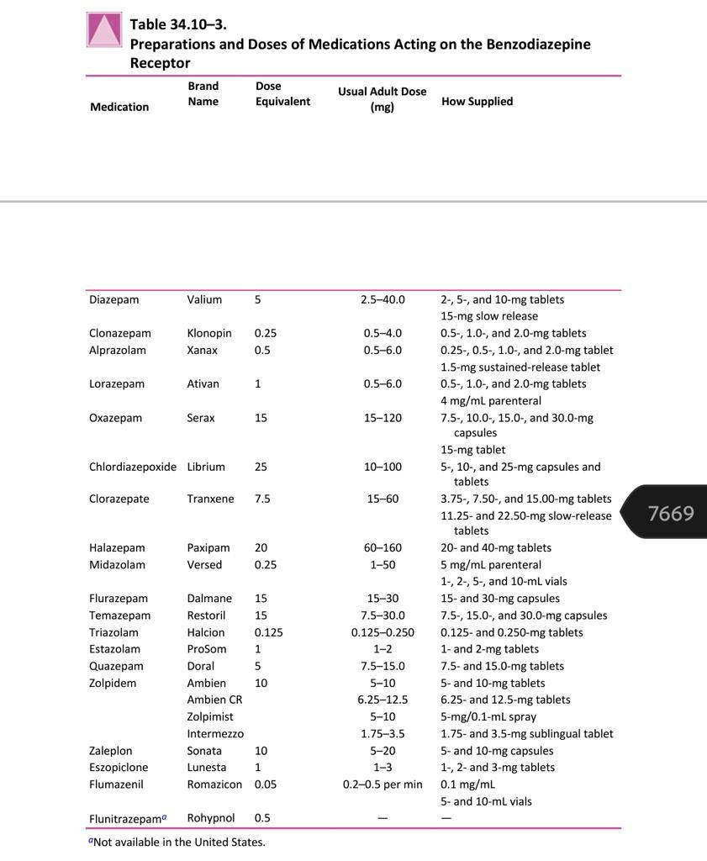

Slide 18
Thanks for your attention

