Slide 1
Classification of disease severity — In the United States, the National Institutes of Health (NIH) have categorized degrees of disease severity in nonpregnant persons as follows [26]:
●Asymptomatic or presymptomatic infection – Positive test for SARS-CoV-2 but no symptoms.
●Mild illness – Any signs and symptoms (eg, fever, cough, sore throat, malaise, headache, muscle pain) without shortness of breath, dyspnea, or abnormal chest imaging.
●Moderate illness – Evidence of lower respiratory disease by clinical assessment or imaging and a saturation of oxygen (SaO₂) ≥94 percent on room air at sea level.
●Severe illness – Respiratory frequency >30 breaths per minute, SaO₂ <94 percent on room air at sea level, ratio of arterial partial pressure of oxygen to fraction of inspired oxygen (PaO₂/FiO₂) <300, or lung infiltrates >50 percent.
●Critical illness – Respiratory failure, septic shock, and/or multiple organ dysfunction

Slide 3
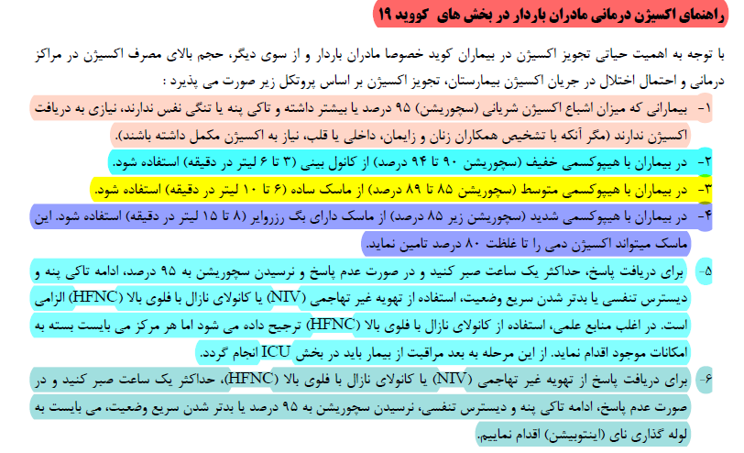

Slide 4
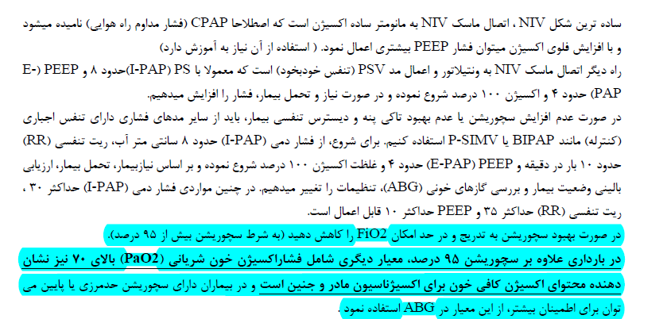

Slide 5
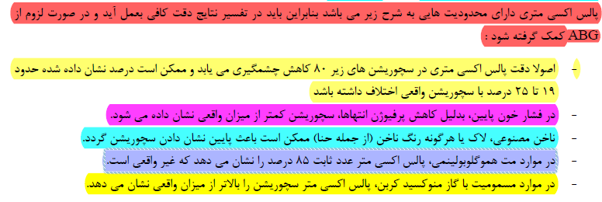

Slide 8
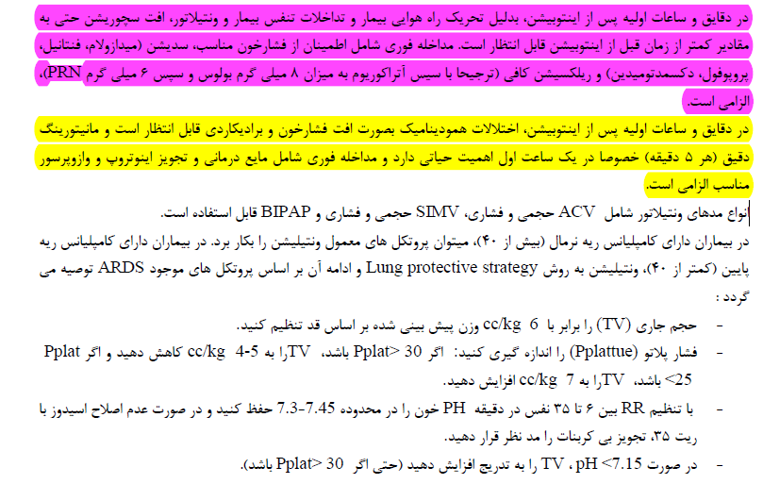

Slide 9
