Slide 1
Pulmonary embolism:
update on management and controversies

Slide 2
Clinical Epidemiology Program, Ottawa Hospital Research Institute, Ottawa, ON, Canada Department of Medicine, Faculty of Medicine, University of Ottawa, Ottawa, ON, Canada

Slide 3
The use of either clinical probability adjusted or age adjusted D-dimer interpretation has led to a reduction in diagnostic imaging to exclude pulmonary embolism.

Slide 4
Direct oral anticoagulation therapies are safe, ef f ective, and convenient treatments for most patients with acute venous thromboembolism, with a lower risk of bleeding than vitamin K antagonists.

Slide 5
These oral therapeutic options have opened up opportunities for safe outpatient management of pulmonary embolism in selected patients.

Slide 6
Af t er a diagnosis of pulmonary embolism, all patients should be assessed for risk of recurrent venous thromboembolism to guide duration of anticoagulation.

Slide 7
Patients with a venous thromboembolism associated with a strong, transient, provoking risk factor can safely discontinue anticoagulation af t er three months of treatment.

Slide 8
Patients with an ongoing strong risk factor, such as cancer, or unprovoked events are at increased risk of recurrent events and should be considered for extended treatment.

Slide 9
The use of a risk prediction score can help to identify patients with unprovoked venous thromboembolism who can benef i t from extended duration therapy.

Slide 10
Box 1: Transient risk factors for venous thrombosis Strong risk factor (odds ratio >10)
• Hip or leg fracture
• Hip or leg joint replacement
• Major general surgery
• Major trauma
• Spinal cord injury Moderate risk factor (odds ratio 2-9)
• Arthroscopic knee surgery
• Central venous lines
• Congestive heart or respiratory failure
• Hormone replacement therapy
• Malignancy
• Oral contraceptive therapy
• Paralytic stroke
• Postpartum
• Previous venous thromboembolism
• Thrombophilia
Weak risk factor (odds ratio <2)
• Bed rest >3 days
• Immobility due to sitting (eg, prolonged road or air travel)
• Increasing age
• Laparoscopic surgery (eg, cholecystectomy)
• Obesity
• Pregnancy (antepartum)
• Varicose veins

Slide 11
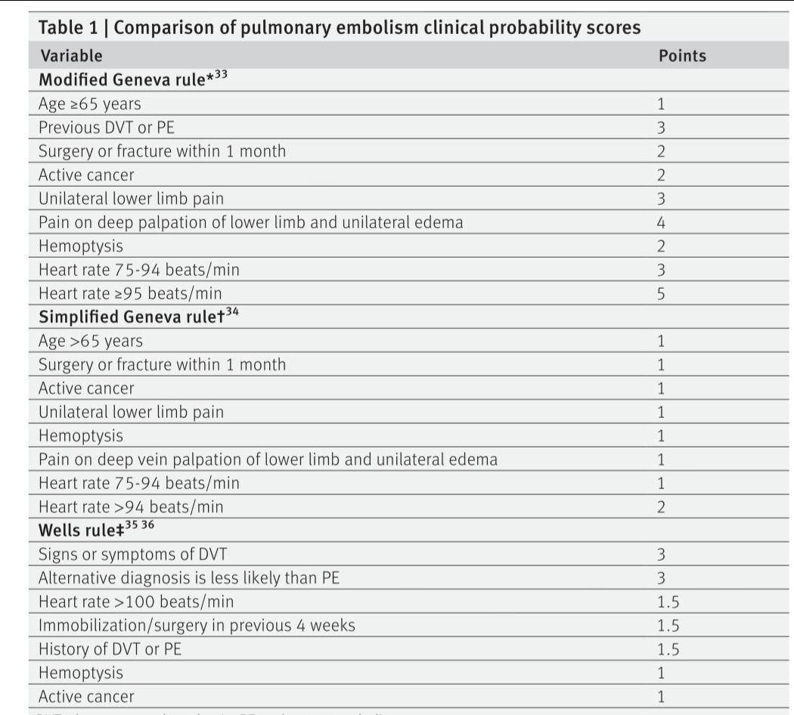

Slide 12
Thrombophilia testing

Slide 13
Family history of venous thromboembolism portends higher risk,55 particularly when the venous thromboembolism is unprovoked or the patient is under 50 years of age.56 Despite this, considerable controversy remains around the value of inherited thrombophilia testing (factor V Leiden mutation, prothrombin gene mutation, protein C def i ciency, protein S def i ciency, and antithrombin def i ciency), as evidence suggests that the presence of thrombophilia does not alter management.5

Slide 14
If thrombophilia testing is used, it should be done after completion of treatment for an acute venous thromboembolism event and preferably in the absence of anticoagulation therapy, as false positive results are associated with warfarin (protein C def i ciency, protein S def i ciency), heparin (lupus anticoagulant), and DOACs (lupus anticoagulant)

Slide 15
We suggest that inherited thrombophilia testing should not be done when venous thromboembolism is associated with a strong provoking factor, as such patients have a low risk of recurrent venous thromboembolism, even when an inherited thrombophilia is identif i ed.60 We also suggest that thrombophilia testing should not be done in patients with unprovoked venous thromboembolism who already have an indication for long term anticoagulation (based on sex or risk predictions scores). In the remaining patients with unprovoked venous thromboembolism and no indication for indef i nite anticoagulation, we suggest discussing inherited thrombophilia testing with them. In most cases, testing will not change the decision on duration of anticoagulation, but rare exceptions include high risk inherited thrombophilia such as antithrombin def i ciency, or combined thrombophilia

Slide 16
Initial treatment for pulmonary embolism

Slide 17
Family history of venous thromboembolism portends higher risk,55 particularly when the venous thromboembolism is unprovoked or the patient is under 50 years of age.56 Despite this, considerable controversy remains around the value of inherited thrombophilia testing (factor V Leiden mutation, prothrombin gene mutation, protein C def i ciency, protein S def i ciency, and antithrombin def i ciency), as evidence suggests that the presence of thrombophilia does not alter management.5

Slide 18
If thrombophilia testing is used, it should be done after completion of treatment for an acute venous thromboembolism event and preferably in the absence of anticoagulation therapy, as false positive results are associated with warfarin (protein C def i ciency, protein S def i ciency), heparin (lupus anticoagulant), and DOACs (lupus anticoagulant)

Slide 19
We suggest that inherited thrombophilia testing should not be done when venous thromboembolism is associated with a strong provoking factor, as such patients have a low risk of recurrent venous thromboembolism, even when an inherited thrombophilia is identif i ed.60 We also suggest that thrombophilia testing should not be done in patients with unprovoked venous thromboembolism who already have an indication for long term anticoagulation (based on sex or risk predictions scores). In the remaining patients with unprovoked venous thromboembolism and no indication for indef i nite anticoagulation, we suggest discussing inherited thrombophilia testing with them. In most cases, testing will not change the decision on duration of anticoagulation, but rare exceptions include high risk inherited thrombophilia such as antithrombin def i ciency, or combined thrombophilia

Slide 20
Initial treatment for pulmonary embolism

Slide 21
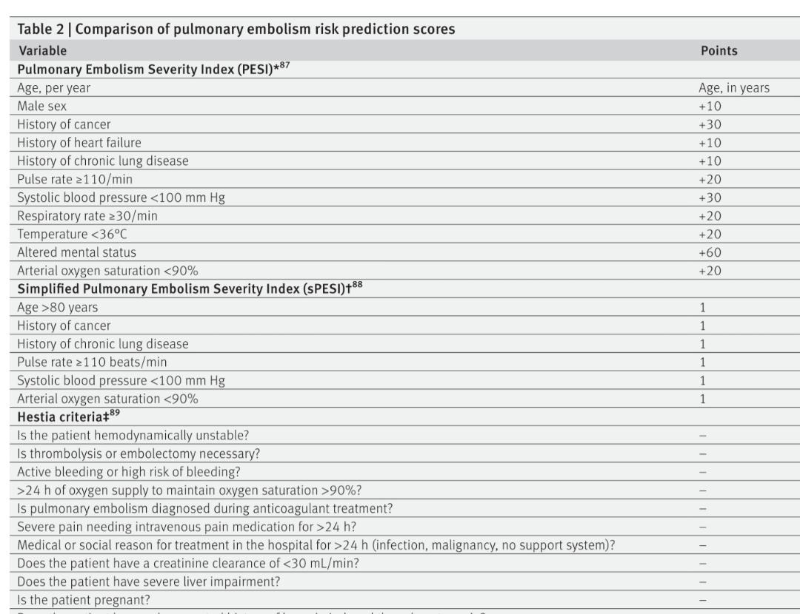

Slide 22
Initial hemodynamic instability, def i ned as systolic blood pressure below 90 mm Hg for 15 minutes or more, is an important marker of prognosis. However, this presentation is uncommon, being found in only 5% of cases; the short term mortality exceeds 15%.14-16 86 For the remaining 95% of cases, several risk prediction scores have been proposed to estimate the risk of an adverse outcome

Slide 23
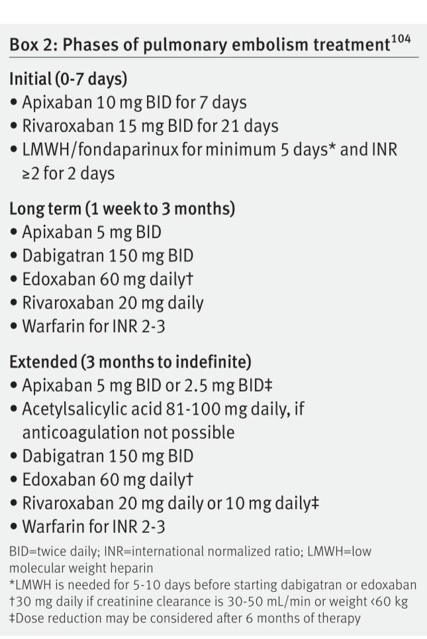

Slide 25
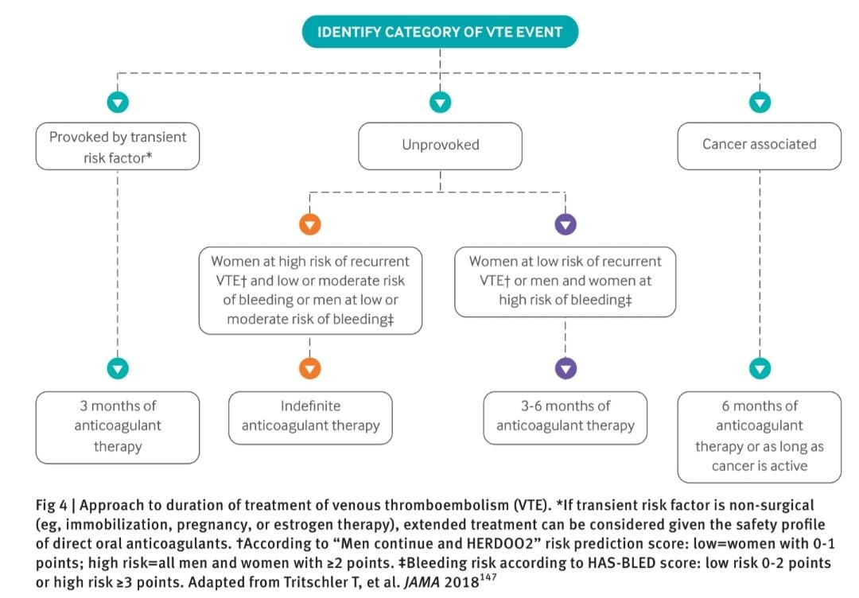

Slide 26
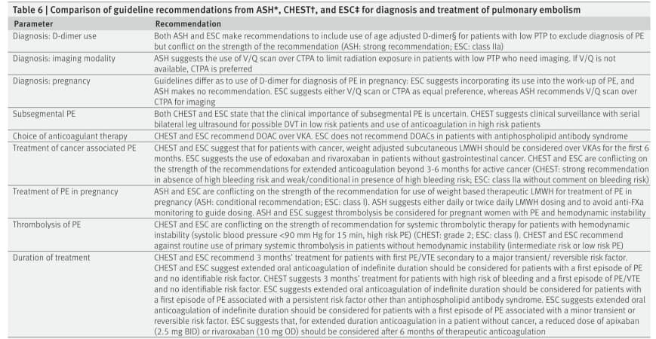

Slide 27
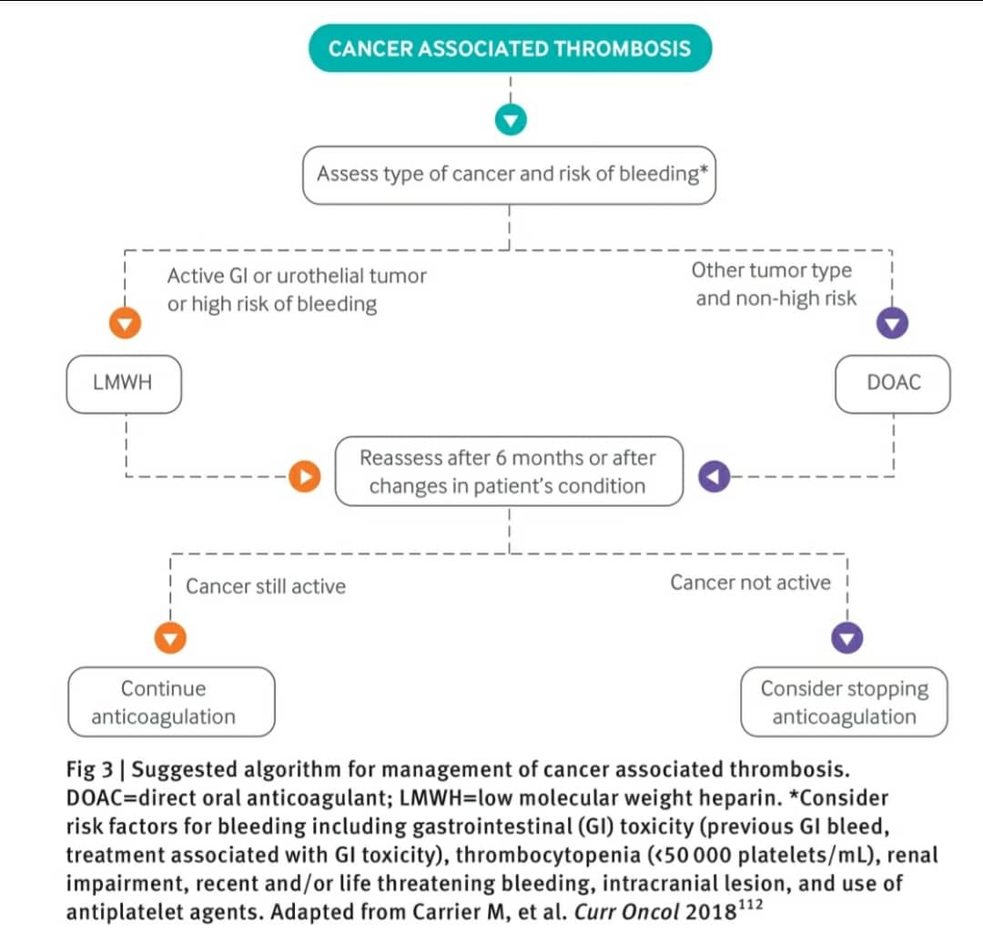

Slide 28
Subsegmental pulmonary embolism

Slide 29
The increased use and sensitivity of CTPA has seen an increase in single or multiple pulmonary emboli isolated to the smaller, subsegmental pulmonary arteries.99 Despite this increase, overall pulmonary embolism related mortality has not changed, and this may account for the decrease in case fatality.

Slide 30
In the PIOPED study, 17% of patients had defects isolated to the subsegmental pulmonary arteries, which corresponds to a “low probability” ventilation-perfusion lung scan.32 In observational studies, these low probability ventilation-perfusion patients were not treated if bilateral leg compression ultrasonography and serial compression ultrasonography were performed

Slide 31
Until further research is completed, we suggest that isolated subsegmental pulmonary embolism on CTPA, in the absence of cancer or high risk features such as poor cardiopulmonary reserve, may be approached as one would a non-diagnostic ventilation-perfusion lung scan: with baseline and serial bilateral leg compression ultrasonography and no anticoagulation treatment unless DVT is found. An ongoing observational study is assessing the safety of such a management strategy (clinicaltrials.gov NCT01455818).

Slide 32
Choice of anticoagulation for acute pulmonary embolism

Slide 33
Anticoagulation therapy for conf i rmed acute pulmonary embolism is the mainstay of treatment and can be divided into three phases: initial phase from zero to seven days, long term therapy from one week to three months, and extended therapy from three months to indef i nite

Slide 34
Parenteral anticoagulation with low molecular weight heparin (LMWH), fondaparinux, or intravenous unfractionated heparin is typically used in patients admitted to hospital for initial management of pulmonary embolism. Stable patients on discharge from hospital or those patients suitable for outpatient treatment from the time of diagnosis of acute pulmonary embolism may be treated with DOACs. DOACs are given at fi xed doses and do not necessitate routine laboratory monitoring

Slide 35
Each DOAC has been deemed non-inferior to the VKA/LMWH combination in phase III RCTs for the prevention of symptomatic recurrent venous thromboembolism in patients with an acute venous thromboembolism). DOACs also have signif i cantly fewer major bleeding events compared with VKAs

Slide 36
Treatment of pregnancy associated pulmonary embolism

Slide 37
DOACs and fondaparinux cross the placenta and should be avoided in pregnancy. Unfractionated heparin and LMWH are safest during pregnancy as they do not cross the placenta; LMWH is the mainstay of treatment owing to its once daily dosing and self-administered subcutaneous route.

Slide 38
In patients with an acute venous thromboembolism event in the current pregnancy that occurred more than a month before the expected delivery date, we suggest a scheduled induction of labor with the last dose of LMWH administered 24 hours before. Stopping LMWH 24 hours before delivery allows the safe use of neuro-axial anesthesia if needed. In the absence of any postpartum hemorrhage, LMWH is restarted six hours after delivery and continued for at least six weeks post partum.

Slide 39
In patients who have an acute pulmonary embolism within one month of expected delivery, we also suggest scheduled induction of labor but administration of unfractionated heparin at therapeutic dose until active labor to avoid prolonged interruptions of therapy

Slide 40
If pulmonary embolism occurred less than two weeks from time of delivery, an inferior vena cava (IVC) fi lter may be considered

Slide 41
Post partum, anticoagulant treatment options for women who are breast feeding include unfractionated heparin, LMWH, VKA, fondaparinux, or danaparoid. DOACs concentrate in breast milk and are contraindicated but can be considered in women who are not breast feeding or after completion of breast feeding in those who have an indication for longer term treatment.

Slide 42
Antepartum and postpartum venous thromboembolism prophylaxis with LMWH are recommended for future pregnancies

