Slide 1
NOACs in liver disease

Slide 2
Advanced liver disease
Increased bleeding risk
Prothrombotic disorder
Affect hepatic clearance and drug metabolism
Altered functionality of liver enzymes and transporters may affect drug response and facilitate drug induced liver injury.

Slide 3
NOACs are contraindicated in Child C cirrhosis
Rivaroxaban should not be used in Child B due to a >2-fold increase in drug exposure
Dabigatran, Apixaban and Edoxaban used with caution in Child B

Slide 4
Recent registry data :in AF and liver disease NOACs may be associated with a lower incidence of bleeds and overall mortality
Initiation and follow-up at a specialized center in a multidisciplinary team (hepatologist , hematologist , cardiologist )
No signal for an elevated risk of hepatotoxicity with dabigatran and FXa-inhibitors in a meta analysis of 29 RCTs

Slide 5
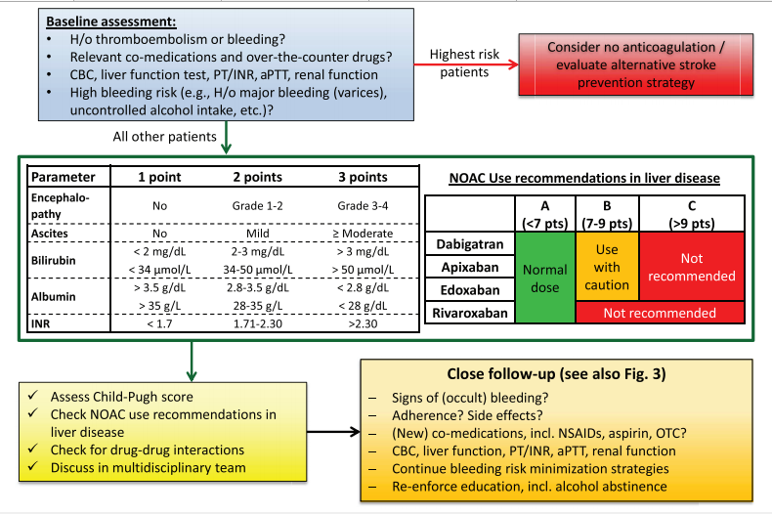

Slide 6
NOAC use during COVID-19 pandemic

Slide 7
AF patients are prone to severe Covid – 19 infection
General preference of NOACs over VKA
Less need to monitor anticoagulant effect
Telemonitoring of bleeding and thrombotic events, side effects , clinical situation affecting renal function
Safer for patients and health care providers

Slide 8
AF patients on NOACs are infected with COVID-19
Continue NOAC
Dose adjust according to clinical situation and DDIs
Switch to LMWH or UFH if in doubt

Slide 9
NOAC and Covid-19 vaccination
Leave out the morning dose of NOAC prior to injection
Fine-gauge needle for injection (23 or 25 )
Firm pressure for 2–5 min after the injection
QD NOACs: take the left-out morning dose 3 h after injection(esp.in case of high stroke risk and QD NOAC)
In BID NOACs: re-start NOAC with the next scheduled dose

Slide 10
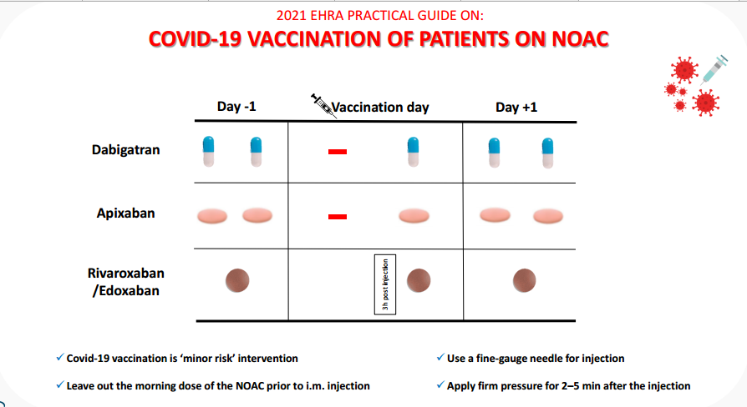

Slide 11
Patients with atrial fibrillation and coronary artery disease

Slide 12
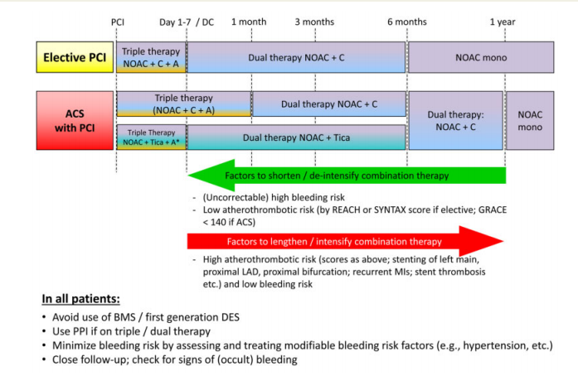

Slide 13



Slide 14
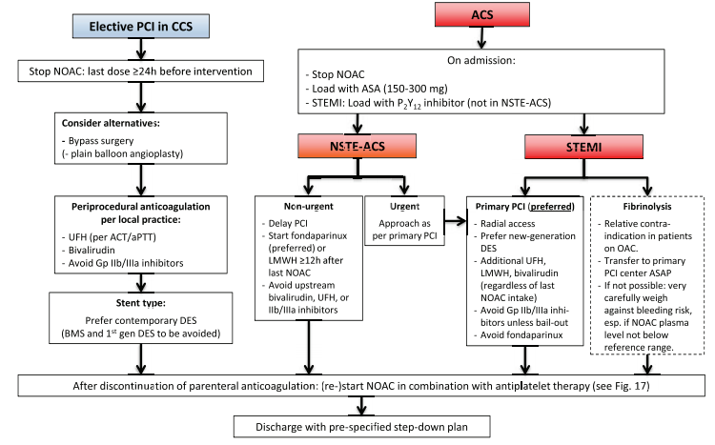

Slide 16
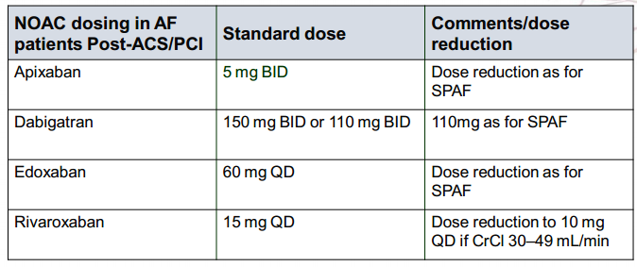

Slide 17
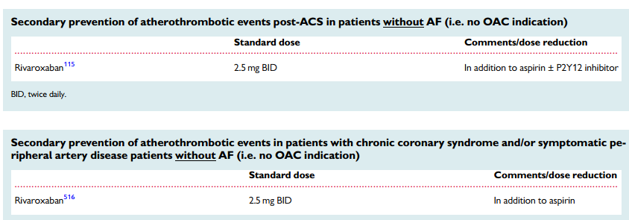
CAD or PAD patients in sinus rhythm

Slide 18
NOACs in high- and low body weights

Slide 19
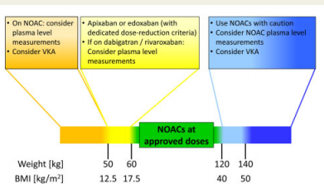

Slide 20
NOAC vs NOAC

Slide 21
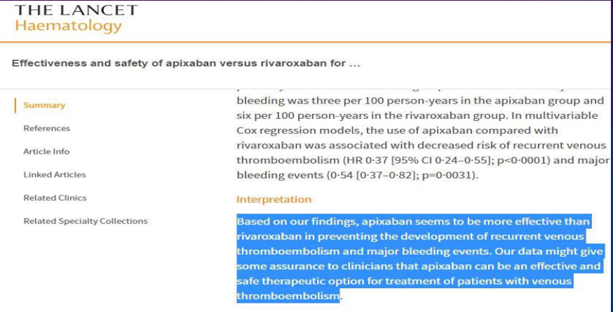
Cohort study Lancet Hematology 2019

Slide 22
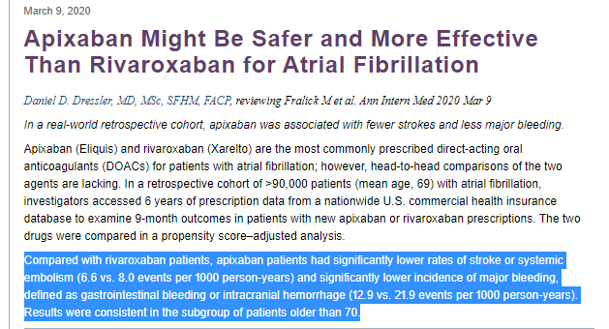
NEJM 2020

Slide 23
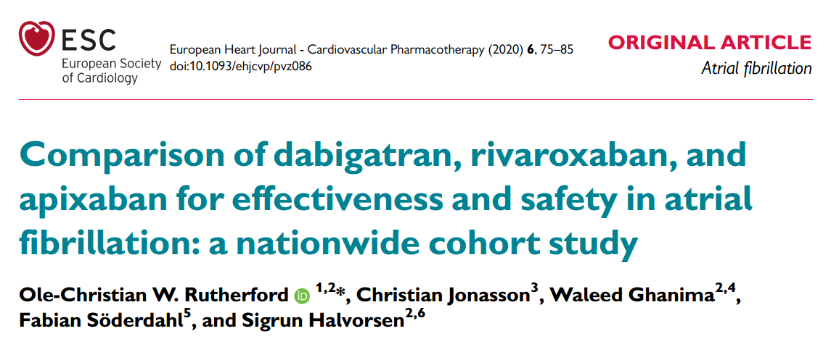

Slide 24
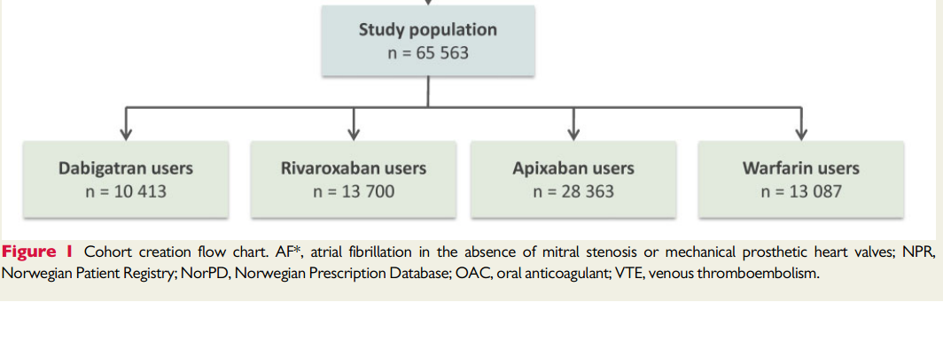

Slide 25
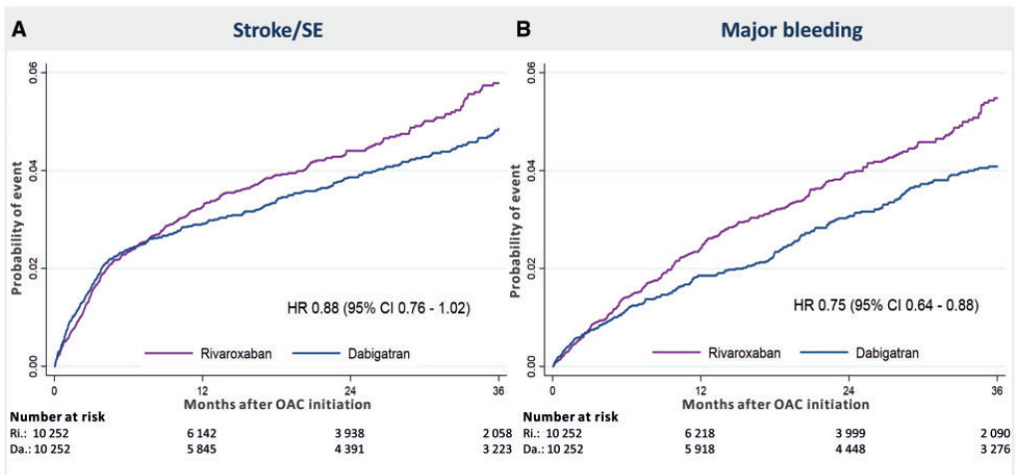

Slide 26
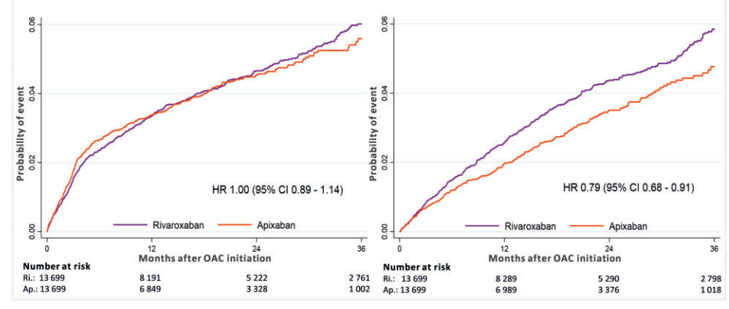
Stroke or SE bleeding

Slide 27
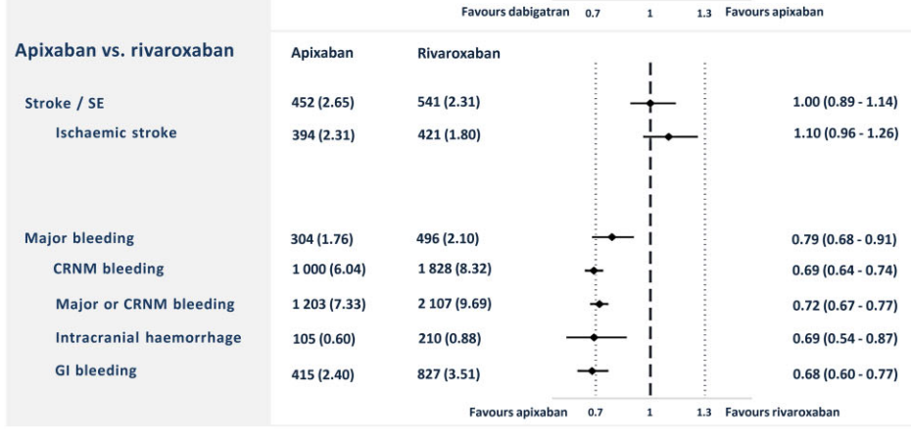

Slide 28
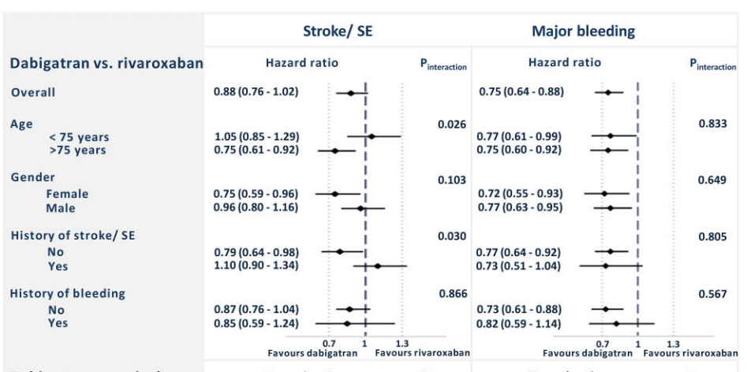

Slide 29
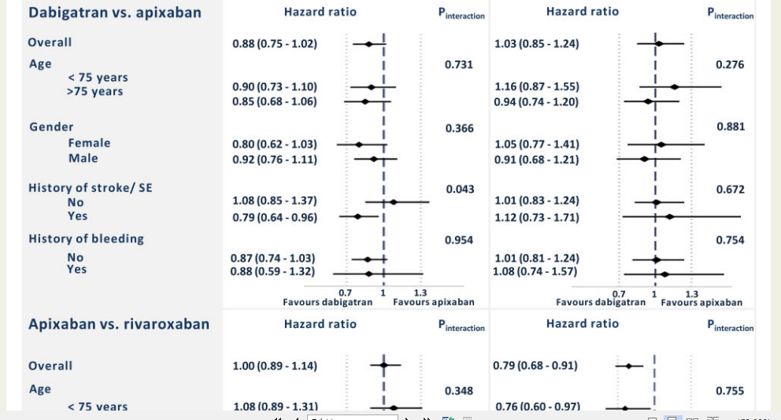

Slide 30
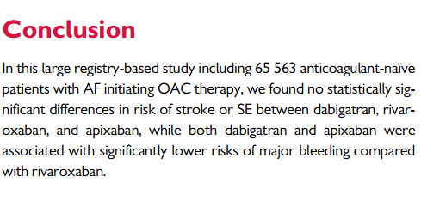

Slide 31
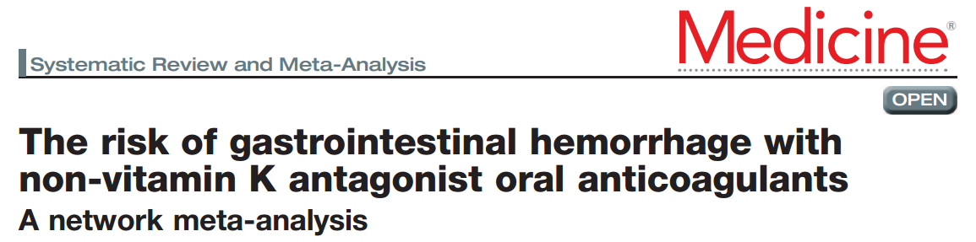
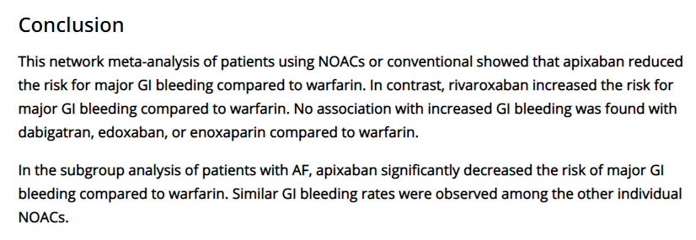
Medicine: March 19, 2021 - Volume 100 - Issue 11 - p e25216

Slide 32
DOAC Counseling Points
Dabigatran is a prodrug given in an acidic core¹
  Increased risk of GI upset
Must store in original container—NOT in pill boxes²
  Swallow whole; do not crush
Rivaroxaban should be given with the largest meal of the day³
  This may NOT be the evening meal for all of our patients
  Real-world data suggest rivaroxaban is associated with higher rate of GI bleeding
Apixaban and rivaroxaban may be crushed for administration³
1. Ellis. Vasc Health Risk Manag. 2013;9:341 2. https://www.fda.gov/drugs/drug-safety-and-availability/fda-drug-safety-communication-special-storage-and-handling-requirements-must-be-followed pradaxa#:~:text=Tell%20patients%20that%20Pradaxa%20must,pill%20boxes %20or%20pill%20organizers. 3. Steffel. Eur Heart J. 2018;39:1330.
Notes:
DOAC, direct oral anticoagulant; GI, gastrointestinal.

Slide 33
