Slide 1
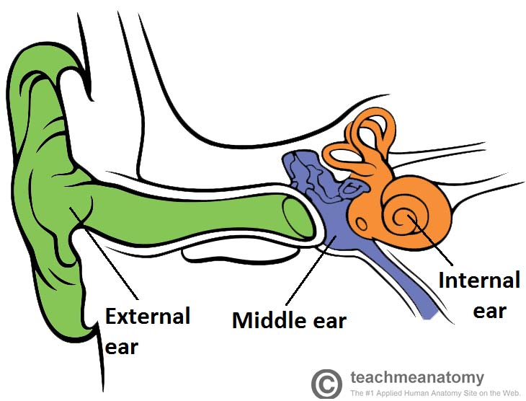
INNER EAR ANATOMY
DR Z KARBASI
FELLOWSHIP OF H&N SURGERY

Slide 2
Ear Anatomy – Inner Ear
The inner ear has two main parts.
The cochlea: which is the hearing portion,
The cochlea is shaped like a snail and is divided into two chambers by a membrane.
The chambers are full of fluid which vibrates when sound comes in and causes the small hairs to vibrate and send electrical impulses to the brain.
The semi-circular canals :is the balance portion
are lined up at right angles (90°) to each other.
This allows the brain to know in which direction the head is moving. These semi-circular canals are filled with fluid and have some small calcium crystals

Slide 3
the eighth cranial nerve
the auditory nerve: Coming from the inner ear and running to the brain
This nerve carries both balance and hearing information to the brain.
Along with the 8TH cranial nerve runs the 7TH cranial nerve.

Slide 4
How does the system work?
The outer ear captures sound waves.
The sound travels down the ear canal and hits the ear drum.
The ear drum vibrates which causes the ossicles (middle ear bones) to vibrate.
A piston action of the ossicles creates a wave in the fluid in the inner ear.
The fluid wave stimulates the hair cells in the cochlea and an electrical impulse is sent through the eighth cranial nerve to the brain.

Slide 5
The balance system works by sending continuous electrical impulses to the brain.
Moving the head causes the fluid in the semi-circular canals to shift.
turn changes the electrical impulses to the brain.
The brain uses this information to make any adjustments the body needs for balance.

Slide 6
Anatomical Position and Structure
The inner ear is located within the petrous part of the temporal bone.
It lies between the middle ear and the IAC
The inner ear has two main components:
Bony labyrinth
It is composed of the cochlea, vestibule and three semi-circular canals.
All these structures are lined internally with periosteum and contain a fluid called perilymph.
Membranous labyrinth – lies within the bony labyrinth.
It consists of the cochlear duct, semi-circular ducts, utricle and the saccule.
The membranous labyrinth is filled with fluid called endolymph.

Slide 7
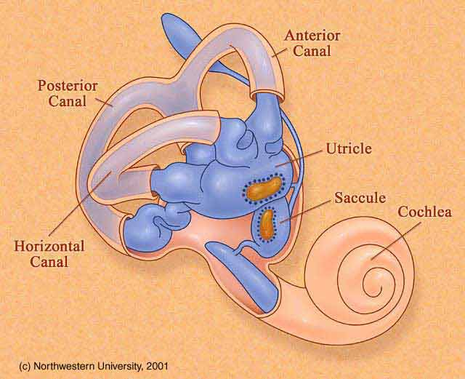

Slide 8
The inner ear has two openings into the middle ear, both covered by membranes.
The oval window lies between the middle ear and the vestibule,
The round window separates the middle ear from the scala tympani (part of the cochlear duct).

Slide 9
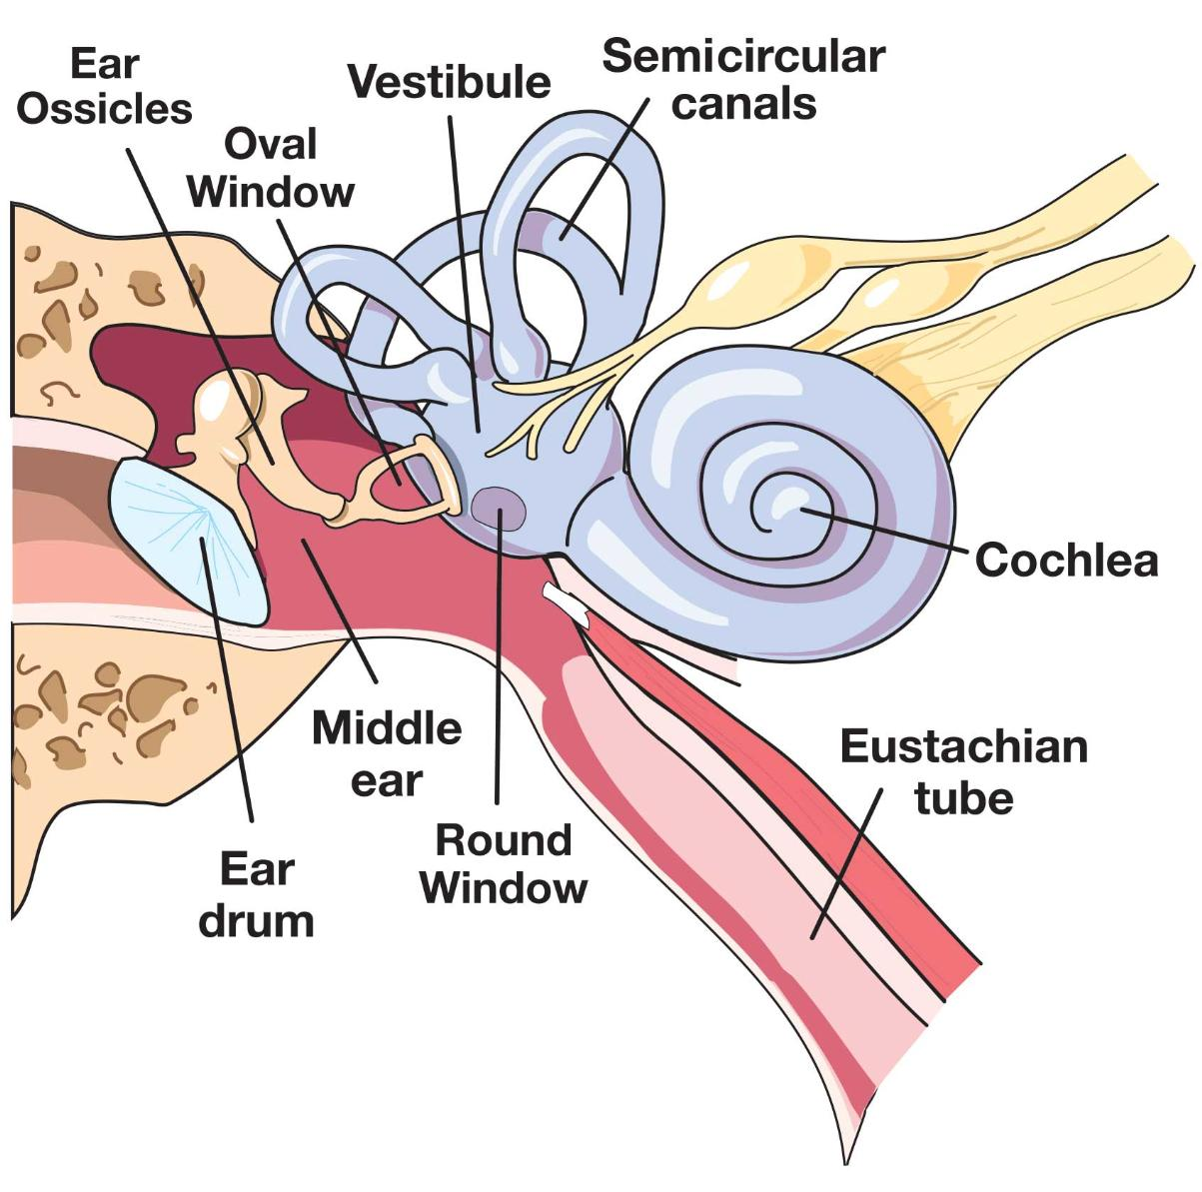
RW & OW

Slide 10
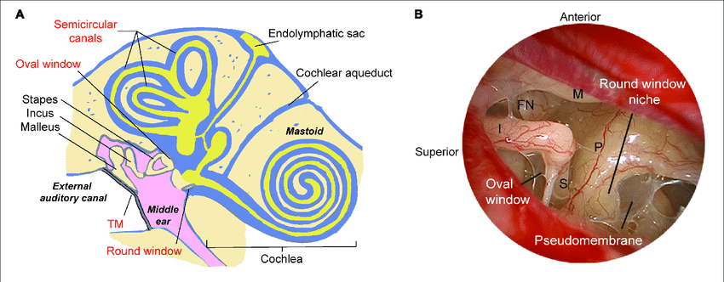

Slide 11
Vestibule
The vestibule is the central part of the bony labyrinth
It is separated from the middle ear by the oval window,
communicates anteriorly with the cochlea and posteriorly with the semi-circular canals
Two parts of the membranous labyrinth; the saccule and utricle, are located within the vestibule.

Slide 12
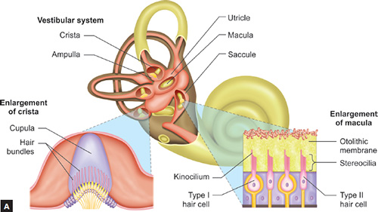

Slide 13
Cochlea
The cochlea houses the cochlea duct of the membranous labyrinth – the auditory part of the inner ear.
It twists upon itself around a central portion of bone called the modiolus, producing a cone shape
Branches from the cochlear portion of the vestibulocochlear (VIII) nerve are found at the base of the modiolus.

Slide 14
The presence of the cochlear duct creates two perilymph-filled chambers above and below:
Scala vestibuli: Located superiorly to the cochlear duct.
  As its name suggests, it is continuous with the vestibule.
Scala tympani: Located inferiorly to the cochlear duct.
  It terminates at the round window

Slide 15
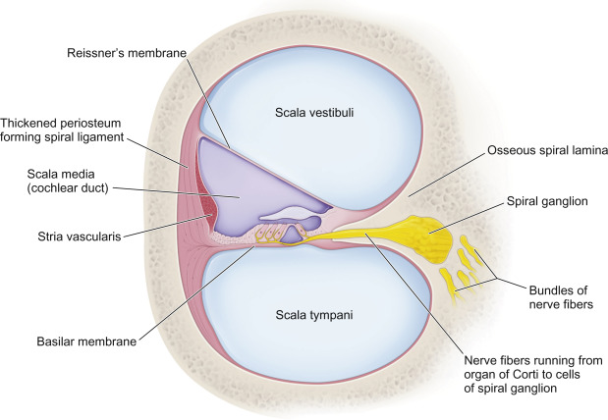

Slide 16
Semi-circular Canals
There are three semi-circular canals: anterior, lateral and posterior.
They contain the semi-circular ducts, which are responsible for balance (along with the utricle and saccule)
They have a swelling at one end, known as the ampulla

Slide 17
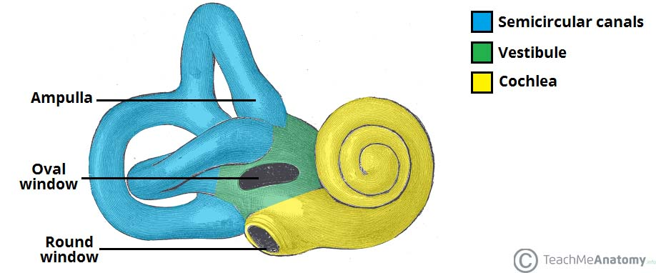
The three parts of the bony labyrinth

Slide 18
Membranous Labyrinth
The membranous labyrinth is a continuous system of ducts filled with endolymph
It lies within the bony labyrinth, surrounded by perilymph.
It is composed of the cochlear duct, three semi-circular ducts, saccule and the utricle.
The cochlear duct is situated within the cochlea and is the organ of hearing.
The semi-circular ducts, saccule and utricle are the organs of balance

Slide 19
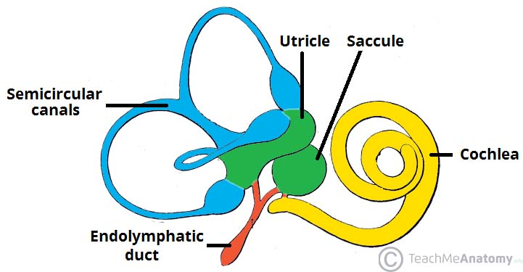
The components of the membranous labyrinth

Slide 20
The cochlear duct
having a triangular shape:
Lateral wall – Formed by thickened periosteum, known as the spiral ligament.
Roof – Formed by a membrane which separates the cochlear duct from the scala vestibuli, known as the Reissner’s membrane
Floor – Formed by a membrane which separates the cochlear duct from the scala tympani, known as the basilar membrane.
The basilar membrane houses the epithelial cells of hearing – the Organ of Corti

Slide 21
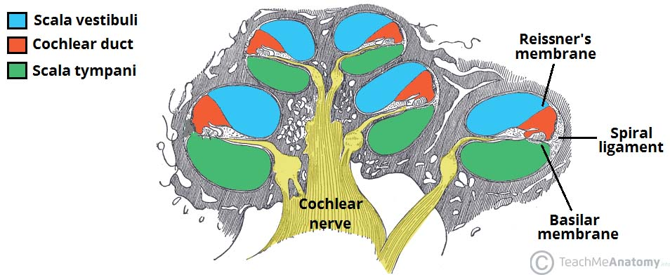
Structure of the cochlea, and borders of the cochlear duct.

Slide 22
Saccule and Utricle
The saccule and utricle are two membranous sacs located in the vestibule.
They are organs of balance which detect movement or acceleration of the head in the vertical and horizontal planes, respectively.
The utricle is the larger of the two, receiving the three semi-circular ducts.
The saccule : receives the cochlear duct.

Slide 23
Endolymph drains from the saccule and utricle into the endolymphatic duct.
The duct travels through the vestibular aqueduct to the posterior aspect of the petrous part of the temporal bone.
Here, the duct expands to a sac where endolymph can be secreted and absorbed.

Slide 24
Semi-circular Ducts
The semi-circular ducts are located within the semi-circular canals, and share their orientation.
Upon movement of the head, the flow of endolymph within the ducts changes speed and/or direction.
Sensory receptors in the ampullae of the semi-circular canals detect this change, and send signals to the brain, ......processing of balance

Slide 25
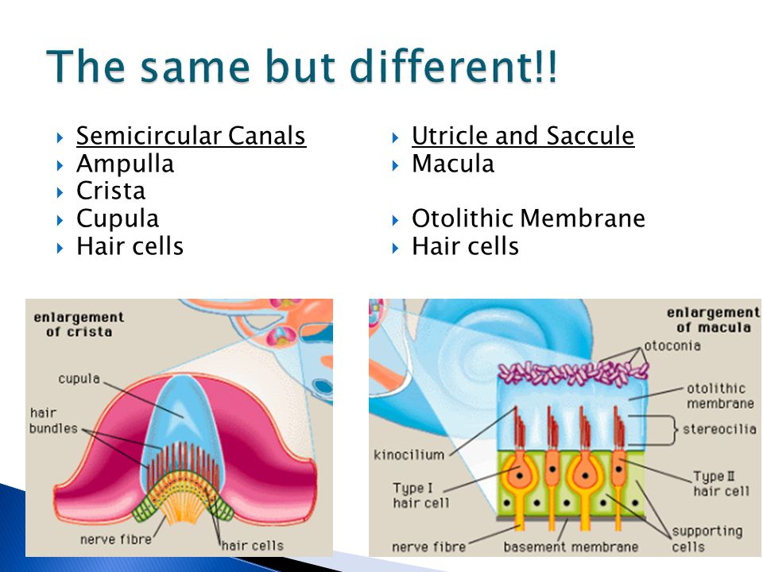

Slide 26
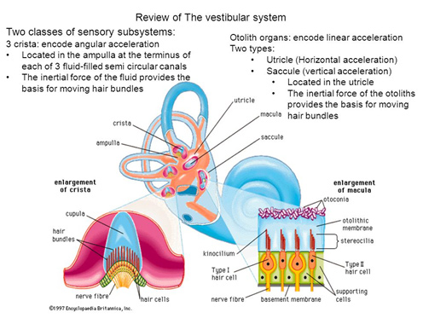

Slide 27
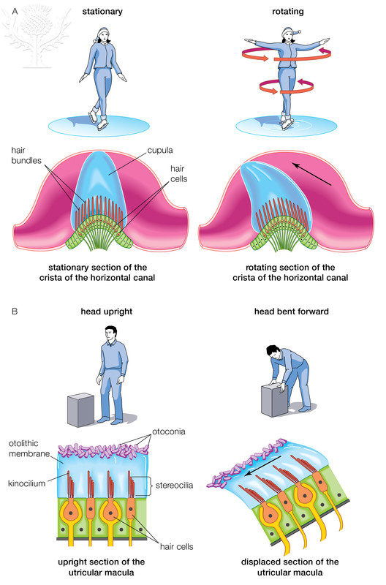

Slide 28
Vasculature
The labyrinthine artery arising from the basilary artery
The bony labyrinth and membranous labyrinth have different arterial supplies.
The bony labyrinth receives its blood supply from three arteries, which also supply the surrounding temporal bone:
  Anterior tympanic branch (from maxillary artery).
  Petrosal branch (from middle meningeal artery).
  Stylomastoid branch (from posterior auricular artery).

Slide 29
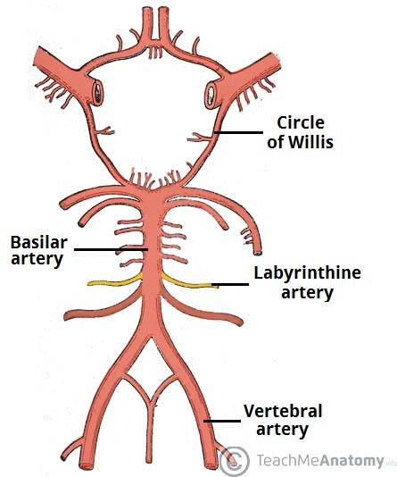

Slide 30
The membranous labyrinth is supplied by the labyrinthine artery, a branch of the inferior cerebellar artery (or, occasionally, the basilar artery).
It divides into three branches:
Cochlear branch – supplies the cochlear duct.
Vestibular branches (x2)
Venous drainage of the inner ear is through the labyrinthine vein, which empties into the sigmoid sinus or inferior petrosal sinus.

Slide 31
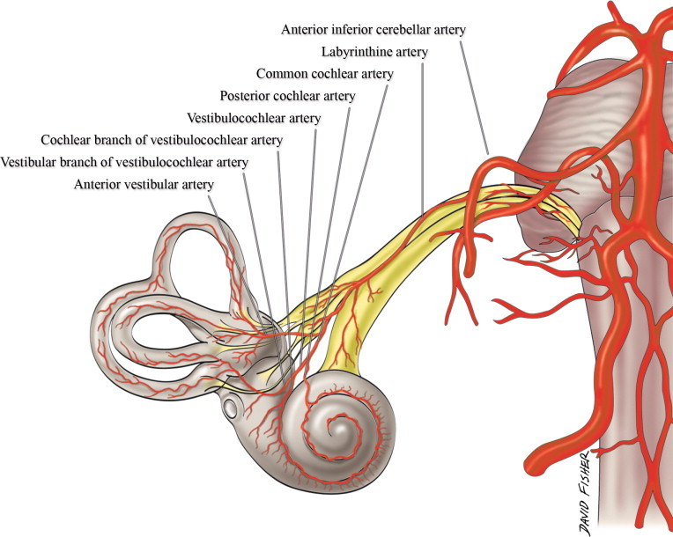

Slide 32
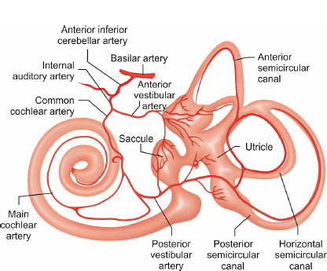

Slide 33
Innervation
The inner ear is innervated by the vestibulocochlear nerve (CN VIII).
It enters the inner ear via the IAC , where it divides into the vestibular nerve (responsible for balance) and the cochlear nerve (responsible for hearing):
Vestibular nerve – enlarges to form the vestibular ganglion, which then splits into superior and inferior parts to supply the utricle, saccule and three semi-circular ducts.
Cochlear nerve – enters at the base of the modiolus and its branches pass through the lamina to supply the receptors of the Organ of Corti.
The facial nerve, CN VII, also passes through the inner ear, but does not innervate any of the structures present.

Slide 34
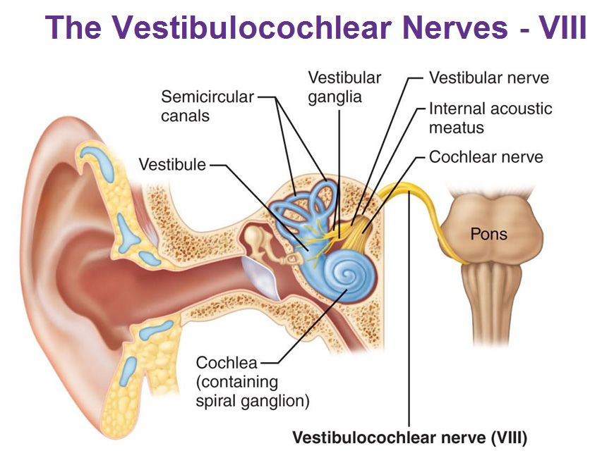

Slide 35
THANK YOU

