Slide 1
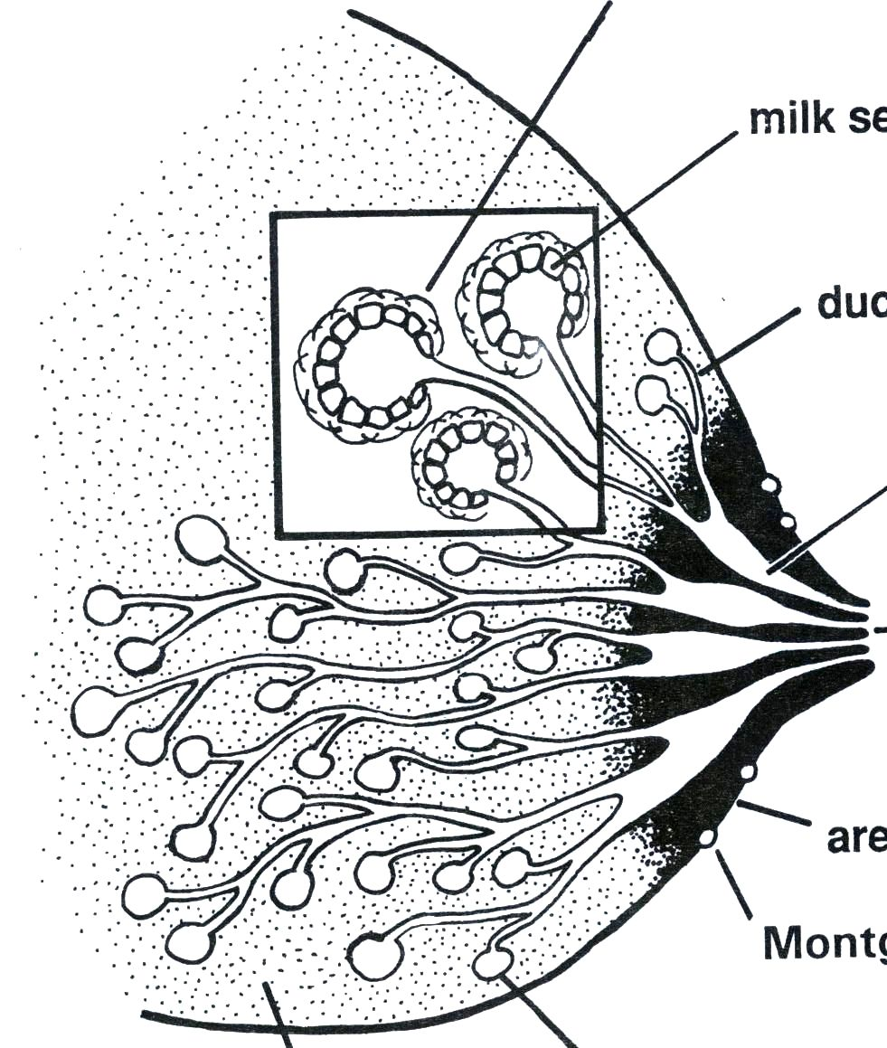
Anatomy of breast
Myoepithelial cells
Epithelial cells
ducts
Lactiferous sinus
Nipple
Areola
Montgomery gland
Supporting tissue and fat
Alveoli

Slide 2
Physiology of lactation
Hormonal secretions in the mother
Prolactin helps in production of milk
Oxytocin causes ejection of milk
Reflexes in the baby – rooting, sucking & swallowing

Slide 3
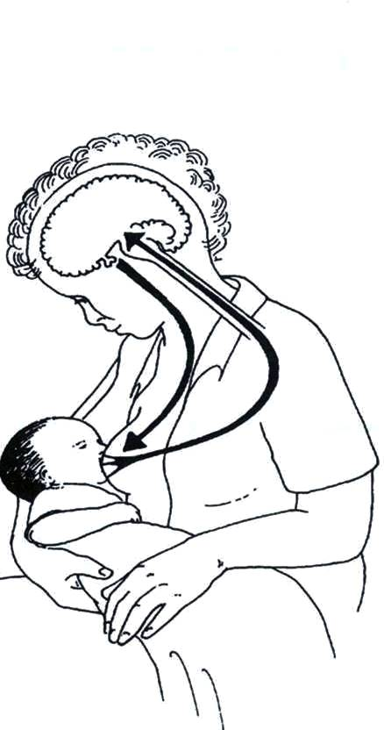
Prolactin “milk secretion” reflex
Enhancing factors
Hindering factors
Early initiation
of breastfeeds
Delay in initiation
of breastfeeds,
Pre-lacteal feeds,
Bottle feeding,
Incorrect positioning,
Painful breast
Good attachment
& effective suckling
Frequent feeds
including night
feeds
Emptying
of breast
Prolactin in blood
Sensory impulse from nipple

Slide 4
Oxytocin “milk ejection” reflex
Oxytocin contracts myoepithelial cells
Sensory impulse from nipple to brain
Baby sucking

Slide 5
Oxytocin reflex
Stimulated by
Inhibited by
Thinks lovingly of baby
Sound of the baby
Sight of the baby
CONFIDENCE
Worry
Stress
Pain
Doubt

Slide 6
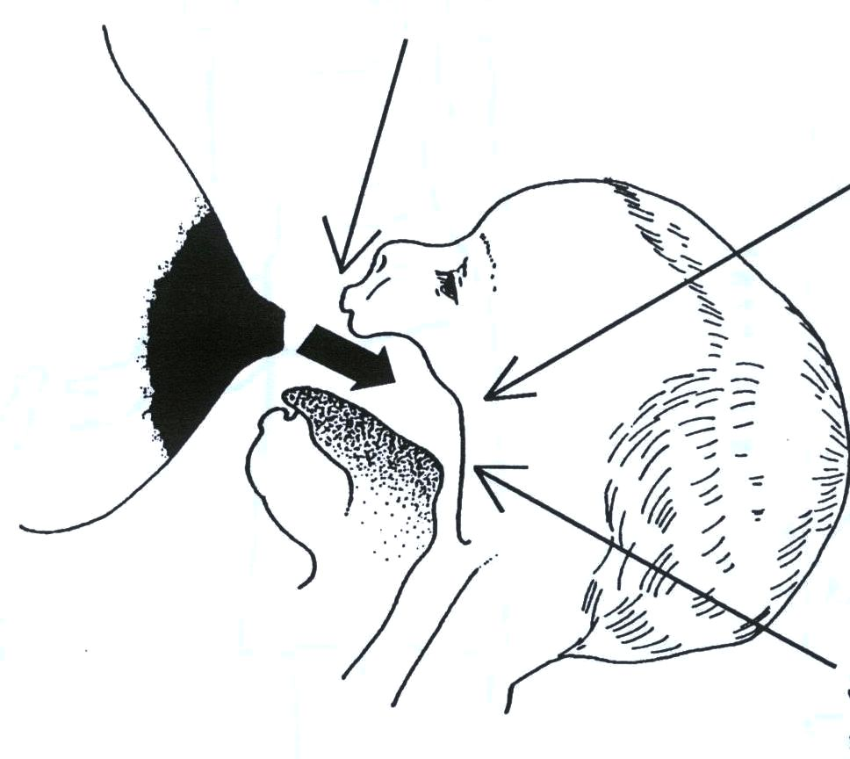
Feeding reflexes in the baby
Rooting reflex
Sucking reflex
Swallowing reflex

Slide 7
Neonatal feeding reflexes:- 1) Rooting reflex: touching the check or circumaural area leads to turning the head to the side of the stimulus leading to opening the mouth seeking for the nipple. 2) Suckling reflex: tactile stimuli of the nipple or aereolar tissue filling the mouth leading to milking action by tongue against hard palate.

Slide 8
3) Swallowing reflex: follows suckling or allows interruption to breathing to prevent choking during swallowing.

Slide 9
Physiology of location: -preparation of breast for lactation:-
a) During pregnancy: estrogen ;progesterone ; placentae
lactogen
development of
acini and duct system
b) In puerperium:
Milk secretion initiated by prolactin.

Slide 10
Maternal reflexes:- Initiated by suckling of the nipple. 1) Nipple erection reflex. 2) Prolactin reflex: sensory stimuli to hypothalamus Anterior-Pituitary prolactin glandular cells of breast acini milk secretion .

Slide 11
(3) Oxytocin reflex (let down reflex or milk ejection reflex) from post. pit contraction of neuroepithelial cells Surrounding alveoli ejection of milk.

Slide 12
Key points of positioning
Mother:
Make the mother sit in a comfortable and convenient position (she can feed in lying down position)
Ensure that she is relaxed and comfortable
Baby:
Baby’s head and body are in a straight line
Baby’s whole body is supported
Baby’s face is opposite the nipple and the breast
Baby’s abdomen touches mother’s abdomen

Slide 13
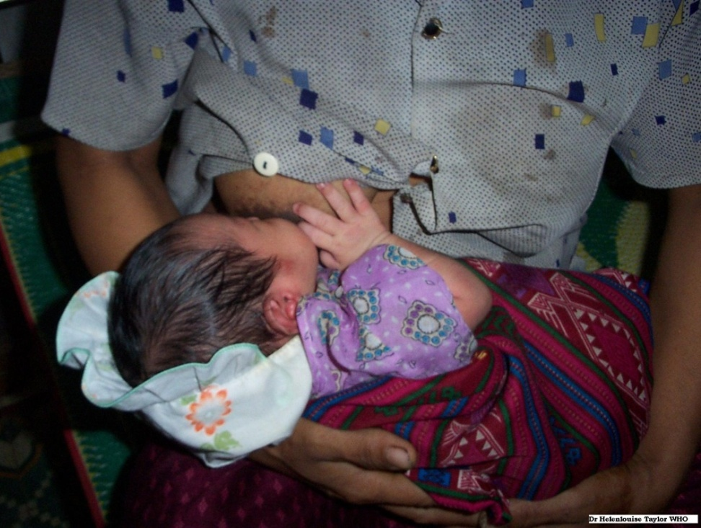
Good positioning

Slide 14
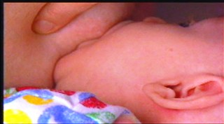
Good attachment
lower lip is curled outward
baby’s mouth is wide open
chin touches the breast
lower portion of the areola is not visible

Slide 15
Good and poor attachment

Slide 16
Effective suckling
For an infant who shows signs of good attachment, the next step would be to assess suckling:
If the infant takes several slow deep sucks followed by swallowing and then pauses, then he/she is sucking effectively

Slide 17
Cradle Position
Copyright © 2003, Rev 2005 American Academy of Pediatrics
Notes:
Let’s take a look at the various breastfeeding positions.
The cradle position is the traditional “Madonna” hold and is the position most people associate with breastfeeding. The position can be used in a rocker or glider, or while semi-reclining or seated in bed.

Slide 18
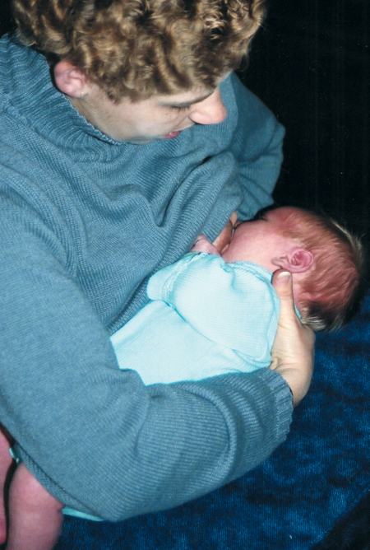
Cross-cradle or Transitional Position
Photo © La Leche League International
Copyright © 2003, Rev 2005 American Academy of Pediatrics
Notes:
This slide demonstrates the cross-cradle or transitional position. The cross-cradle position provides more control and support of the infant’s back and neck. It is particularly useful for newborns and young infants. Notice how the infant is being held by the mother’s opposite hand and arm instead of the arm on the same side as the breast being offered.

Slide 19
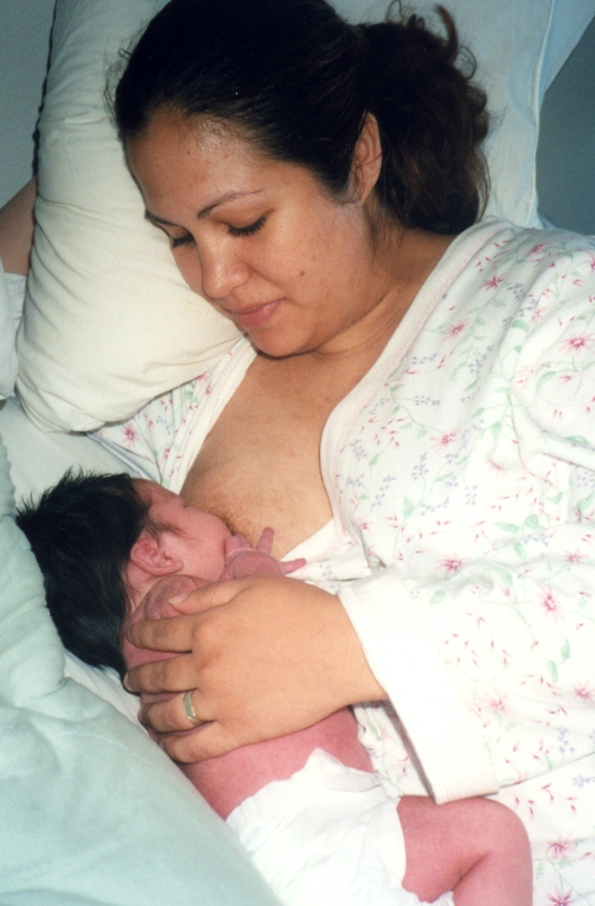
Side-lying Position
Photo © Roni M. Chastain, RN
Copyright © 2003, Rev 2005 American Academy of Pediatrics
Notes:
The side-lying position can be used to allow the mother to rest during the day or for nighttime feedings. This also is a useful position for cesarean deliveries. The baby can be supported by placing a pillow behind the baby’s back or underneath to raise the baby to the proper position. To feed at the other breast, the mother can either hug the baby to her chest and roll to the other side, repositioning the baby and pillows, or simply roll her body forward until the baby can latch onto the other breast.

Slide 20
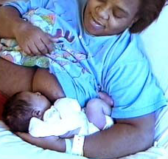
Clutch or Football Position
Photo © Lori Feldman-Winter, MD, MPH, FAAP
Copyright © 2003, Rev 2005 American Academy of Pediatrics
Notes:
The clutch or football position keeps the weight of the infant off of the mother’s abdomen and is particularly useful for cesarean deliveries. Premature infants can be easily supported in this position.
Mothers should be taught at least 2 different positions prior to hospital discharge. They should rotate breastfeeding positions to encourage optimal draining of milk from all segments of the breast and to help to eliminate nipple or breast discomfort during the early days of breastfeeding.

Slide 21
Common Breastfeeding Positions
Notes:
Review pages 42 of syllabus about breast feeding and bottle feeding
Four common breastfeeding positions.

Slide 23
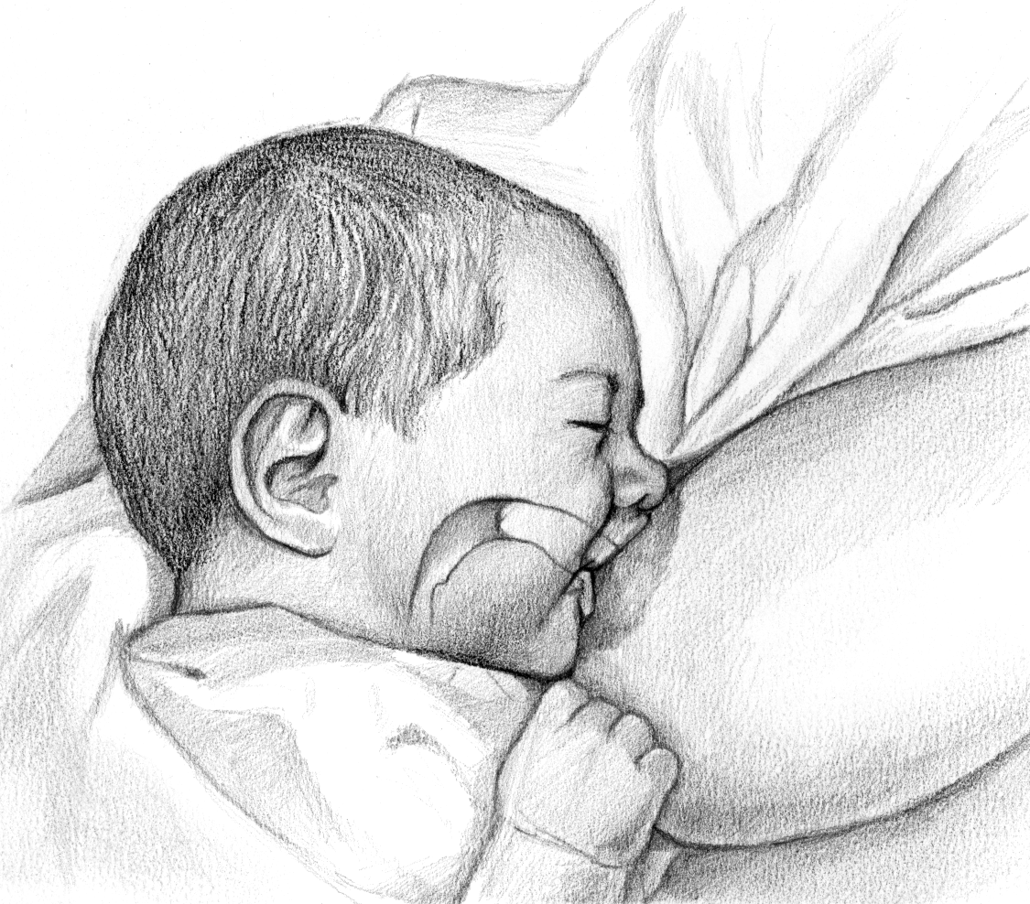
Latch
Stimulate rooting reflex.
Take sufficient areola into mouth.
Flange lips around the breast— “fish lips.”
Have wide angle at corner of mouth.
Illustration by Tony LeTourneau
Copyright © 2003, Rev 2005 American Academy of Pediatrics
Notes:
Latching onto the breast can be stimulated by gentle stroking of the middle of the bottom lip with the nipple. As the infant opens the mouth widely in response to the rooting reflex, the mother should draw the infant to the breast.
The newborn should not be attached just to the nipple, but should have sufficient areolar tissue in the mouth so that the mother’s nipple is actually positioned near the junction of the newborn’s hard and soft palates. In this position, the nipple should not be traumatized.
The angle of the mouth should be as wide as possible and the lips should be everted or turned outward. The baby’s nose, mouth, and chin all should be touching or very close to the tissue of the breast as the baby latches.

Slide 24
Immediate Essential Newborn Care
Deliver the baby in prone position on the mother’s abdomen, face turned to the side
Call out time of birth.
Dry the newborn thoroughly. Check the baby’s breathing while drying. Remove wet cloth.
Place the newborn on the mother’s abdomen in skin-to-skin contact. Cover the back with a dry blanket.
Notes:
Emphasize that most babies 90% of newborns are normal. Routine Care for babies who do not have problems at birth,

Slide 25
Time: WITHIN THE 1ST 30 SECS
Intervention: Dry and provide warmth.
Action:
Use a clean, dry cloth to thoroughly dry the baby by wiping the face, eyes, head, front and back of the trunk, arms and legs.
Do a quick check of newborn’s breathing while drying.
Remove the wet cloth.

Slide 26
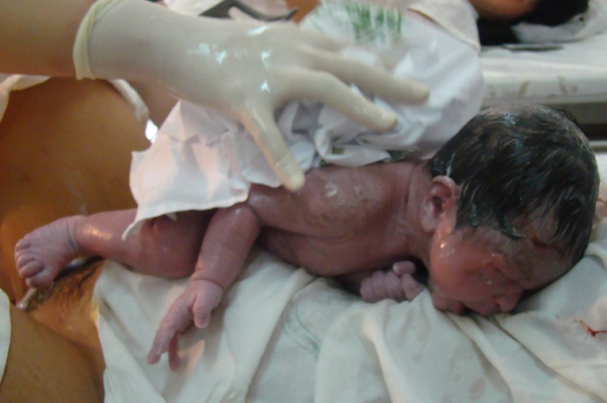
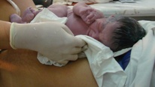
Drying The Newborn
Stimulates the newborn to breathe normally
Minimizes heat loss

Slide 27
Drying the newborn
During the 1st 30 seconds of drying/stimulation:
Do not suction unless mouth/nose are obstructed with secretions or other material
Do not ventilate unless the baby is floppy and not breathing
Phil. ENCC
27
Notes:
M1-S3_Care_baby_at_time_birth.ppt
27
ｷ After a baby is born, regardless of gestational age, he/she should be dried while positioning on the mother’s abdomen.
To ‘breathe normally’ was identified as one of the baby’s immediate and basic ‘needs’. A baby can die or become brain damaged very quickly if breathing does not start soon after birth. Drying stimulates breathing.
The WHO emphasizes thermal care of the newborn as an essential intervention
ｷ Oxygen is needed to keep the baby’s brain and other vital organs healthy. When the umbilical cord is cut the baby no longer receives oxygen via the placenta.
ｷ If the baby is crying, he/she should, not be routinely suctioned unless, he/she is gurgly or has frothing secretions at the mouse or nose.
ｷ Once a baby is born, and while being dried, the baby’s breathing should be assessed. If a baby is breathing normally both sides of its chest will rise and fall equally at around 30 to 60 times a minute.

Slide 28
Time band: If after 30 secs of drying, newborn is breathing or crying
Intervention: Skin -to-skin (STS) contact
Action:
Avoid any manipulation, such as routine suctioning.
Place the newborn prone on the mother’s abdomen or chest skin-to-skin.
Cover newborn’s back with a blanket and head with a bonnet.
Place identification band on ankle

Slide 29
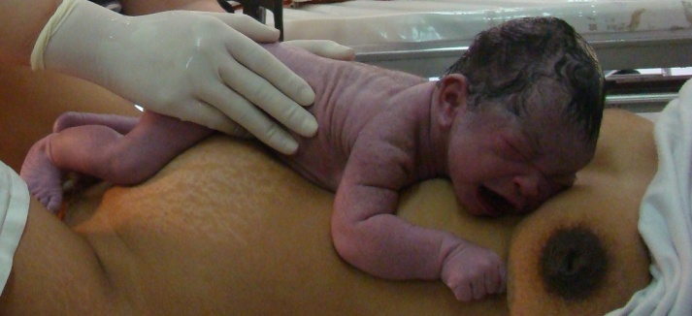
Immediate skin-to-skin contact
Notes:
A baby’s skin temperature falls within seconds of being born.
ｷ If the temperature continues to fall the baby will become ill (hypoglycaemic) and may die.
ｷ This is why a baby MUST be dried immediately after birth and delivered onto his/her mother’s abdomen covered with a warm towel or piece of cloth over his/her back.
ｷ It also explains why the mother and baby should be covered with a warm and dry cover if the room temperature is lower than 25⁰C.
ｷ This skin-to-skin contact not only helps the baby regulate his temperature, but it also improves bonding, protects the baby from infection by exposing him/her to good bacteria of the mother and increases the baby’s blood sugar.
ｷ Later, after the cord has been cut, positioning the baby between the mother’s breasts ensures the baby’s temperature is kept at the correct level for as long as the skin contact continues.
ｷ This first skin-to-skin contact should last uninterrupted for at least one hour after birth or until after the first breastfeed.
ｷ Skin-to-skin contact can re-start at any time if the mother and baby have to be parted for any treatment or care procedures.

Slide 30
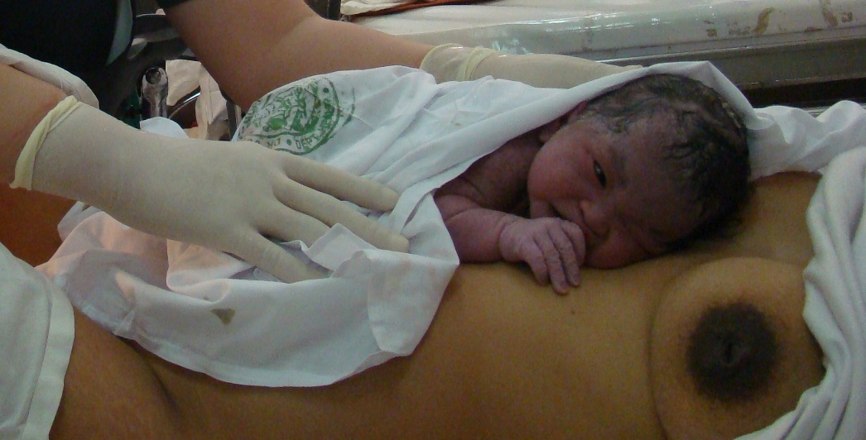
Immediate skin-to-skin contact
Notes:
A baby’s skin temperature falls within seconds of being born.
ｷ If the temperature continues to fall the baby will become ill (hypoglycaemic) and may die.
ｷ This is why a baby MUST be dried immediately after birth and delivered onto his/her mother’s abdomen covered with a warm towel or piece of cloth over his/her back.
ｷ It also explains why the mother and baby should be covered with a warm and dry cover if the room temperature is lower than 25⁰C.
ｷ This skin-to-skin contact not only helps the baby regulate his temperature, but it also improves bonding, protects the baby from infection by exposing him/her to good bacteria of the mother and increases the baby’s blood sugar.
ｷ Later, after the cord has been cut, positioning the baby between the mother’s breasts ensures the baby’s temperature is kept at the correct level for as long as the skin contact continues.
ｷ This first skin-to-skin contact should last uninterrupted for at least one hour after birth or until after the first breastfeed.
ｷ Skin-to-skin contact can re-start at any time if the mother and baby have to be parted for any treatment or care procedures.

Slide 31
Skin-to-skin
A healthy infant may be placed in skin-to-skin contact with their mother immediately after delivery until the first feeding is accomplished
An alert healthy newborn is able to latch on to a breast without specific assistance
within the first hour after birth

Slide 32
What are the benefits of immediate skin-to-skin contact?
A. Provides warmth
B. Increases overall duration of exclusive breastfeeding
C. Allows colonization with good bacteria
D. All of the above

Slide 33
Skin-to-Skin Contact
Provides warmth
Improves bonding
Provides protection from infection by exposure of the baby to good bacteria of the mother
Increases the blood sugar of the baby
Contributes to the overall success of breastfeeding
Notes:
Effect of SSC on Babies’ Temperature
Christensson K, et al. Temperature, metabolic adaptation and crying in healthy full-term newborns cared for skin-to-skin or in a cot.
Axillary and skin temperatures were significantly higher in the skin-to-skin group.
Babies kept in cots cried significantly more than those kept skin-to-skin with the mother.
Keeping the baby skin-to-skin with the mother preserves energy and accelerates metabolic adaptation and may increase the well-being of the newborn
1992. Acta Paediatr. 1992 Jun-Jul;81(6-7):488-93.

Slide 34
Skin-to-Skin Contact
Effect on Immunoprotection
Colonization with maternal skin flora
Stimulation of the mucosa-associated lymphoid tissue system.
Ingestion of colostrum

Slide 35
Risks of Hypothermia
Hypothermia can lead to :
Infection
Coagulation defects
Acidosis
Delayed fetal to newborn circulatory adjustment
Hyaline membrane disease
Brain hemorrhage.
[i] Tunell R. Hypothermia: epidemiology and prevention, in Improving Newborn Health in Developing Countries, A. Costello and D. Manandhar, Editors. 2000, Imperial College Press: London, UK. p. 207-220.

Slide 36
Maintain skin-to-skin contact
- uninterrupted for at least 90 minutes after birth and until the first thorough breastfeed is complete

Slide 37
SIGNS OF READINESS TO BREASTFEED
Only once the newborn shows feeding cues (e.g. opening of mouth, tonguing, licking, rooting), make verbal suggestions to the mother to encourage her newborn to move toward the breast e.g. nudging.

Slide 38
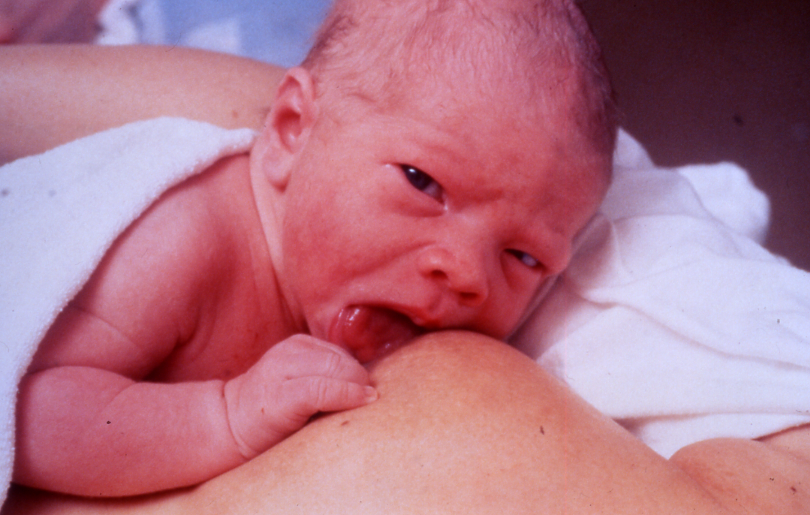

Slide 39
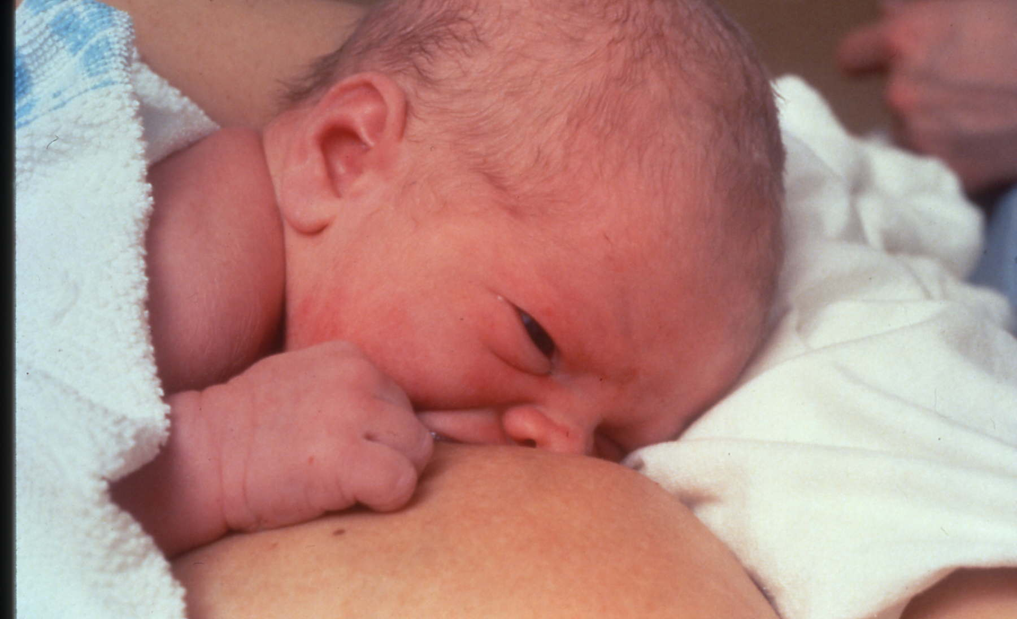

Slide 40
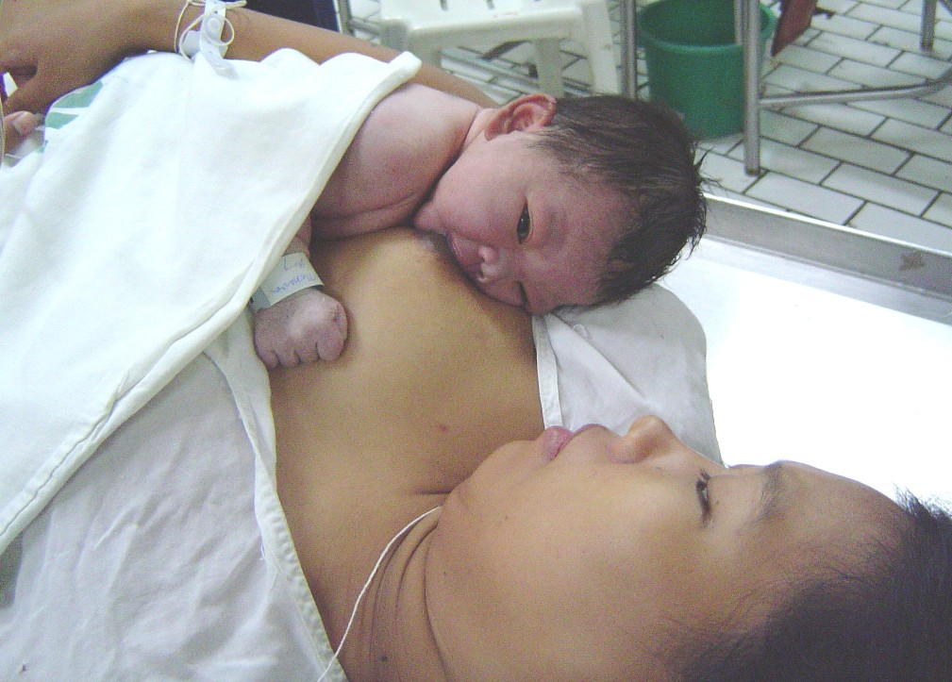
Help the mother and baby into a comfortable position

Slide 41
Initiation of breastfeeding
Health workers should not touch the newborn unless there is a medical indication.
Do not give sugar water, formula or other prelacteals.
Do not give bottles or pacifiers.
Do not throw away colostrum.
If the mother is HIV-positive, counsel the mother on breastfeeding

Slide 42
The first breast feed
Check attachment and positioning when the baby is feeding
Let the baby feed for as long as he wants on both breasts
Keep the mother and baby together for as long as possible after delivery
Delay tasks such as weighing, immunizations, etc. until after the first feed

Slide 43
Rooming-in
A hospital arrangement where a mother/baby pair stay in the same room day and night, allowing unlimited contact between mother and infant
Slide 4.7.2

Slide 44
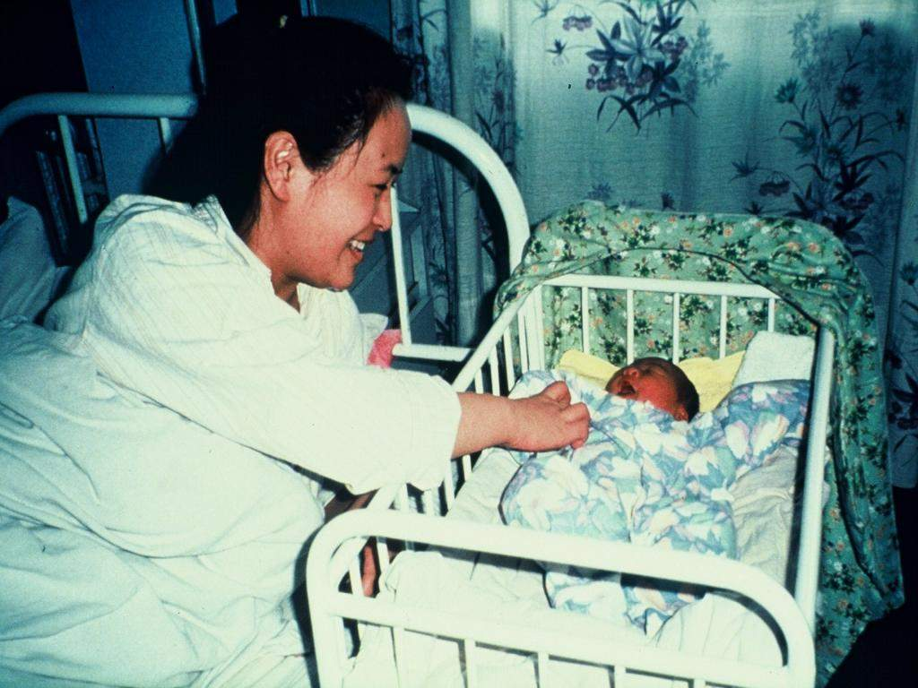
Slide 4p

Slide 45
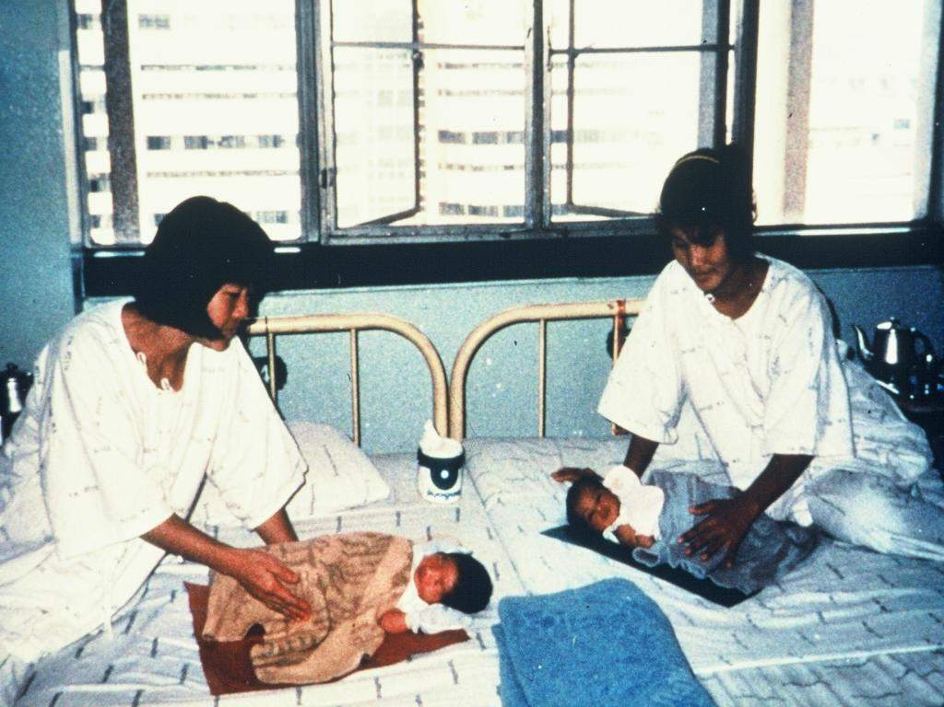
Slide 4q

Slide 46
Rooming-in Why?
Reduces costs
Requires minimal equipment
Requires no additional personnel
Reduces infection
Helps establish and maintain breastfeeding
Facilitates the bonding process
Slide 4.7.3

Slide 47
Breastfeeding on demand:
Breastfeeding whenever the baby or mother wants, with no restrictions on the length or frequency of feeds.
Slide 4.8.2

Slide 48
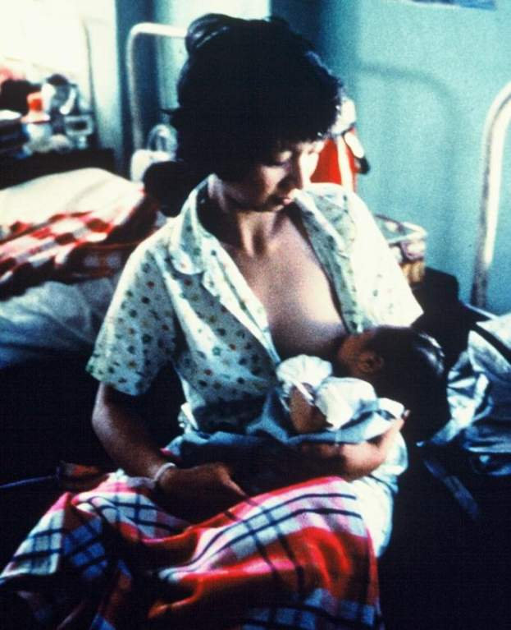
Slide 4r

Slide 49
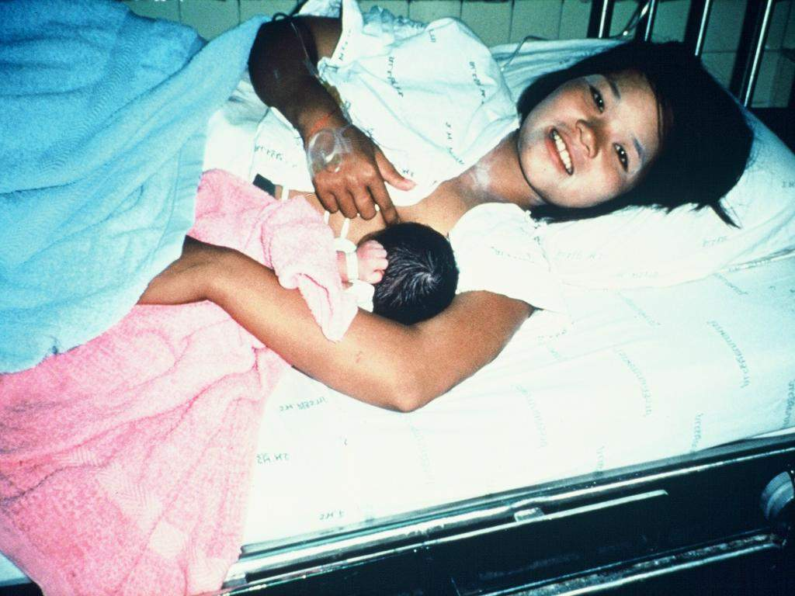
Slide 4s

Slide 50
Alternatives to artificial teats
cup
spoon
dropper
Syringe
Slide 4.9.2

Slide 51
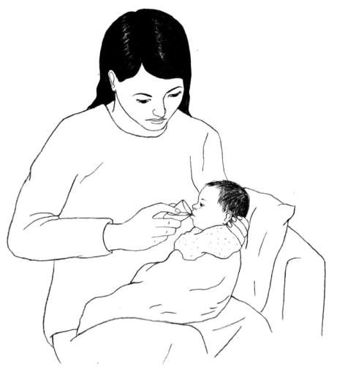
Cup-feeding a baby
Slide 4.9.3

Slide 52
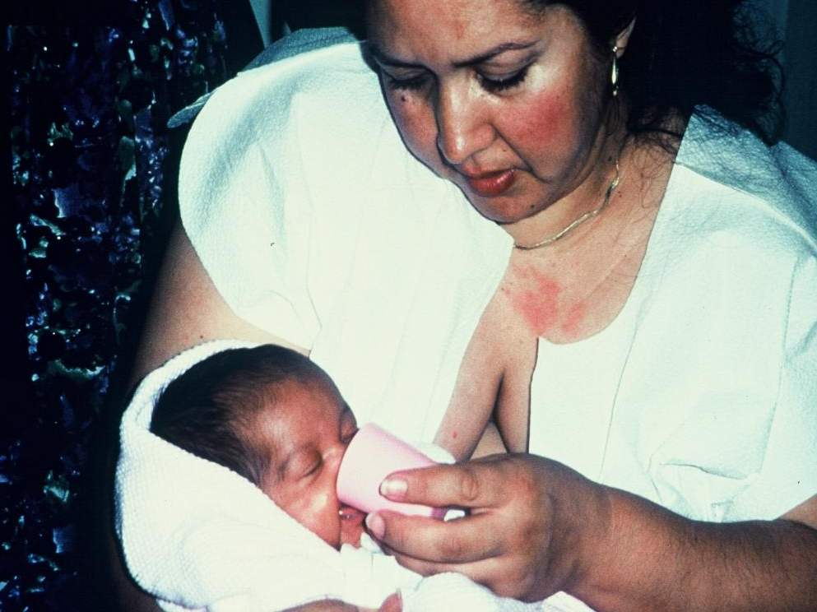
Slide 4v

Slide 53
 The key to best breastfeeding practices is continued day-to-day support for the breastfeeding mother within her home and community.
From: Saadeh RJ, editor. Breast-feeding: the Technical Basis and Recommendations for Action. Geneva, World Health Organization, pp.:62-74, 1993.
Slide 4.10.2

Slide 54
RECOMMENDATIONS
Exclusive breast feeding until 6 months of age
Introduce complimentary foods with continued breastfeeding
Optimum to breastfeed for 2 years or longer

Slide 55
“Physiological norm”
Recommendations (AAP, AAFP, WHO, etc.):
promote exclusive breastfeeding of all babies for the first six months
rare exceptions
6 months - 1 year
breastfeeding should continue with the addition of complementary foods

Slide 56
Exclusive Breastfeeding
An infant’s consumption of human milk with no supplementation of any type (no water, juice, non-human milk, and no foods) except for vitamins, minerals, and medications
AAP

Slide 57
Benefits of Exclusive Breastfeeding
Positive effects of breastfeeding are most significant during the first six months of life with exclusive breastfeeding
Exclusive breastfeeding has been shown to:
provide better protection against many diseases and infections
increase the likelihood of continued breastfeeding for at least the first year of life

Slide 58
Health Effects
Babies who are not fed human milk have higher rates of:
Otitis media
Allergies
Respiratory tract infection
Necrotizing enterocolitis
Urinary tract infection
Gastroenteritis

Slide 59
Health Effects
Babies who are not breastfed have a higher risk of hospitalization in the first year of life due to increased risk of bacterial illness
Bacterial meningitis
Bacteremia
Diarrhea

Slide 60
Health Effects
Intelligence
Studies have shown slightly higher IQ and developmental scores among children who were breastfed

Slide 61
Breast feeding
*Neonatology:-
Feeding
What are the advantages of breast milk or breast feeding?
Breast feeding:
Availability ; cheep ; decreased incidence of breast cancer : improve mother infant bonding.

Slide 62
Composition of breast milk:-
Colostrum:
Bright lemon yellow ; alkaline ; viscous fluid secreted during first 5-7 days : compared to mature milk it is :
1) More rich in protein (2.3gm/dl) but less CHO or fat.

Slide 63
Protein composition of human colostrum and mature breast milk (per litre)
From: Worthington-Roberts B, Williams SR. Nutrition in Pregnancy and Lactation, 5th ed. St. Louis, MO, Times Mirror/Mosby College Publishing, p. 350, 1993.
Slide 4.4.7

Slide 64
2) Very rich in immunoglobulin especially IgA. 3) rich in cholesterol , Na , K , Cl , Zinc , Copper , leucocytes ( macrophages , lymphocytes ) Antibacterial ( lactofissin , lactofirrin ) more rich in Vit.A than mature milk.

Slide 65
4) Laxative effect by enhancing GIT motility leading to prevention of meconium blood formation which is the most common cause intestinal destruction.
5) reducing enterohepatic circulation and prevent hyperbilirubinaemia.

Slide 66
Maternal Benefits
Maternal health is also affected by breastfeeding…

Slide 67
Maternal Benefits
Suckling stimulates the release of oxytocin
Oxytocin ~> contractions
helps prevent postpartum hemorrhage
promotes uterine involution

Slide 68
Maternal Benefits
Breastfeeding assists in the natural spacing of pregnancies
Mothers who bottle-feed typically begin their menstrual cycle again within 6-8 weeks
Breastfeeding mothers often stay amenorrheic for several months

Slide 69
Maternal Benefits
Mothers who breastfeed have a lower risk of iron-deficiency anemia
iron lost during menstruation is much more than the amount the body uses for milk production

Slide 70
Maternal Benefits
Breastfeeding mothers have an easier time losing weight gained during pregnancy and maintaining that weight loss
Milk production is an active metabolic process
200 to 500 calories per day

Slide 71
Maternal Health Benefits
Potential long-term health benefits:
Decreased rates of ovarian, endometrial, and breast cancer
Possible decreased risk of postmenopausal osteoporosis
increase in maternal bone density after weaning

Slide 72
Maternal Benefits
Women with Type I diabetes prior to pregnancy tend to need less insulin while breastfeeding

Slide 73
Psychological Benefits
Provides a unique skin to skin bonding interaction between the mother and infant
Suckling by the infant stimulates Prolactin
has been shown to produce a calming effect in nursing mothers

Slide 74
Recognize Early Signs of Hunger
Offer the breast anytime the infant shows early signs of hunger:
Increased alertness
Physical activity
Rooting
*Crying is considered a late indicator of hunger

Slide 75
Frequent Feedings
First few weeks:
mothers are encouraged to have 8 to 12 feedings every 24 hours

Slide 76
As breastfeeding is established…
The frequency of feedings may decrease to approximately 8 times per 24 hours
Frequency may increase again as the infant experiences periods of rapid growth, or if an increase in milk volume is desired

Slide 77
Breastfeeding Beyond Infancy
All the benefits of human milk continue beyond infancy
Recommendation (AAP and AAFP):
breastfeeding continue beyond the first year for as long as the mother and child desire

Slide 78
There is no time limit to how long a mother may choose to breastfeed her infant
There is no evidence of psychologic or developmental harm from breastfeeding into the first few years of life
This is strictly a personal choice to be made by the individual

Slide 79
Health Effects
Children who are breastfed have lower incidences of certain health problems that may develop later in life such as:
Type I and II diabetes
Allergic disease
Asthma
Lymphomas
Inflammatory bowel disease

Slide 80
IMMUNOLOGIC SPECIFICITY
Protection against pathogens & allergens
Kills pathogenic organisms or modifies their growth
Stimulates epithelial maturation for future defence
First immunization
Protection against common respiratory and intestinal diseases

Slide 81
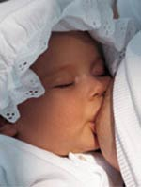
PERFECT FOOD FOR BABIES
Just the right amount of nutrients in the right proportions
Over 200 components in human milk
Composition of breast milk:
-Live cells, fat, carbohydrates, proteins, vitamins, minerals
-Less fat than most other mammals
-More lactose than other mammals

Slide 82
BREAST MILK COMPOSITION
Fat (4% concentration provides up to 50% of caloric needs, cholesterol levels constant, lipolytic enzymes aid in fat digestion)
Carbohydrates (lactose = milk sugar predominantly in human milk, 7% concentration provides up to 40% caloric needs, essential for development of CNS, enhances calcium & iron absorption)

Slide 83
PROPERTIES OF BREASTMILK
Biologic specificity => Long-chain omega-3 Fatty Acids (DHA and AA)
-Important for brain and retinal development
-Higher IQs

Slide 84
IMMUNOLOGIC SPECIFICITY
Colostrum = Baby’s first vaccination
Less risk of illness such as:
Ear infections, pneumonia, crohn’s disease and other bowel illnesses, stomach flu and other intestinal illnesses, ear infections, childhood cancers, diabetes, arthritis, allergies, asthma and eczema

Slide 85
BREAST MILK COMPOSITION
Carbohydrates (Bifidus factor = growth factor present only in human milk required for establishing an acidic environment in the gut to inhibit growth of bacteria, fungi and parasites)
Protein
-Lactoferin => Isolates external iron
-Secretory IGA => Most important immunoglobulin, breast milk = only source for first 6 weeks

Slide 86
BENEFITS OF BREASTFEEDING
Ecological:
-Saves resources
-Less waste
-No refrigeration
-No manufacturing
-No bottles, cans
-No trucking
-No handling

Slide 87
BENEFITS OF BREASTFEEDING
For Society
-Smarter
-Healthier
-Less cost to healthcare system
-Stronger families

Slide 88
BENEFITS OF BREASTFEEDING
To Families
-Less trips to doctors, hospitals
-Less prescriptions
-Less stress
-Less illness
-More bonding
-Inexpensive

Slide 89
BENEFITS OF BREASTFEEDING
Benefits to baby:
-Better dental health
-Increased visual acuity
-Decreased duration and intensity of illnesses
-Less allergies
-Better health & less risk of illnesses

Slide 90
HARMFUL EFFECTS OF FORMULA MILK

Slide 91
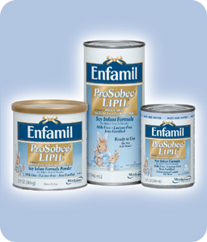
Mother’s milk vs. formula milk
Formula milk for 3 days old babies is no different than formula milk for 3 months old infants.
Breast milk is ingeniously different every single day; adapted to the changing needs of the baby.
store.enfamil.com/ media/pr_prosobee_lipil.jpg
breastfeeding.8k.com/ Resources/breastfeeding.jpeg

Slide 92
Mother’s milk vs. formula milk
Human milk is designed to support the development of large brains, capable of processing and storing lots of information.
Cows milk is designed to support functions, like constant grazing.
www.babymall.com.au/ images/readingroomcartoon.gif
myxo.css.msu.edu/danimal/ quiz/cow_picture.png

Slide 93
Illness Relative risk
Allergies, eczema 2 to 7 times
Urinary tract infections 2.6 to 5.5 times
Inflammatory bowel disease 1.5 to 1.9 times
Diabetes, type 1 2.4 times
Gastroenteritis 3 times
Hodgkin's lymphoma 1.8 to 6.7 times
Otitis media 2.4 times
Haemophilus influenzae meningitis 3.8 times
Necrotizing enterocolitis 6 to 10 times
www.geocities.com/.../ Canopy/4116/stalk.gif

Slide 94
Illness Relative risk
Pneumonia/lower respiratory tract infection 1.7 to 5 times
Respiratory syncytial virus infection 3.9 times
Sepsis 2.1 times
Sudden infant death syndrome 2.0 times
Industrialized-world hospitalization 3 times
www.mamashealth.com/ images/lungs1.gif

Slide 95
Barriers to Bonding
* A Bottle places a physical barrier between mom and baby
*Less skin to skin contact
*Less eye contact
* The hormonal connection between the breastfeeding mother and baby cannot be experienced by the bottle feeding mother
www.photohome.com/.../ mom-and-baby-1a.jpg

Slide 96
Other Options If Breastfeeding is Not Possible
Mom can still use her milk, even if she decides not to breastfeed:
Use a breast pump (electric/manual)
Cup or bowl feeding
Spoon feeding
Eyedropper or feeding syringe
Nursing supplementer
Get milk from donation bank
graphics.iparenting.com/. ../womanpumping.jpg

Slide 97
Ten steps to successful breastfeeding
Every facility providing maternity services and care for newborn infants should
Have a written breastfeeding policy that is routinely communicated to all health care staff
Train all health care staff in skills necessary to implement this policy
Inform all pregnant women about the benefits and management of breastfeeding

Slide 98
Ten steps to successful breastfeeding (contd….)
Help mothers initiate breastfeeding within half hour of birth
Show mothers how to breastfeed, and how to maintain lactation even if they are separated from their infants
Give no food or drink, unless medically indicated
Practice rooming-in : allow mothers and infants to remain together 24 hrs a day

Slide 99
Ten steps to successful breastfeeding (contd….)
Encourage breastfeeding on demand
Give no artificial teats or pacifiers (also called dummies or soothers) to breastfeeding infants
Foster the establishment of breastfeeding support groups and refer mothers to them on discharge from the hospital.

Slide 100
Problems in breastfeeding: Inverted nipple
Treatment should begin after birth
Manually stretch and roll the nipple between the thumb and finger several times a day
Teach the mother to grasp the breast tissue so that areola forms a teat, and allows the baby to feed
Syringe suction method

Slide 101
Problems in breastfeeding: Sore nipple
Look for a cause:
Check the baby’s attachment at the breast
Check the baby’s position if attachment is poor
Examine the breasts – engorgement, fissures, candida
Ask if mother washes the
breasts after each feed (frequent washing leads to sore nipple)
If the problem persists, check the baby’s oral cavity for candida

Slide 102
Sore nipple: management
Give appropriate treatment:
Build mother’s confidence
Improve the baby’s attachment and continue breastfeeding
Reduce engorgement, feed frequently, express breast milk
Treat candida
Advise the mother to:
Wash breasts only once a day; avoid using soap
Avoid medicated lotions and ointments
Gently apply hind milk onto nipple and areola after each feed

Slide 103
Problems in breastfeeding: Breast engorgement
Causes
Delayed and infrequent breastfeeds
Incorrect latching of the baby
Treatment
Give analgesics to relieve pain
Apply warm packs locally
Gently express milk prior to feed
Put the baby frequently to the breast

Slide 104
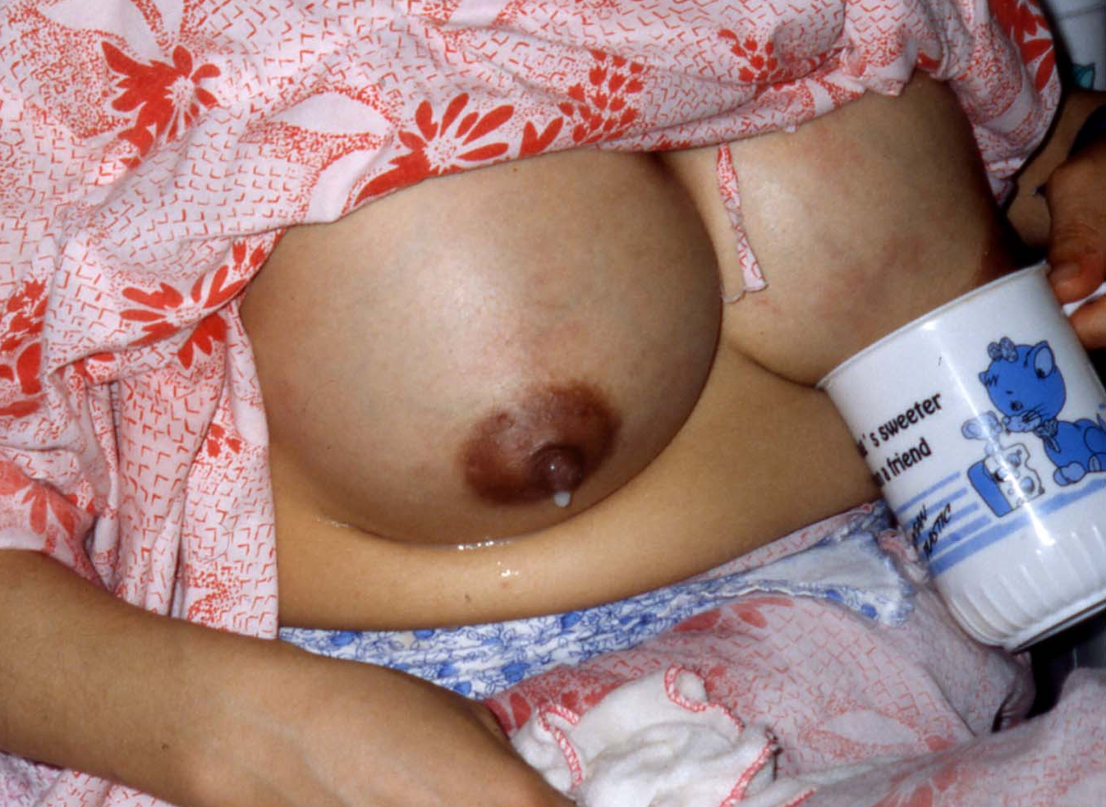
Full vs. engorged breasts
Full breasts = NORMAL
Engorged breasts = ABNORMAL

Slide 105
Full vs. engorged breasts
Full breasts:
36/72 hours after birth.
Hot, heavy, may be hard
Milk flowing
Fever uncommon
Engorged breasts:
can occur at any time during breastfeeding
Painful; edematous
Tight, especially nipple area
Shiny
May look red
Milk NOT flowing
Fever may occur
May cause a decrease in milk supply if it happens often

Slide 106
“Not enough milk”: causes
Not breastfeeding often enough
Too short or hurried breastfeeding
Night feeds stopped early
Poor suckling position
Poor oxytocin reflex (anxiety, lack of confidence)
Engorgement or mastitis

Slide 107
“Not enough milk”: management
Put baby to breast frequently
Baby to be correctly attached to breast
Build mother’s confidence
Back massage and relaxation can help
Use galactogogues (metaclopropamide) judiciously
Adequate weight gain and urine frequency 5-6 times a day are reliable signs of enough milk intake

Slide 108
Contraindications
While breastfeeding is considered optimal for infants, there are some conditions under which it may not be in their best interest…

Slide 109
Contraindications to Breastfeeding
These include:
Infants who have galactosemia
Mothers with active (untreated) TB
Mothers who are using “street drugs”
Mothers with HIV (in the USA)
The presence of a herpes simplex lesion on the breast
infants may feed from the opposite breast if it is free of lesions

Slide 110
Factors Influencing Drug Safety
Drugs factors :-
Diffusion / active transport
Plasma level
Lipid solubility
Drug pH
Molecular weight
Protein binding
Half life
Oral bioavailability
Non-dose-related toxicity

Slide 111
Drugs contraindicated

Slide 112
Drugs Contraindicated During Breastfeeding
Amiodarone
Antineoplastic agents
Chloramph. .
Ergotamine .
Gold salts .
Lithium
Phenindione
Hypothyroidism reported
Possible immune suppression, effect on growth
(May-->idiosyncratic BM supp. at high conc. in breast milk )
Vomiting,diarr.,convulsion (dose>migraine)
Possible facial edema in one infant 3 mo. after Rx in mother
Severe rash reported
Increased PT & PTT in 1 infant

Slide 113
Drugs Contraindicated
Retinoids . .
Tetracycline (chronic-months)
Pseudoephedrine . .
Radioactives .
Combined oral contraceptives
Very lipid soluble,wide range of AEs in adult, mutagenic & carcinogenic in animals
Staining immature teeth, change in epiphyseal bone growth
Unpublished result, may inhibit prolactin & milk production significantly
Temporary cessation of BF, based on presence of radioactivity in milk
Dec.breast milk product^{n}, dec.protein & nitrogen content of milk

Slide 114
Drugs of Abuse : Contraindicated (1)
Amphetamine
.
Cocaine. .
Heroin .
Marihuana
Nicotine (smoking) .
Phencyclidine
Irritability, poor sleeping pattern ( conc. in human milk )
Cocaine intoxication (N/V, diarrhea, tremulousness, agitat^{n}, gasping,HT, inc.HR)
Tremor, restlessness, vomiting, poor feeding
Only 1 report; no effect mentioned
Shock,vomiting,diarrhea, rapid HR, restlessness, dec.milk production
Potent hallucinogen
Committee on drugs # hazardous to infant, detrimental to physical & mental health of mother

Slide 115
Drugs having been associated with sig. effects on some nursing infants, use with caution
Drugs
Reported effects
5- Aminosalicylic a.
Aspirin
Clemastine .
Phenobarbital . .
Primidone
Sulfasalazine
Diarrhea (1 case)
Metabolic acidosis (1 case, high dose)
Drowsiness, irritability, feeding refusal, high pitch cry, nuchal rigidity (1 case)
Sedation, infantile spasm after weaning from milk containing phenobarbital, methemoglobinuria (1 case)
Sedation, feeding problem
Bloody diarrhea (1 case)

Slide 116
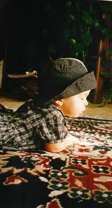
Other drugs commonly used

Slide 117
Lactation Risk Category
L1 Safest : taken by large No. of BF mothers without any observed SE
L2 Safer : studied in limited No. of BF mothers without any observed SE
L3 Mod.safe : no controlled studies, but poss. untoward effects; / controlled studies-->min. non-threatening AE
L4 Poss.hazardous : +ve evidence of risk to BF infant / to breast milk production
L5 Contraindicated : studies--> sig./ high risk to infants

Slide 118
Antimicrobials (1)
Ciprofloxacin- L4 ( Arthropathies reported in animal embryo, no evidence in humans)
Nalidixic acid - L4 (reported case of hemolysis in infants with G6PD def.
Clindamycin - L3 (1 case of pseudomemb.colitis but rare, observe for diarrhoea, approved by AAP for use in BF mother

Slide 119
Antimicrobials (1)
Sulfonamides - L2-3 (avoid in sick infants, prematurity, stress, hyperbilirubinemia, G6PD def.
Cotrimoxaxole - L3 (non reported, caution in hyperbilirubinemia & G6PD def.)
Metronidazole - L2 (BF should be withheld until 12-24 hr after 2 g dose)

Slide 120
Antimicrobials (2)
Metronidazole T_{1/2} = 8.5 hr
In mother receiving 2 g dose
Av. drug conc. 2 hr = 45.8 mg/L
8 hr = 27.9 mg/L
12 hr = 19.1 mg/L
12 -24 hr = 12.6 mg/L
Rx level in infants /children = 7.5-30 mg/L
No report of AE in breastfed infants for 2 g dose or 250 mg X 3 /d X 10 d

Slide 121
Analgesics & NSAIDS
Codeines- L3 (rare cases of neonatal apnea at high dose
Aspirin - L3 (metabolic acidosis 1 case, at high dose)
Indomethacin - L3 (seizure 1 case)
Cox-2 inhibitors - No available information
Diclofenac - L2 (non reported via milk) (Voltaren)

Slide 122
Antidepressants (1)
SSRI :
Fluoxetine -L3 in newborn, L2 in olders (Prozac) [ longer T_{1/2} --> relatively greater amount in breastmilk > sertraline (Zoloft) & paroxetine(Paxil) ]
Citalopram -L3 (2 cases of excessive somnolence, (Celexa) decreased feeding, & wt. loss )

Slide 123
Antidepressants (2)
Tricyclic antidepressants:
Doxepin - L5 (1 case of resp. depression & (Sinequan) sedation)
Nortryptilene (Aventyl )
Dothiepin (Prothiaden)
Nefazodone, reboxetine, venlafaxine, monoamine oxidase inhibitors - lack of published data
L2 - safer

Slide 124
Antipsychotics
Haloperidol - L2 ( dose < 10 mg / d = safe)
Diazepam - L3, L4 in chronic use (hypotonia, lethargy & reduced suckling)
Temazepam - L3 (safer than diazepam for (Restoril) shorter T _{1/2} )
Clozapine, olanzapine,quetiapine, risperidone - lack of published data

Slide 125
Immunological drugs
Sera and immunoglobulins
Vaccines

Slide 126
Others (1)
PTU : L2 (non reported, observe closely for thyroid function
Thyroxine : L1 (extremely low in breastmilk) (Eltroxin)
Prednisolone : L2, L4 for chronic high dose
Propanolol : L3 (none reported via breastmilk in numerous studies)
Phenobarbital : L3 ( Sedation, infantile spasm after weaning from milk containing phenobarbital, methemoglobinuria 1 case)

Slide 127
Others (2)
Domperidone : L2 (Motilium) (Galactagogue dose~10-20 mg X 3-4/d)
Gliabendazide : L3 (non reported, observe for (Daonil) hypoglycemia)
Clemastine : L4 ( Drowsiness, irritability, (Tavist) feeding refusal, high pitch cry, nuchal rigidity 1 case)
Primidone : L3 ( Sedation, feeding problem ) (Mysoline )
Flunarizine : L4 (non reported, use with caution ) (Sibelium)

Slide 128
Others (3)
Dopamine / Dobutamine : L2
Oxytocin : L2
Cisapride (Prepulsid): L2
Cimetidine (Tagamet): L2
Bisacodil ( Dulcolax ) : L2
Loperamide (Imodium) : L2
Metopropamide (Plasil) : L2
Loratadine ( Claritine ) : L2
Loraxepam ( Ativan) : L 3
Metyldopa (Aldomet) : L2
Nifedipine (Adalat) : L2
Griseofulvin : L2
Furosemide (Lasix) : L3

Slide 129
Learning objectives - 2
Ensuring good start
To be able to describe how breastfeeding works
To recognise good and poor attachment and positioning of a baby feeding at the breast
Overcoming difficulties
To help a mother breastfeed her newborn baby
Help a mother prevent common problems

