Slide 1
Modern pharmacies focus on medications safety

Slide 2
It is estimated that each year in the US hospitals, 6.7% of all patients admitted will experience a medical error.
Of these errors, 3.1% will cause harm, and 13% will have fatal outcomes.
A large percentage of medical errors occur frequently, and are both predictable and preventable. MEs and ADEs are both included in the broad category of medical errors.
Preventable ADEs occur in 2% of hospitalized patients, and MEs resulting in harm contribute to approximately 7,000 deaths annually in the United States

Slide 3
Useful websites
National Patient Safety Foundation | www.npsf.org
Institute for Safe Medication Practices | www.ismp.org
Agency for Healthcare Research and Quality | www.ahrq.gov
Centers for Medicare & Medicaid Services | www.cms.gov
The Joint Commission | www.jointcommission.org
National Coordinating Council for Medication Error Reporting and Prevention | www.nccmerp.org
Institute of Medicine of the National Academies | www.iom.edu

Slide 4
Medication Error
The National Coordinating Council for Medication Error Reporting and Prevention (NCCMERP) defines an ME as follows
Any preventable event that may cause or lead to inappropriate medication use or patient harm while the medication is in the control of the healthcare professional, patient, or consumer.”
This NCCMERP definition of MEs has recently been implemented in other agencies guidelines most notably CMS and TJC

Slide 5
Patients can experience an ADE even if the correct medication was prescribed and administered because an ADE refers to the effect the drug had on the patient, not necessarily that an error occurred in the medication process.
This is in direct contrast to MEs, which involve any mistake in the medication process, regardless of patient outcome.

Slide 6
Not all MEs lead to serious consequences; however, preventing MEs at any point in the medication-use process has the potential to reduce harm (eg, ADEs).
Although an ME in one patient may not cause harm, that same ME in another patient could prove to be fatal.

Slide 7
The following example illustrates the differences between MEs and ADEs.
Consider the case of two patients (patient A and patient B) who each received a dose of digoxin that was too high for their respective compromised renal function.
An ME in prescribing occurred in patient A and patient B because the incorrect dose was prescribed for each patient. However, harm from this prescribing error (digoxin toxicity) occurred only in patient A. This event would be documented as an ME and ADE in patient A and an ME in patient B.

Slide 8
ADEs can be categorized as preventable, nonpreventable, or, if they have not actually occurred, potential.

Slide 9
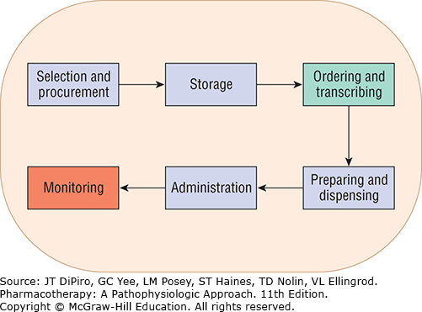

Slide 10
Harm: impairment of the physical, emotional, or psychological function or structure of the body and/or pain resulting therefrom
Monitoring: to observe or record relevant physiologic or psychological signs
Intervention: changes in therapy, active medical and/or surgical treatments, or other responses of health professionals or the patient
Intervention Necessary to Sustain Life: cardiovascular and respiratory support or other measures that maintain basic physiologic functioning

Slide 11
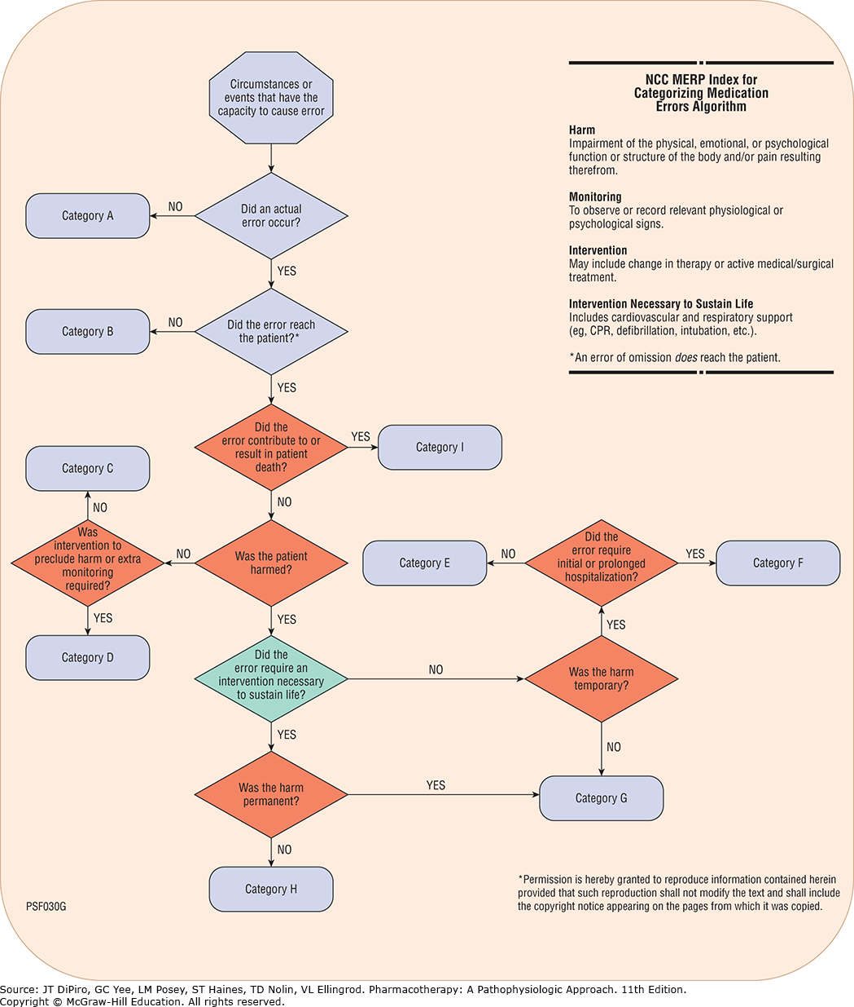

Slide 12
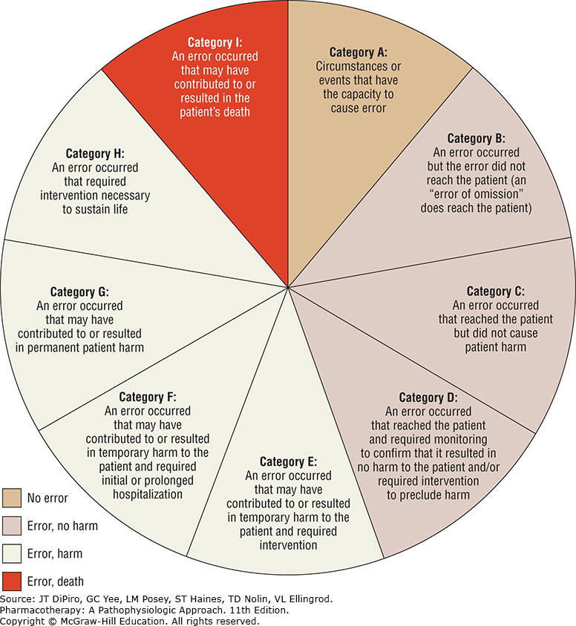

Slide 13
Medication errors occur for a number of reasons
Ambiguous strength designation on labels or in packaging
Drug product nomenclature (look-alike or sound-alike names, use of lettered or numbered prefixes and suffixes in drug names)
Equipment failure or malfunction
Improper use of electronic order entry systems
Inaccurate dosage calculation

Slide 14
Medication errors occur for a number of reasons
Inadequately trained personnel
Inappropriate abbreviations used in prescribing
Labeling errors
Excessive workload
Lapses in individual performance
Medication unavailable

Slide 15
Type of Error | Examples
Prescribing error | Incorrect drug selection (based on indications, contraindications, known allergies, existing drug therapy, or other factors), dose, dosage form, quantity, route, concentration, rate of administration, or instructions for use of a drug product ordered or authorized by physician (or other legitimate prescriber); illegible prescriptions or medication orders that lead to errors that reach the patient
Omission error | Failure to administer an ordered dose to a patient before the next scheduled dose
Wrong time error | Administration of medication outside a predefined time interval from its scheduled administration time (this interval should be established by each individual healthcare facility)
Unauthorized drug error | Administration of medication not authorized by a legitimate prescriber for the patient
Improper dose error | Administration of a dose that is greater than or less than the amount ordered by the prescriber or administration of duplicate doses to the patient (ie, one or more dosage units in addition to those that were ordered)
Wrong dosage-form error | Administration of a drug product in a different dosage form than ordered by the prescriber

Slide 16
Wrong drug-preparation error | Drug product incorrectly formulated or manipulated before administration
Wrong administration-technique error | Inappropriate procedure or improper technique in the administration of a drug
Deteriorated drug error | Administration of a drug that has expired or for which the physical or chemical dosage-form integrity has been compromised
Monitoring error | Failure to review a prescribed regimen for appropriateness and detection of problems, or failure to use appropriate clinical or laboratory data for adequate assessment of patient response to prescribed therapy
Adherence error | Inappropriate patient behavior regarding adherence to a prescribed medication regimen
Other medication error | Any medication error that does not fall into one of above redefined categories

Slide 17
Medication Reconciliation Approach
Joint Commission | Institute for Healthcare Improvement
Develop a list of current medications Develop a list of medications to be prescribed Compare the medications on the two lists Make clinical decisions based on the comparison Communicate the new list to appropriate caregivers and to the patient | Verification (collection of the medication history) Clarification (ensuring that the medications and doses are appropriate) Reconciliation (documentation of changes in the orders)

Slide 18
At the end of the medication reconciliation process, there should be an accurate, up-to-date best-possible medication list that should include all prescription drugs, over-the-counter medications, vitamins, minerals, herbals, and other supplements.
The best-possible medication list should also include topical products, inhalers, injectables, eye- and eardrops, and nose sprays that are often left off mistakenly by patients during medication history and review.

Slide 19
Case presentation
Chief Complaint
“My right hip hurts and nothing is helping.”
History of Present Illness
KR is a 76-year-old male who was admitted to the hospital for total hip arthroplasty (THA) after a long history of left hip pain due to osteoarthritis. He had been suffering with progressively worse pain in the left hip over the past few years and has tried analgesics with minimal pain relief. KR has experienced increased difficulty with performing activities of daily living and can no longer tolerate the pain. He now opts for surgical intervention. KR successfully underwent left THA with no complications. He is now post-op day 3 and is ready for discharge back to the assisted living facility with outpatient physical therapy.

Slide 20
Past Medical History
Diabetes
Early-onset dementia
Glaucoma
Gout
Heart failure with preserved ejection fraction
Hyperlipidemia
Hypertension
Osteoarthritis
Surgical History
N/A

Slide 21
Family History
Father: died at age 75 from natural causes
Mother: died at age 67 from heart attack
Social History
Widowed; one grown son lives out of state.
Immunization
Up to date
Insurance
Medicare and Medicaid
Allergies
No known allergies

Slide 22
Prior-to-Admission Medications
Allopurinol 100 mg, 1 tablet PO once daily
Amlodipine 10 mg, 1 tablet PO once daily
Calcium carbonate/vitamin D 600 mg/800 IU, 1 tablet PO once daily
Capsaicin 0.025% cream, apply thin film topically to left hip 3 to 4 times daily
Celecoxib 100 mg, 1 capsule PO twice daily
Furosemide 20 mg, 1 tablet PO daily as needed for edema
Latanoprost 0.005%, 1 drop in each eye once daily in the evening
Lisinopril 10 mg, 1 tablet PO once daily
Metformin 1000 mg, 1 tablet PO twice daily
Multivitamin, 1 tablet PO once daily
Rosuvastatin 20 mg, 1 tablet PO daily

Slide 23
Current Medications
Acetaminophen 325 mg, 1-2 tablets PO every 4-6 hours PRN for mild-moderate pain
Atorvastatin 40 mg, 1 tablet PO daily
Heparin 5000 units subcutaneously every 8 hours
Hydrocodone/acetaminophen 5/500 mg, 1 tablet PO every 4-6 hours PRN for severe pain
Regular insulin sliding scale
Latanoprost 0.005%, 1 drop in each eye once daily in the evening
Omeprazole 20 mg, 1 capsule PO daily

Slide 24
Physical Examination
Vital Signs
Temp 98.7°F (37.1°C), P 82, RR 18, BP 146/82 mmHg, O₂ saturation 99%
General
Comfortable other than left hip pain.
HEENT
PERRLA, EOMI.
Respiratory
Normal breath sounds.
Cardiovascular

Slide 25
Normal rate and regular rhythm.
Abdominal
Soft. Bowel sounds are normal. No abdominal tenderness.
Neurologic
Alert and oriented to person, place, and time.
Musculoskeletal
Normal other than decreased range of movement in external rotation of left hip.
Extremities
Skin is warm and dry. Not edematous.

Slide 26
Na = 138 mEq/L | Hgb = 12 g/dL
K = 6 mEq/L | Hct = 36.8%
Cl = 100 mEq/L | Plt = 156 × 10³/uL
CO₂ = 25 mEq/L | WBC = 6.2 × 10³/uL
BUN = 13 mg/dL
SCr = 0.66 mg/dL
Glu = 200 mg/dL

Slide 27
Useful resources
Lexicomp®
Medscape®
Fact and comparisons®
AHFS®
Stockley drug interactions
UpToDate®

