Slide 1
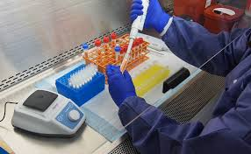

دكترعقيل ميري
يافته هاي آزمايشگاهي در كرونا

Slide 2


Contents
Diagnostic Modalities | Laboratory Findings
AAP & CDC | پروتکل کشوری
WHO | Text Book
Up-To-Date | New Research

Slide 3

Laboratory Findings
راهنمای تشخیص و درمان کوید در کودکان
مرداد 1400

Slide 4

سیستم نمره دهی در مرحله پیش بیمارستانی
جدول شماره 1
Host factors
Vital sign
Co- Morbidities

Slide 5


جدول شماره 2
آزمایشات اولیه
Score | Cut off | Predictive factor | Predictors
2 | 1-12m ⇒<3.000 1-5y⇒<2.000 ↑5y⇒<1.100 | Lymphopenia | Lab Tests
2 | 500> | LDH
1 | 245-500
2 | 70> | CRP
1 | 40-70

Slide 6
مجموع نمره براساس جدول سیستم پیش بیمارستانی
مجموع نمرات جدول شماره 1 یا مجموع نمرات جدول شماره 1+2 ، بیشتر یا مساوی 8 | 7-5 | کمتر یا مساوی 4
Sever Dis Critical | Mild Dis + High Risk Moderete Without RF | Mild Dis Without RF
Hospital Admition | Out Patient + Close Follow Up | No Lab Test
 | آزمایشات ابتدایی در صورت صلاحدید پزشک CBC,CRP,LDH,…… | Out Patient
 | Moderete Without RF در صورت انجام آزمایشات ، امتیاز نهایی مجددا محاسبه و تصمیم گیری شود

Slide 7
درخواست سایر آزمایشات و الکترولیت ها براساس شرایط بیمار و امکانات مرکز و طبق جدول شماره 3 خواهد بود
CRP , ESR , BUN , Cr , AST , ALT , Ferritin , LDH , D-dimer
اندیکاسیون تست های سرولوژی :
شک به MIS-C
مطالعات اپیدمیولویک

Slide 8
آزمایشات بیماران بستری در بیمارستان
جدول شماره 3
BUN , Cr Na , K Ca, P , Mg U/A | CBC diff CRP , ESR LDH , CPK AST , ALT , ALP | Routin Lab روز اول بستری
PT , PTT , INR Ferritin , LDH , D-dimer ABG, Fibrinogen, IL6, NT-proBNP B/C(شک به عفونت باکتریال) Procalcitonin(شک به عفونت باکتریال) Urine Pr/Cr |  | Optional Lab (براساس شرایط بیمار)

Slide 9
جدول شماره 4
فاکتورهای پیش بینی کننده پیشرفت بیماری در فرد بستری

Slide 10

Laboratory Findings
TEXT BOOK

Slide 11
Laboratory Findings
Laboratory Findings Are Variable
% | LAB
54 | CRP
47 | Ferritin
37 | LDH
35 | D-dimers
30 | Amino-Transferases
25 | CK-MB
20 | Procalcitonin & WBC & ESR
19 | Lymphocytopenia
8 | Lymphocytosis

Slide 12
Elevated Inflammatory Markers & Lympho-Cytopenia May Indicate
MIS-C

Slide 13
Renal Function Test
Kidney Dysfunction May Occur In Severely Ill Child
In A Series of Child Admitted To Tertiary Care Hospital
46% ⇒ Creatinine Greater Than NL Upper Level
28% ⇒ Met AKI Criteria
Most Cases of AKI Occurred In ICU Admitted & MIS-C Patient
None of Child With AKI Required Kidney Biopsy or Continuous Kidney Replacement Therapy
Cr Decreased To NL Upper Limit In All

Slide 14

Laboratory Findings
New Research

Slide 15
New Research
Changes In Mean Lym Count : Severe Cases
Elevated LDH Level Was More Common Among Child Than Adults

Slide 16
New Research
Diagnostic Markers May Increase Diagnostic Success, Especially In Asymptomatic Patients
Leukocytopenia
Monocytopenia
Mean Platelet Volume Elevation

Slide 17
New Research
Lympho-Penia & Uric Acid Are Indicators That COVID‐19 Infection May Progress More Severely

Slide 18
New Research
70% of Child With COVID Had Normal WBC Count

Slide 19
New Research
Moderate Cases Compared With Mild Cases Were Associated With :
Decrease In Lymphocyte Counts
Higher Levels Procalcitonin
Increased D‐dimer Levels

Slide 20

New Research
Children Admission To ICU Was Associated With :
Higher Levels of CRP
Higher Levels of Procalcitonin
Increased Platelet Count

Slide 21
New Research
Guide In Determining Severity :
Lymphopenia
High CRP
High Procalcitonin Levels
Lympho-Penia Is Stronger Predictor of Mod-Severe Infections
Hypo-Albuminemia & High Uric Acid Associated With Mod‐Severe Dis

Slide 22
New Research
Severe Cases Showed :
Normal or Increased Leukocyte Count
High Levels of CRP
High Levels of Procalcitonin
High Levels of LDH

Slide 23
CDC
Typical Laboratory Findings Include :
Mild Abnormalities In WBC(Either Increased or Decreased Lym Counts)
Mildly Elevated Inflammatory Markers (Procalcitonin)
Mildly Elevated Liver Enzymes

Slide 24
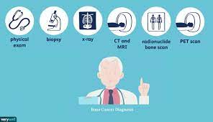
Diagnostic
Modalities

Slide 25
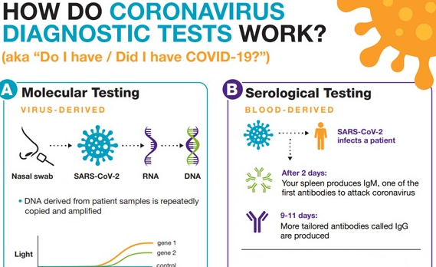

Slide 26
3 Main Test Type
AAP
Serologic Test | Viral Test
Not Useful For Acute | Detect Acute Infection & Screening Test
Antibody Tests | Antigen Tests | Nucleic Acid Amplification Tests (NAAT)
 | Immunoassays | PCR
Detect Previous Infection & MIS-C | Less Sensitive High-Specificity | High-Sensitivity High-Specificity
 | Detect Viral Ag | Detect Viral RNA Gene
 | Point Of Care-min | In Laboratory 1–3 d
Blood | Nasopharyngeal Ant Nasal | Nasopharyngeal, Anterior Nasal Oropharyngeal/Sputum/Nasal Mid-Turbinate/ Saliva

Slide 27
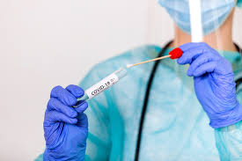
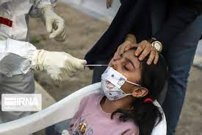
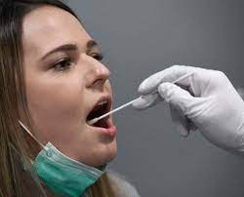
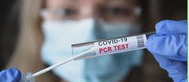
تست پی سی آر کرونا

Slide 28
Nucleic Acid Amplification Tests (NAAT)
AAP
NAAT Include :
PCR Tests = Gold Standard
Iso-Thermal Amplification Assays Such As Loop-Mediated Isothermal Amplification (LAMP) And Nicking Enzyme Amplification Reaction (NEAR)
PCR Test Is “Gold Standard” For Testing Child For Acute COVID Infection

Slide 29
NAAT To Diagnose Current Infection
Types of NAAT
Diagnosis of COVID Is Made Primarily By Direct Detection RNA By NAAT
Most Commonly Reverse-Transcription Polymerase Chain Reaction (RT-PCR) From URT
Various RT-PCR Assays Are Used Around World
Different Assays Amplify & Detect Different Regions of Genome :
Target 2 or More Genes, Including Nucleocapsid (N), Envelope (E), Spike (S) Genes
Region In First Open Reading Frame,Including RNA Dependent RNA Polymerase (RdRp)
Gene Isothermal Amplification
Crispr-Based Assays
Next-Generation Sequencing

Slide 30
PCR Accuracy
Accuracy & Predictive Values of PCR Have Not Systematically Evaluated
They Are Highly Specific Tests
PCR Have High Sensitivity In Ideal Settings (Ie, They Are Able To Accurately Detect Low Levels of Viral RNA In Test Samples Known To Contain Viral RNA)
Clinical Performance Is More Variable
False-Positive Results Are Rare
False-Negative Rates Have Ranged From Less Than 5 To 40%

Slide 31
PCR Accuracy
As An Example :
In Study of Patients Who Were Hospitalized In China With Fever or Acute Respiratory Symptoms And Ultimately Had Positive PCR Test, 29% Had Negative Initial Test And Only Were Diagnosed By Serial Testing
In Similar Study In Singapore, Initial Nasopharyngeal Testing Was Negative In 11%
In Both Studies, Rare Patients Were Repeatedly Negative And Only Tested Positive After 4 or More Tests
However, Lower False-Negative Rates Have Also Been Suggested
In Study of 626 Patients Who Had Repeat Nasopharyngeal RT-PCR Test Within 7 d of Initial Negative Test In USA , 3.5 Percent of Repeat Tests Were Positive

Slide 32
Sensitivity of PCR Depends On :
Type of Specimen
Quality of Specimen Obtained
Duration of Illness At Time of Testing
Specific Assay

Slide 33
Test Performance By Specimen Type
Test Sensitivity May Vary By Type of Specimen
Lower Respiratory Tract Specimens May Have Higher Viral Loads & Be More Likely To Yield Positive Tests Than Upper Respiratory Tract Specimens
Rates of Positive Viral RNA Tests :
Broncho Alveolar Lavage > Sputum > Oropharyngeal Swab
Among Upper Respiratory Tract Specimens :
Nasopharyngeal, Nasal, Saliva Similarly High Sensitivity
Sensitivity of Oropharyngeal Swab Specimens Is Lower

Slide 34
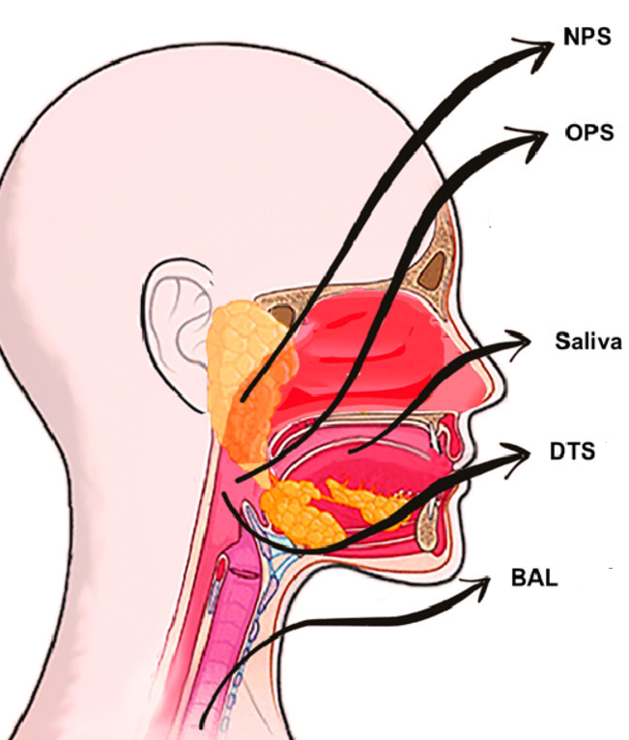
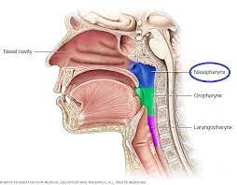

Slide 35
Test Performance By Illness Duration
Likelihood of Detectable RNA May Also Vary By Duration of Illness
Estimated Rates of False-Negative PCR Results Were :
100% On Day of Exposure 38% On Day 5
20 Percent At Day 8 66% At Day 21
Combination of PCR & IgM Serologic Test Negative Rates Were :
<10 Percent On Days 1 To 3 >20 Percent At Day 6
>50 Percent After Day 14

Slide 36
Test Performance By Assay Type
There Are Differences In Limit of Detection Among Major Commercial PCR
Assays, And Retesting Samples On Different Platforms May Yield Conflicting Results
Additionally, Certain Point-Of- Care Or Rapid PCR Assays May Not Be As Sensitive As Standard Laboratory-Based Tests

Slide 37

Preferred Initial Test
PCR As Preferred Test
RT-PCR Assay From Upper Respiratory Tract Is Preferred Initial Diagnostic Test
Rapid RT-PCR Tests Appear To Perform Comparably To Standard Laboratory-Based NAAT, But Rapid Iso-Thermal Tests May Be Less Sensitive
In Settings Where Access To PCR Is Limited or Too Costly, Ag Testing May Be Initial Test Used, But Sensitivity f Ag Tests Is Lower Than That of PCR & Negative Antigen Tests May Warrant Confirmation With Additional Testing

Slide 38
Preferred Specimen Collection
Upper Respiratory Samples Are Primary Specimens PCR
CDC Recommends Collection of One of Following Specimens :
Nasopharyngeal Swab Specimen, Collected By Health Care Professional
Nasal Swab Specimen From Both Anterior Nares, Collected By Health Care Professional Or By Patient On-Site Or At Home
Nasal Mid-Turbinate Swab, Collected By Health Care Professional Or By Patient Supervised On-site
Nasal Or Nasopharyngeal Wash/Aspirate, Collected By Health Care Professional
Oropharyngeal Swab Specimen, Collected By Health Care Professional
Saliva Specimen (1-5 cc) Collected By Patient While Supervised

Slide 39
Preferred Specimen Collection
There Is Uncertainty Regarding Optimal Upper Respiratory Tract Specimen
Nasopharyngeal , Mid-Turbinate , Ant Nasal , Saliva Rather Than Oropharyngeal
Although RNA Can Be Detected In Non-Respiratory Specimens (Stool, Ocular, Blood), Testing of These Specimens Has Limited Role In Diagnosis Of COVID

Slide 40
Test Interpretation
Positive PCR Result
Positive PCR Confirms Diagnosis
No Additional Diagnostic Testing Is Necessary
Patients With Covid Can Have Detectable RNA In Upper Respiratory Tract Specimens For Weeks After Onset of Symptoms
Prolonged Viral RNA Detection Does Not Necessarily Indicate Ongoing Infectiousness

Slide 41
Test Interpretation
Negative PCR Result
For Many Individuals, Single Negative PCR Is Sufficient To Exclude Diagnosis
If Initial PCR Is Negative But Suspicion Remains (eg, Suggestive Symptoms Without Evident Alternative Cause) And Confirming Presence of Infection Is Important For Management or Infection Control ⇒ Repeating Test
Optimal Time For Repeat Testing Is Not Known :
Generally 24-48 h After Initial Test
Repeat Testing Within 24 Hours Is Not Recommended

Slide 42
Test Interpretation
Lower Respiratory Tract Specimens
In Patients With Evidence of Lower Respiratory Tract Illness, Lower Respiratory Tract Specimens Can Be Option For PCR
WHO Recommend To Reserve Lower Respiratory Tract Specimen PCR For Hospitalized Patients Who Have Initial Negative PCR On Upper Respiratory Tract Specimen But For Whom Suspicion For Lower Respiratory Tract Infection Remains
Expectorated Sputum ⇒From Patients With Productive Cough
Tracheal Aspirate or Broncho-Alveolar Lavage ⇒ From Patients Who Are Intubated
Induction of Sputum Is Not Recommended

Slide 43

Negative PCR Result
In Hospitalized Patients Suspected of Having COVID Who Have Negative PCR , Characteristic Laboratory or Imaging Findings Can Further Support Clinical Diagnosis of COVID And Be Reasons To Maintain Infection Control Precautions
For Patients Who Present 3-4 w Into Course of Illness And Have Negative PCR , Checking Serologic Test May Be Informative
If Serology Is Performed In This Setting, Suggest IgG Test Reactive IgG Would Be Suggestive Of COVID-19 Negative IgG Test Could Suggest Decreased Likelihood

Slide 44

Negative PCR Result
In Many Cases, Because of Limited Availability of Testing & Concern For False-Negative Results, Diagnosis of COVID Is Made Presumptively Based On :
Compatible Clinical Presentation
In Setting of Exposure Risk
In Absence of Other Identifiable Causes

Slide 45
Indeterminate PCR Result
Interpretation of In-Conclusive or In-determinate Result Depends On Specific PCR Performed
Clinician Should Confer With Performing Laboratory About Additional Testing
In Some Cases, In-Conclusive or In-determinate Result Indicates That Only One of 2 or More Genes That PCR Test Targets Was Identified These Results Can BE Considered Presumptive Positive Results, Given High Specificity Of PCR Assays
If Patient Is Early In Dis Course, Repeat Testing Can Be Helpful To Confirm

Slide 46
Persistent or Recurrent Positive PCR During Convalescence
Patients Diagnosed With COVID Can Have Detectable RNA In Upper Respiratory Tract Specimens For Weeks After Onset of Symptoms
Recurrently Positive PCR Following Several Negative Test Been Documente In Some Patient
Prolonged or Recurrent Viral RNA Detection Does Not Necessarily Indicate Prolonged Infectiousness
Isolation of Infectious Virus From Upper Respiratory Specimens More Than 10 d After Illness Onset Has Only Rarely Documented In Patient Who Recover From Non-Severe Infection
Viral RNA Levels During Convalescence, If Detectable, Are Lower Than Those Detected During Acute Illness

Slide 47

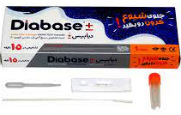
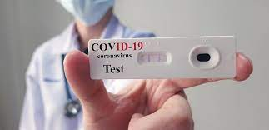
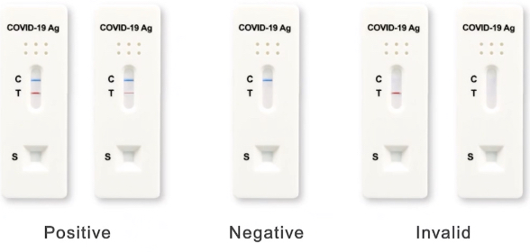
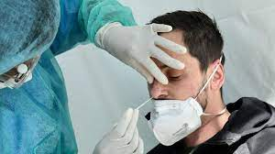
تست سریع کرونا

Slide 48
Antigen Tests
AAP
Antigen Tests Performed On Nasal(Mid Turbinate Not Nasopharyngeal) or Oral Swab
Some Antigen Tests Are Approved For Point-Of-Care Use And Deliver Rapid Results, And Others Require Shipment of Samples To Central Laboratory
Ag Tests Have Lower Sensitivity Than PCR , Particularly In Later Stages of COVID
Utility of Positive or Negative Result Depends on Non-Test Factors, Including Pre-Test Probability of Patient Having COVID(Based On Symptoms, Exposure, Local Epidemiology)
In Individuals With-Out Symptoms or Known Exposures | In Patients With Symptoms Compatible With COVID or With Known Exposures
Positive Antigen Test Results Should Generally Be Confirmed By PCR | Positive Ag Test Results Generally Reliable
Negative Ag Tests Likely To Be Accurate

Slide 49
Antigen Tests
AAP
Ag Tests Are Best Used On :
Patients With Symptoms Who Are In Settings Where Timing Is Important To Notify Others In Efforts To Contain Dis (School, Daycare)
For Whom Follow-Up PCR Test Can Be Performed If Needed
For Purposes of Clearance For Specific Setting Such As Return To School
However, Negative Ag Test Result Does Not Suffice For Individual With Close-Contact Exposure or Symptoms Compatible With COVID

Slide 50
Symptomatic Patients & Ag Tests
Ag Tests Can Be Useful Alternatives To PCR For Diagnosis Symptomatic Individuals Who Are Thought To Be In Early Stages of Infection In Such Cases, Test Should Be Performed Within First 5-7 d of Symptoms
If Ag Test Used For Clinical Diagnosis In Symptomatic Patients :
Positive Ag Tests : Can Be Interpreted As Indicative of Infection
Negative Ag Tests : Could Be False Negative & Should Confirmed Using PCR
If Confirmatory PCR Performed, It Be Done As Soon As Possible, Ideally Within 48 h
If PCR Is Unavailable, Repeat Ag Tes Every 3 -7 d For 14 d To Confirm Negative Result

Slide 51
Asymptomatic Individual With Exposure
Ag Tests Can Be Useful To Evaluate For COVID Following Close Contact With Individual With Known or Suspected Infection
Un-Vaccinated Individual Get Tested Immediately After Exposure To Quickly Document Infection
Positive Ag Test | If Test Is Negative
Indicative Infection | Get Tested 5-7 d After Last Exposure To Help Inform Duration of Quarantine
 | Negative Ag Test 5-7 d After Exposure Is Likely Sufficient To Support Discontinuation of Quarantine After 7 d
 | Risks Transmission Associated With Discontinuing Quarantine At Day 7 With Negative Ag Test Is Not Substantially Different Than With Negative PCR

Slide 52
Potential Transmission Impact of Individual With False-Negative Test Depends On Other Factors, Including Vaccination Rates , Use of Masks, Extent of Exposure
It Is Reasonable To Confirm Negative Ag Test Performed On Day 5-7 Post-Exposure With PCR If Potential Impact of False-Negative Antigen Test Is Thought To Be High
Regardless of Whether Negative Test Is Confirmed, Individuals With Known Exposure Should :
Monitored Closely For 14 d After Exposure
Get Tested If Symptoms of COVID Develop

Slide 53

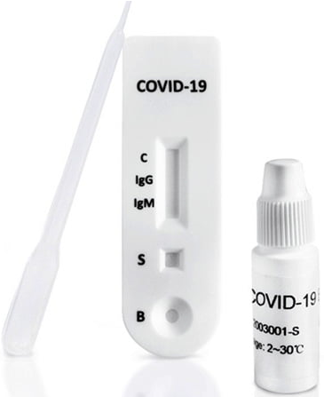
Antibody (Serologic) Tests

Slide 54
Antibody (Serologic) Tests
AAP
Antibody (Serologic) Tests Can Provide Evidence of Previous Infection But Are Not Useful For Diagnosis of Acute & Current Infection
Positive Ab Test Result Does Not Prove Protection Against COVID & Reinfection Although Vaccine Companies Use Serologic Testing As Marker For Immunogenicity & Protection From Infection
Serologic Tests Should Not Be Used To Make Decisions on Grouping People In Classrooms or Other Facilities, And Individuals With Positive Antibody Tests Should Continue To Adhere Preventive Measures (Masking, Physical Distancing)
Ab Testing Is Not Recommended To Determine Immunity To COVID-19 Following Vaccination or To Assess Need For Vaccination

Slide 55
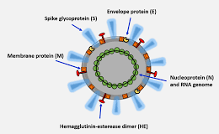
Antibody (Serologic) Tests
AAP
Because Antibody Tests Can Have Different Targets on Virus, Specific Tests Might Be Needed To Assess For Antibodies Originating From Past Infection Versus Those From Vaccination

Slide 56
Serology To Identify Prior/Late Infection
Serologic Tests Detect In Blood
Identify Patients :
Who Previously Had Infection
With Current Infection Who Have Had Symptoms For 3-4 w Because Serologic Tests Are Less Likely To Be Reactive In First Several Days To Weeks of Infection, Very Limited Utility For Diagnosis In Acute Setting
Checking Serology 3-4 w After Onset of Symptoms Optimizes Accuracy of Testing, Since Test Sensitivity Beyond 5 w Is Uncertain
Suggest Using IgG Ab Or Total Ab Tests Rather Than IgM Ab, IgA Ab, Or IgM/IgG Differentiation Tests Because of Their Greater Accuracy

Slide 57
Antibody (Serologic) Tests
Results of Antibody Testing Not Be Used To
Determine Rooming Arrangements In Congregate Settings (Dormitories or Prisons)
Make Decisions About Return To Work
Alter Work And Personal Protective Equipment Requirements

Slide 58

Other Tests
Viral Culture For Safety Reasons, Specimens From Patient With Suspected or Documented COVID Should Not Be Submitted To Clinical Laboratories For Viral Culture , Viral Culture Is Mainly Reserved For Research Purposes
Other Tests of COVID Immunity Clinical Utility of Tests That Can Detect Cell-Mediated Immune Responses To COVID , Such As With Interferon-Gamma Release Assay, Is Also Being Explored(IGRA)

Slide 59
Who Should Be Tested?
AAP
Most Common Scenarios In Which To Consider Testing Include :
Patients With Symptoms Consistent With COVID-19
Patients With Close Contact With Confirmed or Probable Infection
Patients Who Require Screening (eg, Prior To Medical Procedure Such Elective Surgery or School or Workplace Requirement)

Slide 60
Patients With Symptoms Consistent COVID-19
AAP
Testing Should Be Considered With Any of Following Symptoms :
Fever or Chills
Cough
Congestion or Runny Nose
Loss of Taste or Smell
Shortness of Breath or Difficulty Breathing
Body Aches
Fatigue or Headache
Sore Throat
Nausea, Vomiting, Diarrhea

Slide 61
Close Contact With Confirmed or Probable Infection
“Close Contact” Is Defined As :
Distance of Less Than 180 cm
Cumulative Total of At Least 15 min Over 24 h Period
From Person With Laboratory-Confirmed or Probable COVID Infection
Starting From :
2 d Before Illness Onset For Symptomatic Patients
2 d Prior To Specimen Collection For Asymptomatic Patients
Until : Time Patient Is Isolated
Wearing Mask or Cloth Covering Is Presently Not Considered Sufficient To Alleviate Risk of Transmission If Close Contact Conditions Are Met

Slide 62
Close Contact With Confirmed or Probable Infection
Prior To July 2021, Asymptomatic Fully Vaccinated Child (≥ 2 w Following 2th Dose Vaccine) Did Not Require Routine Testing After Close Contact Exposure
Recent Increases In “Breakthrough” Infections From New Variant Strains (Delta) Challenges This Practice
It Is Now Recommended That All Child, Adolescent & Young Adults Seek PCR Testing 3-5 d Following Close Contact Exposure, Regardless of Their Personal Immunization Status
Exposed Patients Who Have Symptoms Should Not Delay Testing

Slide 63
Close Contact With Confirmed or Probable Infection
Testing For Active Infection
Testing For Active Infection May Be Considered For Exposures of Shorter Duration or Greater Distance on A Case-by-Case Basis
Testing For Active Infection Is Not Necessary If There Is Exposure To Close Contact of Individual With Laboratory-Confirmed Infection & Not Infected Person himself/herself, Unless Close Contact Is Symptomatic or Other Criteria Are Met
Testing Household Contacts of Newly Infected Persons For Active Infection Using PCR or Antigen Test Can Be Considered But May Be Falsely Re-assuring If Negative, Because Continued Contact With Infected Household Member May Delay Onset of Active Infection For Up To 14 d Following Last Exposure

Slide 64
Patients Requiring Screening
(In Absence of Symptoms or Known Close Contact)
AAP
Many Hospitals Recommend Testing For Active Infection
Prior To Medical Procedures Such As Elective Surgery
For All Children Admitted To Hospital For Any Reason
Incoming International Travelers
These Decisions Should Be Made on Basis of Local Recommendations & Institutional Policies

Slide 65

What Is Optimal Timing For Testing?
AAP
Immediate Testing
Patient With Symptoms Consistent With COVID Should Tested Without Delay
Testing These Patients In Timely Fashion Is Important Especially If Participating In School, Sports, Work So Local Groups Can Begin Contact Tracing, Outlining School/Work Closures, And Notifying Families To Begin Home Quarantines Until Test Results Are Received

Slide 66
What Is Optimal Timing For Testing?
AAP
Delayed Testing
Asymptomatic Patients With Close Contact Exposure To Infected Persons Should Not Be Tested Until 3-5 d After Exposure
However, It Is Important For Pediatricians To Advise Exposed Patients To Quarantine & Wait To Test Until At Least Day 3-5 In Order To Limit Early False-Negative Results And To Limit Need For Sequential Testing , Probability of False-Negative Result In Infected Person Decreases Substantially Over First 3-5 Days After Exposure
Appropriate Test For Delayed Testing of Symptomatic Exposed Patient Is PCR &Not Rapid Ag

Slide 67
What Is Optimal Timing For Testing?
AAP
No Testing
Testing Not Recommended For :
In-Direct Exposure (Exposure To Close Contact & Not Directly With Infected)
Asymptomatic Patients Who Have Previously Tested Positive Within Past 3 m Against COVID
Negative Test Result Should Not Be Necessary For Return To School/Work Clearance If Patient Has Recently Tested Positive But Meets Criteria For Return To School/Work
Patients May Have Low Levels of Virus In Their Bodies & Can Continue To Test Positive Without Risk of Spreading Dis To Others

Slide 68


