Slide 1
بیماری های دمیلینیزان /MS
دکتر شبنم سهیل نادر- نورولوژیست

Slide 2
اختلال در میلین
نقش میلین: 70 برابرافزایش سرعت پیامها
اختلالات dysmyelinating: نقص بیوشیمیایی اولیه-ارثی-لکودیستروفی هاوبیماری الکساندر
بیماری های demyelinating: تخریب میلین به دلیل عامل بیرونی- اکتسابی-بیماری های خود ایمنی(MS- ADEM)، عفونی(PML)،توکسیک متابولیک(کمبود B12-مسمومیت با CO و جیوه و ...)

Slide 3
Multiple Sclerosis
تاریخچه:
میلین(+آکسون)
از قرن پانزدهم/ ژان مارتین شاکوsclerosis enplaque
اپیدمیولوژی:
زنان 2 برابر
20-40 سالگی
بیشترین: اسکاتلند کمترین: نواحی استوایی
مواجه با عامل محیطی قبل از 15 سالگی

Slide 4
اتیولوژی:
عوامل ژنتیک: بیشتر بودن در سفیدپوستان- افزایش ابتلا خویشاوندان(خواهر-برادر 5-15 برابر)- در دوقلوها(تک تخمکی 25-30%- دو تخمکی 2-5%)- پلی ژنتیک- کروموزوم 6- HLA DR2,DW2
عوامل محیطی و مکانیسم های خود ایمنی: تقلید مولکولی- ویروس های مختلف: سرخک، هرپس، زونا، آنفلوآنزای C / هرپس 6، کلامیدیا پنومونیه،EBV- نقش MBP(Myelin Basic Pr)
پاتولوژی: پلاک( تخریب میلین، سلولهای التهابی B-T، ماکروفاژهای فعال شده- از بین رفتن اولیگودندروسیتها- تخریب اکسون)- تکثیر آستروسیتها و ایجاد گلیوز

Slide 5
تظاهرات بالینی:
نوریت اپتیک: معمولا یک طرفه- درد و اختلال دید رنگ به خصوص قرمزو ...- احتمال التهاب در حاشیه دیسک اپتیک- آتروفی اپتیک- معمولا بهبود دید طی چند هفته
ضعف اندامها: پارا- مونو- کوادری- (همی)/ علائم پیرامیدال(اسپاستیسیتی- بابنسکی- افزایش رفلکسهای وتری)
خستگی زودرس
علائم حسی
دوبینی:INO(آسیب MLF- یک یا دوطرفه)- فلج 6(3-4)

Slide 6
آتاکسی: پلاک در مخچه، ساقه مغز، نخاع/ حسی
اختلالات اسفنکتری
یبوست
مشکلات شناختی
افسردگی
عدم تحمل به گرما: علامت Uthoff
علامت لرمیت
اختلالات جنسی/ سرگیجه/ نورالژی سه قلو/ فلج 7

Slide 7
سیر بالینی:
فرم عود کننده- بهبود یابنده: RRMS
85% بیماران در ابتدا
حمله: حداقل 24 ساعت
فاصله حملات: حداقل یک ماه
فرم پیشرونده ثانویه: SPMS
پیشرفت تدریجی با یا بدون حملات واضح
فرم پیشرونده اولیه: PPMS
بدون حمله از ابتدا
پیشرفت سریعتر ناتوانی
فرم پیشرونده- عود کننده: PRMS
- حمله+ پیشرفت تدریجی

Slide 8
تشخیص:
حملات با پراکندگی در زمان و مکان
عدم توجیه علائم با بیماری دیگر
MRI: پلاک/ دور بطنها- ساب کورتیکال- ساقه مغز- مخچه- نخاع/ enh/ هیپر در T2/ black hole
پلاکها در مغز بیشتر بدون علائم و در نخاع علامتدار
ارتباط شدت علائم بیشتر با T1 است تا T2
CSF: افزایش پروتئین و سلول- افزایش IgG- OCB- رد برخی تشخیصهای افتراقی
پتانسیل های برانگیخته: بینایی – شنوایی- حسی

Slide 9
احتیاط در تشخیص MS:
قابل توجیه بودن علائم با یک محل آناتومیک
عدم ایجاد علائم بینایی، حسی و ادراری در طی زمان
بروز اولیه با آفازی، کره، اختلال هوشیاری، تشنج
نرمال بودن MRI مغز و نخاع

Slide 10
تشخیص افتراقی:
واسکولیتها: لوپوس- بهجت-.../ADEM/ لکودیستروفی ها/ بیماری CADASIL
بیماری ایدز/ لایم/ نوروسیفلیس/ HTLV1
سارکوئیدوز/ کمبود B12
بیماری های دژنراتیو نخاع و مغز مثل آتاکسی فردریش
آسیبهای ایسکمیک پراکنده
لنفوم مغزی- متاستاز و ...
Susac
تروما

Slide 11
پیش آگهی:
50% تا 15 سال و 80% تا 25 سال نیاز به کمک برای حرکت
10-20% خوش خیم
بهتر: شروع قبل از 40 سالگی- مونث- آغاز با نوریت اپتیک- حملات کم در سالهای اول- RRMS- ناتوانی ناچیز در 5 سال اول
بدتر: شروع بعد از 40 سالگی- شروع با علائم مخچه ای- سیر یکنواخت و پیشرونده- شروع با گرفتاری همزمان چند ناحیه- مذکر
CIS: اهمیت داشتن تعداد پلاکها در تبدیل به MS(3<(

Slide 12
درمان:
درمان مرحله حاد: متیل پردنیزولون- PLEX
درمانهای تغییر دهنده سیر بیماری:
اینترفرونهای بتا یک a-b
گلاتیرامر استات
میتوکسانترون: هر 3 ماه/ کاردیومیوپاتی/ SPMS/ بررسی قلبی وخونی قبل ازهر تزریق
ناتالیزوماب: ممانعت ازخروج لنفوسیتها از دیواره عروق/ اثر 2 برابر اینترفرونها/PML
داروهای خوراکی: فینگولیمود- تری فلوناماید- BG12

Slide 13
اینترفرونها:
30-40% کاهش در حملات
عوارض
Avonex- Rebif- Betaferon
Zytax
Ocreus

Slide 14
درمانهای علامتی:
اسپاستیسیتی: باکلوفن- تیزانیدین- دانترولن
خستگی: آمانتادین- مودافینیل- متیل فنیدیت
اختلالات جنسی: سیلدنافیل
درد: کاربامازپین- گاباپنتین- نورتریپتیلین
افسردگی: فلوکستین- آمی تریپتیلین

Slide 15
MS Diagnosis
Dr. Shabnam Soheil Nader
Neurologist

Slide 18
1965- Schumacher Criteria
Based on clinical findings
1983-Poser Criteria
EP/ spinal tap
DIS/DIT
Possible/probable/definite MS
1982:
clinically definite MS
laboratory –supported definite MS
clinically probable MS
laboratory-supported probable MS

Slide 31
McDonald Criteria
2000-2001
Ian McDonald/ 1933-2006/ a New Zealand neurologist
2001-2005-2010-2016-2017
Clinical/ radiographic/ laboratory
MRI

Slide 37
Mc Donald criteria 2001
The diagnosis of multiple sclerosis requires establishing disease disseminated in both time and space.
Disseminated in space
3 out of 4 of the following:
1 gadolinium-enhancing lesion or 9 T2 hyper intense brain and/or cord lesions
1 or more infratentorial (including cord) lesions
1 or more juxtacortical lesions
3 or more periventricular lesions

Slide 39
Mc Donald criteria 2010
As before the diagnosis of multiple sclerosis requires establishing disease disseminated in both space and time.
Dissemination in space
Dissemination in space requires T2 bright lesions in two or more of the following locations ¹:
periventricular (≥ 3 lesions)
cortical or juxtacortical (≥1 lesion)
optic nerve (≥1 lesion)
infratentorial (≥1 lesion)
spinal cord (≥1 lesion)

Slide 40
Mc donald 2017 criteria

Slide 41
The two major changes in the 2017 revision are that :
the early diagnosis of multiple sclerosis can be made in patients with clinically isolated syndrome, demonstration of dissemination of space on MRI, and the presence of CSF-specific oligoclonal bands, without the need for demonstration of dissemination of time on MRI
symptomatic and/or asymptomatic MRI lesions, except those in the optic nerve, can be considered in the determination of dissemination in space or time

Slide 42
2017 Criteria
The diagnosis of multiple sclerosis can be made if there is fulfillment of either of these five categories of criteria, depending on how many clinical attacks have occurred:
≥2 clinical attacks
with ≥2 lesions with objective clinical evidence
with no additional data needed
≥2 clinical attacks
with 1 lesion with objective clinical evidence and a clinical history suggestive of a previous lesion
with no additional data needed
≥2 clinical attacks
with 1 lesion with objective clinical evidence and no clinical history suggestive of a previous lesion
with dissemination in space evident on MRI

Slide 43
1 clinical attack (i.e. clinically isolated syndrome)
with ≥2 lesions with objective clinical evidence
with dissemination in time evident on MRI or demonstration of CSF-specific oligoclonal bands
1 clinical attack (i.e. clinically isolated syndrome)
with 1 lesion with objective clinical evidence
with dissemination in space evident on MRI
with dissemination in time evident on MRI or demonstration of CSF-specific oligoclonal bands

Slide 44
Dissemination in space
Dissemination in space requires ≥1 T2-hyperintense lesions (≥3 mm in long axis), symptomatic and/or asymptomatic, that are characteristic of multiple sclerosis in two or more of the four following locations :
periventricular (≥1 lesion, unless the patient is over the age of 50 in which case it is advised to seek a higher number of lesions)
cortical or juxtacortical (≥1 lesion)
infratentorial (≥1 lesion)
spinal cord (≥1 lesion)
Notably, T2-hyperintense lesions of the optic nerve, such as those in a patient presenting with optic neuritis, cannot be used in fulfilling the 2017 revised McDonald criteria.

Slide 45
Dissemination in time
Dissemination in time can be established in one of two ways :
a new T2-hyperintense or gadolinium-enhancing lesion when compared to a previous baseline MRI scan (irrespective of timing)
simultaneous presence of a gadolinium-enhancing lesion and a non-enhancing T2-hyperintense lesion on any one MRI scan

Slide 46
Primary progressive multiple sclerosis (PPMS)
In addition to the above criteria, the McDonald criteria also define the diagnosis of primary progressive multiple sclerosis. The diagnosis now requires :
≥1 year of disability progression which can be determined either prospectively or retrospectively
with two of the following:
≥1 T2-hyperintense lesions characteristic of multiple sclerosis in one or more of the following regions: periventricular, cortical or juxtacortical, or infratentorial
≥2 T2-hyperintense lesions in the spinal cord
presence of CSF-specific oligoclonal bands

Slide 47
MRI

Slide 48
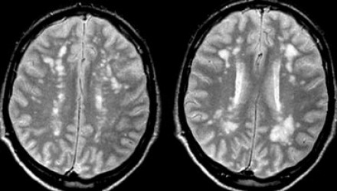
Many neurological diseases can mimic MS both clinically and radiologically.
Most incidentally found WMLs will have a vascular origin.
The list of possible diagnoses of WMLs is long.

Slide 49
Typical for MS is involvement of corpus callosum, U-fibers, temporal lobes, brainstem, cerebellum and spinal cord. This pattern of involvement is uncommon in other diseases. In small vessel disease there may be involvement of the brainstem, but it is usually symmetrical and central, while in MS it is peripheral.

Slide 51
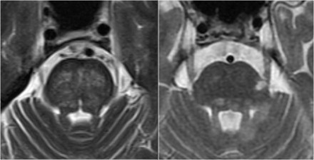
brainstem lesions
The image on the left is an axial T2 weighted image illustrating typical vascular brainstem involvement, with a central involvement of the transverse pontine fibers.
The image on the right is an axial T2 weighted image of the brainstem of an MS-patient, showing typical peripherally located white matter lesions, often in or near the trigeminal tract, or bordering the 4th ventricle.

Slide 52
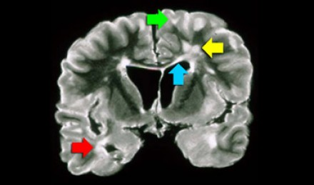
The lesions in the deep white matter (yellow arrow) are nonspecific and can be seen in many diseases.
Typical for MS in this case is:
Involvement of the temporal lobe (red arrow)
Juxtacortical lesions (green arrow) - touching the cortex
Involvement of the corpus callosum (blue arrow)
Periventricular lesions - touching the ventricles

Slide 53
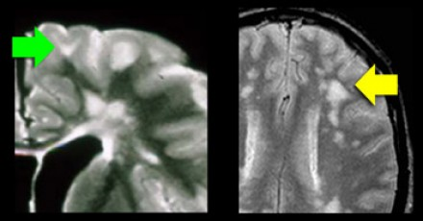
Juxtacortical lesions are specific for MS. These are adjacent to the cortex and must touch the cortex. Do not use the word subcortical to describe this location, because that is a less specific term, indicating a larger area of white matter almost reaching the ventricles. In small vessel disease these juxtacortical U-fibers are not involved and on T2 and FLAIR there will be a dark band between the WML and the (also bright) cortex (yellow arrow).

Slide 54
Temporal lobe involvement is also specific for MS. In hypertensive encephalopathy, the WMLs are located in the frontal and parietal lobes, uncommonly in the occipital lobes and not in the temporal lobes. Only in CADASIL there is early involvement of the temporal lobes.

Slide 55
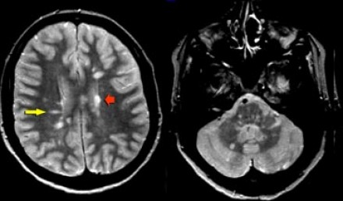
Typical findings for MS as seen in this case are:
Multiple lesions adjacent to the ventricles (red arrow).
Ovoid lesions perpendicular to the ventricles (yellow arrow).
Multiple lesions in brainstem and cerebellum.
These ovoid lesions are also called Dawson fingers. They represent areas of demyelination along the small cerebral veins that run perpendicular to the ventricles.

Slide 56
Typical spinal cord lesions in MS are relatively small and peripherally located. They are most often found in the cervical cord and are usually less than 2 vertebral segments in length.
A spinal cord lesion together with a lesion in the cerebellum or brainstem is very suggestive of MS. Spinal cord lesions are uncommon in most other CNS diseases, with the exception of ADEM, sarcoid, Lyme disease and SLE.

Slide 57
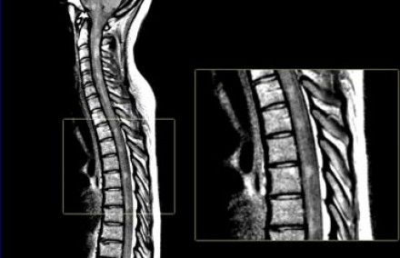
A proton density weighted image (PDWI)is crucial for studying the spinal cord.

Slide 58
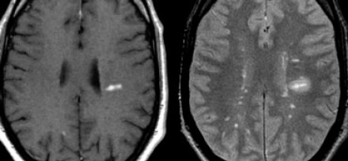
Dawson fingers
Ovoid lesions perpendicular to the ventricles (Dawson fingers).
Dawson fingers are typical for MS and are the result of inflammation around penetrating venules. These veins are perpendicular to the ventricular surface.

Slide 59
Enhancement is another typical finding in MS. This enhancement will be present for about one month after the occurrence of a lesion. The simultaneous demonstration of enhancing and non-enhancing lesions in MS is the radiological counterpart of the clinical dissemination in time and space. The edema will regress and finally only the center will remain as a hyperintense lesion on T2WI.

Slide 60
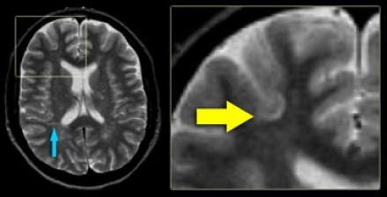
Juxtacortical lesions:
located in the U-fibers are also very specific for MS.

Slide 61
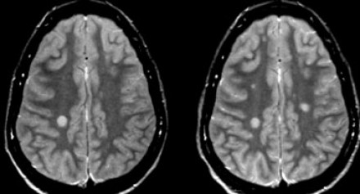
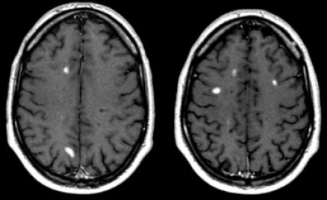
Dissemination in time.
New lesions on T2W images
Gadolinium enhancement is only visible for about 1 month.

Slide 62
Tumefactive MS
It on MRI presents as a large intra-parenchymal lesion with usually less mass effect than would be expected for its size.
After the administration of gadolinium, there may be some peripheral enhancement, often with an incomplete ring. These lesions can be distinguished from gliomas or intraparenchymal abscesses, which typically have a closed-ring enhancement.
The open-ring enhancement pattern with low signal T2 ring and low CBF are all indicative of demyelination.

Slide 63
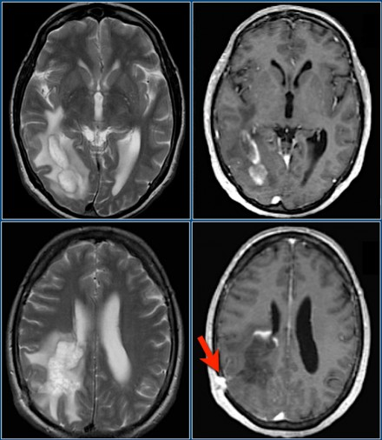

Slide 64
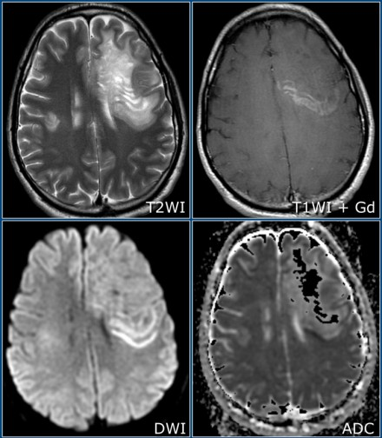
Balo’s Concentric Sclerosis
uncommon demyelinating disease
alternative bands of demyelination and myelin
preservation, often in
whorl-like configurations

Slide 65
Neuromyelitis Optica
A very important differential to keep in mind, especially in patients with a bilateral optic neuritis, is Neuromyelitis Optica (NMO) or Devic's Disease. This is a demyelinating disease in which the optic nerves and spinal cord are usually involved. Often there are few T2-lesions in the brain. Think of NMO when there are extensive spinal cord lesions (more than 3 vertebral segments) with low T1-signalintensity and swelling of the cord. On axial images the lesions often involve most of the cord. This is unlike MS, in which the lesions are usually smaller and peripherally located.

Slide 66
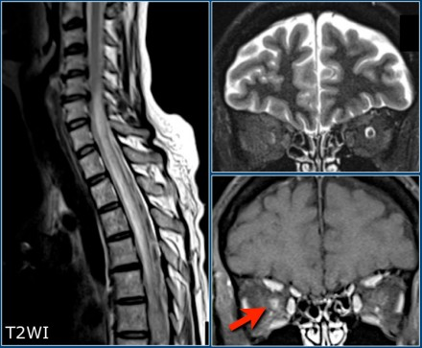

Slide 67
ADEM
Acute Disseminated Encephalomyelitis (ADEM)is another important differential diagnosis of MS. This is a monophasic, immune-mediated demyelinating disease which often presents in children following an infection or vaccination.
On MRI there are often diffuse and relatively symmetrical lesions in the supra-and infratentorial white matter which may enhance simultaneously. There almost always is preferential involvement of the cortical gray matter and the deep gray matter of the basal ganglia and thalami.

Slide 68
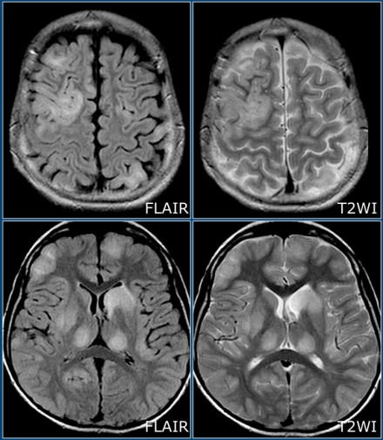

Slide 69
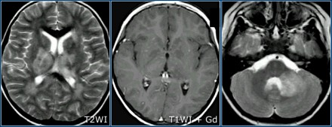
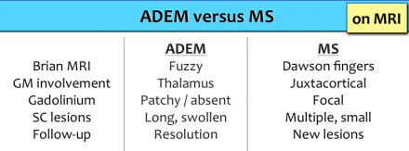
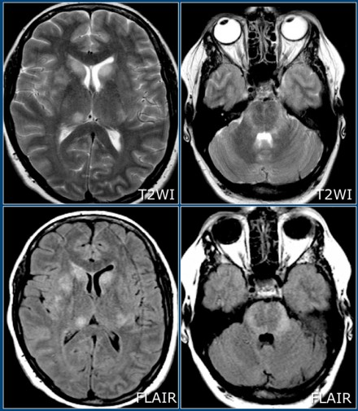
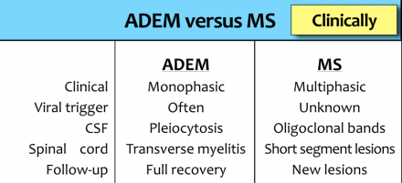

Slide 70
An Attack is:
Neurological disturbance of kind seen in MS
Subjective report or objective observation
At least 24 hours duration in absence of fever or infection
Excludes pseudoattacks, single paroxysmal symptoms (multiple episodes of paroxysmal symptoms occurring over 24 hours or more are acceptable as evidence)
Some historical events with symptoms and pattern typical for MS can provide reasonable evidence of previous demyelinating events, even in the absence of objective findings
Time Between Attacks:
30 days between onset of event 1 and onset of event 2
Positive CSF is:
Oligoclonal IgG bands in CSF (and not serum) or elevated IgG index

Slide 71
For dissemination in space (DIS) lesions in two out of four typical areas of the CNS are required:
Periventricular
juxtacortical
infratentorial
spinal cord

Slide 72
Oligoclonal band

Slide 73
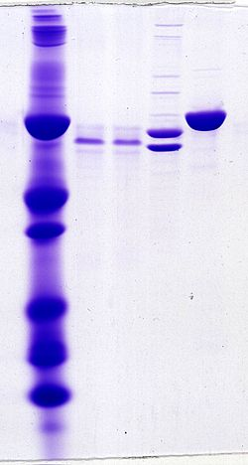

Slide 74
Oligoclonal bands (OCBs) are bands of immunoglobulins that are seen when a patient's blood serum, or cerebrospinal fluid (CSF) is analyzed. They are used in the diagnosis of various neurological and blood diseases, especially in multiple sclerosis.
Two methods of analysis are possible: (a) protein electrophoresis, a method of analyzing the composition of fluids, also known as "agarose gel electrophoresis/Coomassie Blue staining", and (b) the combination of isoelectric focusing/silver staining. The latter is more sensitive.

Slide 75
For the analysis of cerebrospinal fluid, a patient has a lumbar punctureperformed, which collects some of his or her cerebrospinal fluid. The blood serum can be gained from a clotted blood sample. Normally it is assumed that all the proteins that appear in the CSF, but are not present in the serum, are produced intrathecally (inside the CNS). Therefore, it is normal to subtract bands in serum from bands in CSF when investigating CNS diseases.

Slide 76
OCBs are especially important for multiple sclerosis (MS). In MS, normally only OCBs made of immunoglobulin G antibodies are considered, though sometimes other proteins can be taken into account, like lipid-specific immunoglobulin M. The presence of these IgM OCBs is associated with a more severe course.
New techniques like "capillary isoelectric focusing immunoassay" are able to detect IgG OCBs in more than 95% of multiple sclerosis patients.
Even more than 12 OCBs can appear in MS. Each one of them represent antibody proteins (or protein fragments) secreted by plasma cells, although why exactly these bands are present, and which proteins these bands represent, has not yet been fully elucidated. The target antigens for these antibodies are not easy to find because it requires to isolate a single kind of protein in each band, though new techniques are able to do so.

Slide 77
The last available reports in 2017 were pointing to a sensitivity of 98% and specificity of 87% for differential diagnosis versus MS mimickers (specificity respect unselected population should be equal or higher).

Slide 78
It has been reported that oligoclonal bands are nearly absent in patients with pattern II and pattern III lesion types.
Six groups of patients are usually separatd, based on OCBs:
type 1, no bands in CSF and serum;
type 2, oligoclonal IgG bands in CSF,
type 3, oligoclonal bands in CSF and serum with additional bands in CSF;
type 4, identical oligoclonal bands in CSF and serum,
type 5, monoclonal bands in CSF and serum,
type 6, presence of a single band limited to the CSF.
Type 2 and 3 indicate intrathecal synthesis, and the rest are considered as negative results

Slide 79
VEP

Slide 80
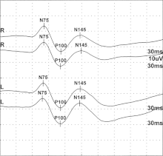
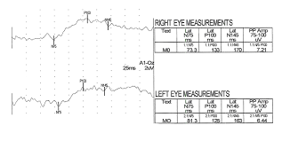

Slide 81
In 1934, Adrian and Matthew noticed potential changes of the occipital EEG can be observed under stimulation of light. Ciganek developed the first nomenclature for occipital EEG components in 1961. During that same year, Hirsch and colleagues recorded a visual evoked potential (VEP) on the occipital lobe (externally and internally), and they discovered amplitudes recorded along the calcarine fissure were the largest. In 1965, Spehlmann used a checkerboard stimulation to describe human VEPs. An attempt to localize structures in the primary visual pathway was completed by Szikla and colleagues. Halliday and colleagues completed the first clinical investigations using VEP by recording delayed VEPs in a patient with retrobulbar neuritis in 1972. A wide variety of extensive research to improve procedures and theories has been conducted from the 1970s to today and the method has also been described in animals.

Slide 82
The VEP nomenclature is determined by using capital letters stating whether the peak is positive (P) or negative (N) followed by a number which indicates the average peak latency for that particular wave. For example, P100 is a wave with a positive peak at approximately 100 ms following stimulus onset. The average amplitude for VEP waves usually falls between 5 and 20 microvolts.

