Slide 1
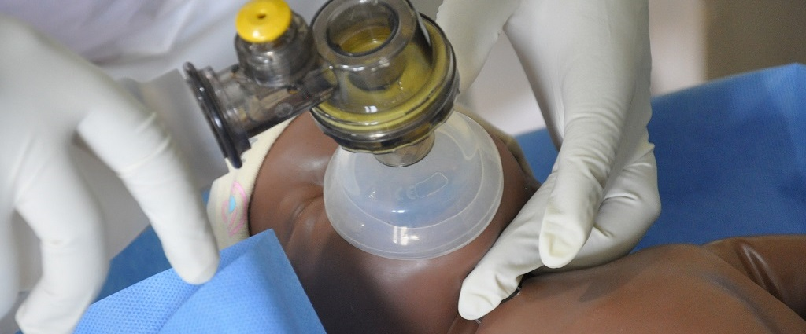
Newborn Resuscitation
Khoshnam rad

Slide 2
Neonatal Resuscitation
Newborn Resuscitation
Delivery room Resuscitation
Indicates the transition from fetal to extra uterine life .
Series of actions, used to assist newborn babies who have difficulty with making the physiological ‘transition’ from the intrauterine to extrauterine life , Assists babies who fail to initiate or sustain regular breathing at birth.
Physiologic changes occur in this transition

Slide 3
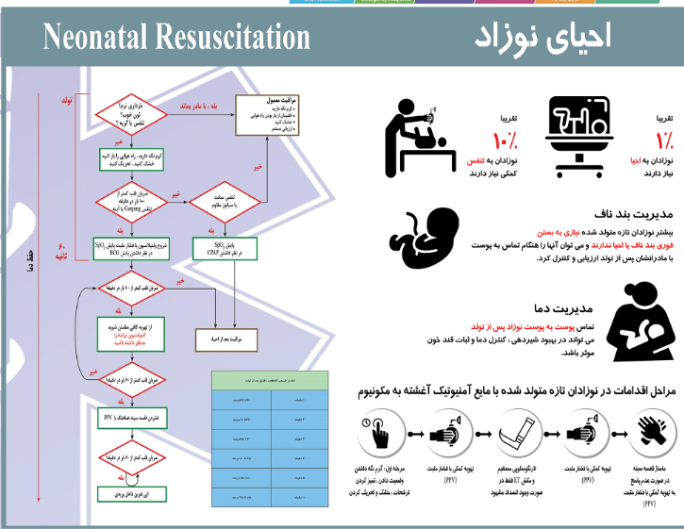

Slide 4
Maternal Risk Factors:
Prolonged rupture of membranes (greater than 18 hours)
Bleeding in second or third trimester
Pregnancy induced hypertension or Chronic Hypertension.
Substance abuse.
Drug therapy (e.g. lithium, magnesium, adrenergic blocking agents, narcotics)
Diabetes mellitus
Chronic illness (e.g. anaemia, cyanotic congenital heart disease)
Maternal pyrexia
Maternal infection or Chorioamnionitis
Heavy sedation
Previous fetal or neonatal death
No prenatal care

Slide 5
Fetal Risk Factors:
Multiple gestation (e.g. twins, triplets)
Preterm gestation (especially less than 35 weeks)
Post term gestation (greater than 41 weeks)
Fetal growth restriction
Alloimmune haemolytic disease (e.g. anti-D, anti-Kell, especially if fetal anaemia or hydrops fetalis present)
Polyhydramnios and oligohydramnios
Reduced fetal movement before onset of labour
Congenital abnormalities which may effect breathing, cardiovascular function or other aspects of perinatal transition
Intrauterine infection
Hydrops fetalis.
Large for dates.

Slide 6
Intrapartum Risk Factors:
Non reassuring fetal heart rate patterns on cardiotocograph (CTG)
Abnormal presentation
Prolapsed cord
Prolonged labour (or prolonged second stage of labour)
Antepartum haemorrhage (e.g. abruption, placenta praevia, vasa praevia)
Meconium in the amniotic fluid
Narcotic administration to mother within 4 hours of birth
Forceps birth
Vacuum-assisted (vento-use) birth
Maternal general anaesthesia

Slide 7
Preparation
Personnel :
Every Birth attendant must be trained in Resusitaion.
    At least two trained people are required for adequate resuscitation involving positive pressure ventilation and chest compressions. Therefore, always call for help.
    The most senior person available needs to co-ordinate resuscitation. 2nd senior on circulation, 3rd senior on resparotery
    Each person must have a dedicated job. For exa. with three people, one should be solely responsible for airway, one solely responsible for chest compressions and the third person should co-ordinate the resuscitation and administer medication as necessary.

Slide 8
2. Check equipment :
Every Birth must have resuscitation equipment and supplies in perfect condition.
Resuscitation equipment should be checked at least daily and after each usage.
When use is anticipated at a birth recheck equipment including(medical air and oxygen supply, suction, positive pressure devices, resuscitation equipment, largyngoscope, and endotracheal tubes).

Slide 9
Suction equipment
Bulb syringe
Mechanical suction, tubing, and catheters
Meconium aspirator
8F feeding tube and 20 cc syringe
Notes:
French units (each French unit equals 0.33 millimeters)

Slide 10
Laryngoscope with straight blades (Number 00 , 0 and 1 for extreme premature , preterm and term infants, respectively)
Face masks (preterm and term infant sizes)
Oxygen source with flowmeter

Slide 11
Others
Radiant warmer
Warm towels
Cardiac monitor
Pulse oximeter and probe
Oropharyngeal airways
Additional equipment for delivery of preterm infants
Compressed air source
Oxygen blender
Transport incubator
Notes:
Compressed air is air kept under a pressure that is greater than atmospheric pressure.

Slide 12
3. Communication :
With anaesthetic and obstetric staff regarding maternal condition, fetal condition, maternal therapies.
If time permits, meet the family before the birth.

Slide 13
4.Environment :
Prevention of heat loss is important.
Where possible deliver infant into a warm draft free environment.
The ambient temperature of the room should be at least 26 C for very preterm infants.

Slide 14
Assessment and recognition of the problem
The need for resuscitation must be recognized before the end of the first minute of life which is when the first Apgar score is taken.
Start resuscitation on zero time
The most important indicator that resuscitation is needed is failure to BREATHE after birth so, if the baby does not breathe, resuscitation must be started immediately.

Slide 15
Continue:
1.Breathing :
The newly born infant should establish regular respirations in order to maintain HR > 100 bpm.
The Baby's Cry is the most obvious sign that there is adequate ventilation after the birth beside in a crying newborn the heart rate is normal.
Breathing immediately after birth may be irregular but is usually still sufficient for adequate ventilation. However, gasping (occasional breaths with long pauses in between) is not sufficient.
If the newborn does not cry or breathe at all, or is gasping within 30 seconds of birth, and after being dried, the essential steps of resuscitation should be taken immediately.

Slide 16
Good cry :
1) normal CNS
2) normal CVS
3) normal RS

Slide 17
2.Heart Rate
The HR should be > 100 bpm in a well newly born infant.
Determined from auscultation over the apex with a stethoscope or direct palpation of cord or with stethoscope.
Peripheral pulses are often difficult to feel.

Slide 18
3.Colour
Assessment of of colour is a poor proxy for oxygenation, therefore assessment of oxygenation can be aided by use of a pulse oximeter with neonatal probe attached to the infant's right hand.
During labour the uncompromised infant has oxygen saturations of about 60% which after birth usually take 5-10 minutes to reach 90%.

Slide 19
Taking an Apgar score is not a prerequisite for resuscitation.
Apgar scoring has been used as a systematic tool to assess and document the clinical status of the newborn at birth (at 1 and 5 minutes of life). The newborn is examined for five signs: breathing, heart rate, muscle tone, reflex irritability and colour .
The score depends not only on the severity of birth asphyxia but also on other factors such as:
  Drugs given to the mother
  Anesthetics
  Fetal infection
  Fetal anomalies
  Prematurity.

Slide 20
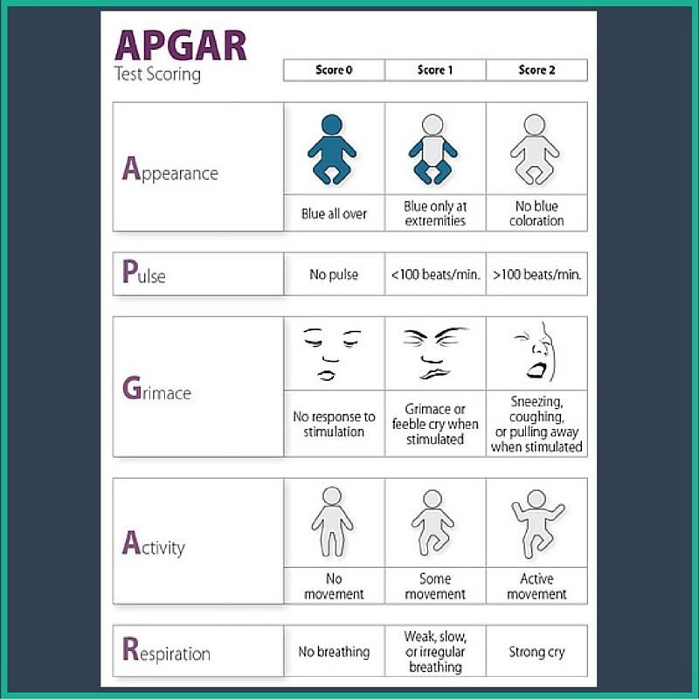
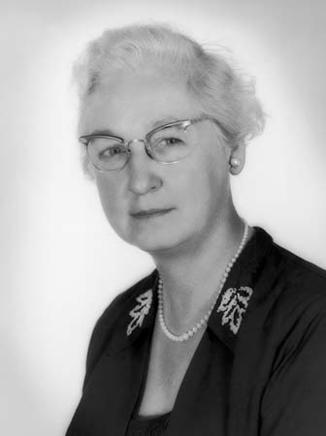
Virginia Apgar

Slide 21
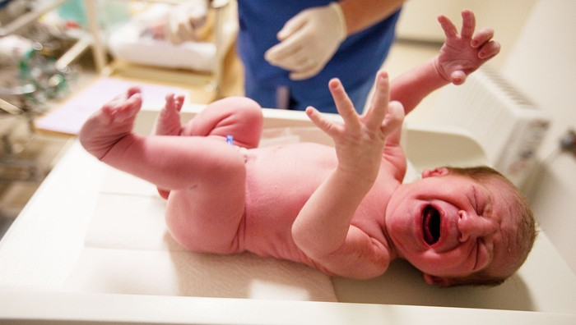
APGAR Score 8-10
Achieved by 90% of neonates
Nothing is required, except
- nasal and oral suctioning
- drying of the skin
- maintenance of normal body temperature.

Slide 22
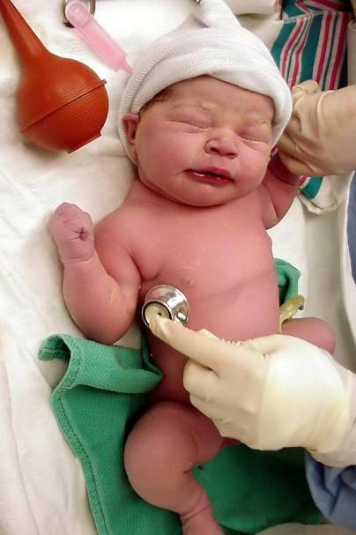
APGAR Score 5-7
” resuscitation “
-Respond to vigorous stimulation
-Oxygen blown over the face.

Slide 23
Apgar Score 3-4
These Neonates are moderately depressed at birth.
They are usually cyanotic and have poor respiratory efforts.

Slide 24
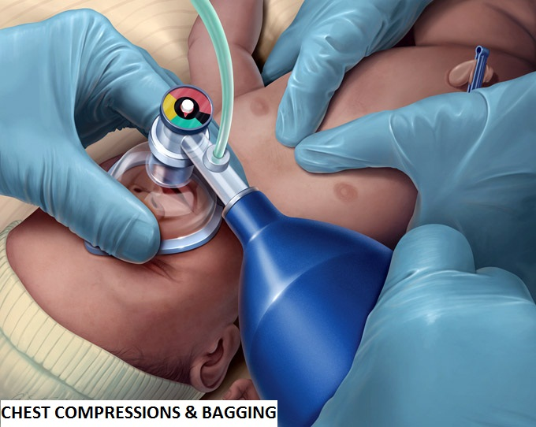
Apgar Score 0-2
These neonates severely asphyxiated and require immediate resuscitation
intubation

Slide 25
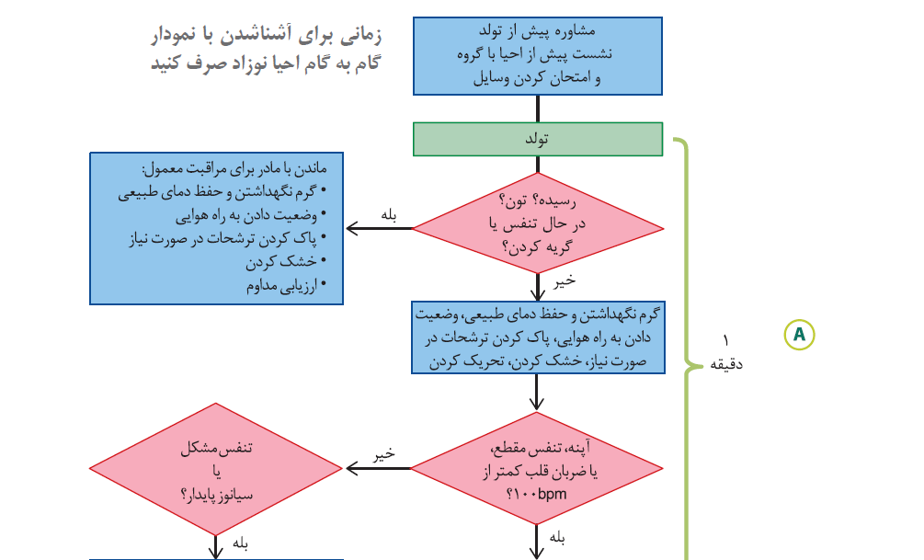

Slide 26
Steps of resuscitation
The initial steps of newborn resuscitation are to maintain normal temperature of the infant,
position the infant in a “sniffing” position to open the airway,
clear secretions if needed with a bulb syringe or suction catheter,
dry the infant which is the best tactile stimulation for breathing (unless preterm and covered in plastic wrap), and stimulate the infant to breathe.

Slide 27
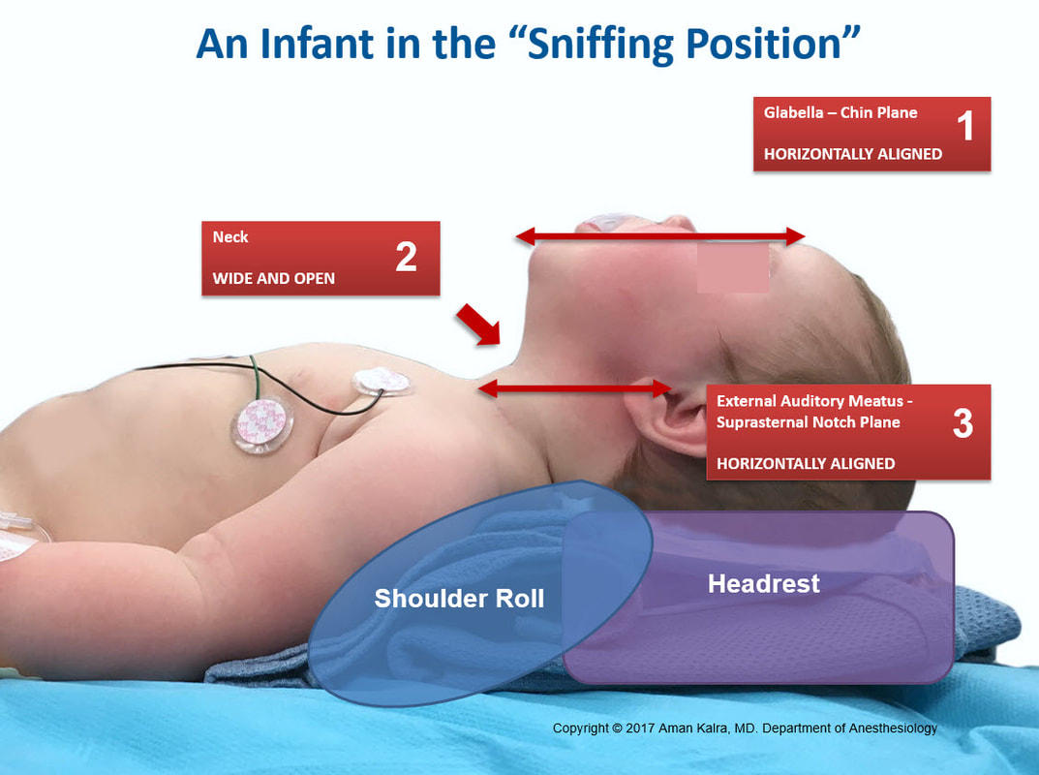

Slide 28
Why babies have hypothermia?
high ratio of skin surface
fluid loss from the skin
(due not to sweating but to direct transdermal water loss)
The thin fetal skin, with blood vessels that are near the surface, provides poor insulation, which leads to further heat loss.
The low amount of musculature and the inability to shiver.
A lack of thermal insulation, e.g., subcutaneous fat and fine body hair (especially in premature).
The nervous system is not fully developed and does not respond quickly and/or properly to cold (e.g., by vasoconstriction of skin blood vessels).
Conduction and Evaporation mainly

Slide 29
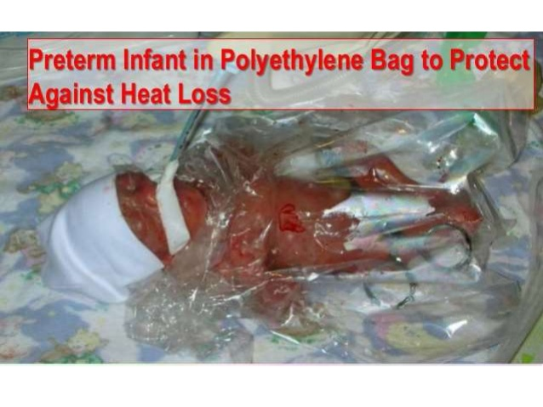

Slide 30
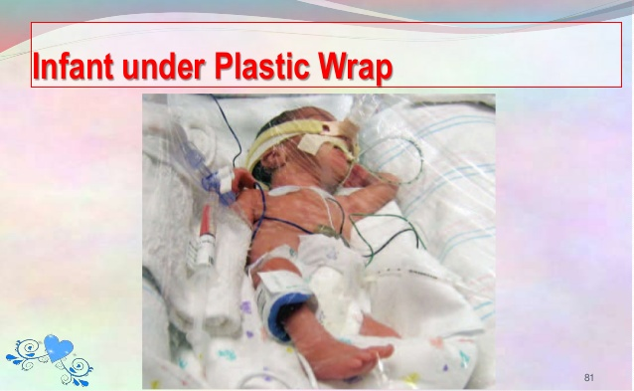

Slide 31
ABC’s of Resuscitation
A – Establish an open Airway
  Position infant
  Suction mouth then nose
B – initiate Breathing
  Use tactile stimulation
  Use PPV if necessary
C – Maintain Circulation
  Stimulate and maintain circulation
    Chest compressions
    drugs

Slide 32
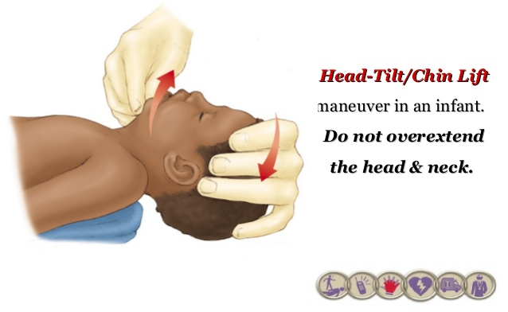
Airway management
Position
The infant should be positioned so as to open the airway

Slide 33
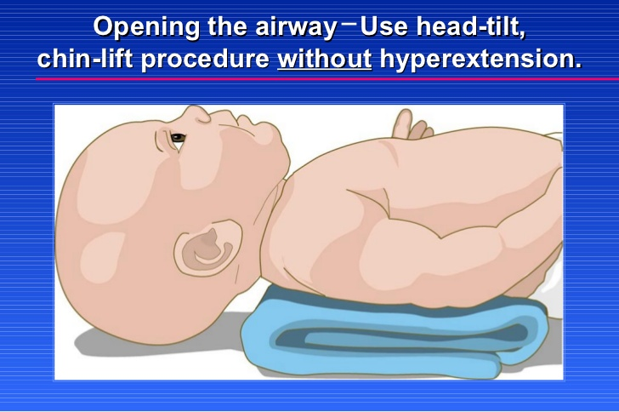

Slide 34
Airway management
Suction :
The mouth and nose should be suctioned.
Mouth then nose to prevent aspiration of mouth contents
A bulb syringe should be used for the initial suctioning.
Suction is done to: assess reflex and clean the airway

Slide 36
Insert Laryngoscope.
Clear the mouth and posterior pharynx using 12F/14F catheter.
Insert ET tube.
Attach ET tube to meconium aspirator and suction source.
Apply suction and remove slowly.

Slide 37
stimulation
Drying and suctioning often provide enough stimulation to initiate breathing; however, if more vigorous stimulation is necessary, gently slapping the soles of the feet or rubbing the back may be effective.
At this point, the infant's respiratory rate, heart rate, and color should be evaluated.

Slide 39
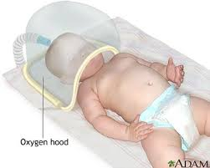
Infants who have a sustained heart rate higher than 100 beats/min and adequate respiratory effort but who remain cyanotic should receive blow-by oxygen via oxygen tubing or a mask.
Supplemental oxygen should be initially provided with a Fio2 of 1 at a flow rate of 8-10 L/min.
If oxygen is to needed for a long period, heated humidified oxygen should be supplied via an oxygen hood

Slide 40
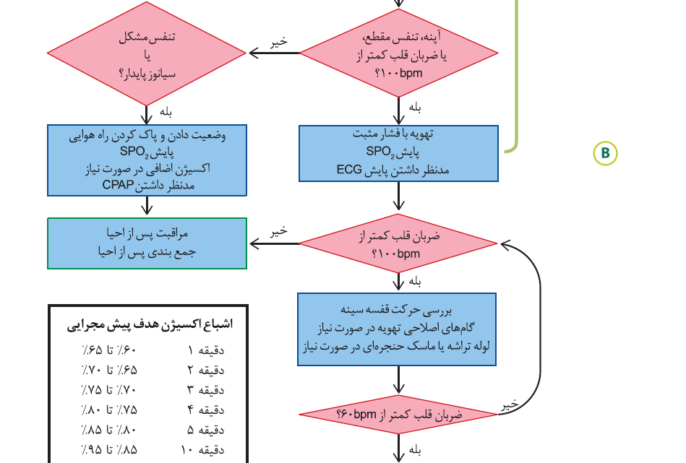

Slide 41
Positive pressure ventilation
Infants with adequate respirations who are experiencing respiratory distress (tachypnea, grunting, flaring, retracting, or persistent central cyanosis) may benefit from PPV.
If the infant is apneic, is making inadequate respiratory efforts (gasping), or has a heart rate lower than 100 beats/min, PPV should be initiated immediately.
Infants who have continued central cyanosis despite supplemental oxygen should also receive PPV.

Slide 42
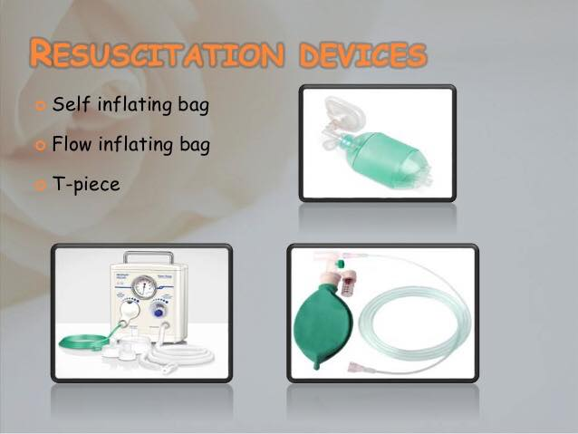
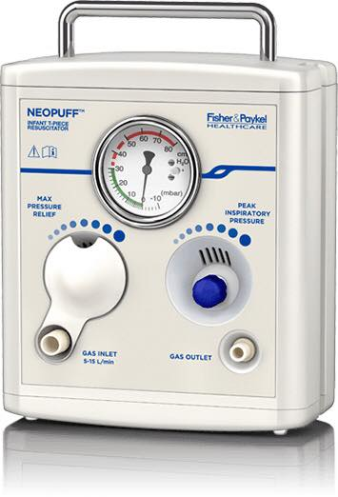

Slide 43
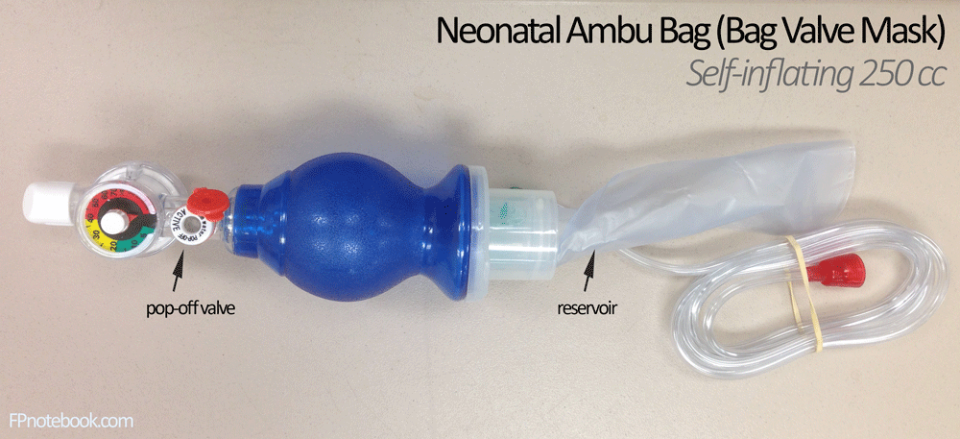
Ambu bag (self-inflating bag)
Make sure the mask size is appropriate ; should cover the nose, mouth and chin
And the head in semi-flexed position

Slide 44
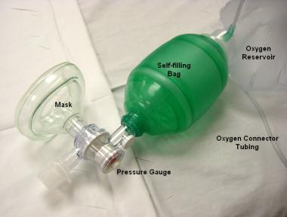

Slide 45
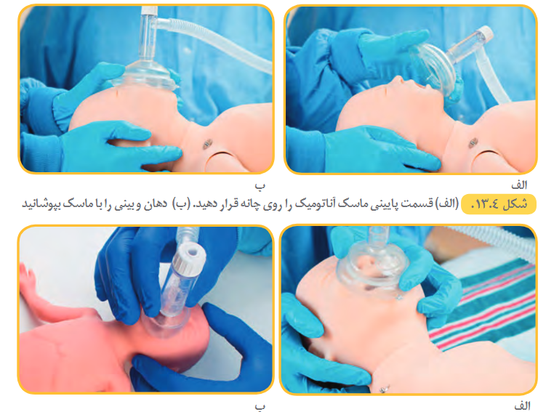

Slide 46
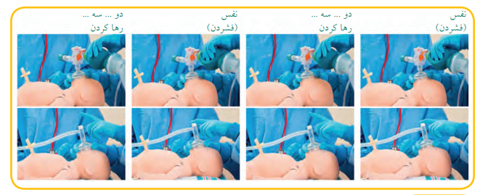

Slide 47
Respiratory rate 40-60 breaths/min to promptly achieve or maintain >HR 100/min
Positive end expiratory pressure (peep) should be 5-7 cm H₂O (to keep the alveoli open)
Fio2 is 21-100 %
Contraindications of Ambu bag : thick meconium and diaphragmatic hernia

Slide 48
CPAP
Recommended in preterm newborn who are breathing spontaneously, but with difficulty.
Starting infants on CPAP, ↓ the rates of intubation and Mechanical ventilation , surfactant use, and duration of ventilation, but ↑ rate of pneumothorax.

Slide 49
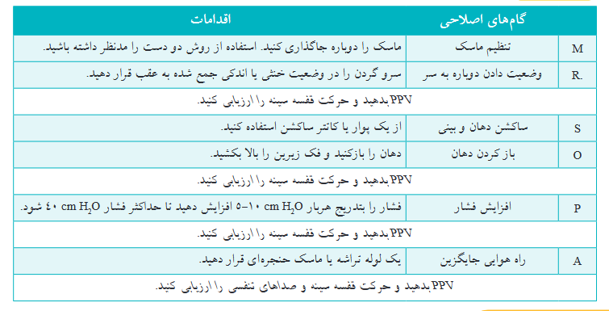

Slide 50
INTUBATION
Initial endotracheal suctioning of non vigorous meconium stained newborns.
If BMV is ineffective or prolonged (Intractable Apnea)
Newborns born without a detectable HR
Apgar score <3
PH < 7.2 , PaO2 <50 mmHg , PaCO2 <55 mmHg
Expected need for continued or prolonged ventilation

Slide 51
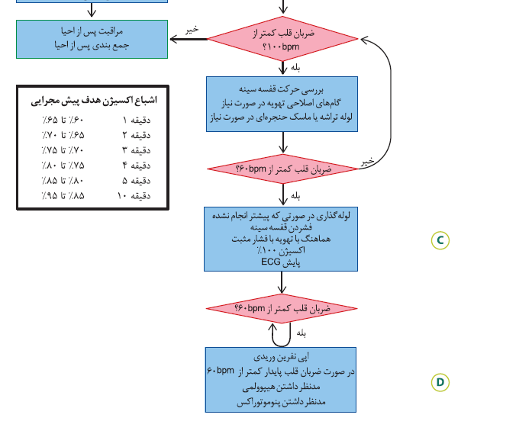

Slide 54
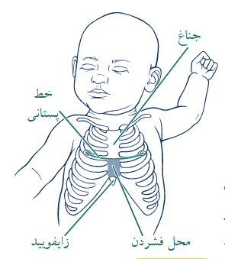

Slide 56
RESUSCITATION DRUGS
If the HR remains < 60/min despite one minute of adequate ventilation and chest compressions with 100% O_{2 ,}adrenaline or volume expansion or both are indicated
Notes:
Drugs are rarely indicated in resuscitation of the newly born infant.

Slide 57
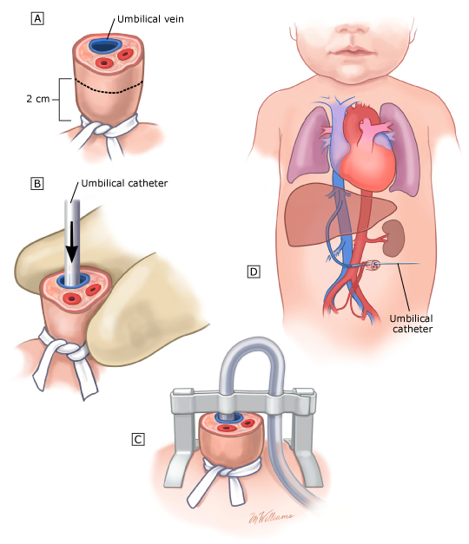

Slide 58
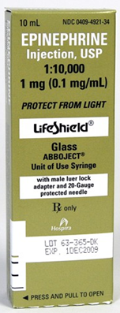
IV is the preferred route: UVC is preferable to intraosseous
Recommended IV dose is 0.01-0.03 mg/kg/dose; rapid bolus
followed by 1ml of 0.9% NS flush
0.1 to 0.3 mL/kg of a 1:10,000 solution [concentration 0.1 mg/mL]

Slide 59
Intratracheal dose is higher (0.05 to 0.1 mg/kg); 1:10,000 (0.1 mg/mL); may be considered while IV access is being obtained; Follow with PPV
Can be repeated every 5 minutes, if HR remains < 60/min.

