Slide 1
In The Name Of God

Slide 2
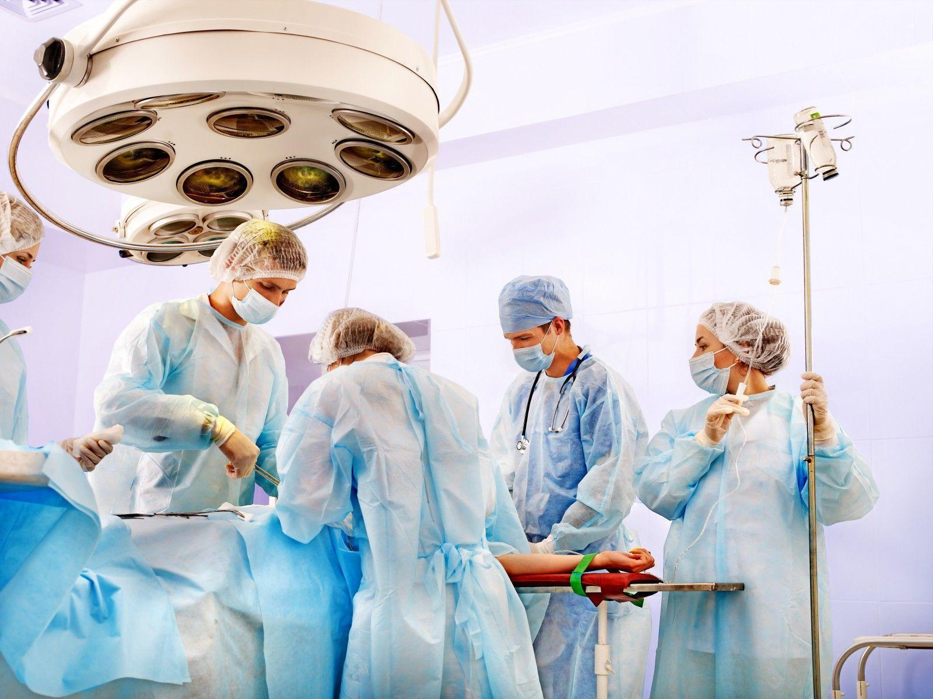
Surgical treatment in mucormycosis
Dr amirhossein ahsani
Assistant professor of otolanyngology
at kashan university of medical sciences

Slide 3
As soon as possible **basic medical condition **late diagnosis >>>> poor prognose

Slide 4
Different from other pathologies -CRS >>> functional endoscopy -malignancy >>>>>radical resection with safe margin -mucormycosis >>>> radical resection without safe margin

Slide 5
An aggressive surgical approach appears to enhance survival
The keys to successful therapy include
suspicion of the diagnosis with early recognition of the signs and symptoms,
correction of underlying medical disorders such as ketoacidosis,
and aggressive medical and surgical intervention

Slide 6
In pulmonary mucormycosis, surgical treatment along with appropriate systemic antifungal therapy has been shown to significantly improve survival compared to antifungal therapy alone

Slide 7
Involment by mucor: -expert eye: especialy in fat and bone -frozen section :in primary case .doubtful case .eye involment. Previous treatment case the use of intraoperative frozen sections to delineate the margins of infected tissues so that uninvolved tissues can be spared from debridement. >>>guiding extent of surgical revision -frozen is not help >>> bone

Slide 8
The important surgery is the first one -if we need staging complete surgical recording is necessary -most patients need frequent debridment

Slide 9
Necrotic tissues removal till >>>> bleeding tissue **the necrotic tissues have not good penetration -bone ( & more thick bone) -fat -dura

Slide 10
Orbital exentration -orbital involment in most cases is from orbital apex -in past: orbital involment and specialy blindness leads to exentration -today: bone removal around the orbit . Necrotic fat and tissues debridment -globe involment >>> exentration

Slide 11
Orbital exenteration may be life-saving in the presence of active fungal invasion of the orbit and should be considered for an actively infected orbit with a blind, immobile eye.
It has been considered helpful even after intracranial spread has occurred. Whether or not to perform orbital exenteration is the most difficult decision in the surgical management of orbital mucormycosis because the procedure may represent a life-saving measure achieved at the cost of permanent mutilation

Slide 12
Staging and revision - in most cases pathology is hidden -decision making is based on : 1.previous surgeicalrecords 2.clinic (exam &ESR .CRP) 3.MRI 4.CT

Slide 13
The most important surgical area that were ignored: -lat &ant walls of maxilla .body of zygoma .palate.clivus.pterigoid and greater wing of sphenoid -orbital apex and sup.orbital fissure

Slide 14
Endoscopic surgery interval : -depended to primary presentation and primary extention of disease and -extention of primary surgery

Slide 15
Intracranial involment of>>>> cribriform palte and orbital apex intracranial nerve >>>>> poor prognose

Slide 16
Treatment Duration
There is no standard duration of treatment for mucormycosis.
Decisions are made on an individual basis, and as a principle, antifungal therapy of mucormycosis is continued until resolution of all clinical, laboratory, and imaging signs and symptoms of infection and reversal of immunosuppression.
posaconazole and isovuconazole have an important role in bridging the initial IV treatment of mucormycosis to long-term treatment .
In selected patients, PET scan might have a role in making the distinction between radiographic signs of active disease and inactive scars, thus facilitating treatment discontinuation

Slide 17
Because late recurrences of mucormycosis in patients who were previously successfully treated >>>> long term treatment

Slide 18
How to monitor for relapse of mucormycosis
There are no validated approaches or biomarker to monitor for clinical relapse.
immunosuppression, uncontrolled hyperglycemia, leukemia relapse, cytomegalovirus reactivation, discounting of antifungal and the presence of anatomic sequestra are factors that increase the risk of recurrent infection
follow up with endoscopy

Slide 19
Thanks

