Slide 1
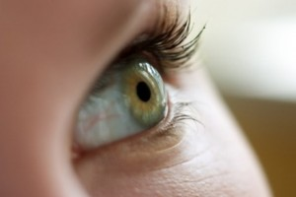
Disorders of the eye

Slide 2
Why eye injuries at work is important?
More than 2,000 people injure their eyes at work
each day.
10-20 % will cause temporary or permanent
vision loss.
The right eye protection could have lessened the
severity or prevented 90% of eye injury accidents.
The financial cost of eye injuries is more than $300
million per year in lost production time, medical
expenses, and workers compensation.

Slide 3
Work place Injuries
Eye injuries represent 11% of all injuries in the construction industry today.
80% of injuries occur because glasses were not being
worn at the time of the accident.

Slide 4
Allergic conjunctivitis:
all occupations & long list of workplace Allergens
systemic allergic manifestations (Asthma & Dermatologic disorders)
The role of work-related factors is the first question to be considered.

Slide 5
Allergic conjunctivitis:
changes in the quality of the tear layer overlying the cornea and conjunctiva symptoms
Mucus protects the cornea becomes thick and uneven.
Small areas of the cornea remain unprotected and dry quickly.
Nerve endings located in the superficial layers of the cornea are stretched and cause a foreign body sensation.

Slide 6
Clinical features of allergic conjunctivitis
The clinical picture is often complicated by post infection allergic reactions.
Are not specific
mucous discharge, dryness, itching, burning, foreign body sensation, tearing, pain and blur vision.
pathognomonic of an allergic reaction:
Thin threads of mucus in the lower fornix

Slide 7
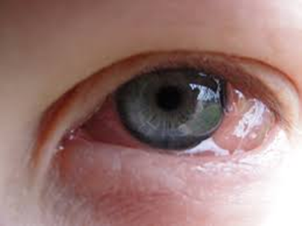
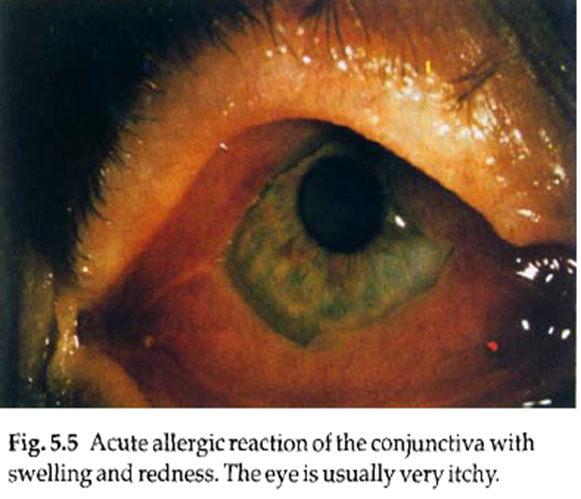
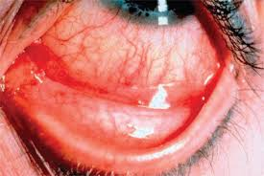
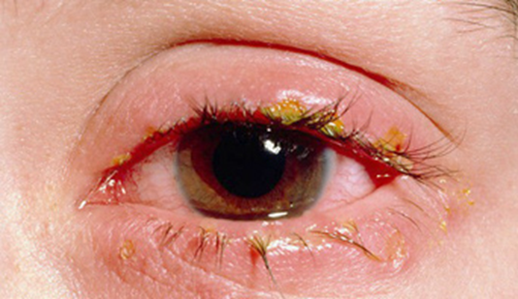
Allergic conjunctivitis:

Slide 8
The key in determination of etiology :
case history ( type and duration of symptoms during working days and weekends ).
Environmental factors should be noted:
Ventilation
sources of irritating and allergic exposures
carpeting, cleaning agents, smoking, various chemicals used in the workplace (including those used by adjacent workers).

Slide 9
Treatment of allergic conjunctivitis
Often a single specific allergen or irritant cannot be identified
Reduction or prevention to the allergen or irritant is preferred, but often not possible
Treatment is offen symptomatically:
cool compresses
artificial tears
avoidance of any preservatives in the medications used, (benzalconium chloride)

Slide 10
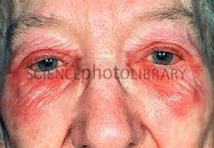

Slide 11
Topical mast-cell stabilizers and antihistamines
Systemic antihistamines
topical steroids (increased intraocular pressure, herpetic or fungal
keratitis, and of cataract formation )
If the employee is entitled to compensation because of work-related disease, the diagnosis needs to be confirmed using exposure in well controlled laboratory conditions.

Slide 12
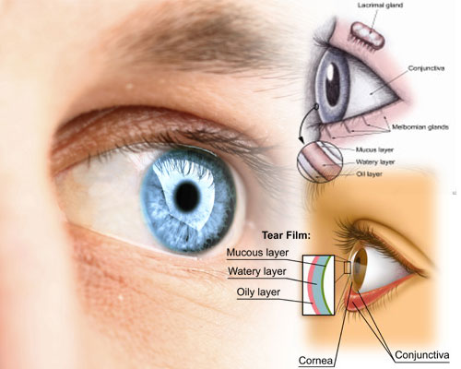
Dry eye syndrome
is common.
the symptoms are often worsened by low humidity at the workplace.
similar to allergic conjunctivitis and generally worsen as the day goes on and with near vision tasks.

Slide 13
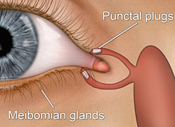
Treatment :
artificial tears is helpful.
Use of a humidifier
Punctal plugs may be indicated if symptoms persist.

Slide 14
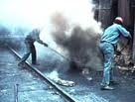
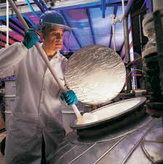
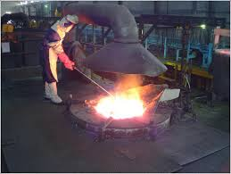
Irritation of the cornea
Chemicals
high or low temperature
dust and other irritant exposures

Slide 15
irritating agents may worsen an underlying allergic condition.
Chemical irritation may lead to accumulation of fluid under the corneal epithelium, as is the case after exposure to triethylamine. Resultant minute subepithelial corneal vesicles, which can be seen only on microscopic examination, can cause blurred, hazy vision.
Exposure to amines may cause corneal opacities

Slide 16
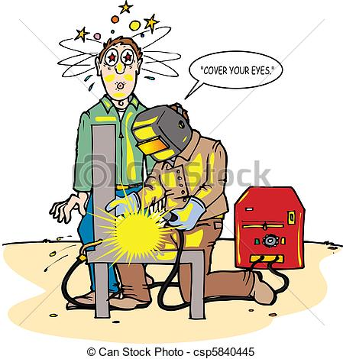
Ultraviolet (UV) light-induced keratoconjunctivitis
common problem

Slide 17
Regular plastic lens materials absorb UV light. Glass lenses vary in their transmission of UV light and should have UV coating when needed.

Slide 18
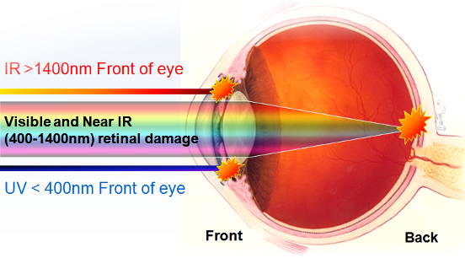
UV light is absorbed in the cornea and the lens, with only minimal amounts reaching the retina in normal eyes.

Slide 19
The symptoms appear within hours after UV exposure (slight irritation to severe sloughing).
Treatment:
sterile ointment, tight bandaging and pain medication.
Subacute damage : occur from lower levels of exposure to UV light. Symptoms include dryness or foreign-body sensation in the late night and early morning hours.
Chronic exposure may lead to thickening of the conjunctiva and changes in the corneal surface.

Slide 20
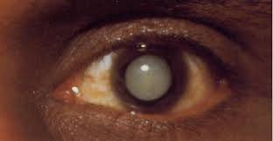
Disorders of the lens
UV-B : Some epidemiologic studies :the correlation between UV light and cortical and posterior subcapsular cataracts.
the role of work-related radiation in cataracts is usually hard to prove.
organic nitrate : Exposure to organic nitrate explosives has been reported to be associated with cataract formation.
infrared radiation : glass and metal workers

Slide 21
Disorders of the retina and optic pathways
Chemicals :
solvents have been reported to cause altered color vision, most commonly in the blue–yellow axis:
styrene, toluene, perchloroethylene, n-hexane, carbon disulfide and solvent mixtures.
Carbon disulfide can cause changes in the retinal capillary.

Slide 22
short-wavelength light : Light-induced retinal damage can occur from phototoxicity or thermal injury.
The former is typically caused by visible and infrared light.
Blue light seems to have particularly unfavorable effects on
the elderly retina.
blue light using special filter lenses.

Slide 23
Laser : serious, permanent loss of central vision.
energy absorption within the melanin granules of the retinal pigment epithelium.
Laser burns are classified into four categories:
Grade 1: retinal edema
Grade 2 : retinal coagulation necrosis
Grade 3 : necrosis with hemorrhage
Grade 4 : hemorrhage bursts into the vitreous.

Slide 24
Small laser burns have clinical importance only when they occur in the center of the macula.
It is advisable to take photographs of the maculae of workers at risk.
Extended exposure to very lowlevel laser energy may cause subtle damage to the retina; (ophthalmologic surgeons).
The damage is measurable only with extremely sensitive techniques and does not lead to functional losses.

Slide 25
Eye strain and visual ergonomics
Many occupations , office based, using computers instead of manual labor.
visual ergonomics have become important, in planning the working conditions of employees.

Slide 26
Symptoms of eye strain :
sore eyes
headaches
Fatigue
associated with intensive close work (reading and use of video display terminals).

Slide 27
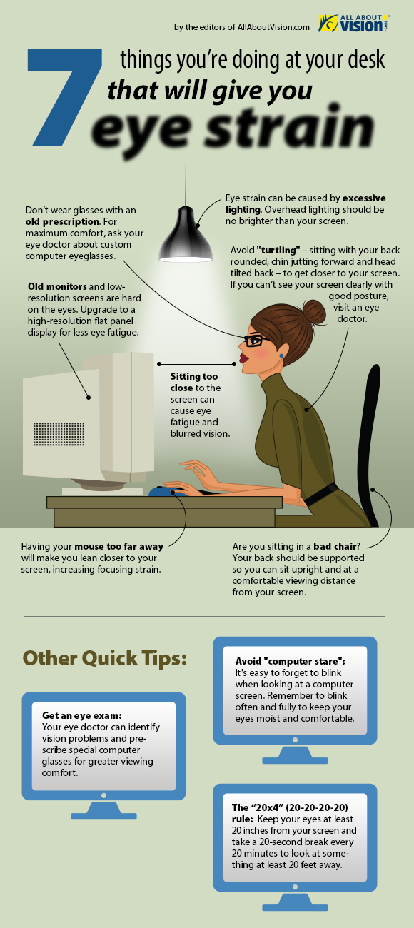

Slide 28
Environmental and ergonomic factors
Poor contrast
small text
too close to their visual threshold
too high direction of gaze (blinking decreases and dry spots , neck muscle tension )
Poor placement of a video display terminal may cause glare

Slide 29
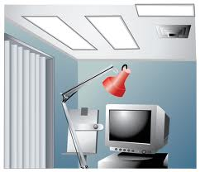
Illumination should be adjustable.
Shared workstations need to be adjustable

Slide 30
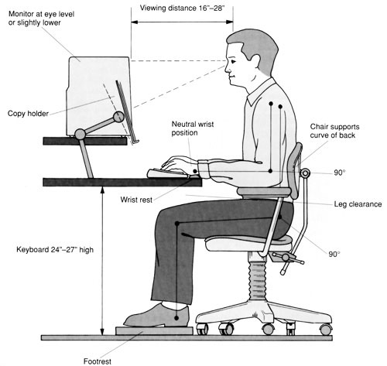
All visual target areas should be placed lower the visual field, so that the head posture is comfortable and nodding is avoided .

Slide 31
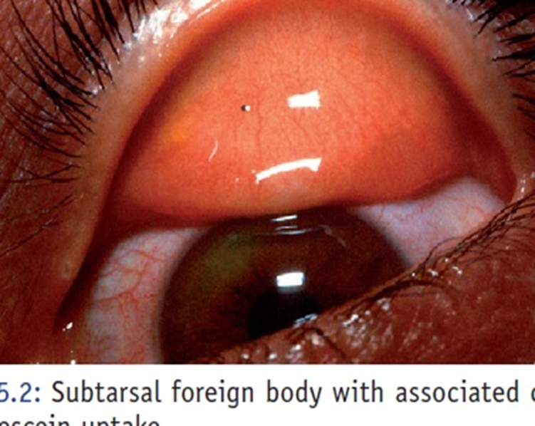
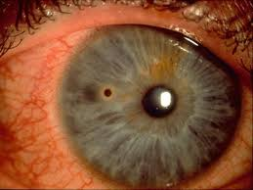
Superficial foreign bodies
the most commonly work-related eye injuries.
foreign body may cause corneal or conjunctival abrasion or become embedded in the cornea or conjunctiva.

Slide 33
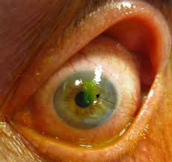
Fluorescein stains the damaged epithelium and helps to locate the foreign body.
After it is removed, antibiotic ointment is applied.
Corneal abrasions usually heal within 48 hours but it is wise to use ointment nightly for a week.

Slide 34
Complications of corneal abrasions :
Infection : should be suspected if a discharge develops
immediate referral to an ophthalmologist.
Recurrent erosion : a common complication and occurs when the basement membrane that underlies the superficial epithelium of the cornea is disrupted. This prevents firm adherence of the corneal epithelium to the basement membrane and the corneal epithelium then breaks down after minor trauma, such as rubbing of the eye. Therefore it is wise to cover the eye with a patch for the first few nights.

Slide 35
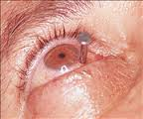
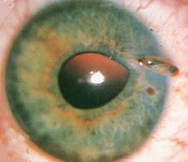
Penetrating ocular foreign bodies
the eye should be covered with a sterile patch. when the patient is sent to the emergency clinic No medications are used.

Slide 36
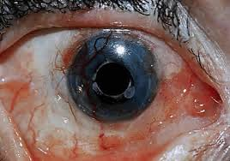
Chemical injuries
may occur in laboratory, agricultural, or industrial settings and represent a significant threat to vision.
Numerous chemicals can cause serious ocular injury, especially strong acids and bases.

Slide 37
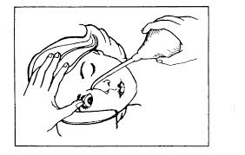
Immediate irrigation is essential to minimize permanent vision loss.
bottles with irrigation fluid must be near all workstations where dangerous chemicals are used and the workers must be trained .
Irrigation is continued while transporting the patient to an emergency room for further treatment.

Slide 38
Alkali burns tend to be more caustic and thus more damaging than acid injuries.
However, both have the potential to cause severe vision loss.
Protective eyewear should always be worn when handling corrosive or caustic fluids and gases, preferably behind a protecting window or screen.

Slide 39
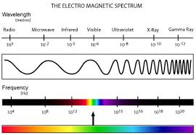
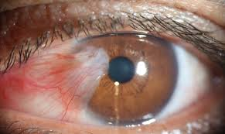
Electromagnetic radiation
Visible, ultraviolet, infrared, microwave, and laser energy have all been implicated in work-related eye injuries.
Visible and ultraviolet : pterygium and macular degeneration.

Slide 40
Infrared : in glass and metal workers has been associated with cataract formation.
Microwaves : cataract formation.

Slide 41
Prevention
Prevention is the most important
According to the Bureau of Labor statistics, 60% of workers who suffer eye injuries did not wear eye protection at the time of the injury; 40% of those who wore protection wore the wrong kind of protection.
the most important single intervention to decrease the eye injury.

Slide 42
Comprehensive workplace strategies to prevent eye injuries :
workplace modifications
use of appropriate personal protective equipment
worker education
appropriate trained personnel

