Slide 1



دکتر مرزبان – دانشیار دانشگاه زنجان
فوق تخصص نوزادان

Slide 2



Slide 3
نوزاد سالم جامعه سالم
تولد:
یکی از پرمخاطره ترین و شگفت انگیز ترین مرحله حیات یک انسان می باشد...
مخاطرات 120 ثانیه اول تولد یک فرد می تواند
سرنوشت 120 سال آینده وی را رقم زند .
- For breath is life, and if you breathe well you will live long on earth

Slide 8
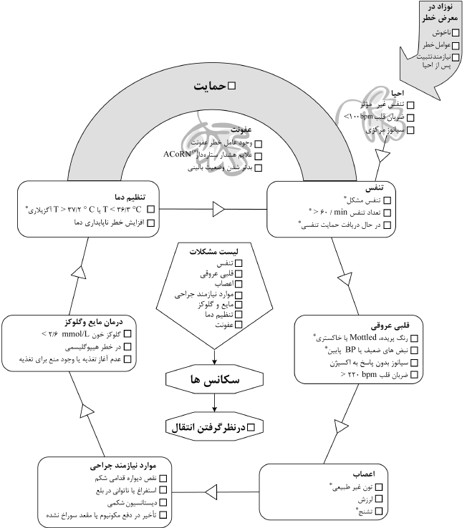

Slide 10
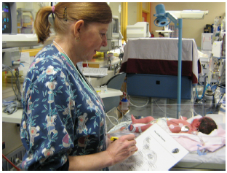

Slide 11
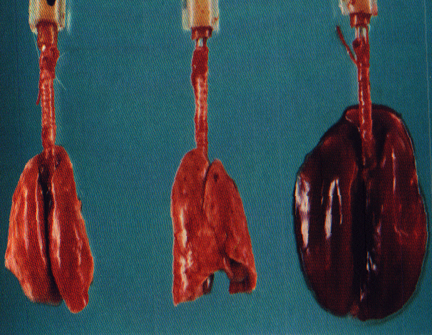
normal
lungs
5 min of
45 cm H₂O
20 min of
45 cm H₂O
Dreyfuss, Am J Respir Crit Care Med 1998;157:294-323

Slide 12
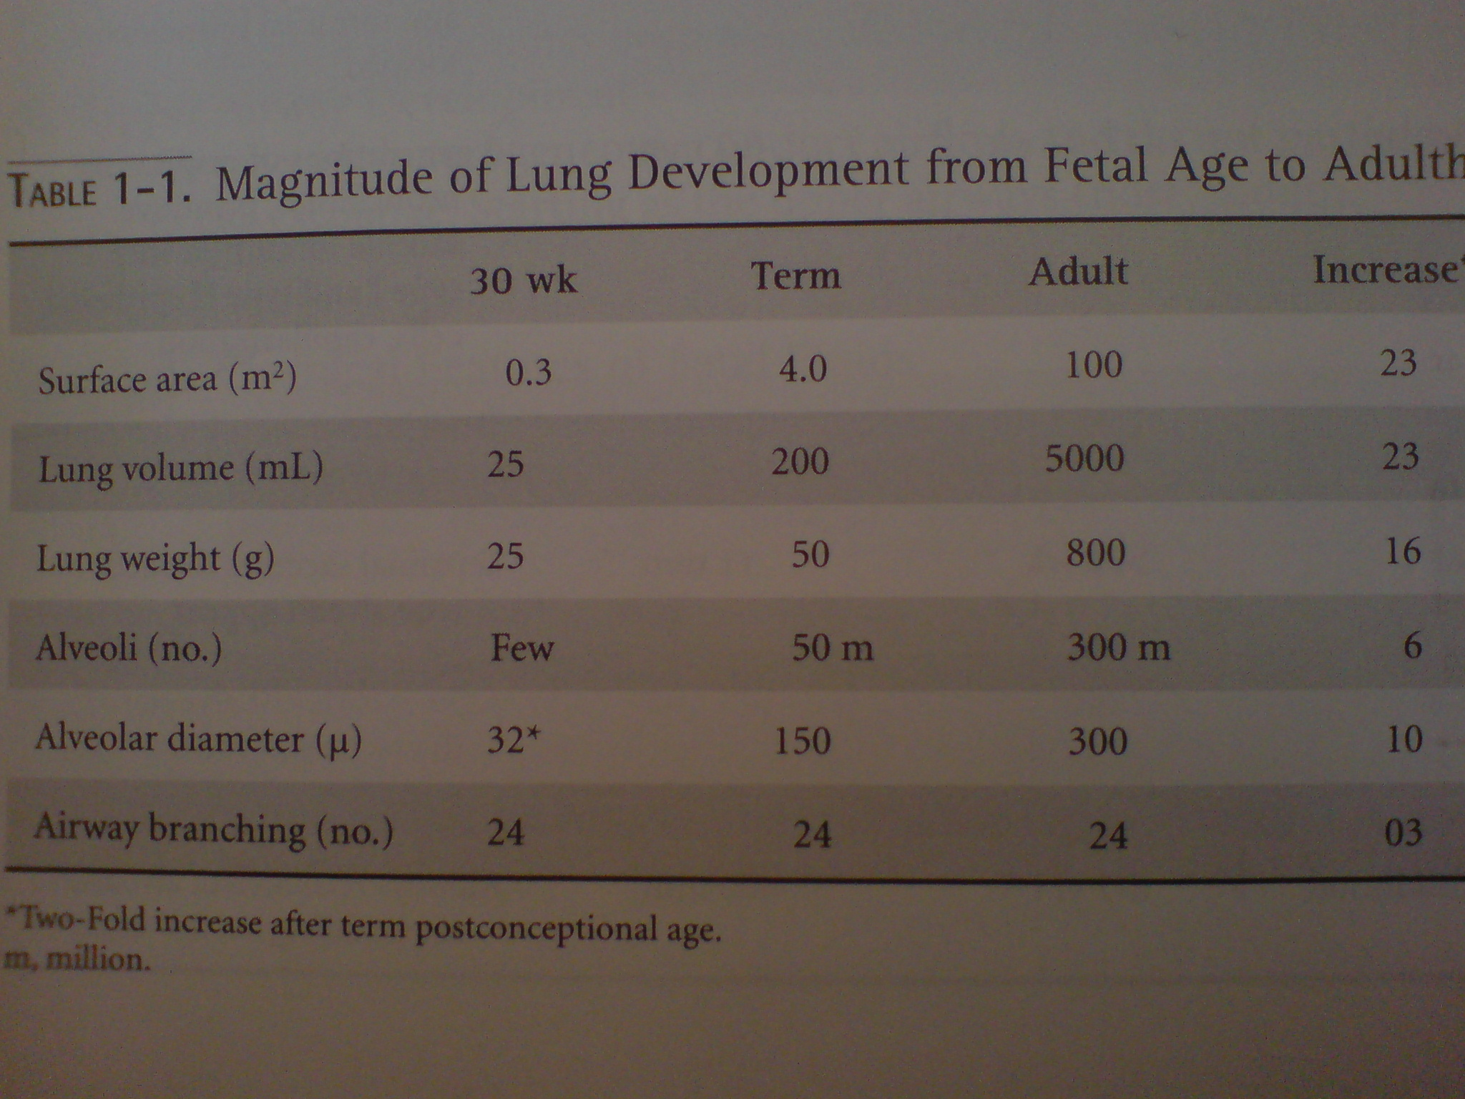

Slide 13
ACoRN Sequences
A lerting signs
C ore steps
O rganization of care
R esponse
N ext steps
S pecific diagnosis
S pecific management
Notes:
Evaluation is represented by ovals, arrows depict decisions, and actions (including monitoring, interventions, and diagnostic tests) are indicated by rectangles. The evaluation-decision-action cycle is repeated throughout the sequence.
As information is acquired, beginning with the Alerting Signs, proceeding through Core Steps, Organization of Care, Response, and Next Steps, evaluations and actions at each stage guide the practitioner to make decisions. These decisions prompt the practitioner to follow a particular pathway through the sequence that culminates in a working diagnosis and Specific Management.

Slide 14
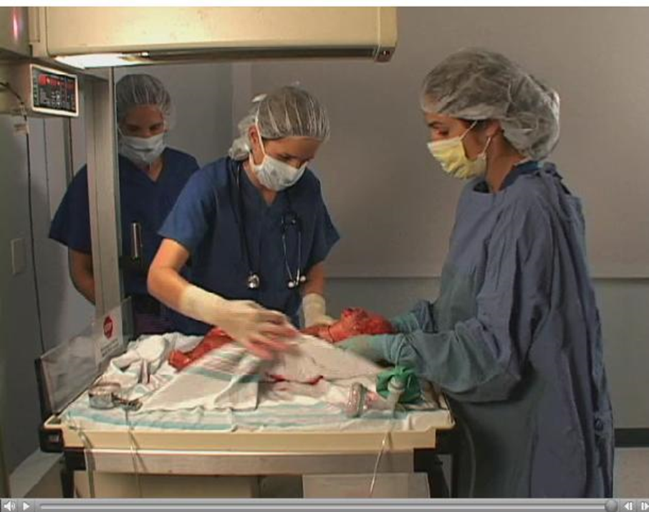
سکانس تنفس :

Slide 15
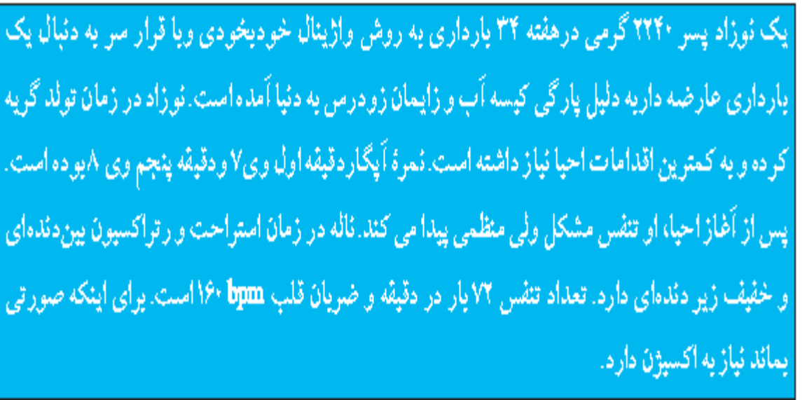
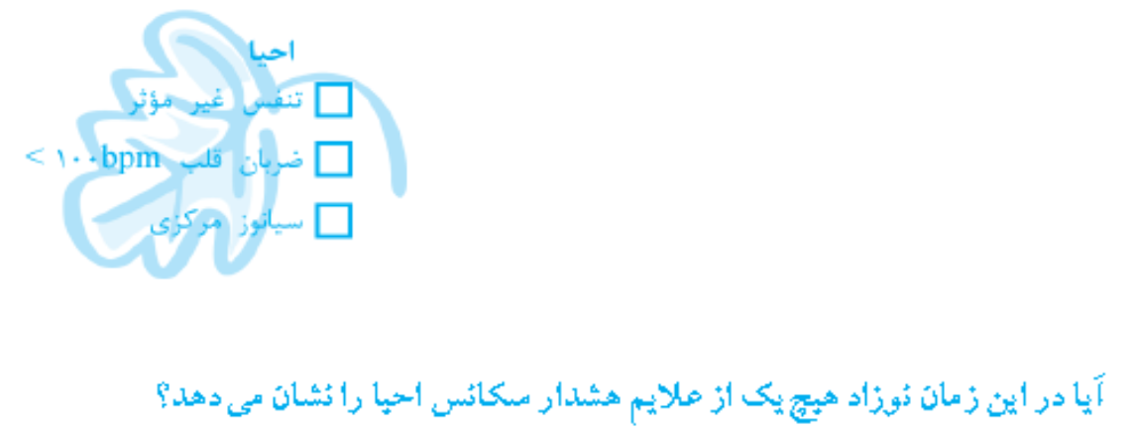
CASE:

Slide 17
سکانس تنفس :

Slide 19
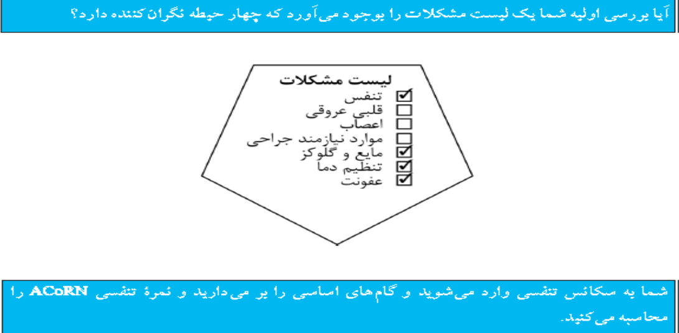

Slide 23
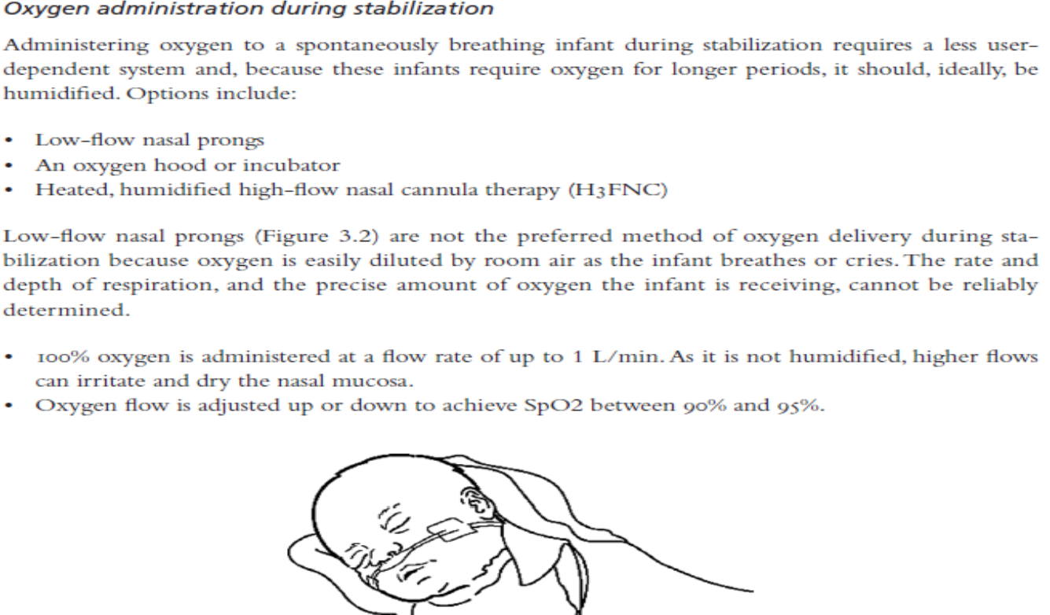
Core steps:

Slide 25
Core steps:

Slide 26
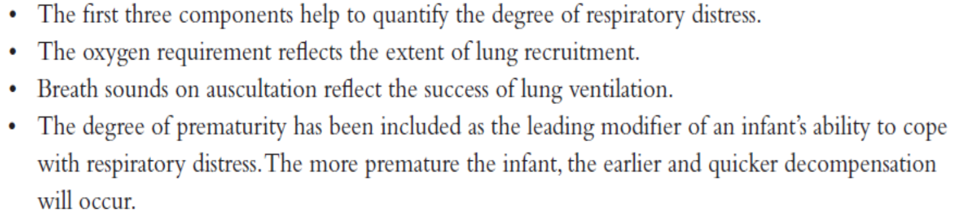
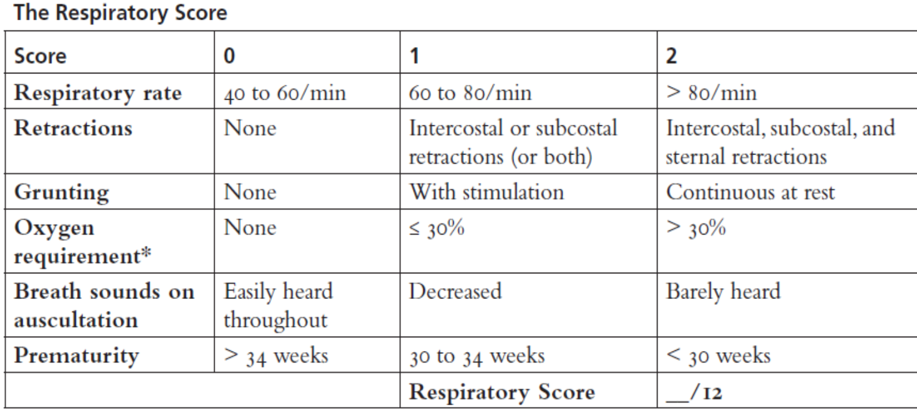
Core steps:

Slide 27
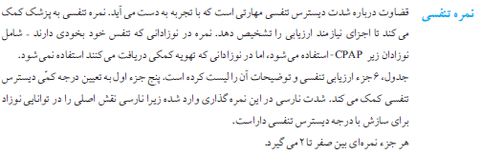

Slide 28
Organization of care:

Slide 31
Organization of care: … moderate

Slide 32
Organization of care:

Slide 33
Response:با مداخله فوری پاسخ دهید

Slide 34
RESPONES:

Slide 35
RESPONES:

Slide 37
RESPONSE :
Severe respiratory distress:
Infants with severe respiratory distress, recurrent apnea, or gasping require immediate intubation and ventilation to prevent respiratory failure. If a care provider with intubation skills is not present, use of a laryngeal mask airway should be considered.
- Intubation:
Intubation should not be delayed for intravenous (IV) access and premedication in infants requiring urgent or emergent care (e.g., during resuscitation). However, newborns should be pre medicated whenever possible because laryngoscopy and intubation are painful procedures that can cause hypertension, increased intracranial pressure, bradycardia, and hypoxia..

Slide 38
RESPONSE :
Mechanical ventilation:
The indications for ventilation include:
• Ineffective respiration with decreased respiratory drive (irregular breathing or apnea),
• Severe respiratory distress (Respiratory Score greater than 8),
• Moderate respiratory distress (Respiratory Score 5 to 8) with unsatisfactory blood gases (pH ≤ 7.25 and PCO2 ≥ 55),
•# Increasing Respiratory Score, increasing oxygen requirements despite CPAP (or both),
• The decision to administer surfactant,
• Use as an alternative to CPAP for infants requiring transport.

Slide 39
RESPONSE :
- In the event of a sudden deterioration in an intubated infant, airway patency should be assessed.
- The DOPE acronym can help identify and troubleshoot possible causes.
D . . . Displaced ETT? Has the infant accidentally extubated or is the ETT in the right main stem bronchus? Ensuring that the ETT is not displaced from its proper position involves:
- O . . . Obstructed airway or ETT? Kinked or blocked by secretions?
- P . . . Pneumothorax or other critical diagnosis? Other possible causes include pulmonary interstitial emphysema, or atelectasis.
- E . . . Equipment working and ventilation optimized?

Slide 40
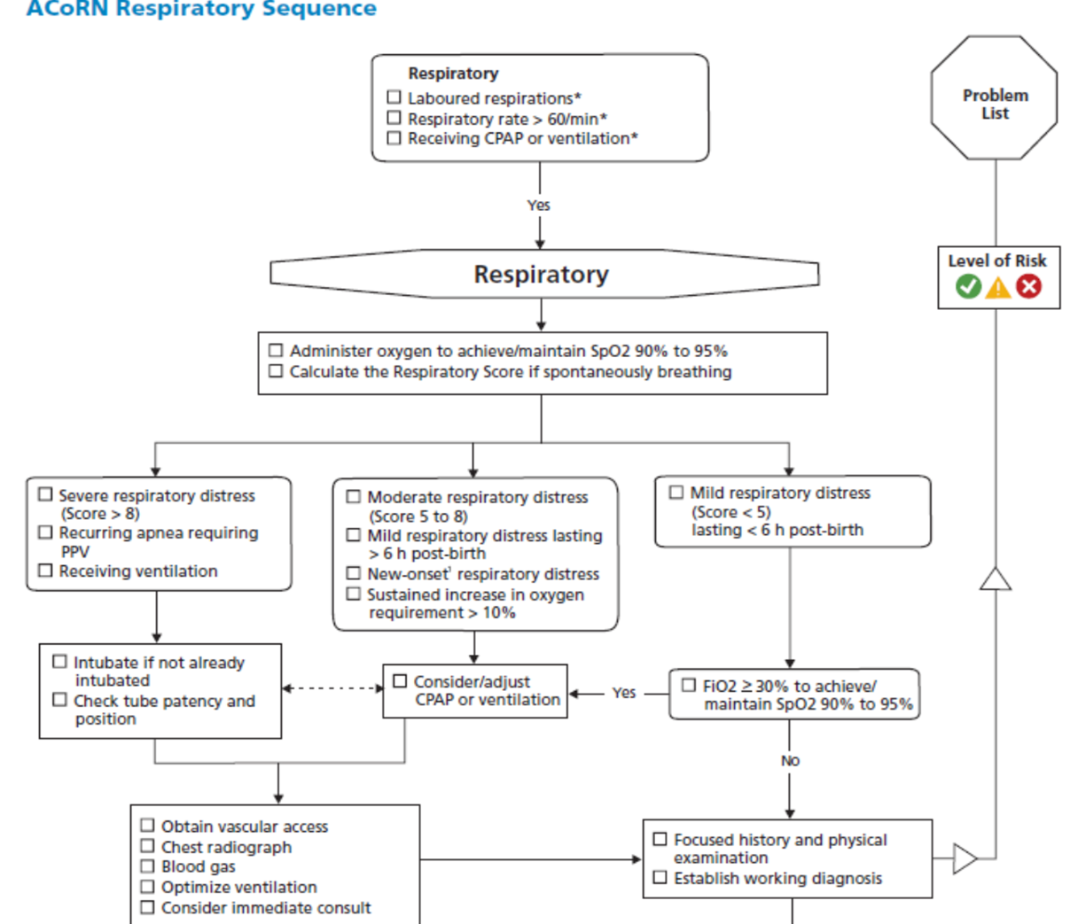

Slide 41
Next Steps:
The Next Steps in the Respiratory Sequence should include obtaining a focused history and conducting a physical examination.
# For infants with moderate to severe respiratory distress, Next Steps also include obtaining vascular access, ordering diagnostic tests and imaging (e.g., blood gases and a chest radiograph), optimizing ventilation, and requesting an expert consult.

Slide 42
Next Steps: Focused history
Important information to gather for a focused respiratory history includes:
# Antepartum
1. Confirm GA and accuracy of dates
2. Prenatal ultrasound findings :
3. Maternal diabetes, as a risk factor for RDS or cardiac out flow tract anomalies
4. Risk factors for congenital pneumonia, including maternal Group B Streptococcus (GBS) status,
5. premature
6. rupture of membranes, maternal fever, or chorioamnionitis
7. Receipt of antenatal steroids for pulmonary maturation
8. Maternal use of medications (e.g., selective serotonin reuptake inhibitors) which may cause tachypnea
or PPHN, or illicit substances, particularly narcotics, which can suppress respiratory drive

Slide 43
Next Steps:
Focused history
# Intrapartum:
• Presence of atypical or abnormal fetal heart rate during labour and delivery
• Meconium- stained amniotic fluid
• Time of rupture of membranes
• Signs of chorioamnionitis (maternal fever, uterine tenderness, fetal tachycardia, foul-smelling vaginal discharge)
• Nature of labour and mode of delivery
• Medications used
• Intrapartum antibiotics for GBS prophylaxis
# Neonatal:
• Umbilical cord blood gas results (arterial and venous)
• Condition at birth, including Apgar score
• Need for resuscitation, and response
• Timing for onset of symptoms (i.e., present at birth or after a period of normal respiratory function)
• GA and birth weight

Slide 44
Next Steps:4 Focused physical examination
A focused respiratory examination includes:
# Examination:
•1.Auscultate both lung fields for equality and nature of breath sounds. Diminished breath sounds unilaterally
may signal intubation of the right bronchus, pneumonia, atelectasis, or a pneumothorax or
other space- occupying lesion (e.g., a diaphragmatic hernia).
2. Listen for grunting, inspiratory stridor, expiratory wheeze, crackles.
3. Check for cleft palate or micrognathia (small jaw).
4. Pass a nasogastric tube through each nare to rule out choanal atresia.
# Observation :
1. Laboured respirations (e.g., nasal flaring, retractions, or grunting)
2. Colour of skin and mucous membranes (i.e., peripheral versus central cyanosis)
3. Respiratory support (e.g., oxygen requirements, size and position of ETT, ventilator settings)
4. Measurement of vital signs should include respiratory rate, heart rate, temperature, blood pressure, and oxygen saturation.

Slide 47
Specific Diagnosis:

Slide 48
Specific Diagnosis and Management:
Formulation of a Specific Diagnosis and Management plan will depend on the provider’s experience
and knowledge of conditions that present with respiratory distress in the newborn, along with radiographic
findings.
Common conditions include:
• Pneumothorax and other air leaks
• RDS
• TTN
• Meconium aspiration syndrome (MAS)
• Pneumonia
• PPHN
Specific diagnosis and management planning may require consultation with your referral centre.

Slide 49
Neonatal respiratory problems
A delay or inability to complete the normal pulmonary transition to extrauterine life results in neonatal
respiratory problems. Common examples include:
1. Transient tachypnea of the newborn (TTN), when reabsorption of alveolar fluid is delayed.
2. Respiratory distress syndrome (RDS), when surfactant is deficient and alveoli do not stay inflated
after alveolar fluid is reabsorbed.
3. Aspiration syndromes, when small airways and alveoli become obstructed by meconium, blood, or
amniotic fluid.
4. Pneumonia, when lungs become infected.
5. Persistent pulmonary hypertension of the newborn (PPHN), when smooth muscle in the pulmonary
vasculature does not relax and pulmonary pressures remain high, causing cyanosis from right to
left or bidirectional shunting at the patent ductus arteriosus (PDA) and patent foramen ovale (PFO).
6. Pneumothorax, when lungs suffer external compression from air trapped between the lung and
chest wall.
7. Pulmonary hypoplasia, when lungs are small and underdeveloped due to a space- occupying
lesion in the chest (e.g., congenital diaphragmatic hernia [CDH]) or prolonged, severe
oligohydramnios.

Slide 50
Normal Newborn CRX
- Clear lung fields
- Lung volume-reflected by diaphragmatic depth
8-10 ribs seen above the diaphragm
- Thymus may be present for the first 24 hour
- Normal heart size –upper limit 65%

Slide 52
Pneumothorax and other air leaks

Slide 53
Pneumothorax and other air leaks

Slide 54
Pneumothorax and other air leaks

Slide 55
Avoiding pulmonary air leaks:
The best strategy to avoid pulmonary air leaks is to prevent lung over distension For infants receiving mechanical ventilation, this is best accomplished by:
1. Limiting initial CPAP levels to 5 to 8 cmH2O,
2. Avoiding overventilation by maintaining PCO2 above 40 mmHg,
3. Considering surfactant administration, and
4. Avoiding suctioning of the ETT as much as possible.

Slide 56
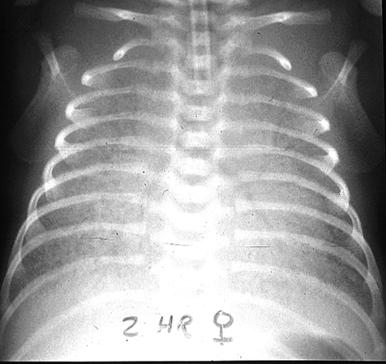
RDS:
Chest X-Ray
- “Reticulo-granular pattern”
- “Ground-glass appearance”
- symmetric & homogeneous
- Airbronchograms

Slide 57
Classic/Traditional , presentation RDS:
  - Preterm
  - Clinical Signs
- grunting,
- retractions,
- increasing O₂ requirement/ fio2
onset < 6hrs age
Development of respiratory failure
Natural course is death or recovery after 3-4 days
Classical X-Ray appearances/There is a ground glass with air bronchograms
--surfactant deficiency

Slide 58
RDS:
the triple therapy :
“prenatal steroids- early CPAP- early rescue surfactant”
and then mechanical ventilation is rarely needed .
Irrespective of the technique for surfactant administration, this combined triple therapy is highly efficacious in RDS.

Slide 59
RDS:

Slide 61
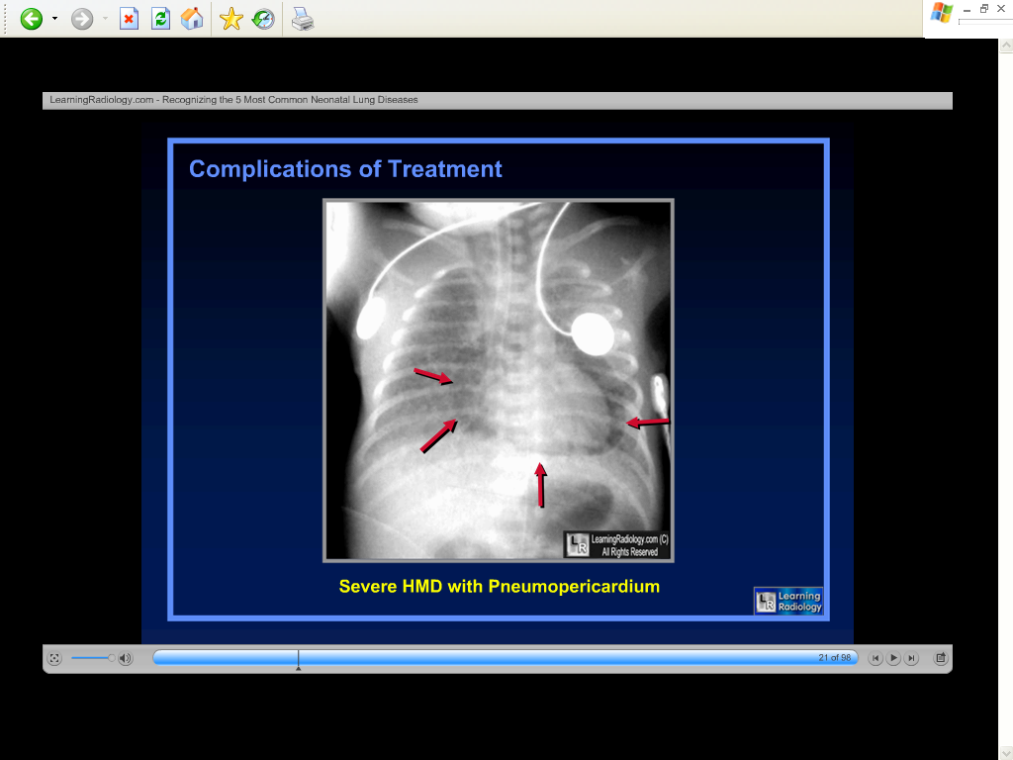

Slide 62
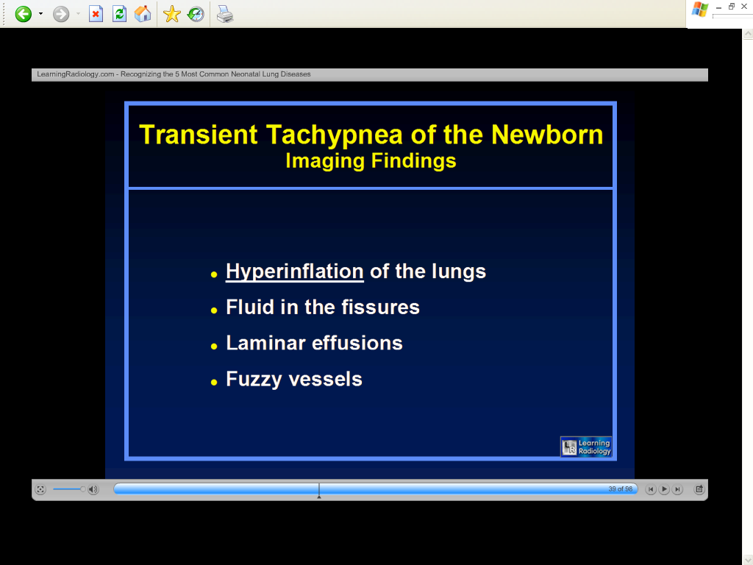
TTN:

Slide 63
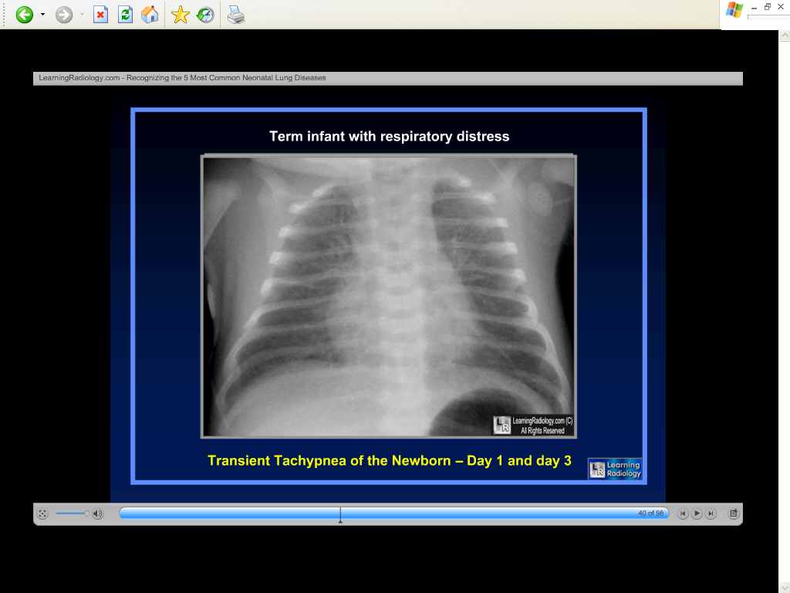
TTN:

Slide 64
TTN:

Slide 65
MAS:

Slide 66
MAS: Avoiding PPHN:
Infants with MAS are predisposed to PPHN and may have labile pulmonary circulation, dropping their oxygenation in response to stimuli such as excessive handling, painful procedures, bright lights, or loud noises.
Once established, PPHN is difficult to treat and may be life- threatening.
The following interventions can help promote stability:
• Shielding the infant’s eyes from light
• Speaking in a low voice, and away from the infant’s bed
• Minimizing handling
• Nesting
• Providing adequate pain relief
• Considering the need for sedation
• Maintaining pre- ductal SpO2 in the 90% to 95% range

Slide 67
Pneumonia:
- Neonatal Pneumonia is usually interstitial and diffuse rather than lobar in appearance. It is more likely to occur in the presence of risk factors for sepsis (e.g., premature rupture of membranes, maternal colonization with GBS, or chorioamnionitis).
# Infants may or may not be systemically ill at onset,
but the clinical course can be fulminant.
# Radiographic diagnosis is always tentative because:
the chest radiograph may mimic RDS, TTN, and,
occasionally, MAS.
• There may be moderately to markedly increased lung inflation.
• Lung fields may show patchy densities and various degrees of ‘whiteout’ and air bronchograms.
• Diaphragm and heart borders may be obscured.
• Discrete segmental or lobar involvement may be present but is not common

Slide 68
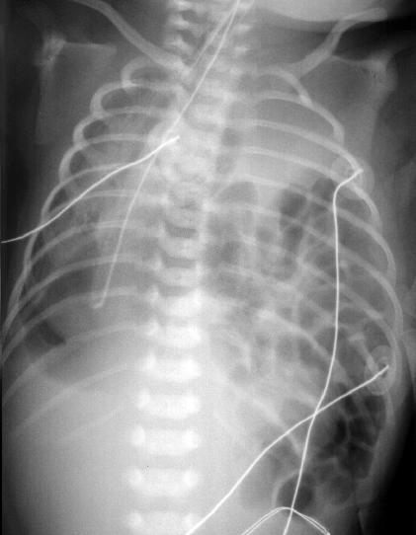
Diaphragmatic Hernia:
# Diagnosed early usually on
prenatal ultrasound
20% associated with other
anomalies (Cardiac) Unilateral with 80% occurring
on the left side Associated with
pulmonary hypoplasia & PPHN

Slide 69
CASE:

Slide 72
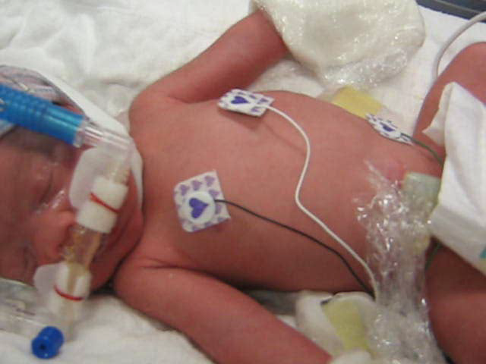

Slide 74

ما زنده به آنیم که آرام نگیریم
موجیم که آسودگی ما عدم ماست
BCTS is not sensitive for detecting changes in the central gray nuclei, which is the most common problem in full- term infants with HIE.
MRI is a very sensitive tool for detecting abnormal signal at the post. Limb of the internal capsule that is very high predictive value for outcome.

