Slide 1
Management of hypertension based on last international guidelines
Fariba Rajabi, MD
Assistant professor of cardiology
Alborz Medical University

Slide 2
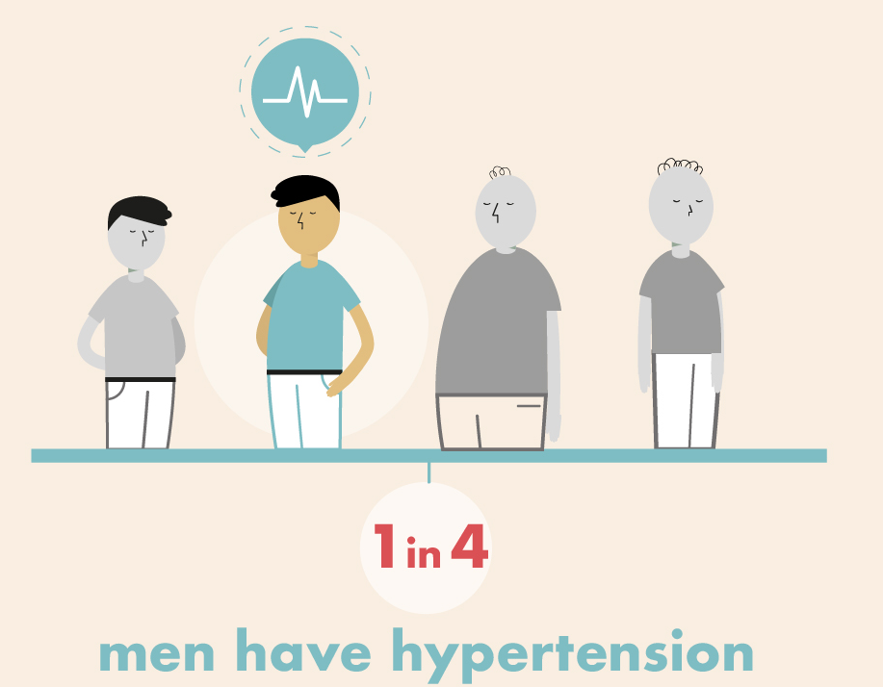
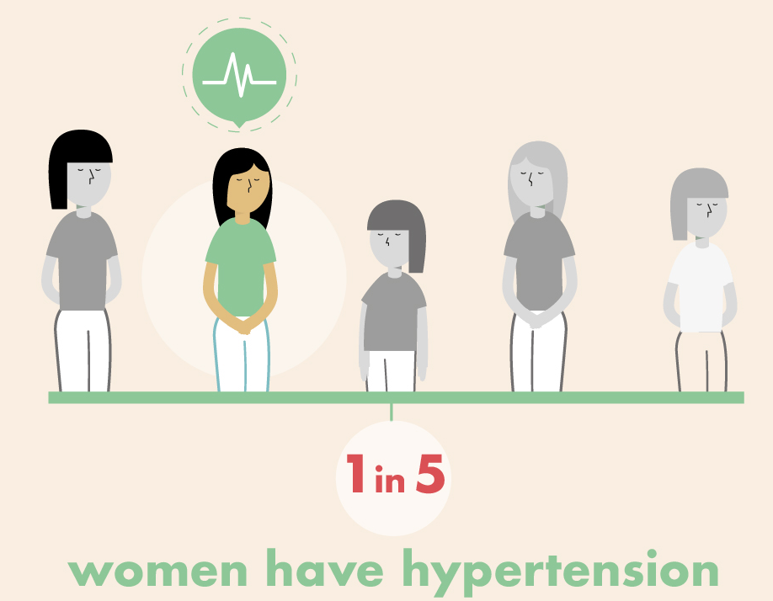
An estimated 1.28 billion adults aged 30-79 years worldwide have hypertension, most (two-thirds) living in low- and middle-income countries
An estimated 46% of adults with hypertension are unaware that they have the condition.
Less than half of adults (42%) with hypertension are diagnosed and treated.
Approximately 1 in 5 adults (21%) with hypertension have it under control.

Slide 3
Checklist for Accurate Measurement of BP
Key Steps for Proper BP Measurements
Step 1: Properly prepare the patient.
Step 2: Use proper technique for BP measurements.
Step 3: Take the proper measurements needed for diagnosis and treatment of elevated BP/hypertension.
Step 4: Properly document accurate BP readings.
Step 5: Average the readings.
Step 6: Provide BP readings to patient.
Hypertension. 2018;71:e13–e115

Slide 4
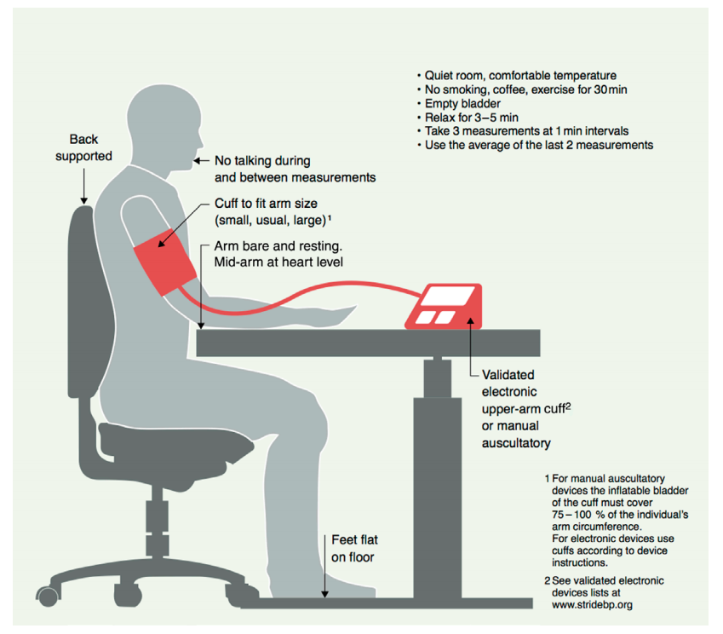
Blood Pressure Measurement
Hypertension. 2020;75:1334–1357

Slide 5
Classification of office blood pressure and definitions of hypertension grade
Category | Systolic (mmHg) |  | Diastolic (mmHg)
Optimal | < 120 | and | < 80
Normal | 120 - 129 | And / or | 80 – 84
High Normal | 130 - 139 | And / or | 85 – 89
Grade 1 hypertension | 140 - 159 | And / or | 90 – 99
Grade 2 hypertension | 160 - 179 | And / or | 100 – 109
Grade 3 hypertension | ≥ 180 | And / or | ≥ 110
J Hypertens 2018;36:1953-2041
Notes:
p

Slide 6
Routine work-up for evaluation of hypertensive patients
Routine laboratory tests
Haemoglobin and/or haematocrit
Fasting blood glucose and glycated HbA_{1c}
Blood lipids: total cholesterol, LDL cholesterol, HDL cholesterol
Blood triglycerides
Blood potassium and sodium
Blood uric acid
Blood creatinine and eGFR
Blood liver function tests
Urine analysis: microscopic examination; urinary protein by dipstick test or, ideally, albumin:creatinine ratio
12-lead ECG
J Hypertens 2018;36:1953-2041

Slide 7
Hypertension and total cardiovascular risk assessment
Hypertension rarely occurs in isolation, and often clusters with other cardiovascular risk factors such as dyslipidemia and glucose intolerance.
Quantification of total cardiovascular risk is an important part of the risk stratification process for patients with hypertension.
This metabolic risk factor clustering has a multiplicative effect on cardiovascular risk
Notes:
a

Slide 8
Factors influencing CV risk in patients with hypertension
Demographic characteristics and laboratory parameters
Sex (men > women)
Age
Smoking – current or past history
Total cholesterol and HDL-C
Uric acid
Diabetes
Overweight or obesity
Family history of premature CVD (men aged < 55 years and women aged < 65 years)
Family or parental history of early onset hypertension
Early onset menopause
Sedentary lifestyle
Psychosocial and socioeconomic factors
Heart rate (resting values > 80 beats per min)
J Hypertens 2018;36:1953-2041

Slide 9
Hypertension and total cardiovascular risk assessment
Very high risk | Documented CVD, DM with target organ damage, Severe CKD (eGFR < 30 mL/min/1.73 m2) A calculated 10-year SCORE of ≥ 10%
High risk | Marked elevation of a single risk factor e.g. FH or grade 3 hypertension Most other people with diabetes mellitus Hypertensive LVH Moderate CKD (eGFR 30-59 mL/min/1.73 m2) A calculated 10-year SCORE of 5-10%
Moderate risk | A calculated 10-year SCORE of 1% to < 5% Grade 2 hypertension Many middle-aged people belong to this category
Low risk | A calculated 10-year SCORE of < 1%
J Hypertens 2018;36:1953-2041
Notes:
a

Slide 10
Hypertension and CV risk assessment
Recommendation | Class | Level
CV risk assessment with the SCORE system is recommended for hypertensive patients who are not already at high or very high risk due to established CVD, renal disease or diabetes, a markedly elevated single risk factor (e.g. cholesterol), or hypertensive LVH. | I | B
J Hypertens 2018;36:1953-2041

Slide 11
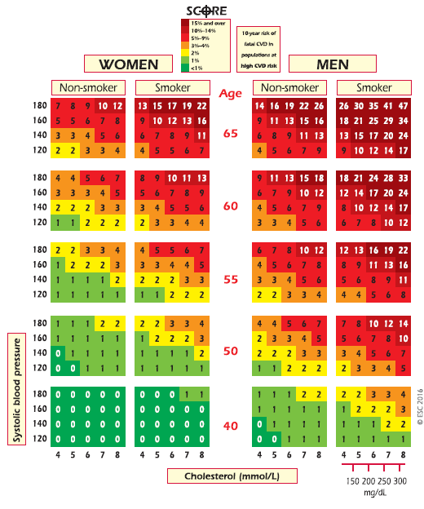
60 y/o
BP = 135/85
male
Smoker
TC = 255
Notes:
p

Slide 12
Screening and diagnosis of hypertension
Optimal BP
< 120 / 80
Repeat BP at least every 5 years
J Hypertens 2018;36:1953-2041

Slide 13
Screening and diagnosis of hypertension
Normal BP
120-129 / 80-84
Repeat BP at least every 3 years
J Hypertens 2018;36:1953-2041

Slide 14
Screening and diagnosis of hypertension
26
High-normal BP
130-139 / 85-89
Consider masked hypertension
Out-of-office BP measurement (ABPM or HBPM)
Repeat BP at least annually
J Hypertens 2018;36:1953-2041

Slide 15
Screening and diagnosis of hypertension
27
Hypertension
≥ 140 / 90
Use either to confirm diagnosis
Repeated visits for office BP measurement
Out-of-office BP measurement (ABPM or HBPM)
J Hypertens 2018;36:1953-2041

Slide 16
Wider use of out-of-office BP measurement with ABPM and/or HBPM, especially HBPM, as an option to confirm the diagnosis of hypertension, detect white-coat and masked hypertension, and monitor BP control
Better prediction of cardiovascular morbidity and mortality than office BP
Night-time BP is a stronger predictor of outcomes than daytime BP

Slide 17
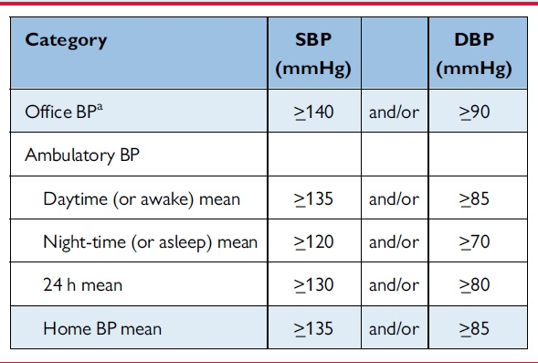
Definitions of hypertension according to office, ambulatory, and home blood pressure levels

Slide 18
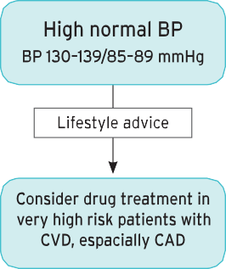
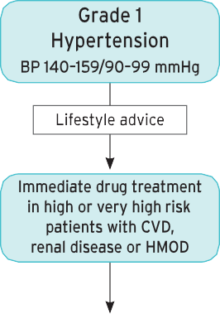
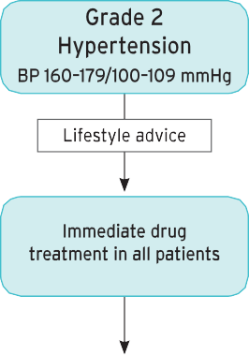
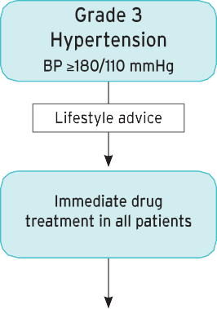
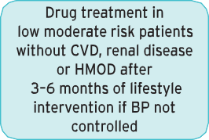
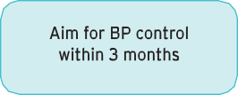

Initiation of blood pressure-lowering drug treatment
J Hypertens 2018;36:1953-2041
Notes:
p

Slide 19
Choice of Initial Medication
COR | LOE | Recommendation for Choice of Initial Medication
I | A^{SR} | For initiation of antihypertensive drug therapy, first-line agents include thiazide diuretics, CCBs, and ACE inhibitors or ARBs.
Ideal Characteristics of Drug Treatment
Treatments should be evidence-based in relation to morbidity/mortality prevention. | 1
Use a once-daily regimen which provides 24-hour blood pressure control. | 2
Treatment should be affordable and/or cost-effective relative to other agents. | 3
Treatments should be well-tolerated. | 4
Evidence of benefits of use of the medication in populations to which it is to be applied. | 5
Hypertension. 2020;75:1334-1357

Slide 20
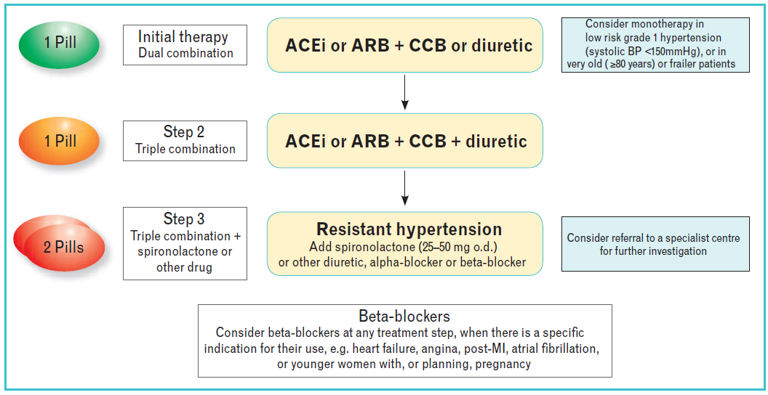
Core drug treatment strategy for uncomplicated hypertension
J Hypertens 2018;36:1953-2041
Notes:
p

Slide 21
Advantages of Combination Drug Therapy
Most patients with hypertension require multiple agents for control of their blood pressure. Many patients started on a single agent will subsequently require ≥2 drugs from different pharmacological classes to reach their BP goals.
Patients with higher blood pressures are at greater risk and more rapid titration of antihypertensive medications began to be recommended in patients with BP >20/10 mm Hg above their target.
Use of combination therapy may also improve adherence.
Hypertension. 2018;71:e13–e115

Slide 22
Advantages of Combination Drug Therapy
Combination therapy is the suggested way to increase treatment efficacy while combined agents also may minimize the adverse effects of each individual agent.
  Thiazide diuretics may stimulate the RAAS. By adding an ACEi or ARB to the thiazide, an additive BP-lowering effect may be obtained.
  Studies show treatment with amlodipine/valsartan 5/160 mg induced significantly less peripheral edema than amlodipine 10 mg for similar BP reduction.
Hypertension. 2018;71:e13–e115

Slide 23
General Principles of Drug Therapy
COR | LOE | Recommendation for General Principle of Drug Therapy
III: Harm | A | Simultaneous use of an ACE inhibitor, ARB, and/or renin inhibitor is potentially harmful and is not recommended to treat adults with hypertension.
Hypertension. 2018;71:e13–e115

Slide 24
Anti-hypertensive Agents in Patients with Other Complications
Consider ACEi/ARB + Thiazide in:
post-stroke
very elderly
incipient HF
CCB intolerance
Hypertension. 2018;71:e13–e115

Slide 25
Management of Hypertension for Secondary Stroke Prevention
COR | LOE | Recommendations for Treatment of Hypertension for Secondary Stroke Prevention
I | A | For adults who experience a stroke or TIA, treatment with a thiazide diuretic, ACE inhibitor, or ARB, or combination treatment consisting of a thiazide diuretic plus ACE inhibitor, is useful.
Hypertension. 2018;71:e13–e115

Slide 26
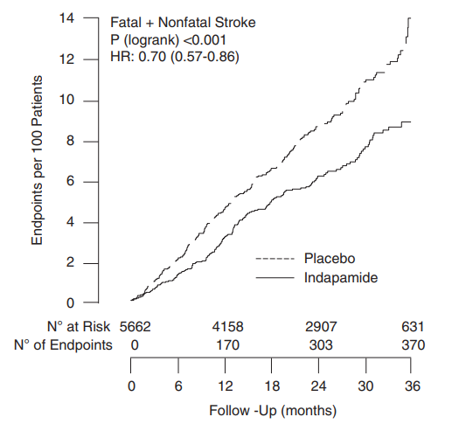
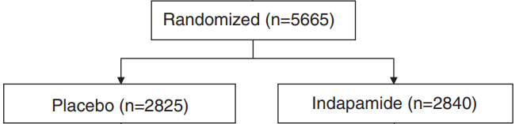
Post-stroke Antihypertensive Treatment Study (PATS)
BP lowering by indapamide treatment reduced the recurrence of stroke and the incidence of cardiovascular events in patients with cerebrovascular disease.
Hypertension Research (2009) 32, 1032–1040

Slide 27
Post-stroke Antihypertensive Treatment Study (PATS)
Post-stroke Antihypertensive Treatment Study (PATS) was a randomized, double-blind and placebo-controlled trial, which aimed at determining whether antihypertensive treatment could reduce the risk of fatal and nonfatal stroke incidence in patients with a history of stroke or transient ischemic attack (TIA)
The findings of this trial indicate that in patients with a history of stroke or TIA, blood pressure reduction of 5/2 mmHg with 2.5 mg indapamide reduced the first incidence of fatal and nonfatal stroke by 29%, with three-year absolute benefit of 29 events per 1000 participants

Slide 28
Management of Hypertension in Patients With Atrial Fibrillation
COR | LOE | Recommendation for Treatment of Hypertension in Patients With AF
IIa | B-R | Treatment of hypertension with an ARB can be useful for prevention of recurrence of AF.
Hypertension. 2018;71:e13–e115

Slide 29
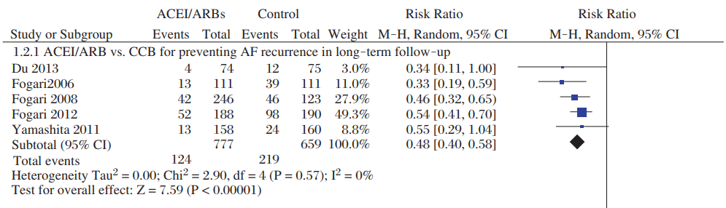
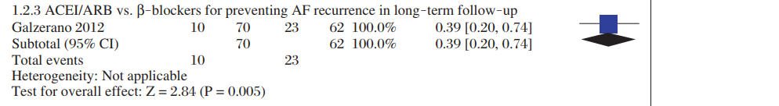
ACEi\ARB vs β-blocker and CCB on preventing AF recurrent in long-term follow-up
J Biomed Res. 2015;29:475–85.

Slide 30
Management of Hypertension in Patients With SIHD
Hypertension. 2018;71:e13–e115

Slide 31
Management of Hypertension in Patients With Heart Failure
COR | LOE | Recommendations for Treatment of Hypertension in Patients With HF
III: No Benefit | B-R | Nondihydropyridine CCBs are not recommended in the treatment of hypertension in adults with HFrEF.
I | C-EO | In adults with HFpEF who present with symptoms of volume overload, diuretics should be prescribed to control hypertension.
I | C-LD | Adults with HFpEF and persistent hypertension after management of volume overload should be prescribed ACEi or ARBs and beta blockers titrated to attain SBP of less than 130 mm Hg.
Hypertension. 2018;71:e13–e115

Slide 32
Management of Hypertension in Patients With CKD
Hypertension. 2018;71:e13–e115

Slide 33
Management of Hypertension in Patients With Diabetes Mellitus
COR | LOE | Recommendations for Treatment of Hypertension in Patients With DM
I | A^{SR} | In adults with DM and hypertension, all first-line classes of antihypertensive agents (i.e., diuretics, ACE inhibitors, ARBs, and CCBs) are useful and effective.
IIb | B-NR | In adults with DM and hypertension, ACE inhibitors or ARBs may be considered in the presence of albuminuria.
Hypertension. 2018;71:e13–e115

Slide 34
Pregnancy
COR | LOE | Recommendations for Treatment of Hypertension in Pregnancy
I | C-LD | Women with hypertension who become pregnant, or are planning to become pregnant, should be transitioned to methyldopa, nifedipine, and/or labetalol during pregnancy.
III: Harm | C-LD | Women with hypertension who become pregnant should not be treated with ACE inhibitors, ARBs, or direct renin inhibitors.
Hypertension. 2018;71:e13–e115

Slide 35
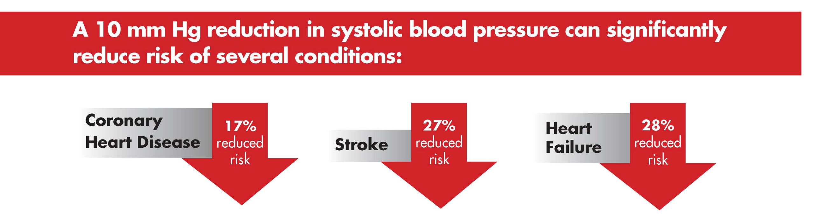

Slide 36


Prevalence of Hypertension in the U.S.
84%
63%
31.5%
Awareness
Treated
Controlled
JAMA November 6, 2018

Slide 37
Prevalence of Hypertension in Iran
50%
40%
16%
Awareness
Treated
Controlled
BMC Cardiovasc Disord 2010; 10: 61

Slide 38
Therapeutic non-adherence is a major contributor to poor control of hypertension and a key barrier to reducing CVD deaths.
Up to 25% of patients do not fill their initial prescription for antihypertensive therapy.
During the first year of treatment, the average patient has possession of antihypertensive medications only 50% of the time, and only 1 in 5 patients has sufficiently high adherence to achieve the benefits observed in clinical trials.
Taking medications several times throughout the day requires greater attention to scheduling, as well as additional issues such as transportation or storage, which can be challenging for some patients.
Simplifying medication regimens, either by less frequent dosing or use of combination drug therapy, improves adherence.

Slide 39
Antihypertensive Medication Adherence Strategies
COR | LOE | Recommendations for Antihypertensive Medication Adherence Strategies
I | B-R | In adults with hypertension, dosing of antihypertensive medication once daily rather than multiple times daily is beneficial to improve adherence.
IIa | B-NR | Use of combination pills rather than free individual components can be useful to improve adherence to antihypertensive therapy.
Hypertension. 2018;71:e13–e115

Slide 40
A Randomized Trial of Intensive versus Standard Blood-Pressure Control List of authors.
The SPRINT Research
Among patients at high risk for cardiovascular events but without diabetes, targeting a systolic blood pressure of less than 120 mm Hg, as compared with less than 140 mm Hg, resulted in lower rates of fatal and nonfatal major cardiovascular events and death from any cause, although significantly higher rates of some adverse events were observed in the intensive-treatment group

