Slide 1
Regional Anesthesia: drug and equipment
Anesthesia miller 2020
Dr.H-Kayalha
Anesthesiologist-pain fellowship

Slide 2
Introduction
Peripheral nerve blocks can be performed using a variety of guidance techniques.
Recently, ultrasound has gained popularity for regional anesthesia because it allows direct imaging of peripheral nerves, the block needle, and injection distribution.

Slide 3
Techniques for Localizing Neural Structures
PARESTHESIA TECHNIQUES
The paresthesia-seeking technique has a long, successful history as a simple method that requires little specialized equipment.
A paresthesia is elicited when a needle makes direct contact with a nerve.

Slide 4
Paresthesia-seeking techniques are reliant on patient cooperation and participation to guide the needle and local anesthetic injection accurately; therefore only small doses of sedation medication are recommended.

Slide 5
Paresthesia techniques have been criticized for causing patient discomfort, although clinical studies have not shown a significant increase in neurologic complications with this technique.
Caution should be used when initiating the injection of local anesthetic to ensure that the needle is not intraneural.

Slide 6
There is controversy in the literature regarding the use of B-bevel (blunt bevel or short bevel) needles versus sharp needles regarding the incidence and severity of nerve injury if the needle inadvertently punctures or pierces the nerve.

Slide 7
Because B-bevel needles have a blunt tip, which is likely to push the nerve aside, they are much less likely to penetrate the nerve; however, when an injury does occur, it appears to be more severe.
In contrast, sharp needles are more likely to penetrate the nerve, but the injury appears to be less destructive.

Slide 8
Success with the paresthesia technique is highly dependent on the skill of the practitioner and requires a thorough understanding of anatomy.
Currently, no single technique has been shown to be superior with respect to incidence of neurologic complications.

Slide 9
PERIPHERAL NERVE STIMULATION
Peripheral nerve stimulators deliver small pulses of electric current to the end of a block needle to cause depolarization and muscle contraction when the tip of the needle is in close proximity to a neural structure.

Slide 10
This technique allows for localization of a specific peripheral nerve without requiring the elicitation of a paresthesia, thus allowing patients to be more sedated during block placement.
It is necessary to attach the cathode (negative terminal) to the stimulating needle and the anode (positive terminal) to the surface of the patient because cathodal stimulation is more efficient than anodal stimulation.

Slide 11
Most current-stimulating needles are coated with a thin layer of electrical insulation along the needle shaft with the exception of the tip.
This allows for higher current density at the tip of the needle.

Slide 12
Higher current output (>1.5 mA) is more likely to stimulate neural structures through tissue or fascial planes and can be associated with painful, vigorous muscle contractions.
After localization of the correct motor response, the current is gradually decreased to a current of 0.5 mA or less.

Slide 13
A motor response at a current of approximately 0.5 mA is appropriate when used to facilitate the location for injection of local anesthetic or catheter placement.
Immediately following injection of local anesthetic or saline (ionic solutions), the current density at the needle tip will rapidly dissipate and the evoked motor response is eliminated (the Raj test).

Slide 14
The stimulating current pulse can be modified to produce a sensory response.
The short-duration impulse commonly used (0.1 ms) is effective in stimulating motor fibers,
but a longer-duration pulse (0.3 ms) will also stimulate sensory fibers, a useful feature if a pure sensory nerve is being sought.

Slide 15
Ultrasound Guidance
Ultrasound imaging allows direct visualization of peripheral nerves, the block needle tip, and local anesthetic distribution.
This imaging modality has proven highly useful for guiding targeted drug injections and catheter placement.

Slide 16
FUNDAMENTAL ASSUMPTIONS AND ARTIFACTS
Ultrasound is sound with a frequency above the audible range (>20,000 cycles per second).
The frequencies used in clinical imaging are within the range of 1 to 20 aMHz.
High-frequency ultrasound beams are well collimated and therefore can provide high resolution.

Slide 17
For most regional blocks, the highest frequency is selected that adequately penetrates the depth of field.
Sound waves reflected at the interface of two tissues with different acoustic impedances generate echoes.
Ambient lighting has a large effect on visual discrimination; therefore dim lighting without glare is especially useful for imaging low-contrast targets such as peripheral nerves.

Slide 18
Ultrasound imaging is predicated on several common assumptions.
First, the speed of sound through soft tissue is 1540 m/s, meaning 13 μs elapse for each centimeter of soft tissue traversed back and forth for the total fly-back time of received echoes.
This assumption allows interconversion of time and distance for echo ranging.

Slide 19
Local heterogeneities in soft tissue can cause artifactual bending of the block needle on ultrasound scans, known as the bayonet artifact

Slide 20
Bayonet artifacts are commonly observed during the lateral in-plane approach to popliteal block because more adipose tissue is present over the nerves near the posterior midline of the leg (adipose tissue has a slower speed of sound than the adjacent muscle).

Slide 21
Second, ultrasound waves are assumed to take a straight path to and from tissue. When this does not occur, reverberation artifacts are displayed deep to the reflector.
Reverberation artifacts are commonly observed from the block needle shaft at shallow angles of insertion because sound waves bounce back and forth between the walls of the needle before returning to the transducer .

Slide 22
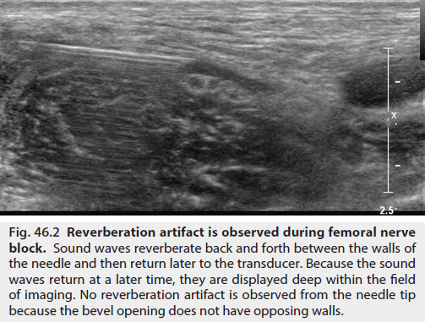

Slide 23
Comet tail artifact is another type of reverberation artifact and helps identify strong reflectors such as the pleura during supraclavicular and intercostal blocks.
At low receiver gain, the comet tail is seen as a tapering series of discrete echo bands just deep to a strongly reflecting structure.

Slide 24
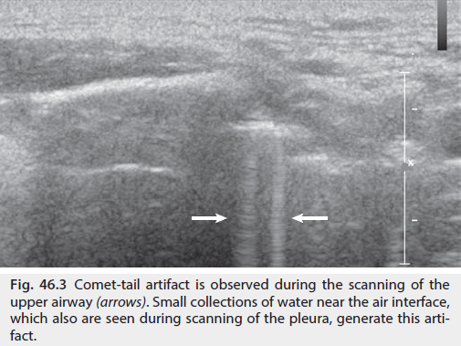

Slide 25
Unlike adjacent soft tissue, most biologic fluids do not significantly attenuate the sound beam and therefore cause acoustic enhancement (sometimes referred to as posterior acoustic enhancement or increased through-transmission).
Acoustic enhancement artifacts deep to blood vessels can be erroneously interpreted as peripheral nerves .

Slide 26
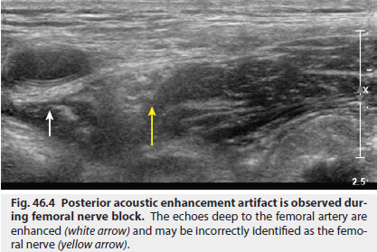

Slide 27
For example, acoustic enhancement deep to the second part of the axillary artery in the axilla can be mistaken for the radial nerve.
In the infraclavicular region, acoustic enhancement deep to the axillary artery can be mistaken for the posterior cord of the brachial plexus (and similarly, for the femoral artery and the femoral nerve in the inguinal region).

Slide 28
Refractive edge shadows can be seen from the carotid artery during stellate ganglion block or from the second part of the axillary artery during infraclavicular block.
Refraction artifacts (e.g., refractile shadowing) are less apparent when spatial compound imaging is used to reduce angle-dependent artifacts.

Slide 29
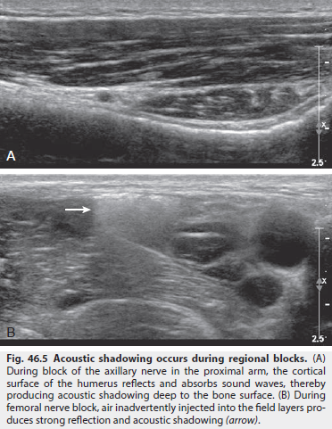

Slide 30
Transducer Selection, Manipulation, and Modes of Imaging
Ultrasound transducers consist of piezoelectric crystals that emit and receive high-frequency sound waves by interconverting electrical and mechanical energy.
Transducer selection is important to the success of ultrasound-guided regional anesthesia procedures.
High-frequency sound waves provide the best resolution but will not penetrate far into tissue.

Slide 31
The frequency range is therefore chosen to be the highest that will allow adequate insonation of the entire depth of field.
A low-frequency transducer can be used to image large nerves that lie deep, such as the cords of the brachial plexus that surround the second part of the axillary artery or the proximal sciatic nerve in the gluteal region.

Slide 32
The footprint size (i.e., the length of the active face transducer that contacts the skin) is chosen to provide a broad enough view of the structures of interest.
As a general rule, the footprint should be at least as large as the anticipated depth of field.
As a rule of thumb, for in-plane technique, every millimeter of the footprint is approximately a millimeter of guidance.

Slide 33
Linear-array transducers generally have a higher scan-line density than curved arrays and therefore produce the best image quality.
Images from linear arrays are usually displayed in a rectangular format.
When a linear transducer is needed but space at the site of block is limited by anatomic structures such as adjacent bone, a compact linear (hockey stick) transducer that has a smaller footprint can be very useful.

Slide 34
Curved arrays provide a broad field of view for a given footprint size and are generally used when space is limited (e.g., infraclavicular region).
Curved probes are easier to rock (see Infraclavicular Blocks) and produce images in sector format.

Slide 35
External surface probes require disinfection between every use and after extended periods of nonuse, per instructions of the manufacturer.
Do NOT drop any ultrasound transducer, because the active face of the transducer is especially sensitive to contact with hard surfaces.

Slide 36
One of the essential skills to acquire for regional block with ultrasound is transducer manipulation .
For this reason, standardized nomenclature has been established:

Slide 37
□ Sliding (moving contact) the transducer along the known course of the nerve using a short-axis view often helps.
□ Tilting (cross-plane, side-to-side) will vary the echo brightness of peripheral nerves. Optimizing this angle is critical to promote nerve visibility.

Slide 38
□ Compression is often used to confirm venous structures.
To improve imaging, compression not only provides better contact, but it also brings the structures closer to the surface of the transducer.
Soft tissue is subject to compression; therefore estimates of tissue distances will vary.

Slide 39
□ Rocking (in-plane, toward, or away from the indicator) is often necessary to improve visibility of the needle and anatomic structures when the working room is limited.
□ Rotation of the probe will produce true short-axis views rather than oblique or long-axis views.

Slide 40
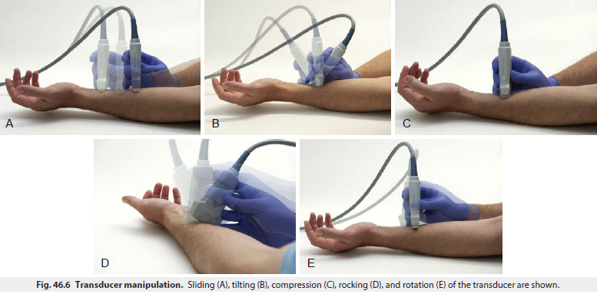

Slide 41
Anisotropy is the change in echogenicity with inclination of the transducer. In general, when objects are obliquely imaged, they appear less echogenic.
This relationship is most pronounced for tendons but also occurs for muscle and nerves.
Although the term anisotropy was first used to describe changes in received echoes when rocking the transducer with structures viewed in long axis, it has also been used for short-axis views when tilting the transducer.

Slide 42
With experience, operators learn to rock and tilt the transducer naturally to fill in the received echoes from peripheral nerves.
Sliding and rotating the transducer achieves needle tip localization after optimizing peripheral nerve echoes by tilting.

Slide 43
A Doppler shift occurs when a wave source and receiver are moving relative to each other, which produces a change in frequency such that the frequencies of the transmitted and reflected sound waves are not the same.

Slide 44
When a wave source and receiver are moving toward each other, the observed frequency is greater than the source frequency; and when moving away from each other, the observed frequency is lower.
The change in frequency is related to the velocity of moving reflectors and the angle of insonation.
In clinical medicine, red blood cells are the primary reflectors that produce Doppler shifts.

Slide 45
Doppler ultrasound imaging has different modes .
Traditional color Doppler encodes mean frequency shifts to provide directional velocity information; that is, conventional
blue color indicates flow away from the transducer, whereas
red color indicates flow toward the transducer.

Slide 46
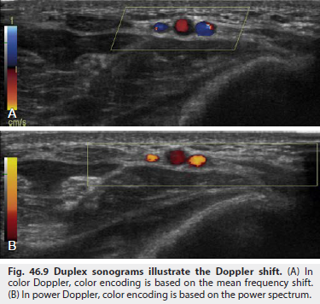

Slide 47
Power Doppler can detect these small arteries and better delineate the course of tortuous vessels that have unfavorable angles to the ultrasound beam.

Slide 48
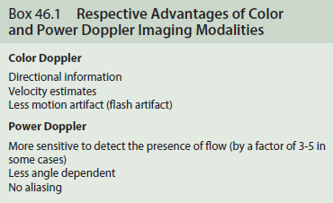

Slide 49
Needle Tip Visibility
A large number of factors influence needle tip visibility in clinical practice.
Metal needles are hyperechoic and can cause reverberation artifact.
Needle tip visibility is best when the needle path is parallel to the active face of the transducer.

Slide 50
Under this condition, the needle is perpendicular to the sound beam; therefore strong specular reflections will be produced; that is, mirror-like reflections will be produced from a smooth surface.
As the angle of incidence is increased, the mean brightness will decrease.
the bevel angles were ground from 10 to 70 degrees but were found to have no effect on the needle tip echo.

Slide 51
However, bevel orientation does influence the needle tip echo; visibility is best with the bevel either directly facing or averting the transducer.
Because needle diameters are smaller than the scan plane thickness, larger needles are more echogenic than finer ones.

Slide 52
Visualization of needles in echogenic tissue is difficult, particularly in bright adipose tissue.
A low-receiver gain can improve the detection of the needle tip echo.
Spatial compound imaging can help identify the needle tip when the needle path is at an angle with respect to the transducer.

Slide 53
Rocking back the transducer can improve the angle between the ultrasound beam and needle during in-plane technique .
Most practitioners orient the needle so that the needle bevel faces the transducer.

Slide 54
Among needles originally developed for use in regional anesthesia, Hustead bevels tended to be more visible than side port needles that lack cutting bevels.
One engineering strategy has been to texture the needle surface so that echoes return to the transducer source, regardless of the angle of insonation.

Slide 55
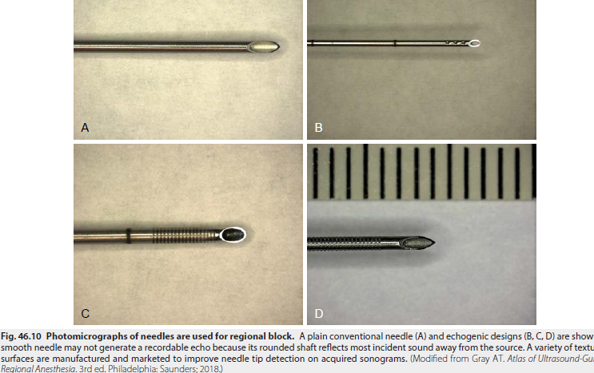

Slide 56
One potential limitation of these needle designs is the finite size of the needle texturing.
Low-frequency transducers produce longer wavelengths that may be too large to reflect strongly back from the textured surface of the needle.

Slide 57
PERIPHERAL AND TRUNCAL NERVE BLOCKADE
Regional anesthetic procedures that inhibit conduction in fibers of the peripheral nervous system can be classified together under the general category of peripheral nerve blockade.
This form of regional anesthesia has been arbitrarily subdivided into minor and major nerve blocks.

Slide 58
Minor nerve blocks are defined as procedures involving single nerve entities such as the ulnar or radial nerve,
whereas major nerve blocks involve the blockade of:
-two or more distinct nerves or
-a nerve plexus or
-the blockade of very large nerves at more proximal sites (i.e., the femoral and sciatic nerves).

Slide 59
Most local anesthetic drugs can be used for minor nerve blocks.
The onset of blockade is rapid with most drugs, and the choice of drug is determined primarily by the required duration of anesthesia.

Slide 60
It has become possible to define the minimum local anesthetic volume for ultrasound-guided peripheral nerve blockade and across several nerves; the volume was approximately 0.1 mL per mm2 of nerve cross-sectional area.
However, as mentioned earlier, minimal volume to achieve sensory blockade 30 minutes after block may also mean decreased duration of the block as compared to “traditional” high volumes clinicians were accustomed to using during stimulator-guided regional anesthesia.

Slide 61
Brachial plexus blockade for upper limb surgery is the most common major peripheral nerve block technique,
but many lower extremity procedures are now carried out under peripheral nerve blocks for anesthesia or postoperative analgesia.

Slide 62
A significant difference exists between the onset times of various agents when these blocks are used.
In general, agents of intermediate potency exhibit a more rapid onset than the more potent compounds do.

Slide 63
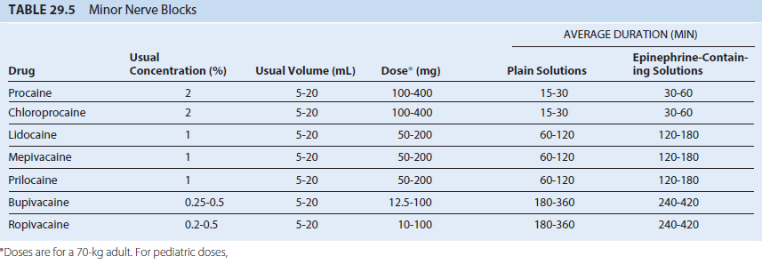

Slide 64
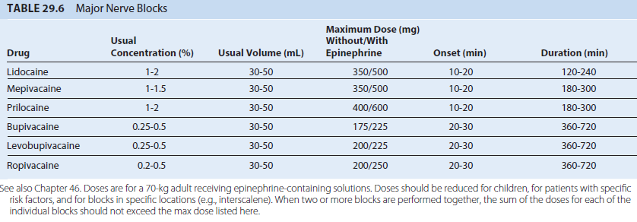

Slide 65
Addition of Additives
Epinephrine
Vasoconstrictors, usually epinephrine, are frequently included in local anesthetic solutions to decrease the rate of vascular absorption, thereby allowing more anesthetic molecules to reach the nerve membrane and thus improve the depth and duration of anesthesia.

Slide 66
Clinically used solutions typically contain 5 μg/mL or 1:200,000 of epinephrine, reflecting a balance between efficacy and vasoconstriction versus systemic side effects of epinephrine.

Slide 67
Epinephrine will significantly extend the duration of both infiltration anesthesia and peripheral nerve blockade with shorter-duration agents (e.g., lidocaine); epinephrine produces mild intensification of blockade but only most modest prolongation of epidural or peripheral blocks with bupivacaine.
Activation of α2- adrenergic receptors in the spinal cord may contribute to the beneficial effect of epidural epinephrine.

Slide 68
Clonidine and Dexmedetomidine.
mechanisms of action include actions on α-2 receptors and on hyperpolarization-induced currents.
adverse systemic events are of concern, including hypotension, bradycardia, and sedation, such that limiting the clonidine dose to 0.5 to 1 μg/kg of ideal body weight has been proposed.

Slide 69
Dexmedetomidine is a much more specific α-2 agonist, and prolongs both motor and sensory block by long-acting local anesthetics by approximately 4 hours.

Slide 70
Dexamethasone
The most effective adjuvant for prolonging block duration with minimal side effects currently available is dexamethasone, able to prolong duration of medium-acting local anesthetics by 2 to 3 hours, and the block of long-acting local anesthetics by up to 10 hours on average.

Slide 71
Despite the fact that perineural administration of dexamethasone seems to be more effective than systemic use, many providers use systemic dexamethasone to avoid mixing drugs which were not designed to be administered together, circumvent the problem of off-label perineural use, and profit from the antiemetic effects of systemic dexamethasone.
Doses between 4 and 10 mg have typically been used in adults.

Slide 72

Have a nice day

