Slide 1
Recent advances and current practices and challenges in diagnosis of MPN
Dr. Farzaneh Ashrafi
Hematologist, Oncologist
Isfahan University Of Medical University

Slide 2
Symptomatology in MPNs
Constitutional symptoms (fever, night sweats, and weight loss),
Symptoms related to spleen enlargement (abdominal discomfort or pain and early satiety),
Symptoms related to microvascular disturbances (vertigo, lightheadedness, dizziness, insomnia, sexual dysfunction, numbness, tingling, headaches, and concentration problems), fatigue, cough, bone pain, inactivity, and pruritus.

Slide 3
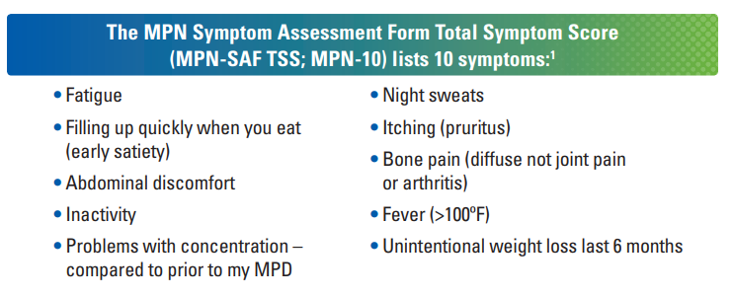

Slide 4
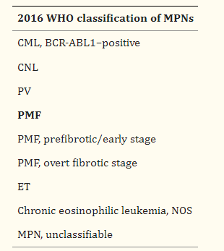
WHO classification for MPNs (2016)

Slide 5
Basic laboratory investigations for MPNs
CBC
Peripheral blood smear
Erythropoietin (EPO) level,
Biochemistry tests (LDH, uric acid, vitamin B12, and iron status)
LDH is a minor criteria in PMF
Serum ferritin and C-reactive protein (CRP) may be useful in establishing a diagnosis

Slide 6
2016 WHO diagnostic criteria for PV
Diagnosis of PV requires meeting either all 3 major criteria, or the first 2 major criteria and the minor criterion
Major criteria
Criterion 1 (clinical)
Hb, or | >16.5 g/dL in men, >16.0 g/dL in women
Hematocrit, or | >49% in men, >48% in women
Red cell mass | Increased 25% above mean normal predicted value
Criterion 2 (morphologic)
BM morphology* | Hypercellularity for age with trilineage growth (panmyelosis), including prominent erythroid, granulocytic, and megakaryocytic proliferation with pleomorphic, mature MKs (differences in size)
Criterion 3 (genetic)
JAK2V617F, or | Presence
JAK2 exon 12 mutation | Presence
Minor criterion
Serum Epo level | Subnormal

Slide 7
Masked PV
JAK2 V617F–positive PV have hemoglobin levels lower than the current WHO criteria (18.5 g/dL [185 g/L] for men and 16.5 g/dL [165 g/L] for women).
Similar clinical evolution course as patients with PV, including an increased risk of thrombosis.
Lower thresholds have been included in the 2016 revision to the WHO diagnostic criteria.

Slide 8
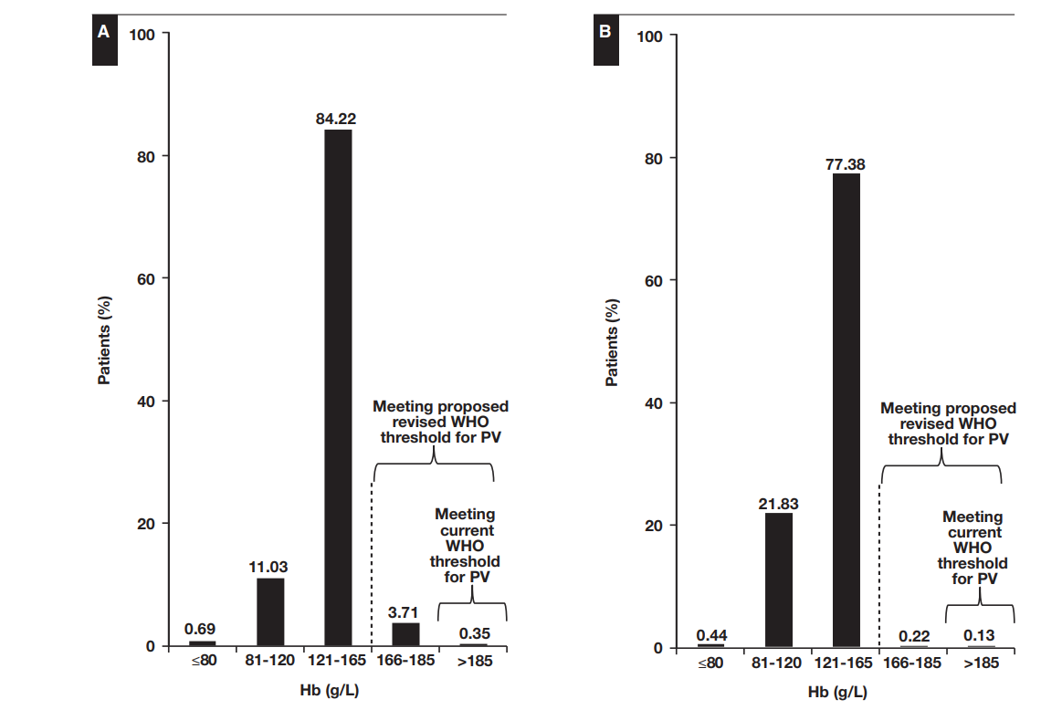
WHO criteria Hb threshold
Am J Clin Pathol 2016;146:408-422

Slide 9
PV diagnosis
The new criteria should not be used as a screening tool for PV
Hemoglobin threshold levels (16.5 g/dL [165 g/L] in men and 16.0 g/dL [160 g/L] in women) should not be taken in isolation but rather in the context of other potential signs and symptoms indicative of PV.
Start with thoroughly excluding reactive conditions in the case of single lineage involvement,
Am J Clin Pathol 2016;146:408-422
Hematology Am Soc Hematol Educ Program (2016) 2016 (1): 534–542.

Slide 10
BMA in PV diagnosis
In patients with clear PV characteristics (increased RBC mass corresponding to the WHO 2008 criteria, low EPO levels, and presence of JAK2 V617F mutation), bone marrow evaluation provides limited additional value
Presence of fibrosis in bone marrow does have some prognostic utility especially in younger patients
A bone marrow evaluation should always be done in patients
who are JAK2 V617F mutation negative or
patients who have hemoglobin values below the 2008 WHO defined threshold
Am J Clin Pathol 2016;146:408-422

Slide 11
Recommendations for Histopathologic Investigations
Megakaryocyte atypia (number, morphology, and distribution) and
The presence of fibrosis (reticulin and collagen stains), as well as
Age-matched bone cellularity,
Iron distribution,
Myeloblast description (blast clusters and percentage of CD34 stain),
Granulopoiesis, and
Erythropoiesis (frequency and distribution)

Slide 12
Detection of JAK2 V617F
it has to be sensitive enough to be able to identify a JAK2 V617F mutant allele burden as low as 1% to 3%.
Quantitative assays may also have diagnostic value since it is rare to have ET with an allele burden of more than 40%.
When reporting results, it is important to indicate the assay sensitivity
DNA extracted from either peripheral blood or bone marrow is acceptable for JAK2 V617F mutation testing, peripheral blood (2-10 mL) is the preferred option

Slide 13
Supplementary Tests for JAK2 V617F–Negative Patients
Mutations in JAK2 Exon 12
Only in PV
BMA sample is more sensitive

Slide 14
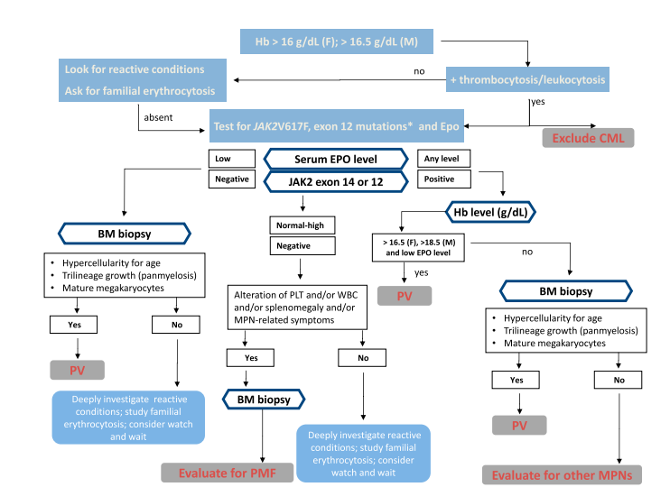
Hematology Am Soc Hematol Educ Program (2016) 2016 (1): 534–542.90

Slide 15
ET diagnosis
A persistent and otherwise unexplained elevation in platelet count (>450 103 /mL [>450 109 /L])
Normal serum ferritin and CRP levels
Am J Clin Pathol 2016;146:408-422
Hematology Am Soc Hematol Educ Program (2016) 2016 (1): 534–542.

Slide 16
2016 WHO diagnostic criteria for ET
Diagnosis of ET requires meeting all 4 major criteria, or the first 3 major criteria and the minor criterion
Major criteria
Criterion 1 (clinical)
Platelet count | >450 × 10⁹/L
Criterion 2 (morphologic)
BM morphology | Proliferation mainly of the MK lineage with increased numbers of enlarged, mature MKs with hyperlobulated nuclei. No significant increase or left-shift in neutrophil granulopoiesis or erythropoiesis, and very rarely minor (grade 1) increase in reticulin fibers
Criterion 3 (clinical)
WHO criteria for BCR-ABL1 + CML, PV, PMF, MDS, or other myeloid neoplasms | Not meeting
Criterion 4 (genetic)
JAK2, CALR, or MPL mutation | Presence
Minor criterion
Clonal marker, or | Presence
Reactive thrombocytosis | Absence
Hematology Am Soc Hematol Educ Program (2016) 2016 (1): 534–542.90

Slide 17
CALR mutations
Among patients with ET or PMF with nonmutated JAK2 V617F or MPL, CALR mutations were detected in 67% of those with ET and 88% of those with PMF.
DNA based and use fragment length analysis.
Can be performed on peripheral blood specimens
Lower risk of thrombosis in ET

Slide 18
MPL mutations
MPL mutations represent the third driver mutation in terms of frequency in MPNs because they have been reported in
3% to 5% of ET
6% to 10% of PMF.

Slide 19
BCR-ABL Assessment
BCR-ABL testing be performed in patients who are JAK2, CALR, and MPL negative (triple negative) or
in those with features suggestive of CML
concomitant BCR-ABL and JAK V617F has been reported in extremely rare instances.

Slide 20
Molecular testing recommendations
• Patients who are JAK2 V612F negative and meet other criteria for ET or PMF should be screened for CALR mutations.
• Patients who are JAK2 V612F negative and meet other diagnostic criteria for PV should be screened for JAK2 exon 12 mutations.
• MPL mutation testing should be reserved for patients who are negative for JAK2 V617F and CALR mutations and in whom bone marrow biopsy and other investigations support a diagnosis of ET or PMF.
BCR-ABL testing be performed in patients who are JAK2, CALR, and MPL negative (triple negative) or in those with features suggestive of CML

Slide 21
Cytogenetic
The value of cytogenetic investigation in PV and ET is limited to
mutation-negative cases or
patients with early signs of transformation.
In patients with MF, cytogenetic abnormalities carry significant prognostic value and are included in the Dynamic International Prognostic Scoring System.

Slide 22
Hemostasis Evaluation
Basic coagulation screening (PT, APTT, fibrinogen level) should be done in all patients.
• Screening for vWD should be done in all patients with
a platelet level greater than 1,000 103 /mL (1,000 109 /L) or
in patients with clinical signs of increased mucocutaneous bleeding

Slide 23
2016 WHO diagnostic criteria for prefibrotic/early PMF
Diagnosis of pre-PMF requires meeting all 3 major criteria, and at least 1 minor criterion
Major criteria
Criterion 1 (morphologic)
BM morphology | Megakaryocytic proliferation and atypia, without reticulin fibrosis > grade 1, accompanied by increased age-adjusted BM cellularity, granulocytic proliferation, and often decreased erythropoiesis
Criterion 2 (clinical)
WHO criteria for BCR-ABL1 + CML, PV, ET, MDS, or other myeloid neoplasms | Not meeting
Criterion 3 (genetic)
JAK2, CALR or MPL mutation, or | Presence
Clonal marker,† or | Presence
Reactive BM reticulin fibrosis‡ | Absence
Minor criteria
Anemia not attributed to a comorbid condition | Presence
Leukocyte count | ≥11 × 10⁹/L
Spleen size | Palpable
Serum LDH | Increased to above upper normal limit of institutional reference range
Hematology Am Soc Hematol Educ Program (2016) 2016 (1): 534–542.90

Slide 24
2016 WHO diagnostic criteria for PMF
Diagnosis of overt PMF requires meeting all 3 major criteria, and at least 1 minor criterion
Major criteria
Criterion 1 (morphologic)
BM morphology | Presence of megakaryocytic proliferation and atypia, accompanied by either reticulin and/or collagen fibrosis grades 2 or 3
Criterion 2 (morphologic)
WHO criteria for ET, PV, BCR-ABL1 + CML, MDS, or other myeloid neoplasms | Not meeting
Criterion 3 (genetic)
JAK2, CALR, or MPL mutation, or | Presence
Clonal marker,† or | Presence
Reactive BM reticulin fibrosis‡ | Absence
Minor criteria
Anemia not attributed to a comorbid condition | Presence
Leukocyte count | ≥11 × 10⁹/L
Spleen size | Palpable
Serum LDH | Increased to above upper normal limit of institutional reference range
Leukoerythroblastosis | Presence
Hematology Am Soc Hematol Educ Program (2016) 2016 (1): 534–542.90

Slide 25
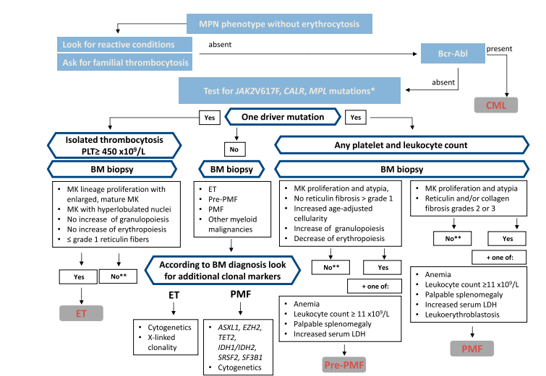
Hematology Am Soc Hematol Educ Program (2016) 2016 (1): 534–542.90

Slide 26
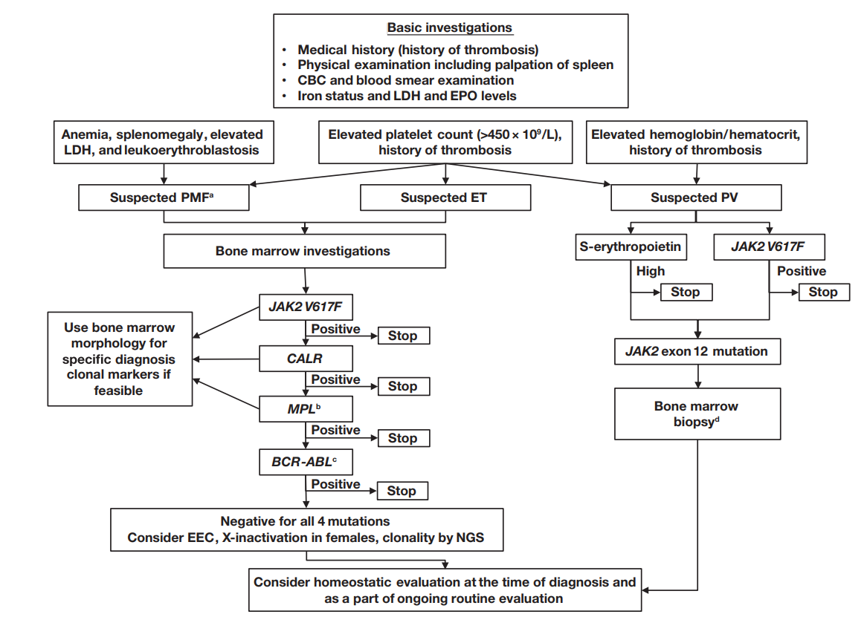
Am J Clin Pathol 2016;146:408-422

Slide 27
Thank you

