Slide 1
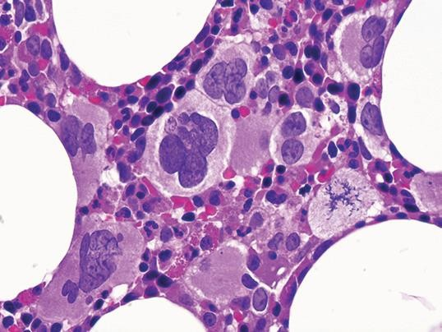
Myeloproliferative Neoplasms Epidemiology, pathology and Pathogenesis
Pardis Nematollahi, MD, Fellowship of Hematopathology
May , 2022

Slide 2
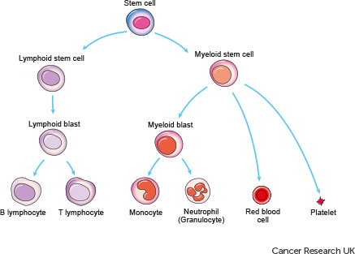
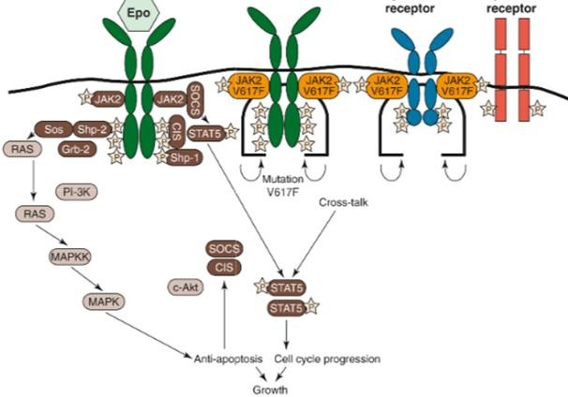
Myeloproliferative Neoplasms
Heterogeneous clonal neoplasms that originate in a pluripotent or multipotent bone marrow stem cell
In most cases, tyrosine kinases (TKs) or related proteins involved in signal transduction pathways that are constitutively activated because of rearrangements or mutations involving the genes that encode them.

Slide 3
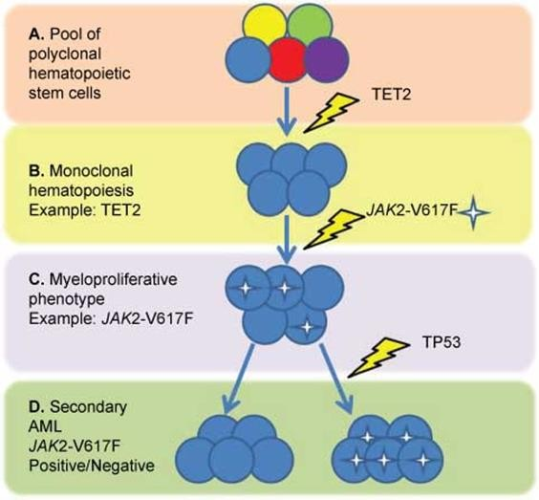
Myeloproliferative Neoplasms
Initially, the proliferation in the bone marrow is effective and associated with maturation of the neoplastic cells that leads to increased numbers of mature granulocytes, red blood cells (RBCs), and platelets in the peripheral blood. Splenomegaly and hepatomegaly are common.
Despite an insidious onset, each MPN entity has the potential to progress to bone marrow failure due to myelofibrosis, ineffective hematopoiesis, transformation to a blast phase, or any combination of these events.
Disease progression is usually accompanied by genetic evolution

Slide 4
World Health Organization Classification of Myeloproliferative Neoplasms, Updated 2016
Chronic myeloid leukemia, BCR-ABL1 positive Chronic neutrophilic leukemia Polycythemia vera Primary myelofibrosis Essential thrombocythemia Chronic eosinophilic leukemia, not otherwise specified* Myeloproliferative neoplasm, unclassifiable From Swerdlow SH, Campo E, Harris NL, et al, eds. WHO Classification of Tumours of Haematopoietic and Lymphoid Tissues. Revised 4th ed. Lyon, France: IARC Press; 2017.

Slide 5
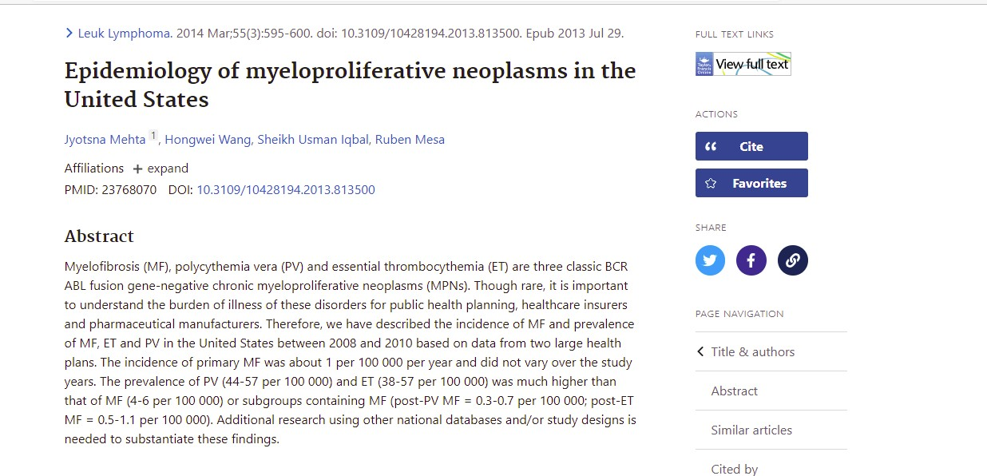
The prevalence of PMF, ET and PV in the US is estimated 13,000, 134,000, and 148,000 The annual incidence of CML, PV and ET are similar at 1-2 per 100,000 person in US. PMF 0.3 per 100,000 person.
https://pubmed.ncbi.nlm.nih.gov/23768070/

Slide 6
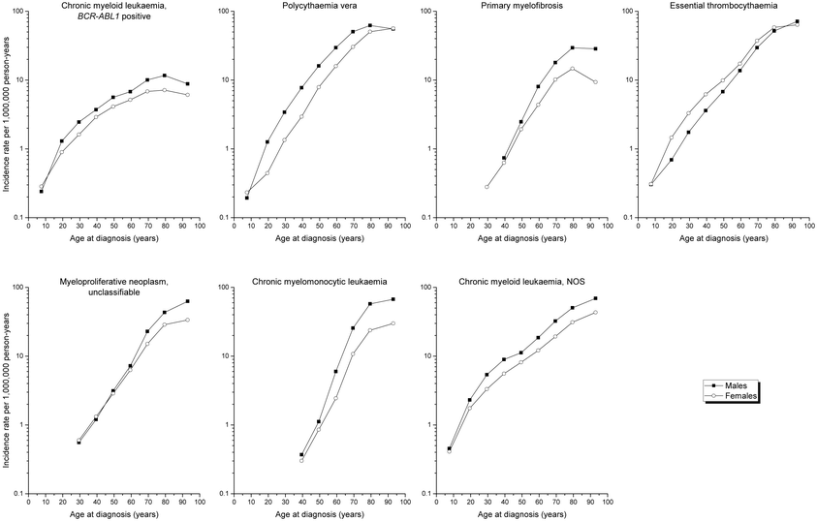
CML an earlier patient age at onset has been reported in areas where socioeconomic status is lower
PMF
prefibrotic stage accounts for 30―50% of all PMF cases
ET second peak in particular women aged about 30 years

Slide 7
CBC and differential
Comprehensive metabolic panel
FISH or multiplex RT-PCR (if available) for BCR-ABL1
PBS
BMA, iron staining, BMB, Reticulin and Trichrome staining
BM or PB cytogenetic (PB if BM is inaspirable)
Molecular testing PB or BM for JAK2 V617 mutation>>CALR, MPL , JAK2 exon12 or molecular tests using multigenes NGS panel that include ↑↑↑↑
Once MPN is confirmed, NGS recommended for mutational prognostication
HLA test if considering allogenic BMT
Serum erythropoietin level
Serum iron study
Coagulation test to evaluate acquired VWD or other coagulopathy
Workup Suspicion of MPN

Slide 8
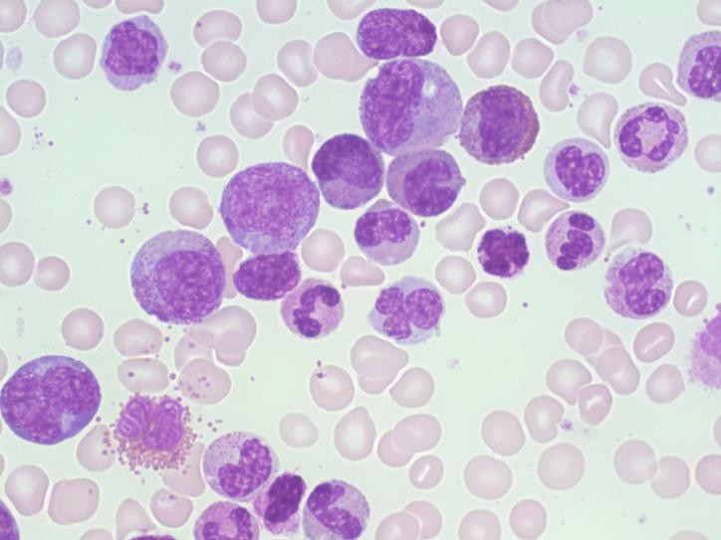
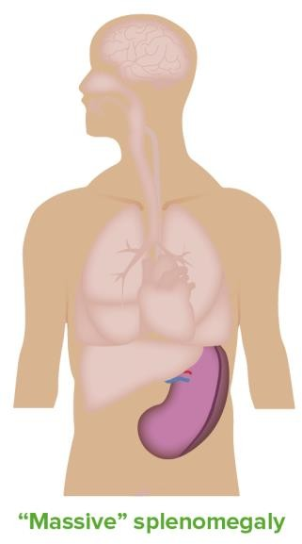
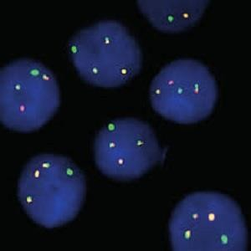
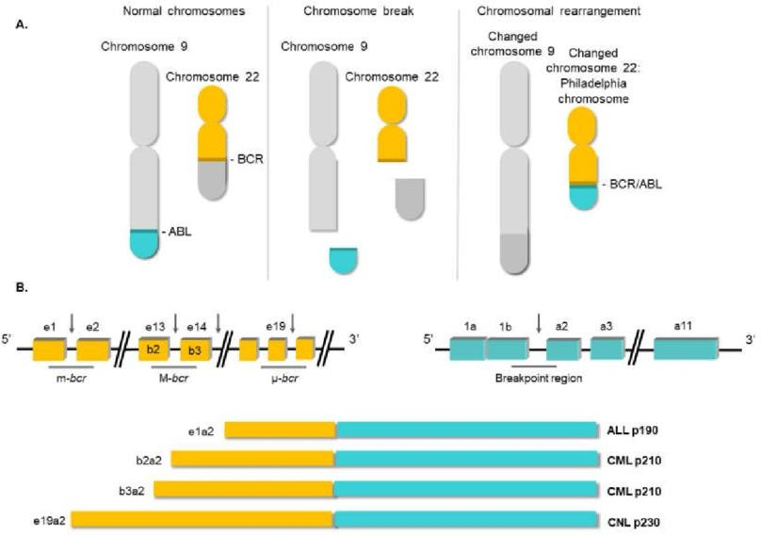
Chronic myeloid leukaemia, BCR-ABL1―positive
Is the prototype of Myeloproliferative Neoplasia
The diagnosis require detection of Ph chromosome- BCR/ABL1 fusion gene in the appropriate clinical and hematological context

Slide 9
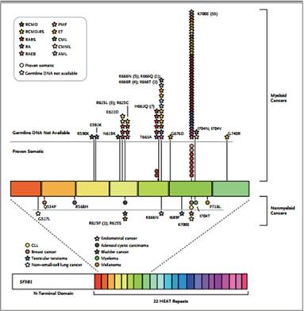
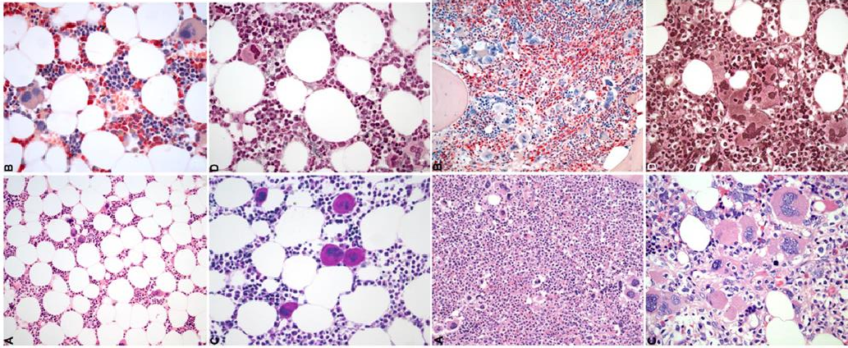
Ph-Negative MPN-Pathogenesis
The diagnosis and management of patients with MPN has evolved since the identification of Driver mutations (JAK2, CALR, and MPL mutations) and development of targeted therapy has resulted in significant improvement in disease related symptoms and quality of life.
Also emphasizing and accentuating marrow cytomorphology and histomorphology- new diagnostic criteria by WHO update for DD of Ph negative MPN

Slide 10
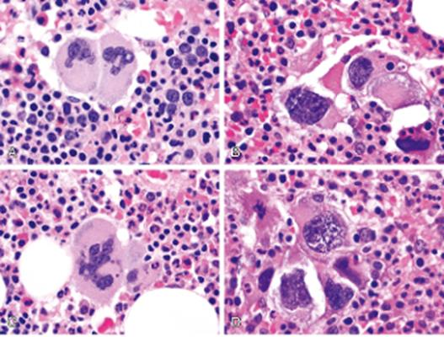
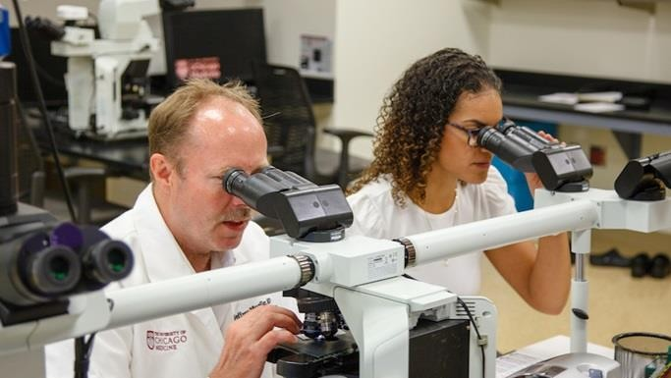
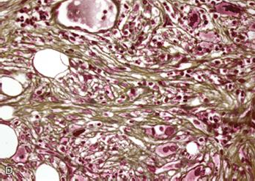
Pathologist has more important role in Dx
In previous schemes, hematologic data or clinical information was more important and histopathology and morphologic features played only a minor role ; but in latest revision specific histopathologic features were included as diagnostic parameters . Therefore, the diagnostic algorithms for MPNs now include clinical, hematologic, genetic, and histologic data to accurately identify and classify the various subtypes.

Slide 11
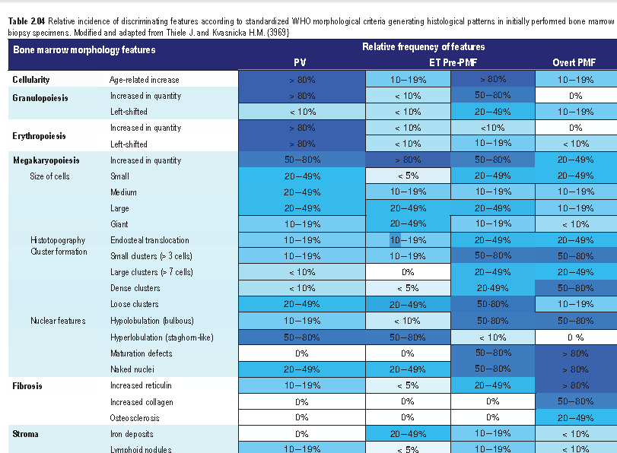

Slide 12
Bone Marrow sampling should be done for initial evaluation and follow up, and differential diagnosis
Histology of the bone marrow is the “gold standard” for reaching the correct diagnosis in the Ph
negative MPNs.
In the other word, pathologist can not reliably diagnose MPN and discriminate between different types of MPN and from other panmyelosis in trephine alone or without Bx.
What should we concentrate on?

Slide 13
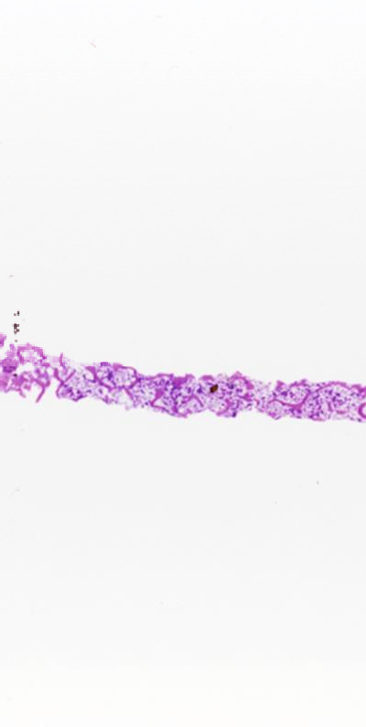
1- Adequacy of specimen, decalcification and fixation
1.5 cm long biopsy, 10 inter trabecular regions
Adequate fixation in proper
time and fixative
– Formalin, B5, B plus
Decalcification by EDTA or
formic acid,
judged by color of trabeculae

Slide 14
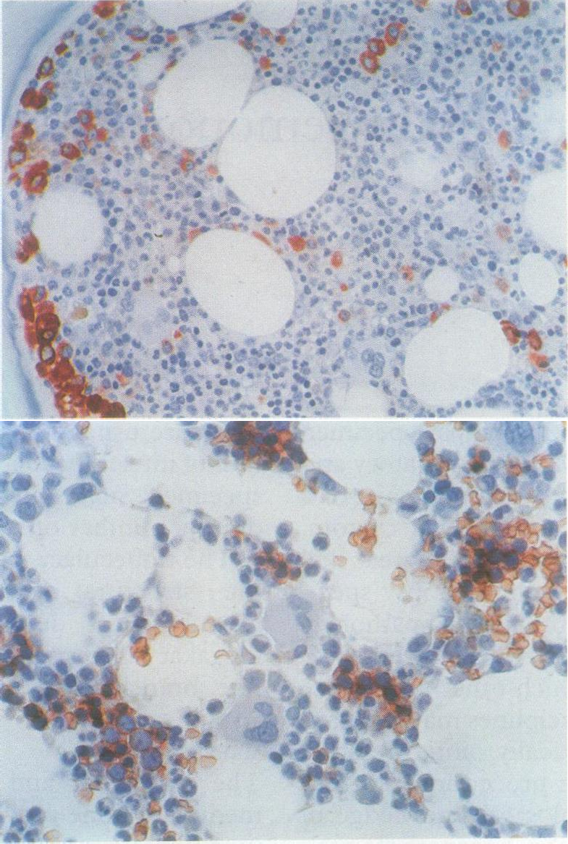
2- Cellularity and distribution
One of the most important parameters in MPN evaluation
Normally Immature myeloids are around trabeculae
Erythroids are in the
center, in cluster and around macrophages
Megs are single in the center
Attention to overall milieu

Slide 15
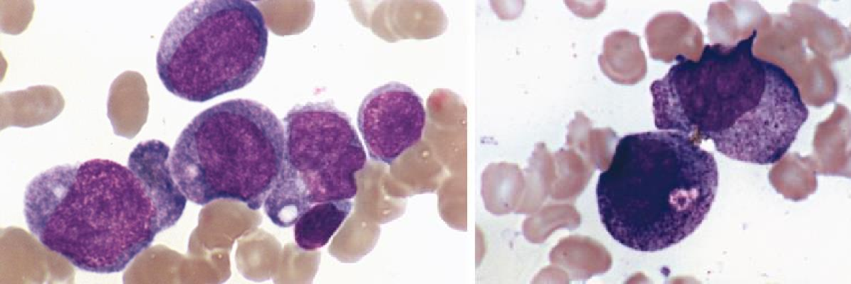
3- Morphology
Well prepared PB and BMA
smears and adequate biopsy are essential
Morphology is a key criterion
in diagnosis >>> In patient
with characteristic clinical and
genetic defect ,if the specimen
is not adequate to evaluate
morphology>>> Resampling should be obtained
Manual blast cell count
preferred to flowcytometry CD34+ cells

Slide 16
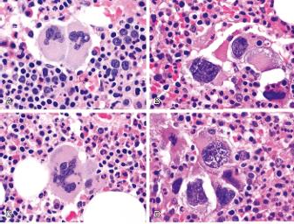
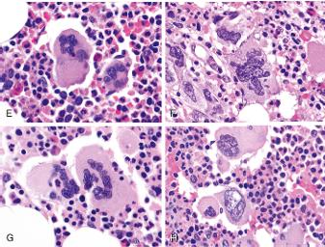
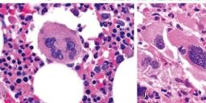
4- Megakaryocytes number, shape and topography
Meg best seen by aim of IHC, CD61
Grouping , loose or dense, small or large
Displacement to near trabeculae
Size and shape
Dysplastic
Isolated nuclei
Small or dwarf meg.
Large hyperlobated nuclei ( staghorn like)
Large hypolobated nuclei ( cloud like)

Slide 17
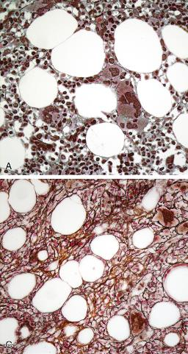
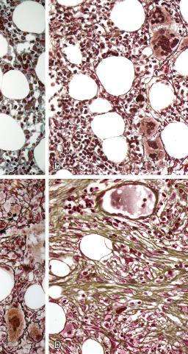
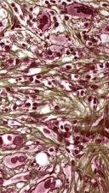
5- Degree of fibrosis
By reticulin, collagen and sclerosis evaluation
One of the most important criteria in evaluating and DD of MPN (Poor survival in PV)
Grad _{e}* | Description
MF-0 | Scattered linear reticulin fibers with no intersections (crossovers), corresponding to normal bone marrow
MF-1 | Loose network of reticulin with many intersections, especially in perivascular areas
MF-2† | Diffuse and dense increase in reticulin fibers with extensive intersections, occasionally with focal bundles of thick fibers mostly consistent with collagen or focal osteosclerosis
MF-3† | Diffuse and dense increase in reticulin with extensive intersections and coarse bundles of thick fibers consistent with collagen, usually associated with osteosclerosis

Slide 18
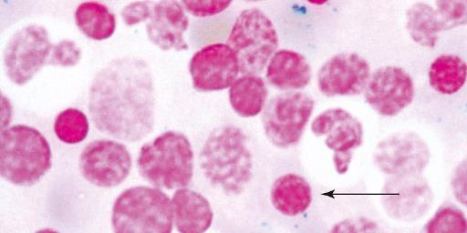
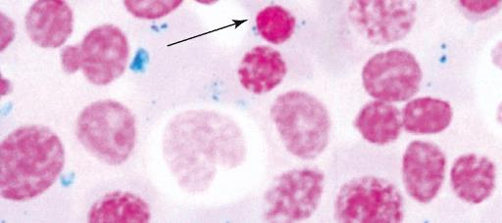
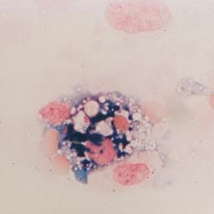
6- Iron staining
Low in the majority of MPN
Absent in P. vera
Ring shape in MDS
Should be performed in all MPN due to DD MPN/MDS-RS-T(60% JAK2
<5% CALR and MPL) which presenting with thrombocytosis

Slide 19
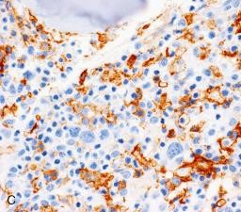
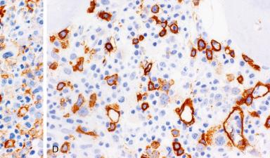
7- Immunohistochemistry
CD34, CD117 , very good when there is doubt about blast crisis
CD34 for evaluation of vascularity(PMF increased)
CD61
Exclude any other malignancy if morphologically suspected
abnormal fibrosis
abnormal collections of lymphocytes
abnormal large single cells

Slide 20
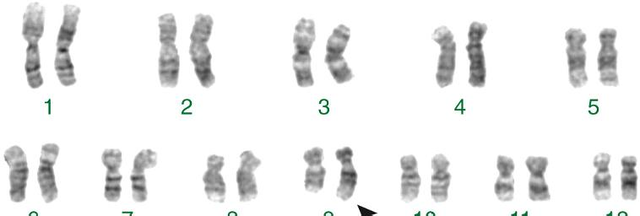
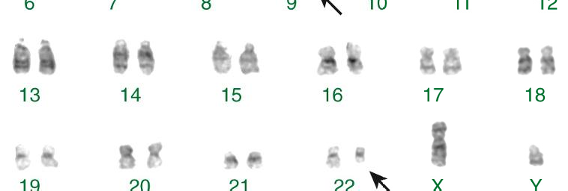
8- Cytogenetic analysis
A complete cytogenetic analysis of bone marrow cells is essential during the initial evaluation and establishing a basement karyotype
Abnormal karyotype>>>Adverse
prognosis in PV, PMF, ET
Additional cytogenetic abnormality other than PH in CML>>> Accelerated phase
Some cytogenetic abnormality exclude ET: del(5q),t(3;3), Ph

Slide 21
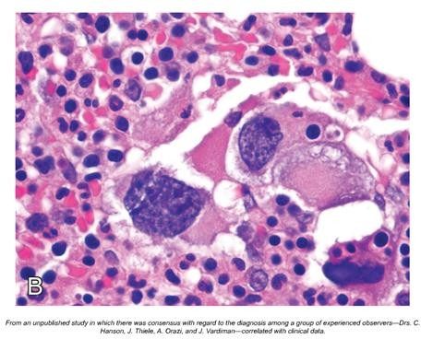
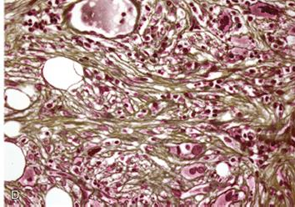
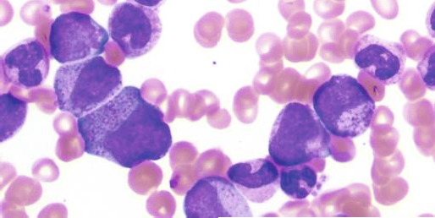
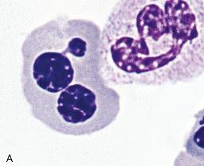
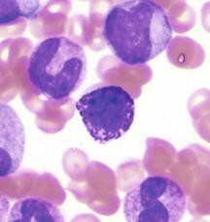
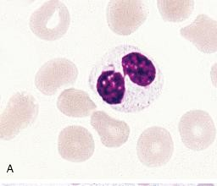
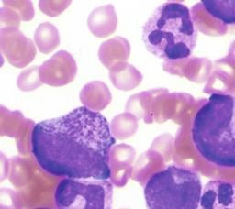
These finding exclude ET diagnosis
Significant reticulin fibrosis or collagen fibrosis
Bizarre, Highly atypical megakaryocytes
Granulocytic or Erythroid proliferation
Significant dysplastic changes in erythroid or granulocytic cells

Slide 22
“Driver” Genetic Abnormalities in Myeloproliferative Neoplasms
Although the etiology is unknown but considerable information about genetic abnormalities that contribute pathogenesis is known
To date, five mutually exclusive mutations have been described that affect genes encoding proteins that directly or indirectly activate downstream signaling in the JAK-STAT pathway and lead to myeloproliferation.
two mutations of the Janus 2 kinase gene, JAK2 V617F and JAK2 exon 12
the myeloproliferative leukemia virus oncogene MPL
Calreticulin gene (CALR)
colony-stimulating factor 3 receptor gene (CSF3R) have recently been recognized in chronic neutrophilic leukemia (CNL)
Additional mutations in ASXL1, EZH2, TET2, IDH1, SRSF2 and SF3B1 genes are noted to be of in determining the clonal nature of disease

Slide 23
Abnormality | Chromosome | CML,CP(%) | PV (%) | ET (%) | PMF (%) | CNL (%)
MPN-Specific “Driver” Abnormalities Affecting Cytokine Signaling
Ph chromosome | t(9;22)(q34.1;q11.2) | 95* | 0 | 0 | 0 | 0
BCR-ABL1 | t(9;22)(q34.1;q11.2) | 100 | 0 | 0 | 0 | 0
JAK2 V617F | 9p24 | 0 | 95-97 | 50-60 | 55-60 | Rare
JAK2 exon 12 mutations | 9p24 | 0 | 2-3 | Rare | Rare | 0
CALR exon 9 mutations | 19p13.2 | 0 | Rare | 25 | 25 | 0
MPL exon 10 mutations | 1p34 | 0 | Rare | 3-5 | 5-10 | 0
CSF3R T6181 | 1p35 | 0 | 0 | 0 | 0 | 80

Slide 24
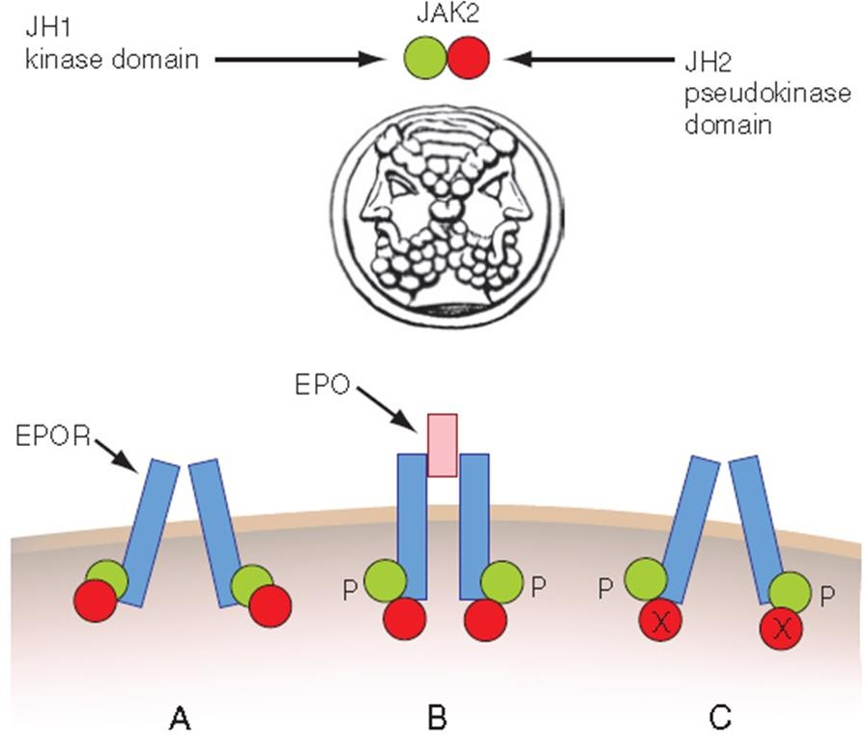
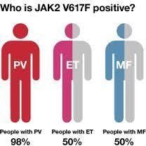
JAK2 Mutation
Nearly all PV (Homozygocity is more commom in PV)
JAK2 mutation accompanied with EPO are upfront tests for PV Dx
some ET and PMF
MDS
MPN/MDS
Acute leukemia
Lymphoma
Healthy individual

Slide 25
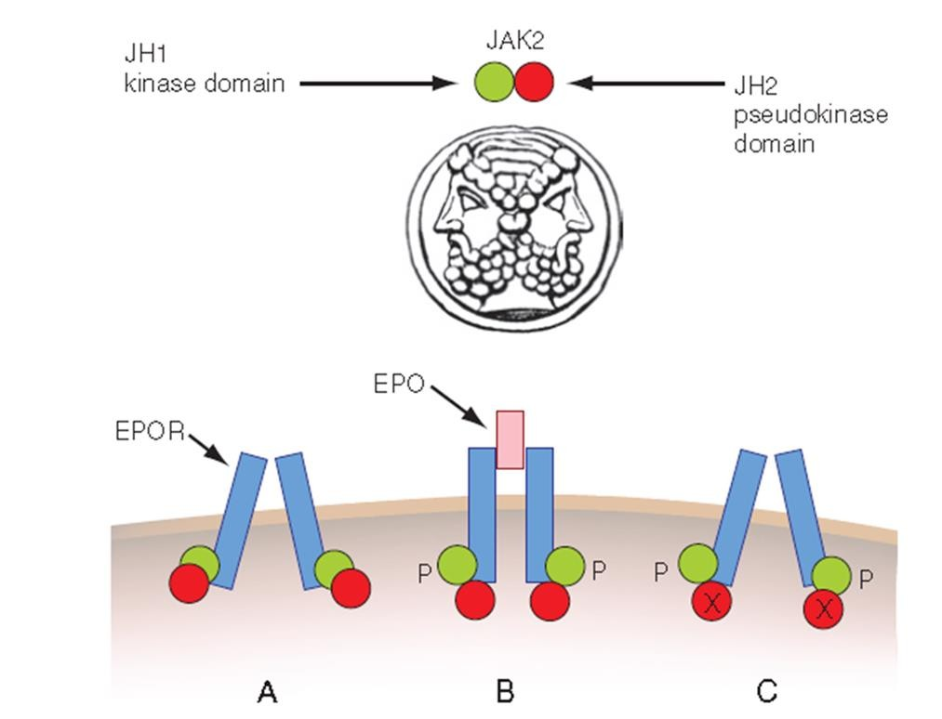

Slide 26
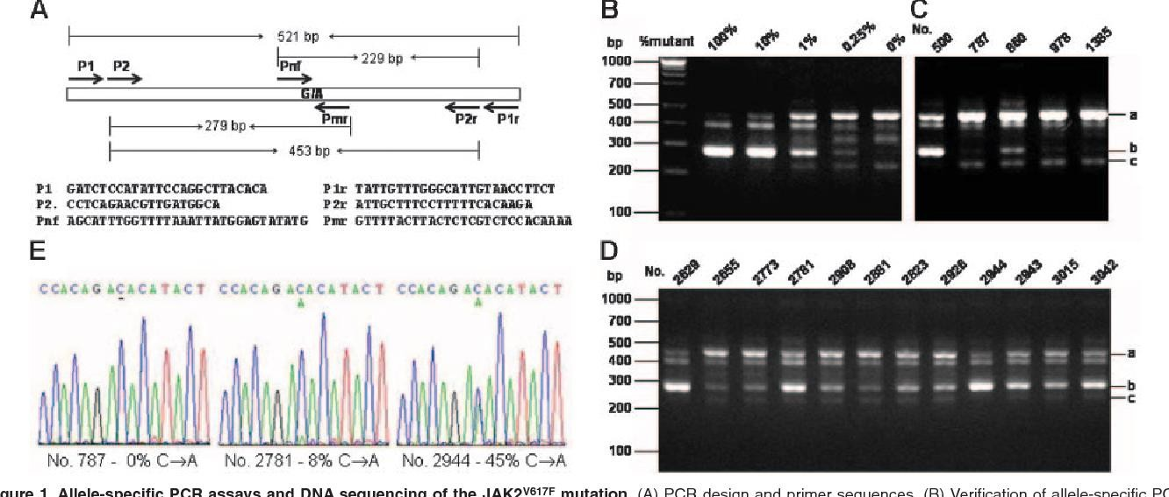
JAK2 Mutation- Molecular Diagnostic Technologies
Sanger Sequencing
ARMS PCR
Quantitative Real time PCR
NGS

Slide 27
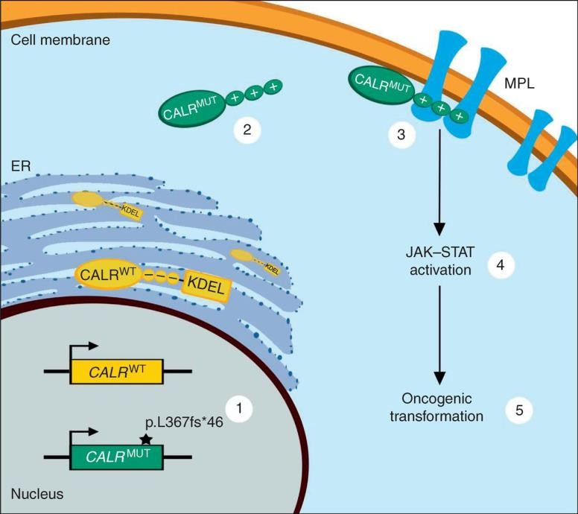
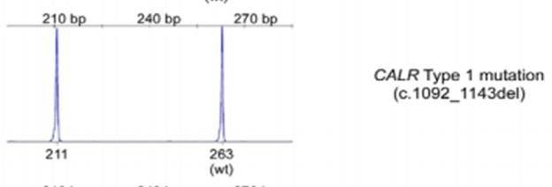
CALR Mutation
ET and PMF
In younger patients of PMF
Favorable prognosis

Slide 28
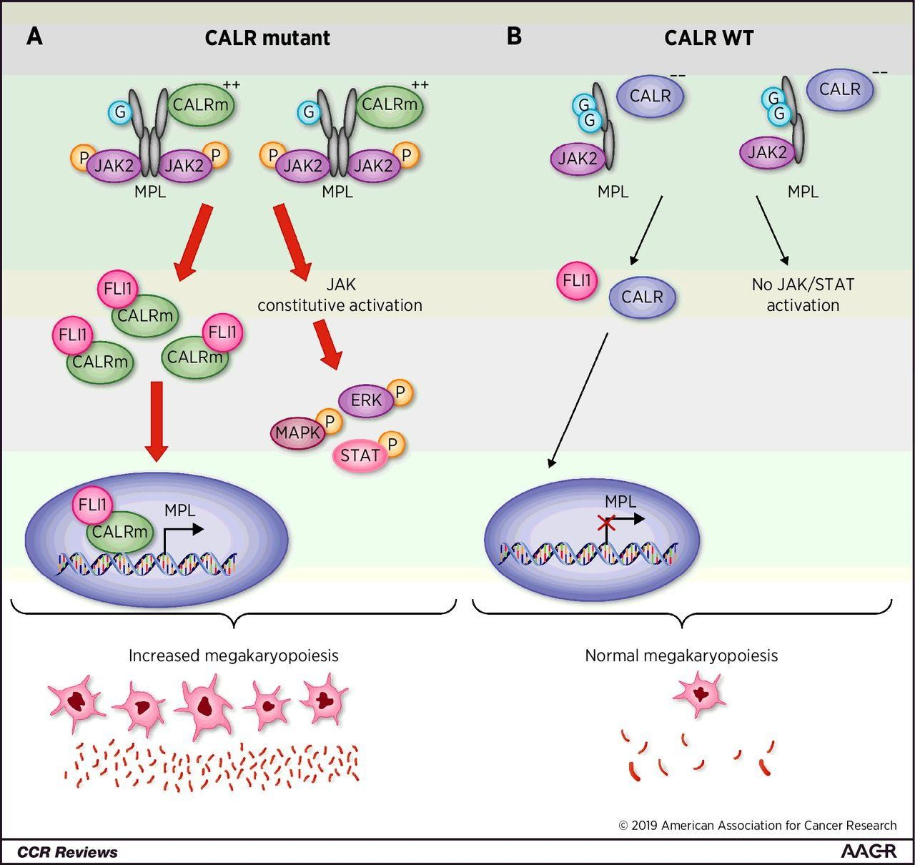
CALR Mutation- Molecular Diagnostic Technologies
PCR- Fragment sizing analysis
Whole Exome Sequencing

Slide 29
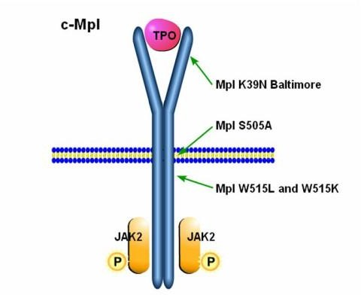
MPL Mutation
ET and PMF
Encode thrombopoietin receptor
Detected by:
PCR
Sanger Sequencing
Next generation sequencing
Bone marrow specimen may have higher detection sensitivity

Slide 30
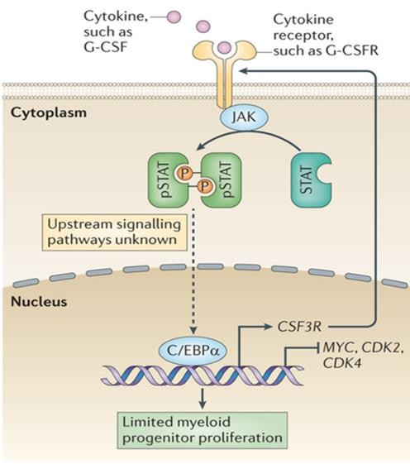
CSF3R Mutation
Colony stimulating factor 3
production, differentiation and function of granulocytes
Mutation in prox region>>JAK STAT pathway
Mutation in Distal region>>Congenital neutropenia responding to GCSF
>70%
aCML

Slide 31
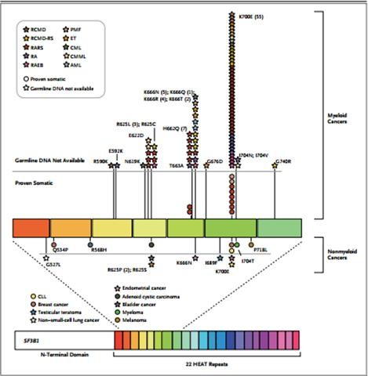
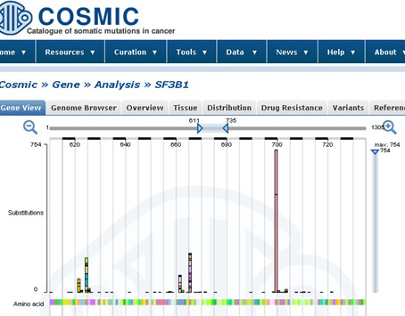
Are not mutually exclusive
Associated Mutations in MPN
Not specific or restricted to MPN
Cooperate driver mutation
>>influence phenotype
Epigenetic regulator
(TET2, ASXL1, EZH2, IDH1, I
DH2, DNMT3A)
RNA splicing (SF3B1, SRSF2, SETBP1, SF3B2)
transcriptional genes (TP53, IKZF1, NFE2, CUX1).

Slide 33
MPN diagnosis needs multidisciplinary approach

