Slide 1
CTD-ILD : chronic to Catasrophic forms
K.Gohari Moghadam MD.
25/01/1401

Slide 2
Why they are important?
Impact of lung involvement on morbidity and mortality,
Better prognosis than idiopathic interstitial Pneumonitis ,
Auto immunity is predominant feature and immunosuppressive therapy may dampen or delay or stop irreversible lung damage ,
Some of idiopathic forms may be earlier manifestation of a CTD ,
The challenge is distinction between Infectious , drug induced lung disease in a CTD-ILD.

Slide 3
Classification
Occupational
Drug induced
Connective Tissue Disease
Idiopathic Pneumonitis
Unknown ( + vasculitis,alveolar group and hereditary )

Slide 4
CTD
RA
SSc
DM
SLE
Sp.Ank.

Slide 5
Up to 30% of patients with Bx proven NSIP have autoimmune features ,This rate for UIP is 13%.
Not necessarily the response of skin , muscles to therapy does not track with and can not predict the response of ILD in dermatomyositis and SSc.

Slide 6
Relative frequency of respiratory system involvement by CT
CTD | UIP | NSIP | OP | LIP | DAD | DAH | Air w. | Nodules | Pleurae
RA | +++ | ++ | ++ |  |  |  | +++ | +++ | +++
SSc | ++ | +++
PM/DM |  | +++ | +++ |  | ++
MCTD |  | ++
SjS |  | ++ |  | ++ |  |  | + | +
SLE |  | ++ |  | ++ | ++ | +++ |  |  | +++

Slide 7
The spectrum includes chronic smoldering NSIP /UIP to acute fulminant respiratory failure due to DAH /DAD ( lupus pneumonitis ), or DAD /OP in amyotrophic dermatomyositis .

Slide 8
The concept of Interstitial Pneumonitis with autoimmune features ( IPAF)
The extrapulmonary manifestations are not prominent and do not meet criteria for making a Dx of CTD ,
Sometimes pulmonary manifestations precede CTD symptoms and signs,
Some of Idiopathic Interstitial Pneumonitis have at least one positive serologic test.

Slide 9
IPAF
Early CTD , formes frustes of CTD, Occult CTD , , Lung-limited CTD.

Slide 10
The role of imaging
Parenchymal involvement,
Extent of involvement,
Response to treatment,
Concomitant pathologies ( Infection , Drug HPs, and malignancy),
show the best areas of sampling,
Prevents unneccessary sampling if Ct findings are typical.

Slide 11
The role of imaging
Prognostication ( eg , extensive honey combing in SSc and RA with high mortality )

Slide 12
The role of autoantibodies
If lab results are negative they are in favor of IIP rather than CT ILD,
Some of them are highly specific and high prediction value for lung involvement for CT ILD such as Antitopoisomerase ( Anti Scl70: 90% ),
Help much more discrimination between groups of CTD with similar symptoms,
The presence of autoantibodies in the absence of extrapulmonary symptoms and signs is observed in , IPAF and occasionally CT ILD.

Slide 13
Core autoantibodies panel
RF, Anticcp,
Anti DNA, Anti sm,
AntiScl 70,
SSA, SSB,
RNP,
Jo1
These are requested in all cases of ILD .

Slide 14
Diagnosis of CTD ILD
Established Dx of CTD
The compatible and typical HRCT
HRCT : Presence , Compatibilty,Extent,Signs of probable activity,Complications)
Serology ( Anti CCP, SCL 70 , Anti jo,Anti SS-A or SS-B, ANA, etc)
BAL ?
Bx?

Slide 15
Systemic Sclerosis
Carries the highest case-based mortality . ( median survival 11yrs),
Pulmonary involvement in 80% of cases,
NSIP ( mainly fibrotic ) as the most common form,

Slide 16
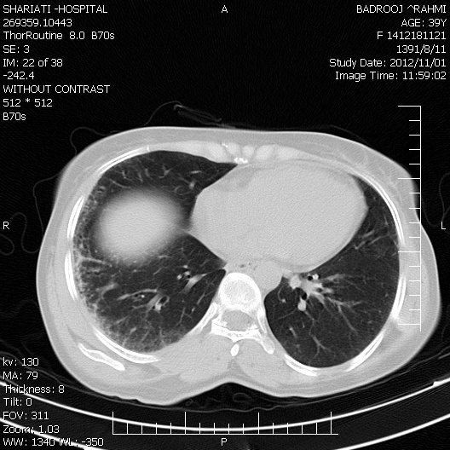
Subpleural crescent ( early Scleroderma lung disea

Slide 17
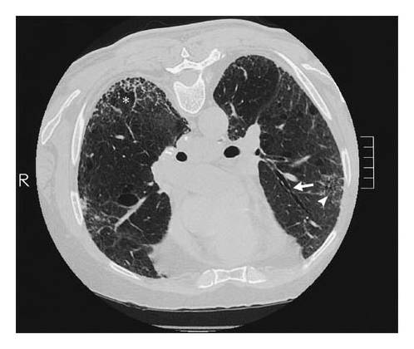
Prone HRCT

Slide 18
Rheumatoid Arthritis
Usually in middle aged men , smokers , extra articular manifestations ,
UIP as the most common form,
RA-ILD course is slower than IPF.
No specific therapy,
The major challenge is presence of honey comb or GGO in a patient with RA, who takes MTX .RTX or leflunomide.

Slide 19
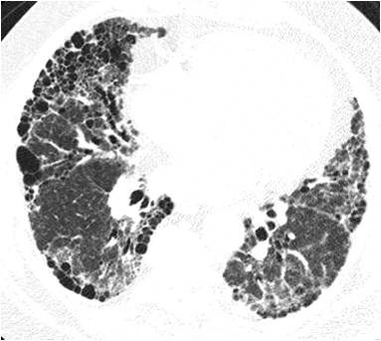

Slide 20
Drug induced pneumonitis
MTX : HP ,alveolar opacities , GGOs , reticular?
Leflunomide : usually within 20 weeks of treatment, and in preexisting ILD or received MTX
RTX: macronodular OP weeks to mo

Slide 21
In the presence of GGO , the question is whether opportunistic infection such as Pneumocystis , drug induced Hypersensitivity pneumonitis or ILD ,
In the above cases it is prudent to discontinuing the drug .( American college of Rheumatology )( before 2020)

Slide 22
Systemic Lupus Erythematous
Chronic forms are infrequent,
Acute pulmonary presentation with unilateral or bilateral pulmonary infiltration , fever rapidly progressive dyspnea ,and sometimes hemoptysis .
The above mentioned manifestations are one of the most difficult challenges for a pulmonologist.

Slide 23
The problem of rapidly progressive dyspnea with pulmonary infiltration( GGO, consolidation) in SLE patient
Infection ?
Lupus pneumonitis ( DAD)?
DAH?
Heart failure/myocarditis?

Slide 24
DAH
ICU mortality reaches 16% and for mechanically ventilated is as high as 31%,
About 50% needs mechanical ventilation ,
Immune mediated capillaritis , also associated with Antiphospholipid Abs.,
Hemoptysis may be present in 50% of cases , More bloodier BAL by repeated lavages, and hemosiderin laden macrophages make Dx.

Slide 25
Dermatomyositis/Polymyositis
Some patients are amyotrophic dermatomyositis with paucity of muscular symptoms may progress to fulminant ILD resembling acute DAD /OP ( AIP like),
Presence of various pathologies concomitantly such as NSIP and OP .

Slide 26
Management
Decision to treat in progressive or extensive forms is easy , but in limited forms the risk and benefits should be considered,
The intensity of immunosuppression is related to disease severity , extent of involvement , its course and probable response to it.

Slide 27
Factors influencing therapeutic regimen
Severity ,
Extent ,
Degree of reversibility, age,
Course,
Presence of comorbid diseases.

Slide 28
Decreased FVC to 10% or decreased FVC 5-9% with more than 15% decreased DLCO mandates treatment.

Slide 29
Response to treatment is defined by halting the decline in pft , to be realistic no normalization in values.
First line :
Prednisolone up to 15 mg/d
Mtx 7.5 -15 mg/week
Azathioprine 2 mg/kg
Mycophenolate mofetil , up to 3g/d
Cyclophosphamide

Slide 30
2nd line : Rtx ,
Calcineurin inhibitors Such as Tacrolimus , cyclopsporine.
IV Ig,
Plasmapheresis.

Slide 31
New insights in treatment after 2020
Introduction of antifibrotics ( Nintedanib : OFEV) by INBUILD study , Pirfenidon ).
New immunomodulatories: Tocilizumab by focuSSed study,
Rtx,
Autologous BMT.

Slide 32
Some misconceptions
About MTX ILD : In a study by Juge* :
‘’Our results suggest that MTx use is not associated with an increased risk of RA-ILD in patients with RA and that ILD was detected later in MTx treated patients “
Indeed early treatment of RA with MTX delays lung involvement by RA about 3.6 yrs,
*ERJ: Juge et al , DOI: 10.1183/13993003-00337/2020

Slide 33
Bx is not necessary if there is typical form,
Routine and serial lung CT : not .
BAL has controversies and is not routinely advised .
GGO in HRCT does not mean cellular and active alveolitis, mainly they are fine fibrosis by fibrotic NSIP, the major form of NSIP rather than cellular type

